Slide 1
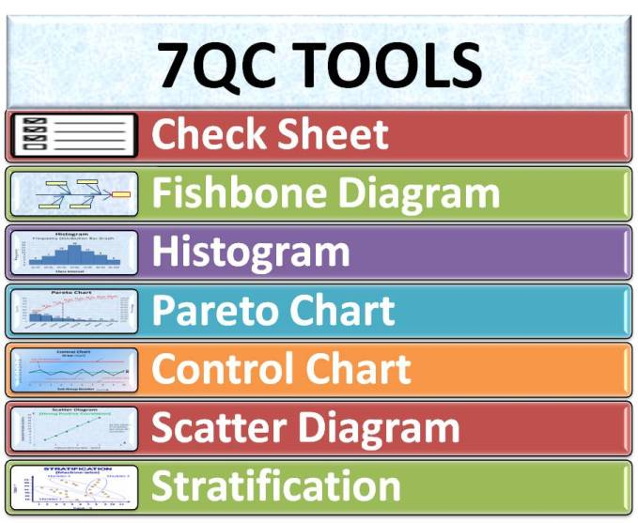



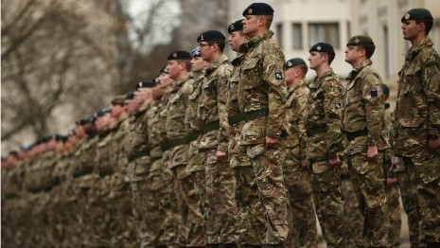



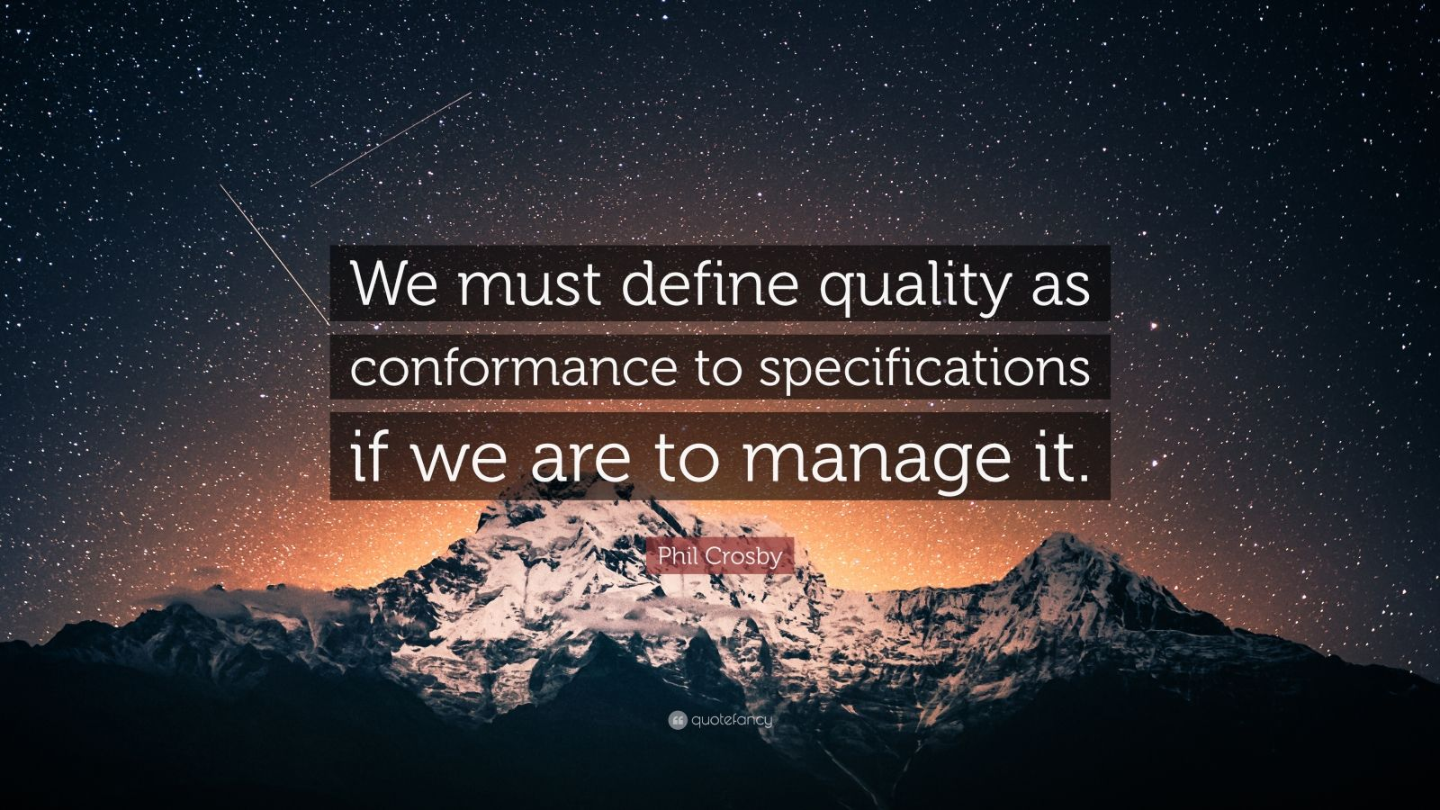
REFLECTIVE
EMPIRICAL
www.vankemenade-act.nl
reflective
empirical
emergence
reference
REFERENCE
EMERGENCE
Notes:
Quality: Decision: Values: Motto, Metaphor: Logic (Freidson): Leadership: Science: Risk: Leadership: Tools:

Slide 2
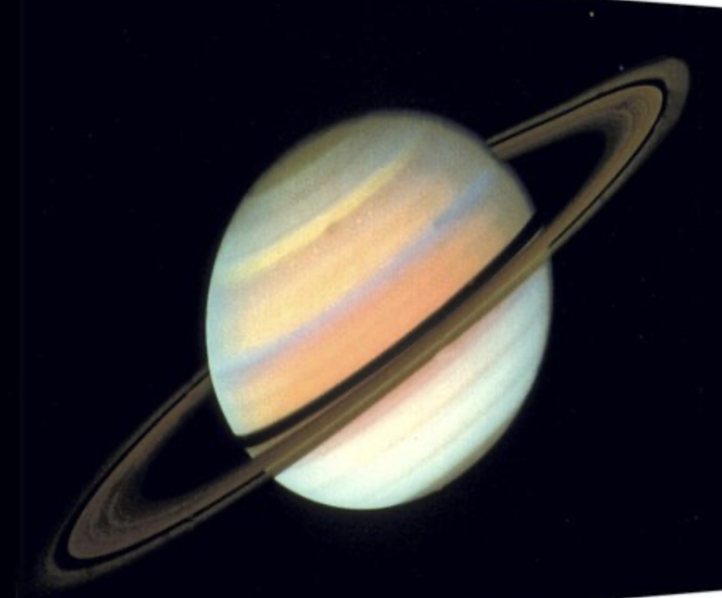
Saturnus
Waarom Saturnus?
Saturnus staat bekend om zijn spectaculaire, rigide ringsysteem.
Dit systeem symboliseert de absolute structuur, de regels en
standaarden die het empirische paradigma definieert.
De baan van Saturnus is nauwkeurig en voorspelbaar, wat de behoefte aan
nauwkeurigheid en controle weerspiegelt.
Het is een koudere, meer afstandelijke planeet,
wat past bij de objectieve aard van de metingen, waarbij 'ja of nee’
het antwoord is.

Slide 3
Frunobulax: the artist and the auditor
I need four volunteer artists and t auditors that give feedback.
The artists are requested to draw a “Frunobulax” in 5 minutes max.

Slide 4
Judgment
The auditors judge the quality of the drawing on four criteria (on score sheet, 0-25) and gives a total score (0-100):
  Technique
  Use of colours
  Creativity
  Emotional value

Slide 5
Presentation
The auditors present their findings to the artists.
How did this feel?
  Criteria clear ???
  Circumstances ???

Slide 6
P.s. Frunobulax
Frunobulax is mentioned in a song called “Cheepnis” about monster movies by Frank Zappa (American composer, 1940-1993). The monster is named after Zappa’s pet dog Fruney.

Slide 7
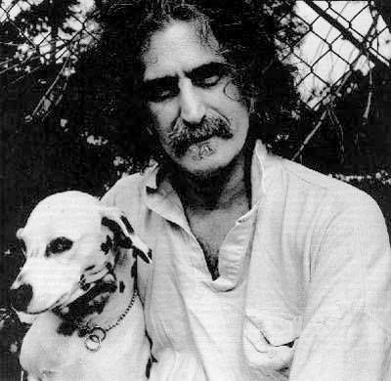

Slide 8
3.1. Wat kunnen we (nog meer) leren van het empirisch paradigma?

Slide 9
What is Quality?
Quality is conformance to requirements (Crosby, 1979)
  de ‘preciezen’
Quality is fitness for use (Juran, 1992)
  The customer
Quality cannot be defined (Pirsig, 1972).
  de filosoof / professional
Quality is dynamic (Pirsig, 1991)
  De ‘rekkelijken’

Slide 10
Wat kunnen we leren van het empirisch paradigma?
Control (accreditatie)
Key performance indicators
Directive leadership
Management review
7 tools of quality

Slide 11

Fishbone diagram

Slide 12
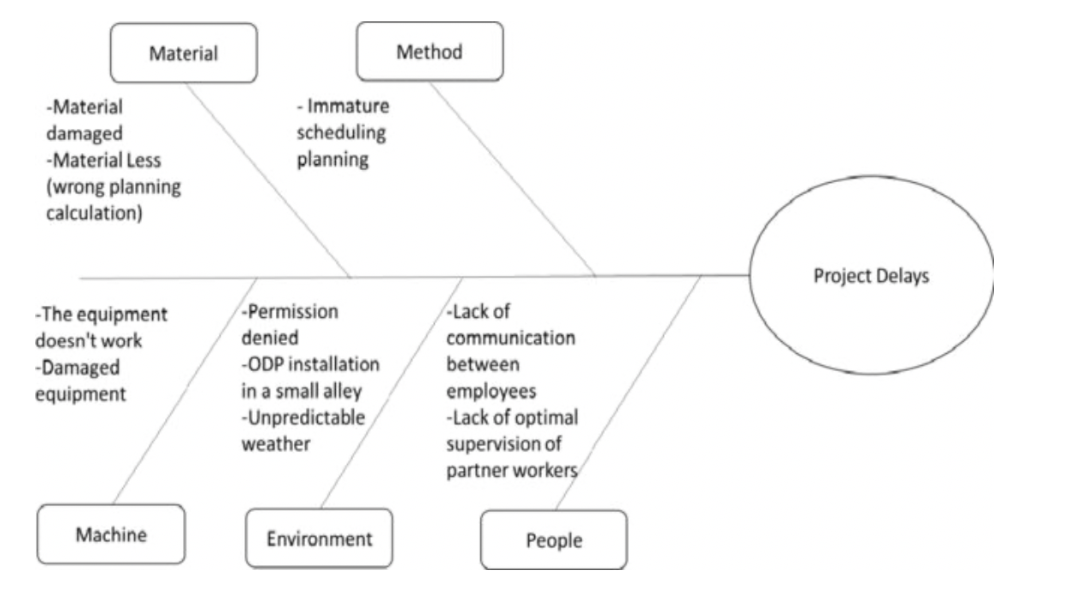

Slide 13
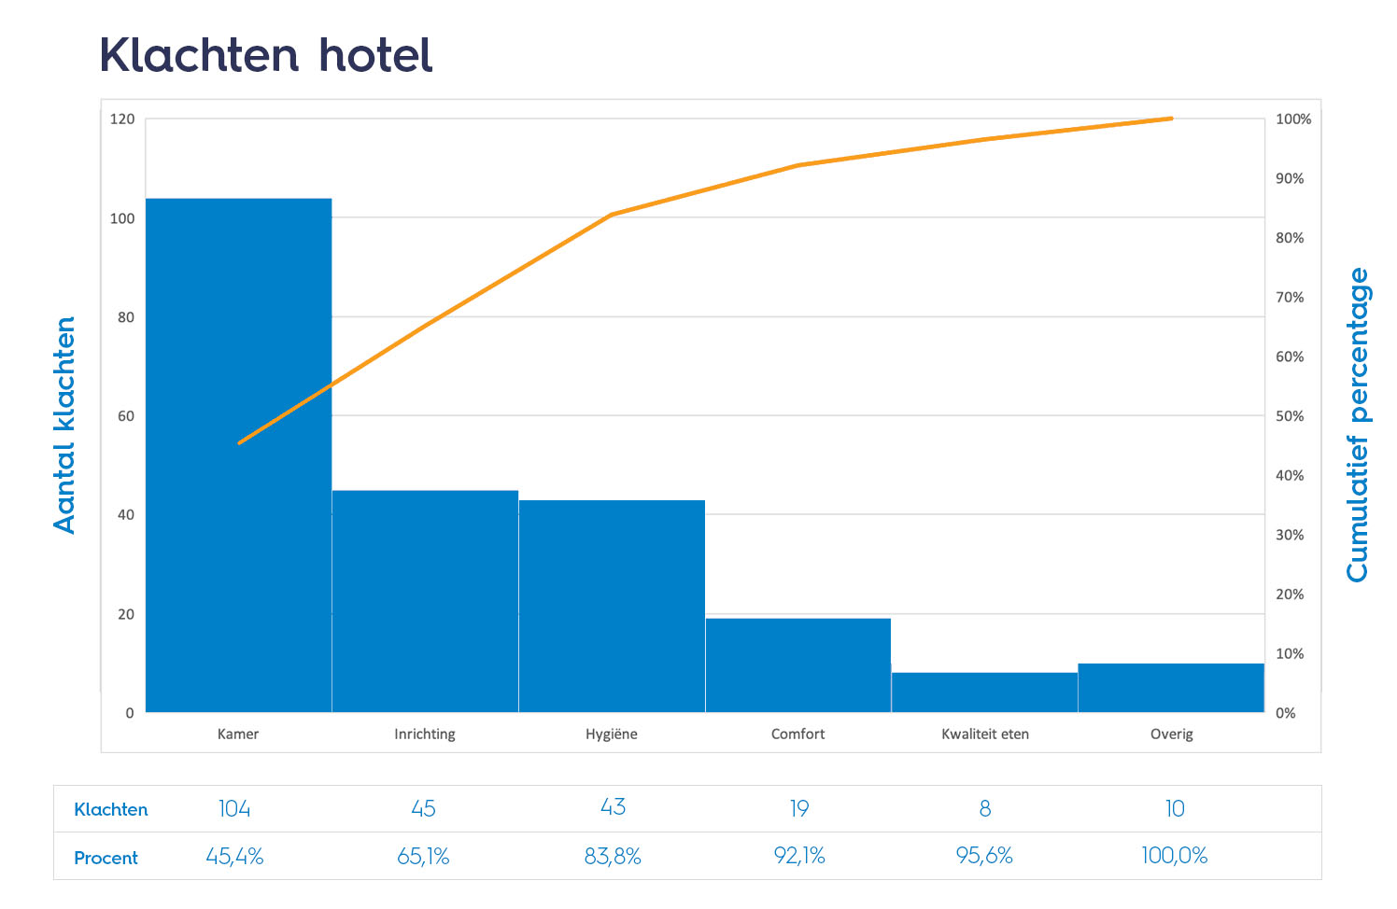
Pareto
20% van de inspanningen levert 80% van de resultaten op.

Slide 14
Directive leadership
Komt het bij jullie voor? Hoe ziet er dat bij jullie uit?

Slide 15

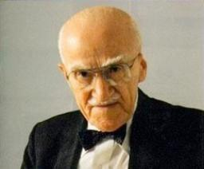
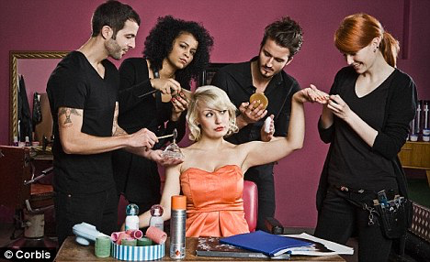
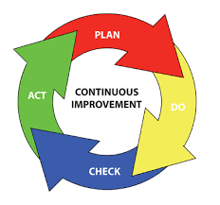

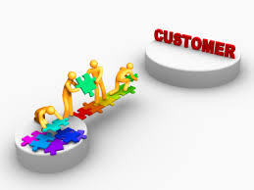
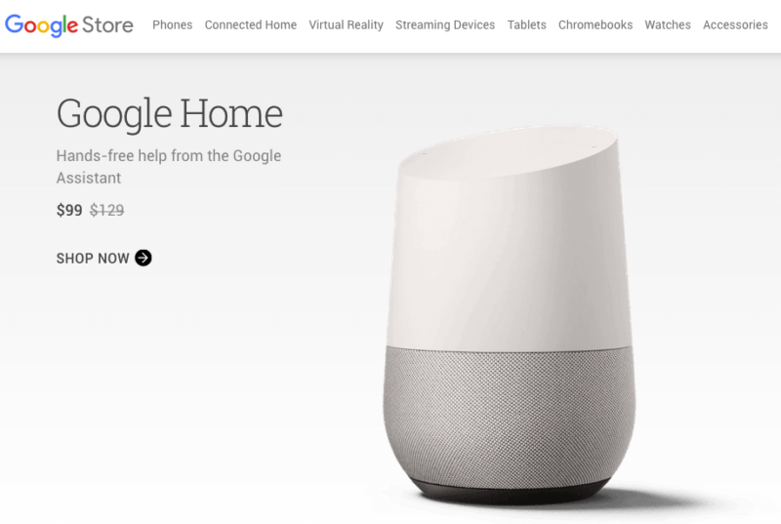

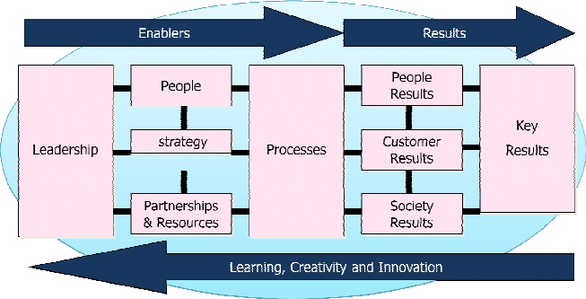
REFLECTIVE
EMPIRICAL
www.vankemenade-act.nl
reflective
empirical
“fitness for use”
emergence
reference
REFERENCE
EMERGENCE
Notes:
Quality: Decision: Values: Motto, Metaphor: Logic (Freidson): Leadership: Science: Risk: Leadership: Tools:

Slide 16
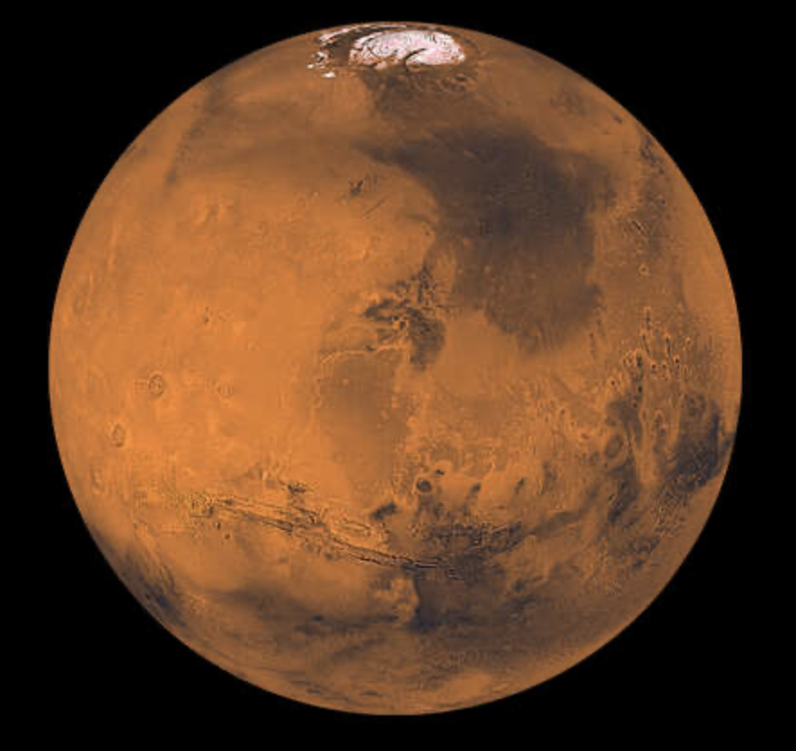
Mars
Mars wordt vaak de 'rode planeet' genoemd.
In de huidige tijd vertegenwoordigt Mars de toekomstige ambitie
van de mensheid; het is het doel van complexe, gestructureerde missies
die modellen en richtlijnen vereisen (zoals het PDSA-model)
om continue verbetering en succes te bereiken.
Mars wordt ook vaak vergeleken met de Aarde (als referentie) om te
beoordelen of het 'geschikt is voor gebruik' (kolonisatie).
Het vertegenwoordigt een gestructureerd, gefaseerd streven.

Slide 17
3.2. Wat kunnen we leren van het referentie paradigma?

Slide 18
What is Quality?
Quality is conformance to requirements (Crosby, 1979)
  de ‘preciezen’
Quality is fitness for use (Juran, 1992)
  The customer
Quality cannot be defined (Pirsig, 1972).
  de filosoof / professional
Quality is dynamic (Pirsig, 1991)
  De ‘rekkelijken’

Slide 19
Wat kunnen we leren van het referentie paradigma?
Customer delight
Continous improvement
PDSA cycle
EFQM model
Coaching leadership

Slide 20
Customer delight
A positive emotional and rational state of mind that leads the customer to enthusiasm about the institute.

Slide 21
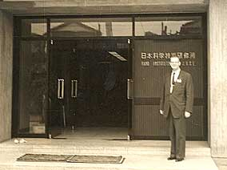
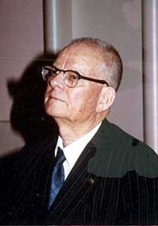
W. Edwards Deming:
“Meeting expectations is not enough”.

Slide 22
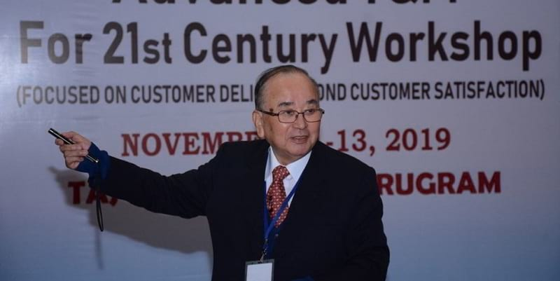
KANO-model
Must Be: The quality characteristic must be present
or the customer will go elsewhere.
Performance: The better we are at meeting these needs,
    the happier the customer is.
Delighter: Those qualities that the customer was not
expecting but received as a bonus.
Kano, N., Nobuhiku S., Fumio T. & Shinichi T. (1984).
"Attractive quality and must-be quality".
Journal of the Japanese Society for Quality Control
14 (2): 39–48

Slide 23
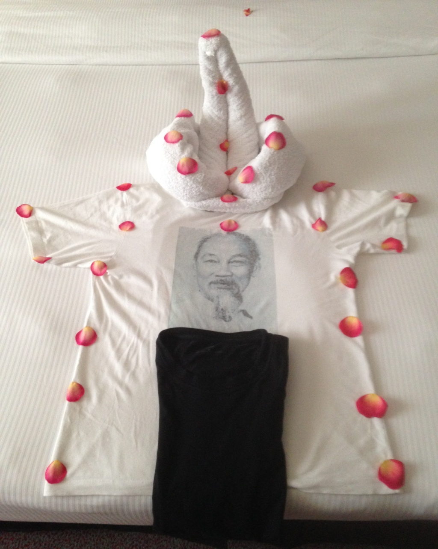

Slide 24
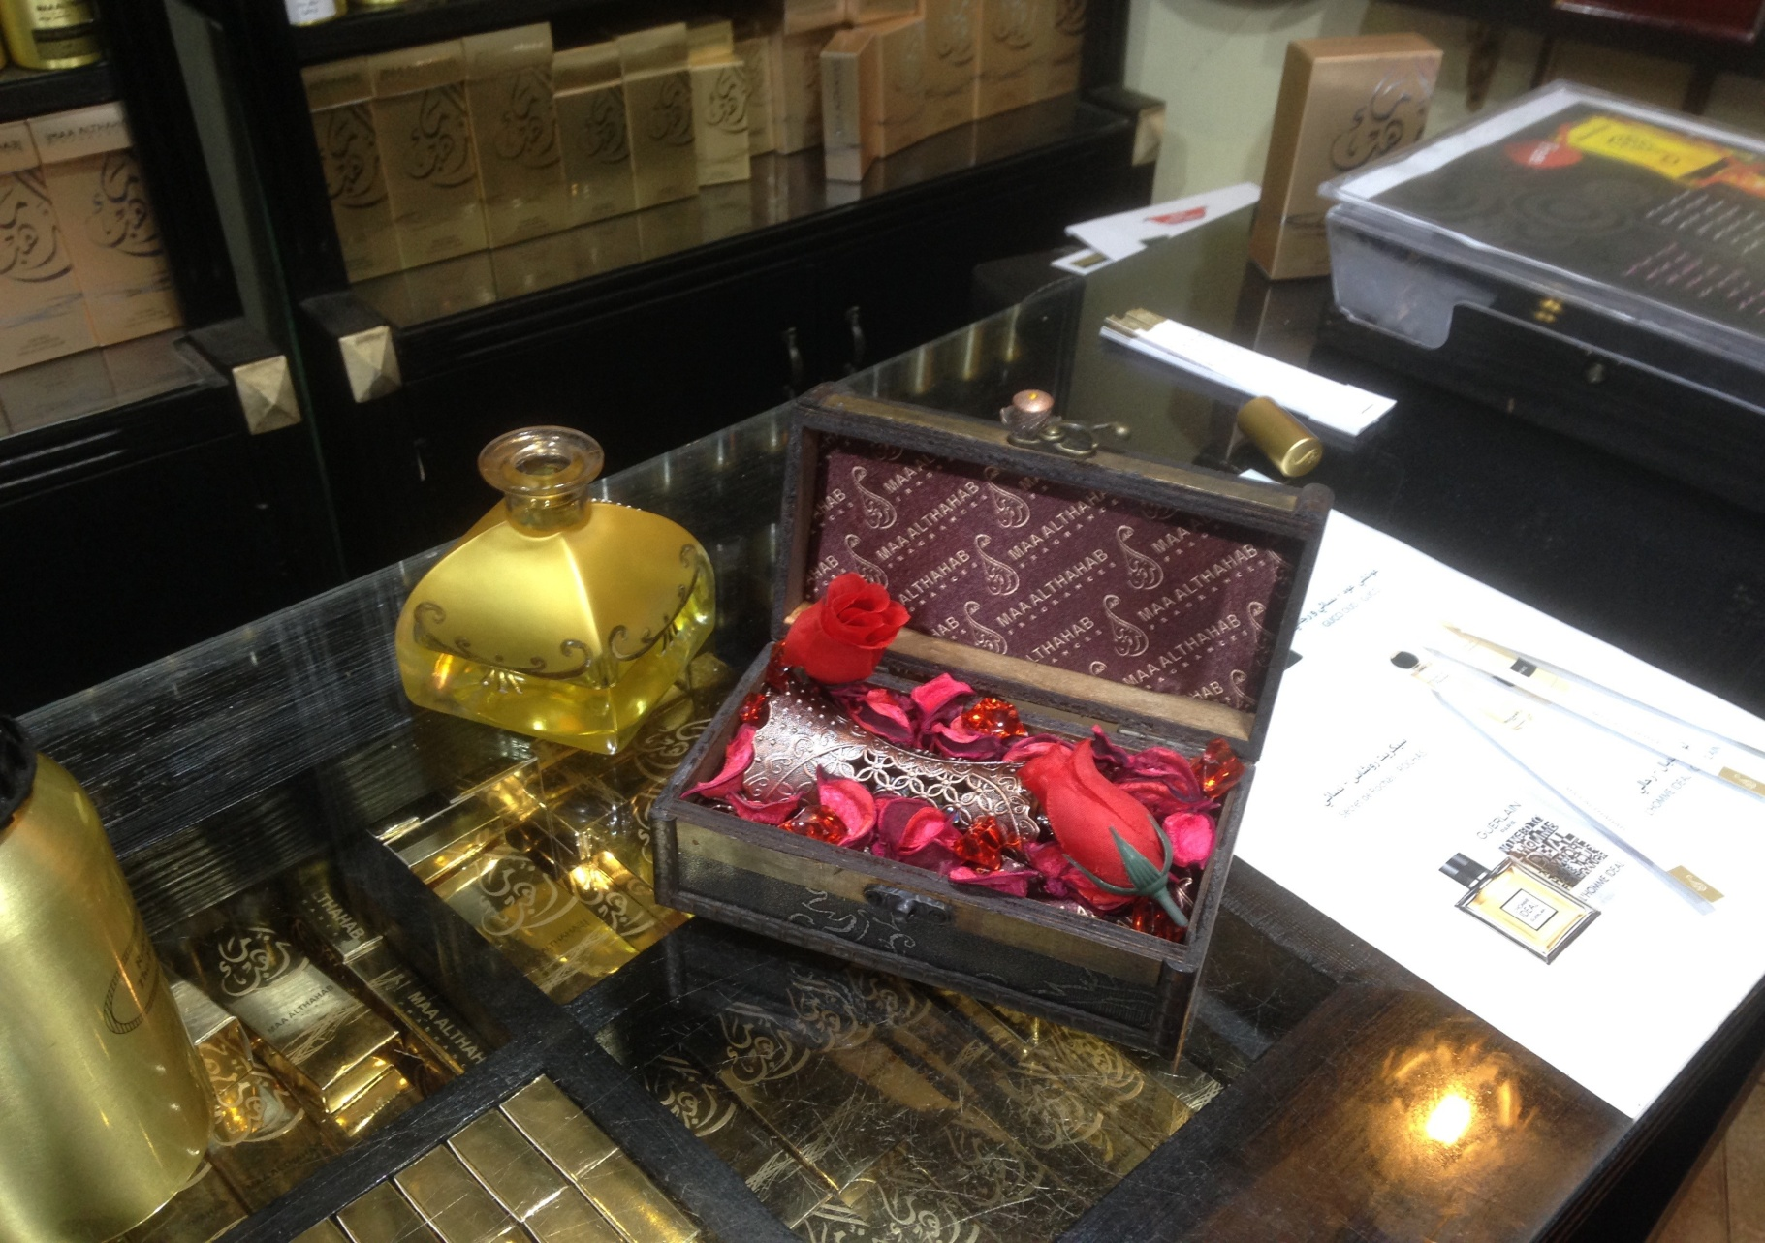

Slide 25
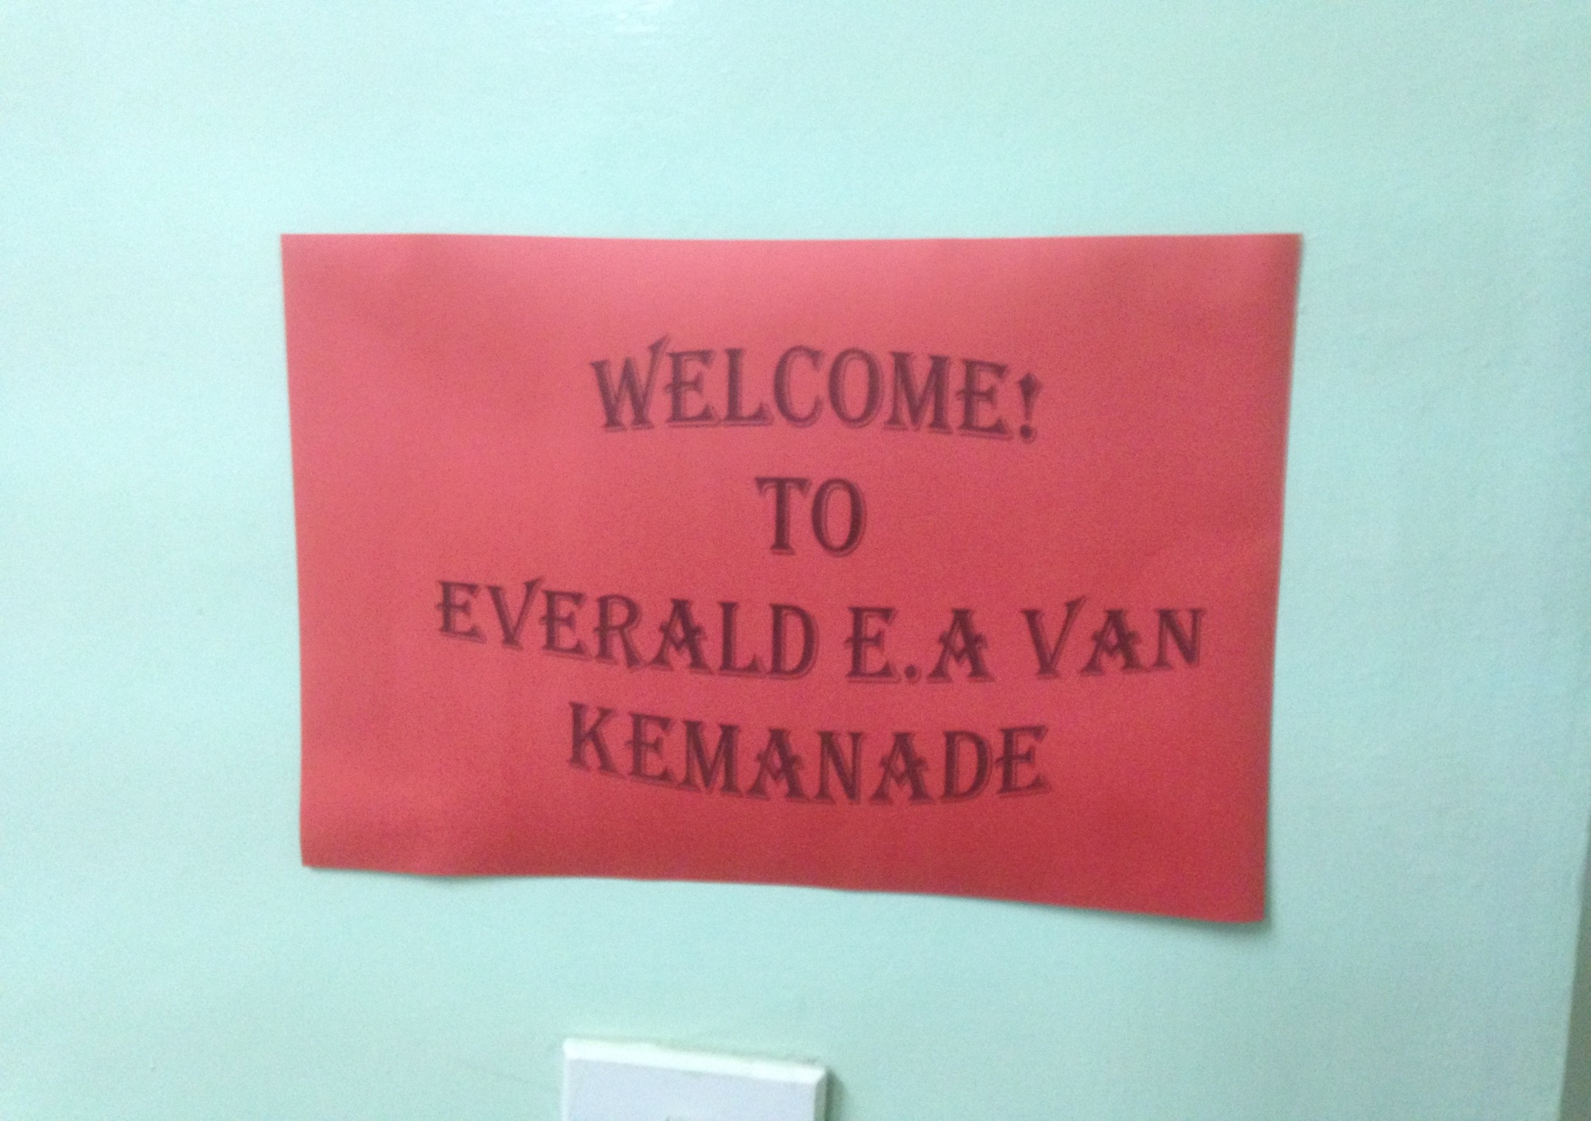

Slide 26
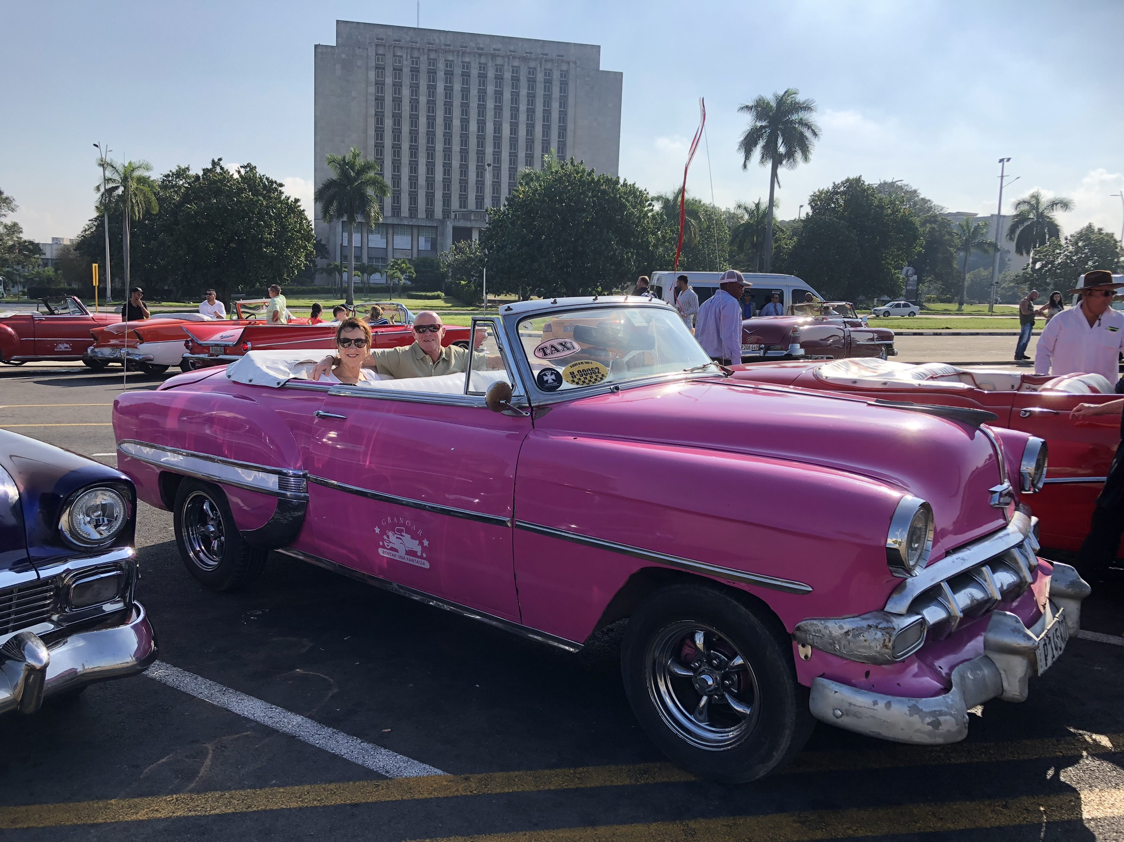
Waar was ik?

Slide 27
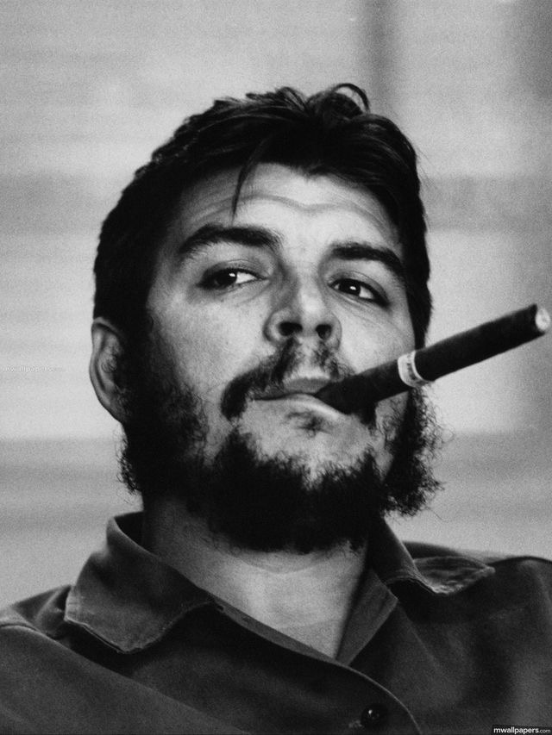
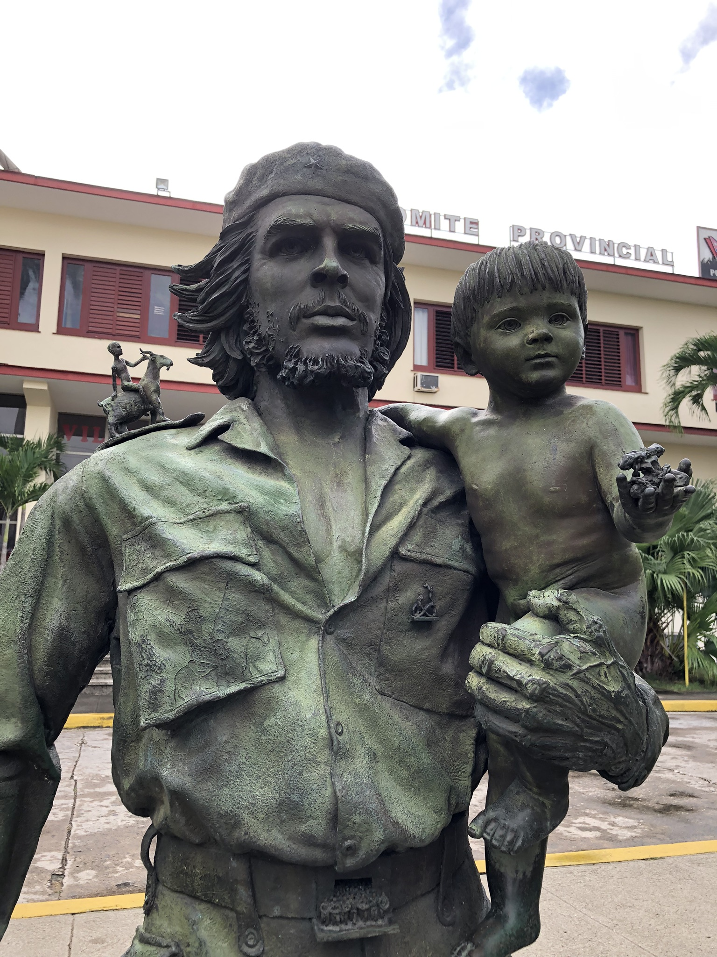

Slide 28
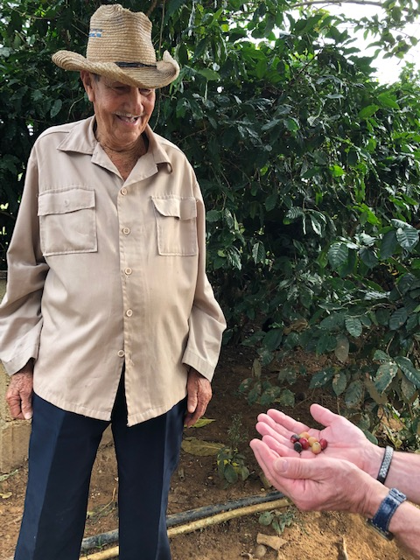
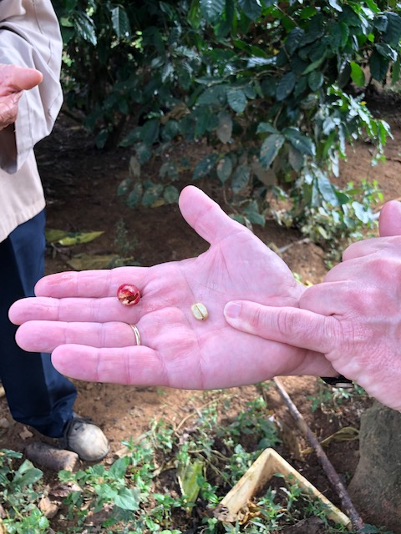

Slide 29
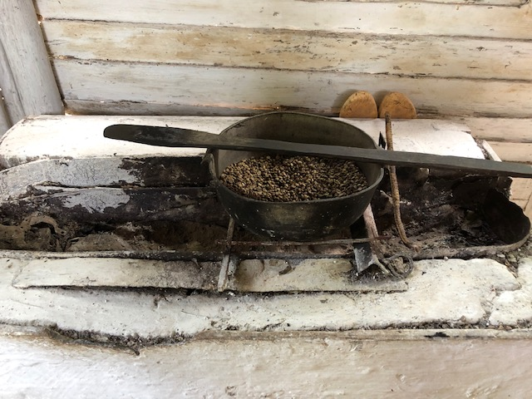
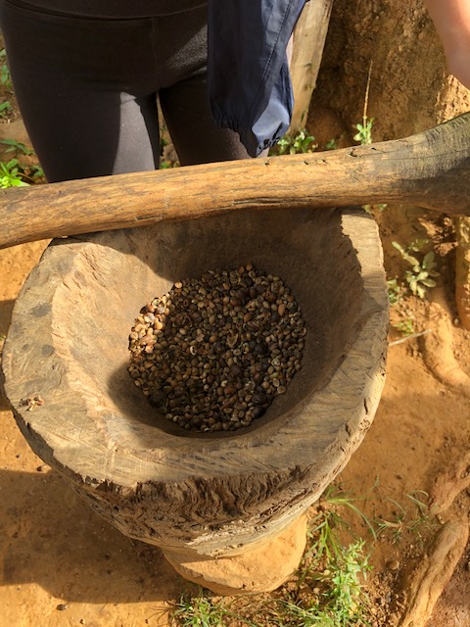

Slide 30
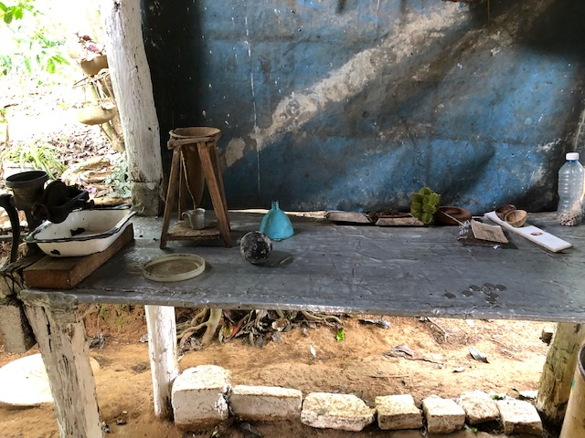
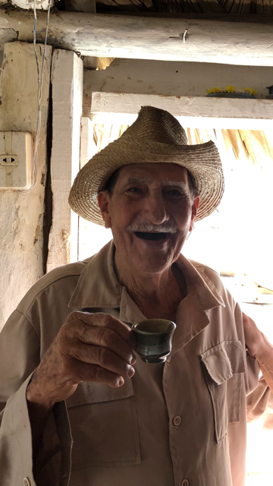

Slide 31

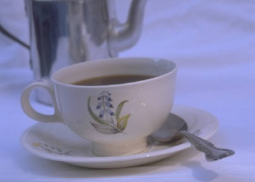
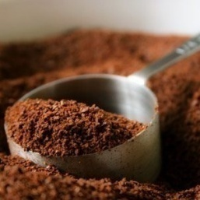
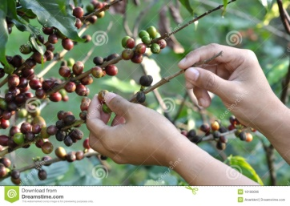
The Value of a cup of coffee
Experiences
3.00
Stage
Services
1.00
Deliver
Goods
.10
Make
Commodities
.02
Extract

Slide 32


Slide 33

Disney

Slide 34
Customer Satisfaction is a fool’s gold
It’s the same as zero!
Neither good nor bad.

Slide 35
Measuring Loyalty
Most businesses measure loyalty
by repeat business.
Healthcare institutes and schools can measure
loyalty by word of mouth…those who sing
our praises.

Slide 36
Net promoter score:
How surely will you recommend us to a friend or colleague ?

Slide 37
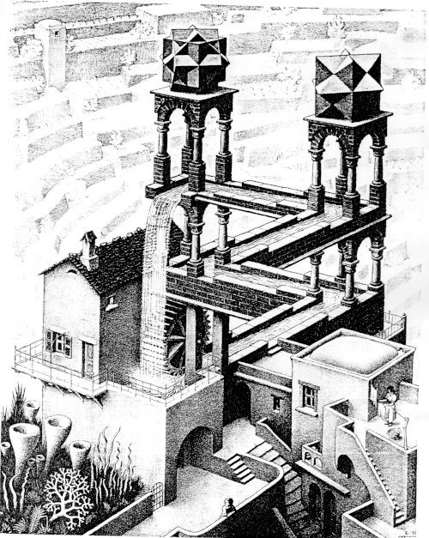
CONTINUOUS IMPROVEMENT
quality
time

Slide 38
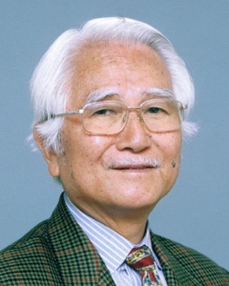
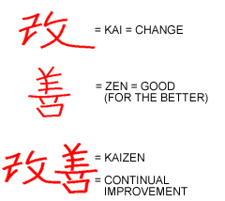
IMAI: KAIZEN

Slide 39

Continuous Improvement

Slide 40
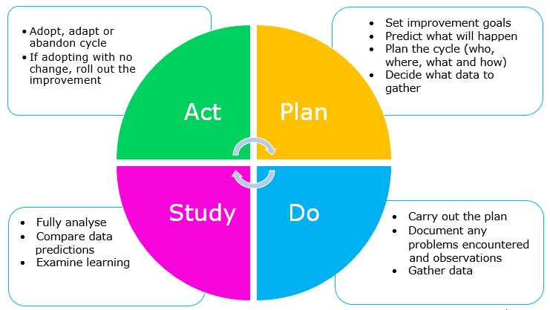
PDSA-circle
A
P
D
C
A
P
D
C
A
P
C
D
A
P
D
C
Shewhart / W.E. Deming

Slide 41

European Foundation for
Quality Management

Slide 42
QUALITY MANAGEMENT SYSTEM
P
D
S
1 Leader-
ship
3. People management
5
Processes/
services
7 People satisfaction
9 Key performance results
2 Policy and strategy
6 Stakeholder satisfaction
4 Resource
management
8 Impact on society
Enablers
Results
A

Slide 43
Coachend leadership
Komt het bij jullie voor? Hoe ziet er dat bij jullie uit?

