Slide 1
THE COACH MODEL

Slide 2
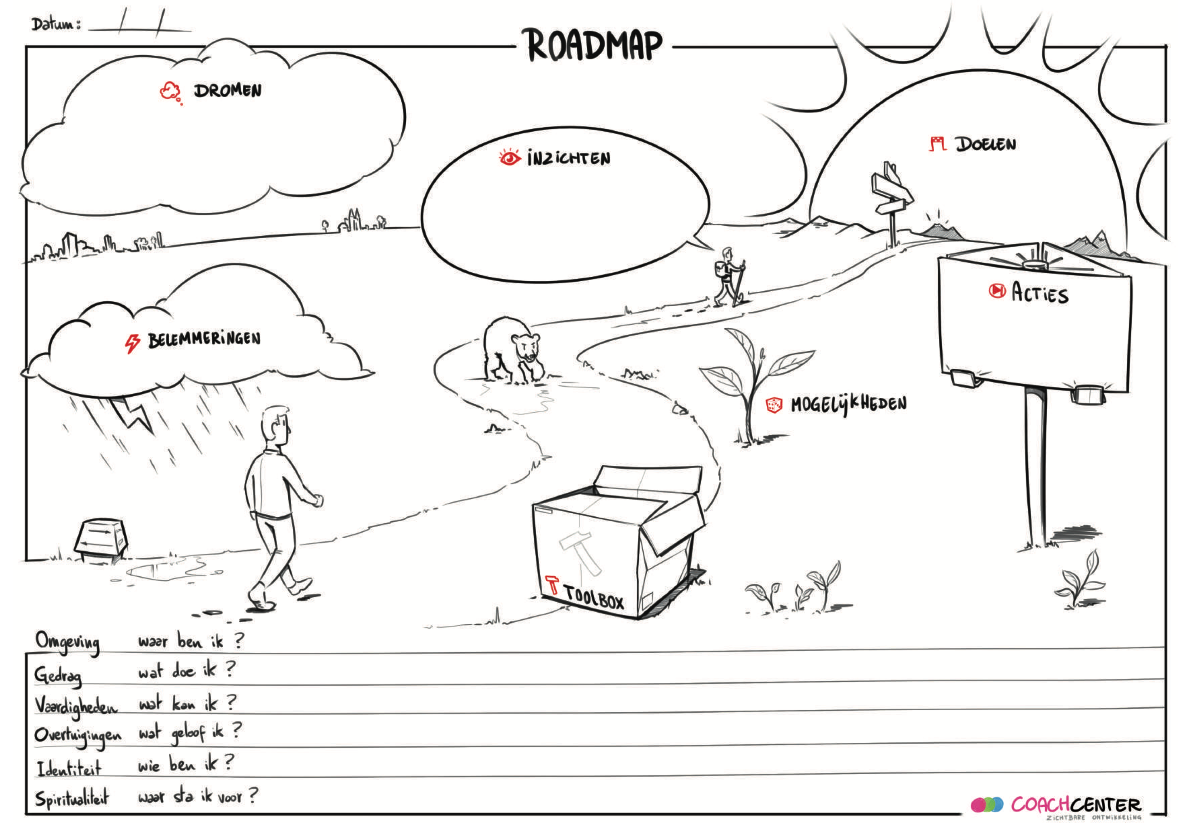
The Coach model roadmap: V
Dreams
Insights
Goals
Insights
Actions
Roadblocks
Resources
Current

Slide 3
future
road blocks
resources
current situation
A Digital

Slide 4
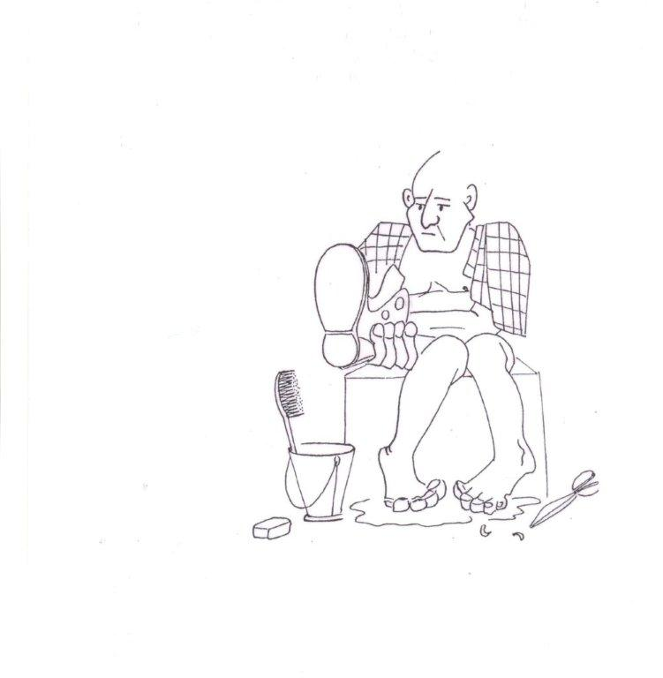

CURRENT SITUATION: K

Slide 5
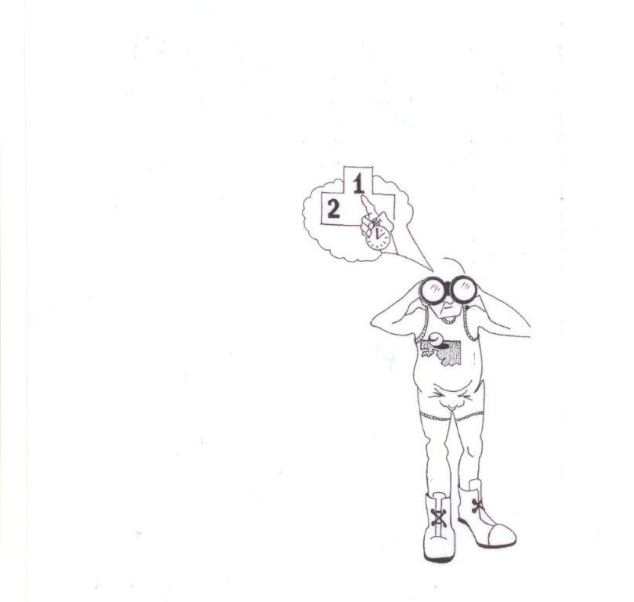
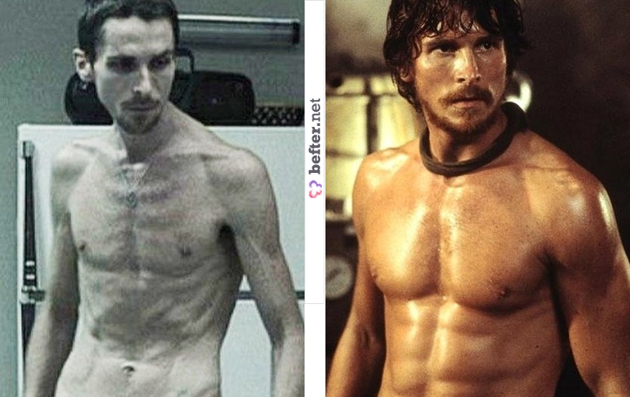
DESIRED SITUATION

Slide 6
Dream

Slide 7


Slide 8
Desired situation
Where would you like to be?
What would be the ideal situation?
What would you hear, see?
Woud would the people in the desired situation say?
How would you feel?
Have you experienced that before?

Slide 9
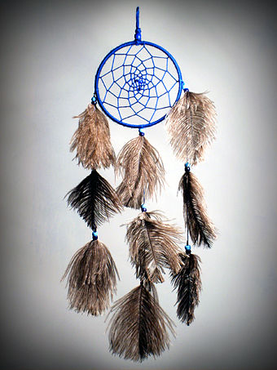
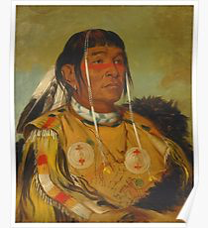
Asubakacin ("net-like”)
In some Native American cultures, a dream catcher is often hung over your bed as protection to give you pleasant, positive dreams.
It originates
in Ojibwe
culture as a
spider web
charm.

Slide 10
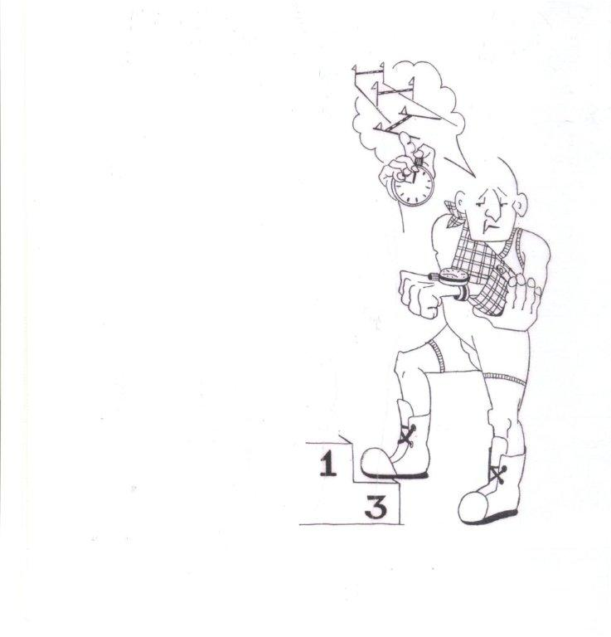
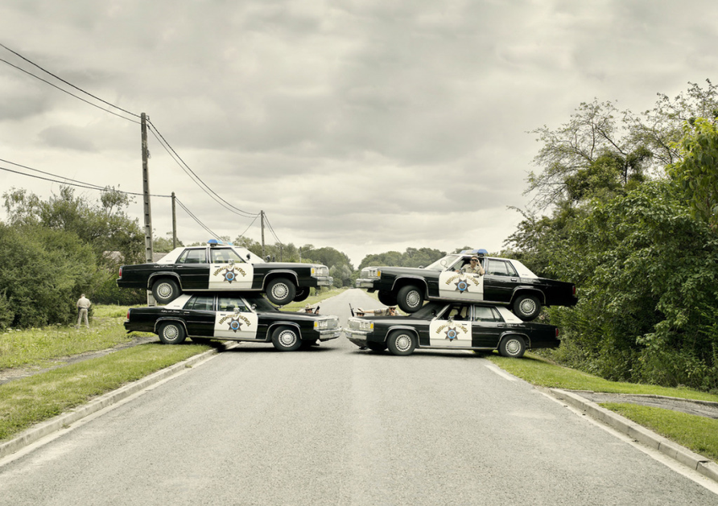
ROAD BLOCKS

Slide 11
Road blocks
What makes that (you are not there yet?) What is in the way? Who is?
It also can be a limiting belief…
“I am not allowed to complain to
the top manager” Challenge that.

Slide 12
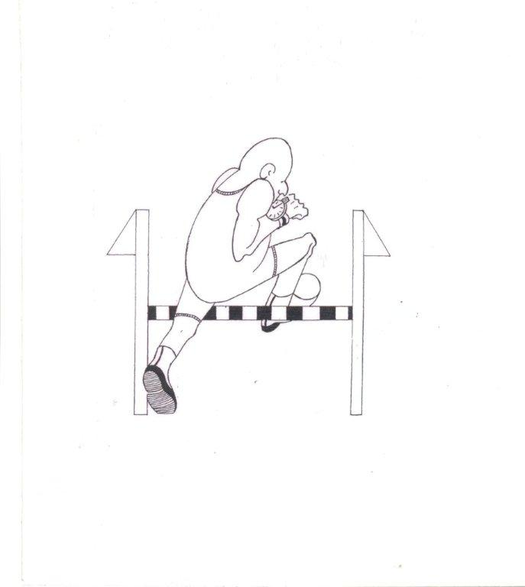
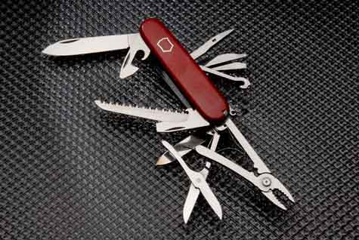
RESOURCES

Slide 13
Resources
To remove a road block:
  How could that … be solved? What would help? Who could help?
  To achieve the goal? What would help to make the next step?

Slide 14
ACTIONS
What are your goals? SMART!!!
What actions are you going to take?
  WHAT WOUD BE THE FIRST STEP TO TAKE?

Slide 15
Individual level
My name: What? | With whom? | When? | How? | Evidence of success
To become a coach, I will…..

