Slide 1
Make Rapport

Slide 2
What is “rapport”?
(Fr)
Rapport is imitating the other to get quick contact and make the other person feel understood and safe. It is about building trust, establishing harmony and cooperation in a relationship.
You can copy (with all your senses) e.g. facial expressions movements, wordings.
You do it all the time, unconsciously.

Slide 3
Following are major elements of rapport:
Physiology (55%)
Posture
Gestures
Facial expressions and blinking
Breathing
Tonality (38%)
Voice
Tone (pitch)
Tempo (speed)
Timbre (quality)
Volume (loudness)
Words (7%)
Predicates
Key words
Common experiences and associations

Slide 4
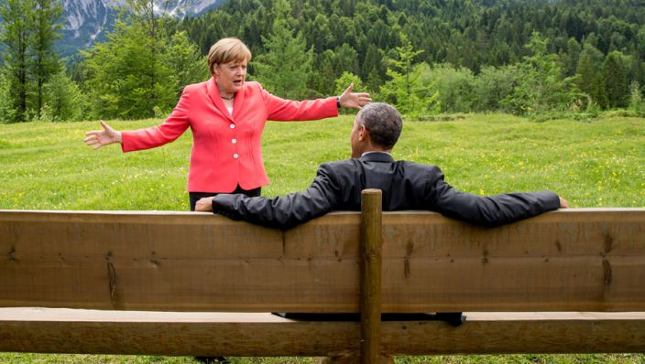
Rapport

Slide 5
A good leader makes “rapport” in a subtle and discrete way. For instance by doing it later, partly or with another part of your body.
Exercise and practice.
Try it in a difficult situation/meeting with somebody.

Slide 6
Exercise
Matching and mismatching 5 plus 5 min
A tells a story about a coach.
B listens and asks questions. B matches physiology, gestures, facial expression, breathing, voice.
After two minutes B changes one of the physiology and later back again.
C observes and keeps the time, gives feedback.
A,B en C discuss the feeling during the conversation.

Slide 7
Exercise: backtracking
A tells a story about a conflict.
B listens especially to key words the other person uses.
After a while B starts to mingle in the meeting by saying:
So, if I understood well, you did….. using the keywords and sentences.
C observes and keeps the time, gives feedback.
A,B en C discuss the feeling during the conversation.

Slide 8
3. Listening
Verbal and non-verbal
Representation systems

Slide 9
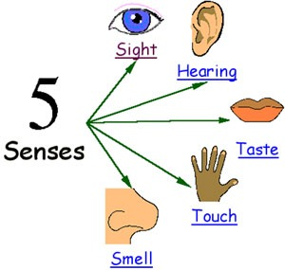
3.1. Representation systems
People have preferences
Visual
Auditive
Kinesthetic
Digital

Slide 10
VAKaD
Each of us has a preferred representational system (visual, auditory, kinesthetic or digital (auditory digital) - often referred to as VAKaD).
For example, when learning something new, some of us may prefer to see it or imagine it performed, others need to hear how to do it, others need to get a feeling for it, and yet others have to make sense of it.

Slide 11
Visual
Memorize by seeing pictures and are less distracted by noise. Often have trouble remembering and are bored by long verbal instructions because their mind may wander. They are interested by how the program looks.

Slide 12
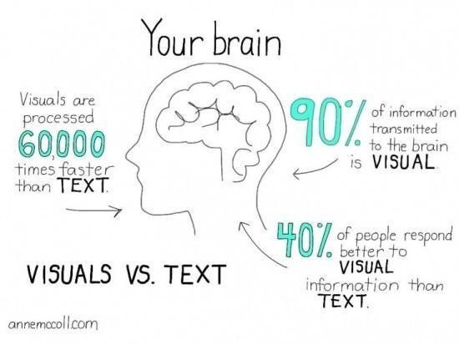

Slide 13
Visual
People with a visual preference, will tend to:
Be organized, neat and well-groomed.
Use visualization for memory and decision making - often getting insights about something.
Speak faster than the general population.
Remember faces more easily than names.

Slide 14
Visual
People with a visual preference,
will tend to:
Prefer in-person interactions - to see the other person and his/her reactions.
Want to see or be shown concepts, ideas or how something is done.
Want to see the big picture.
Be distracted by visual activity and less so by noise.

Slide 15
Auditory
People with an auditory tonal preference, will tend to:
Be more aware of subtle change in the tone of your voice and be more responsive to certain tones of voice.
Perceive and represent sequences and are able to remember directions or instructions more easily.
Learn by listening and asking questions.

Slide 16
Auditory
People with an auditory tonal preference, will tend to:
Enjoy discussions and prefer to communicate through spoken language rather than the written word.
Need to be heard.
Be easily distracted by noise.

Slide 17
Auditory
Typically are easily distracted by noise. They can repeat things back to you easily & learn by listening. They like music and like to talk on the phone. Tone of voice and the words used can be important.

Slide 18
Kinesthetic
Often they talk slowly and breathy. They respond to physical rewards & touching. They memorize by doing or walking through something. They will be interested in a program that feels right or gives them a gut feeling.

Slide 19
Kinesthetic
People with a kinesthetic preference, will tend to:
Speak slower than the general population.
Be more sensitive to their bodies and their feelings and respond to physical rewards and touching.
Learn by doing, moving or touching.

Slide 20
Kinesthetic
People with a kinesthetic preference, will tend to:
Make decisions based on their feelings.
Stand closer to other people than those with a visual preference - to feel the other person's energy, whereas the person with a visual preference will stand back to see more of the other person (body language, etc.).

Slide 21
Digital
Digital is devoid of the senses. People with an auditory digital preference, will tend to:
Have a need to make sense of the world, to figure things out, to understand.
Talk to themselves and carry on conversations with you in their mind.
Learn by working things out in their mind.

Slide 22
Digital
Digital is devoid of the senses. People with an auditory digital preference, will tend to:.
Learn by working things out in their mind.
Not to be spontaneous, as they like to think things through.
Have logic play a key role in the decision process as do facts and figures.

Slide 23
Digital
People with a digital preference, will tend to:
Have a need to make sense of the world, to figure things out, to understand. Talk to themselves and carry on conversations with you in their mind. Often they will say they remember discussing something with you, when you actually did not have the conversation. They did, however, in their mind! Learn by working things out in their mind. Not to be spontaneous, as they like to think things through. Have logic play a key role in the decision process as do facts and figures. Memorize by steps, procedures, sequences.

Slide 24
Your preference
VAKaD questionnaire

Slide 25
How to use representational systems
To model someone else
To make rapport
To align with a person’s learning style

Slide 26
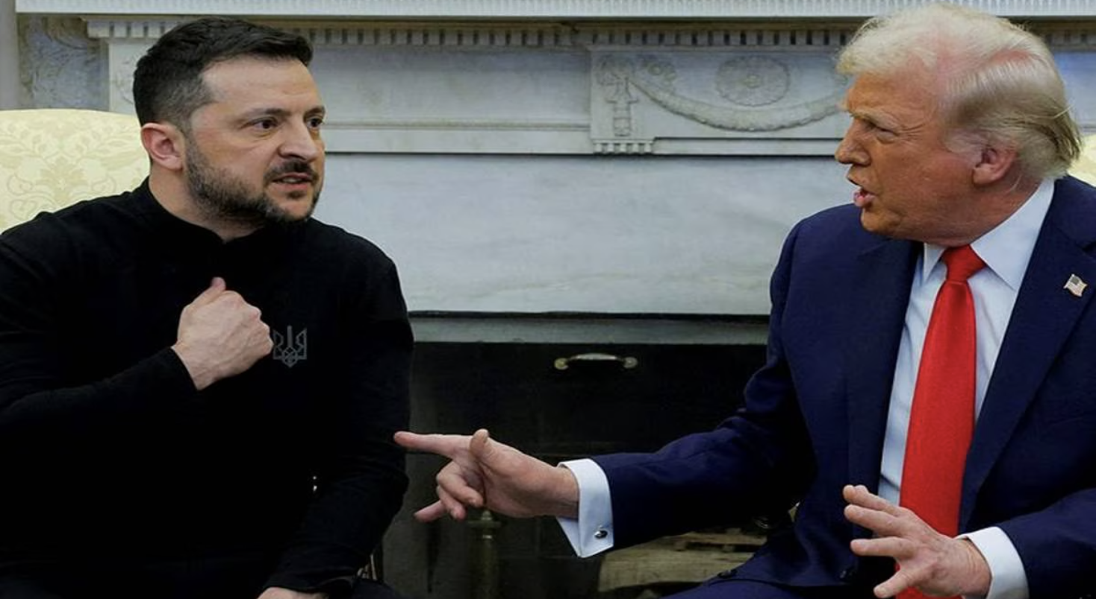
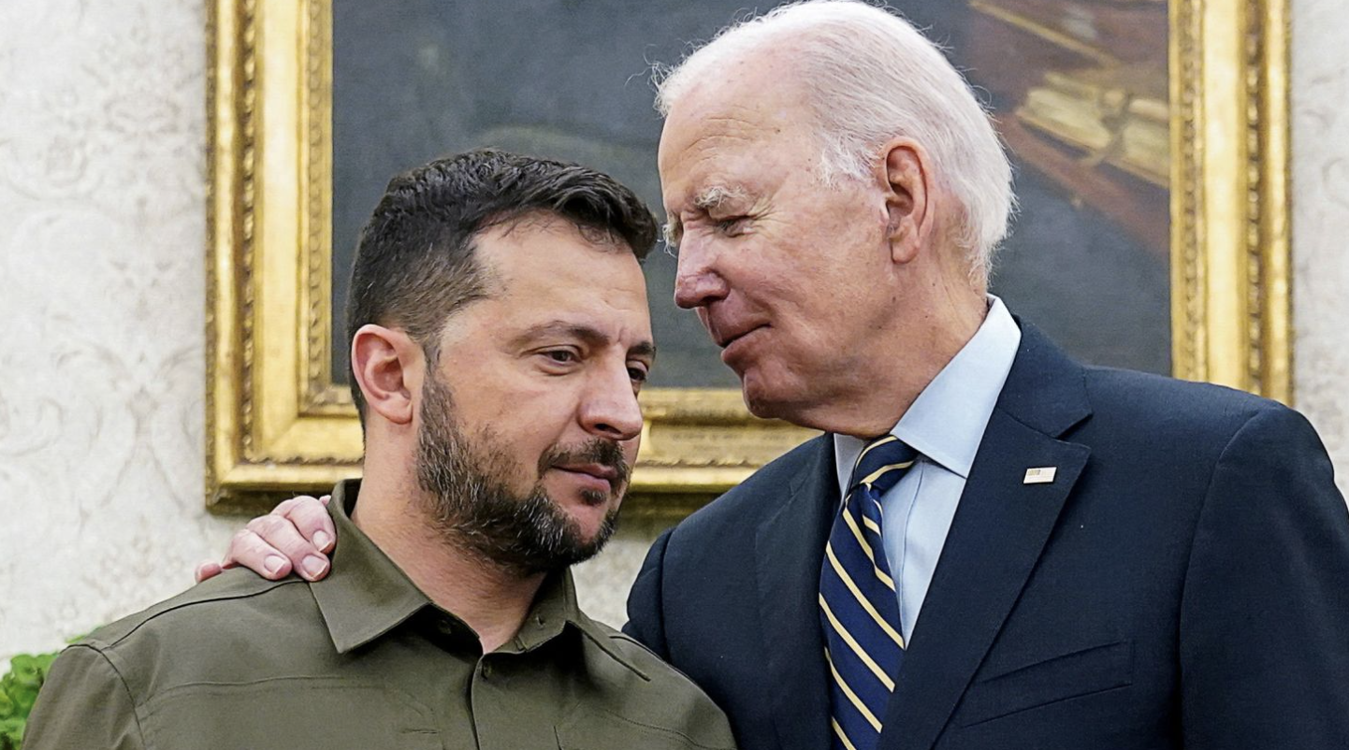
No words

Slide 27
The meeting of two personalities is like the contact of two chemical substances: if there is any reaction, both are transformed.
Carl Jung

