Slide 1
van Kemenade
Audit Coaching Training
Delegating

Slide 2
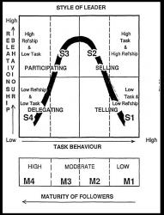
Situational leadership
Notes:
What kind of skills does this require from management?
Diagnosing maturity of followers?
Flexibility in style of leadership.

Slide 3
Content
Delegation
Advantages
Convenient
Inconvenient
How?

Slide 4
Delegation
What is delegation?
When you delegate, you put another one in place to achieve your results.
You trust a task with its powers and resources to another party.
What you do is retain overall responsibility for the result!

Slide 5
Advantages of Delegation
You better do, because you're dealing with pressure and (eventually) save time.
You make better use of the qualities of others.
You motivate your employees.
You develop your staff.
You can concentrate on the tasks for you as a manager really matter, such as developing a vision.
The higher you get, the more important it is to delegate.

Slide 6
Can be convenient for Delegation
Whatever can be done by someone else
What can be done better by someone else
What others had to learn
What others like to do

Slide 7
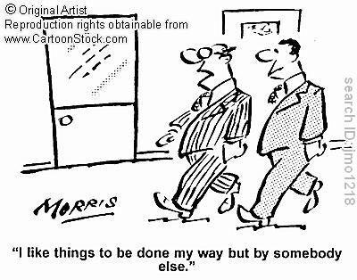

Slide 8
Inconvenient
What is sensitive: for example dismissal
issues, conflicts, etc.
Your core business as a leader: conducting assessment interviews or approval of annual plans.
Keeping the overview.
The ultimate responsibility for tasks you
have delegated.

Slide 9
How do you delegate?
Characteristic of good delegation is the care with which you delegate the work transfer.
You don’t give the first employee you see after a short chat about the weather, a quick job.

Slide 10
Leave enough scope
Allow the team enough scope to arrange the process in their own way
Delegation rules (Ashridge):
Evaluate the risks
Agree clear objectives
Monitor progress
Review afterwards
Look actively for opportunities

Slide 11
Delegation Meeting
- Make an appointment.
Prepare the interview very well.
You focus on content and on the relationship with the employee.
How exactly to delegate depends on every individual employee.
Make appointments about results that have to be achieved and about the process.
After the delegation leave the employee as much as possible to do his own work.
Check when the work is finished.

Slide 12
QUESTIONS???

Slide 13
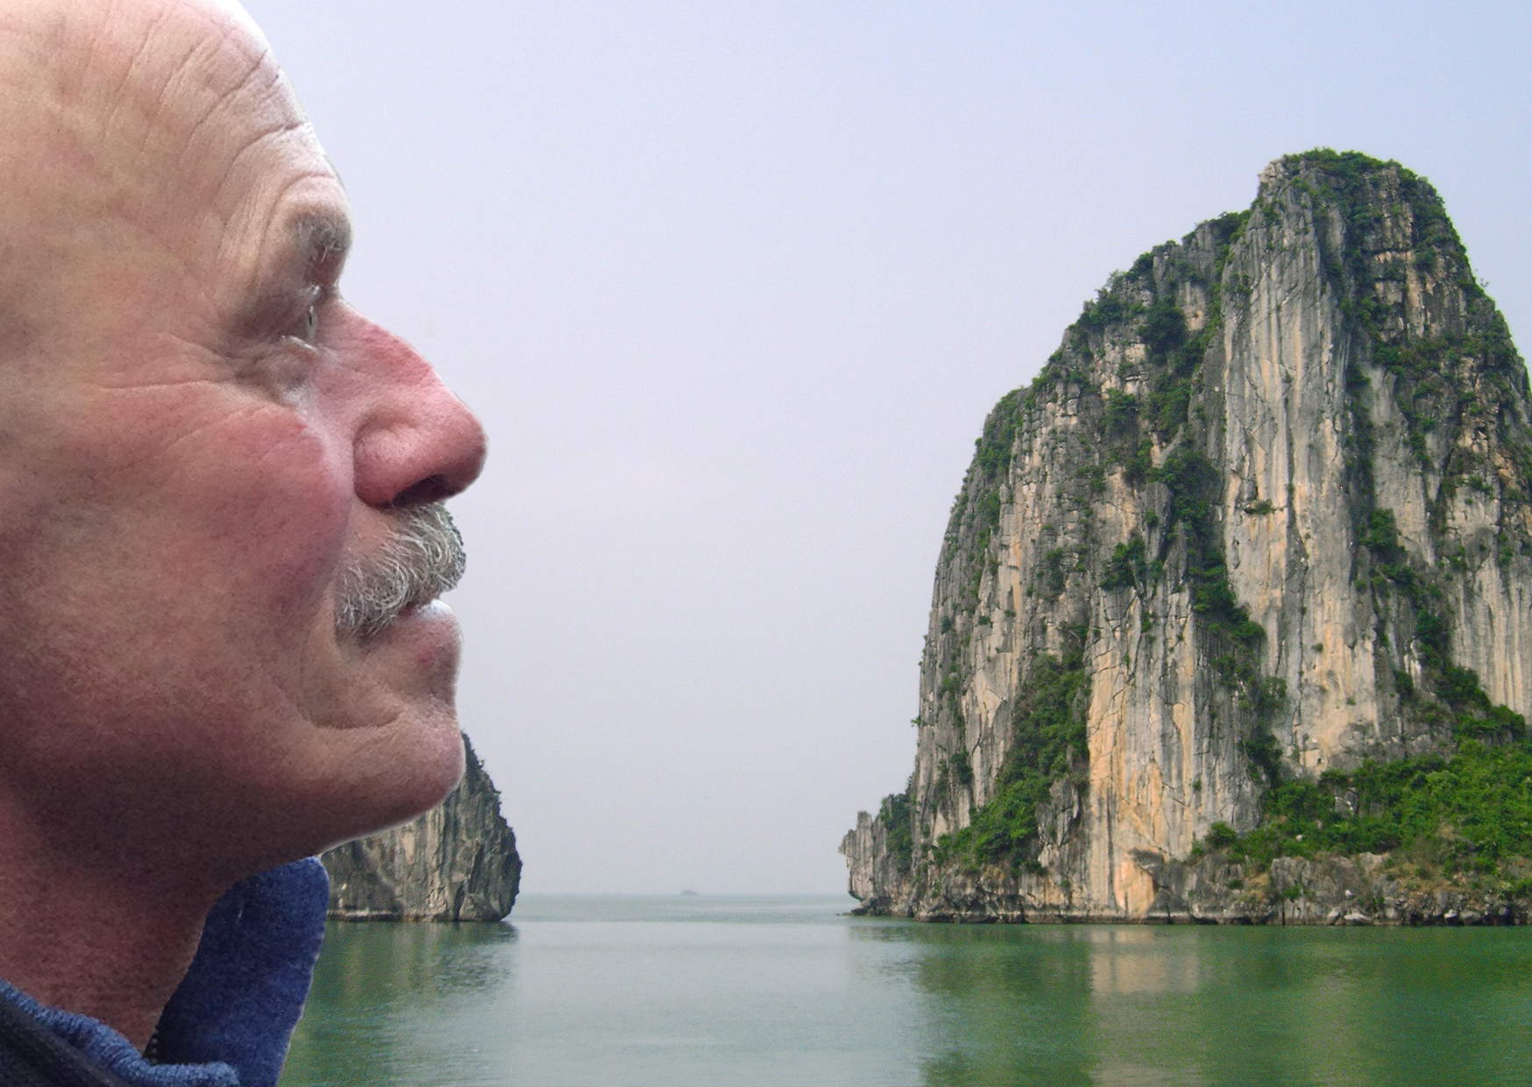
everard@onsnet.nu

