Slide 1
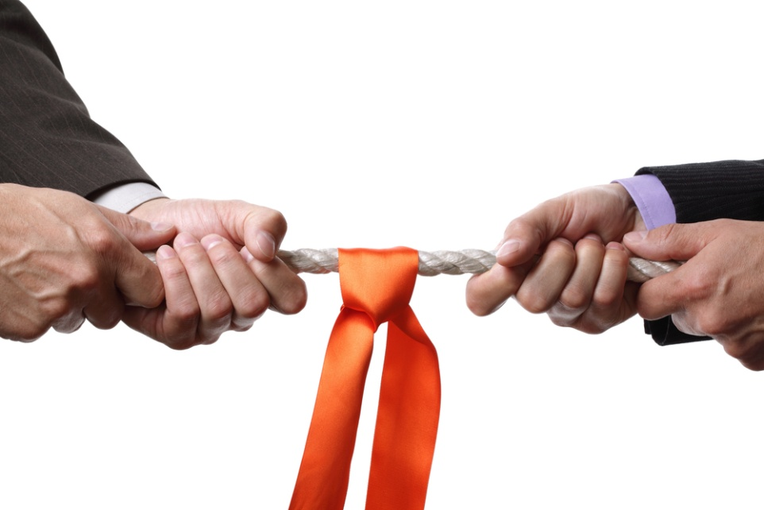
CONFLICT MANAGEMENT

Slide 2


Slide 3
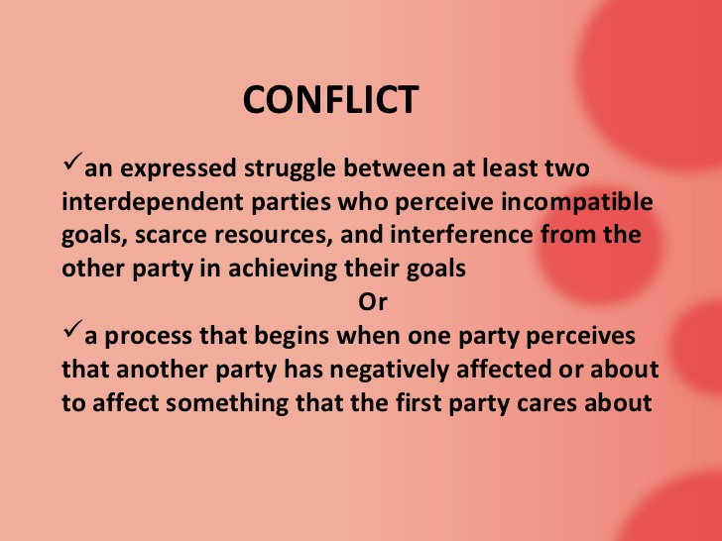
Definition

Slide 4
EXAMPLES

Slide 5
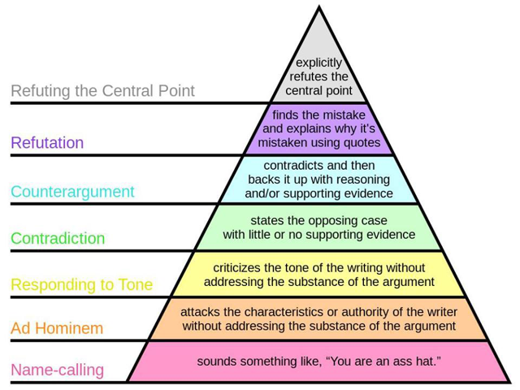
The way we react

Slide 6


Slide 7
Conflicts
........ are not good nor bad.
……… are inevitable
......... are necessary for a team
Unresolved conflicts are bad for
health and for
healthcare.

Slide 8
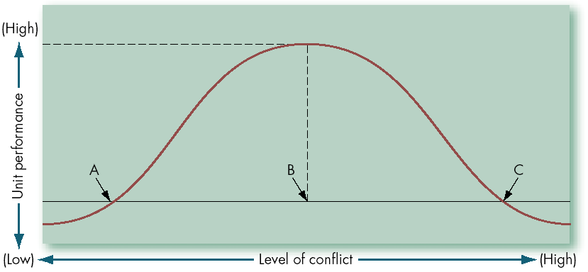
Conflict and unit performance

Slide 9
Conflict can be
Personal
  Space needs
  Stress
  Interpersonal
    Difference of opinion/approach
    Imcompatible characters
    Competing interests/goals
    Value conflicts
Structural
  Scarcity from resources
  Unclear responsibilities
Unclear/unspoken

Slide 10
Core
Quality
Pitfall
You
Challenge
Core
Quality
Allergy
Pitfall
Allergy
Challenge
Other
Incompatible characters
18

Slide 11
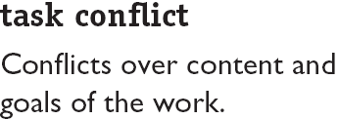
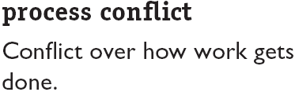
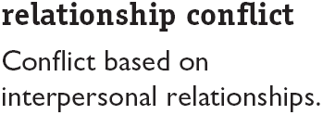
Types of Conflict

Slide 12
Type of conflicts
functional | dysfunctional
Creates outlet | Becomes personal
Increases cohesion | Work is not done or badly
Increases involvement of people | When it dictates conformity, people are forced to decision

Slide 13
Can result in
……….
Loss of productivity
Low motivation
Turnover
Violence

Slide 14
Symptoms
Individual
- Avoidance (absenteeisme, yes-ing the boss)
- Repression (illness, heavy drinking, low
satisfaction, irritability)
- Reactive (anger, strike)

Slide 15
Symptoms
Team
- Decreased interaction
- Asking boss to make team decisions
- Low trust
- Competition

Slide 16
Thomas-Kilmann Conflict Mode Instrument
assertiveness
COMPETITION
COLLABORATION
COMPROMISE
AVOIDANCE
ACCOMODATION
cooperativeness

Slide 17
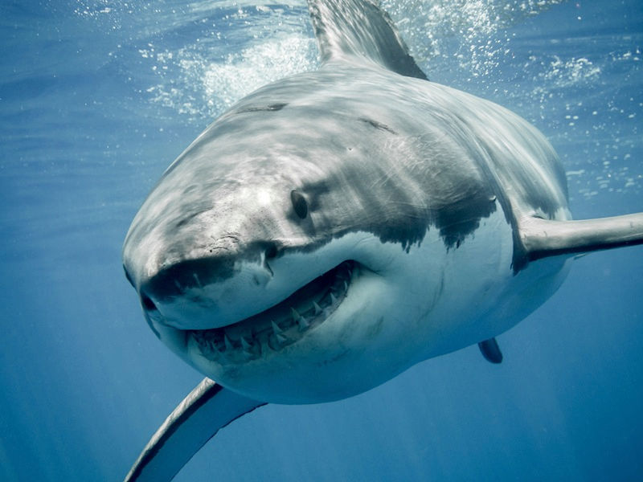

Slide 18

Conflict resolution strategies
Competition (I win, you loose)
  Negotiation, confrontation
  Force and fight
If there is an emergency and quick action is needed
But the winner may get
an increased ego

Slide 19
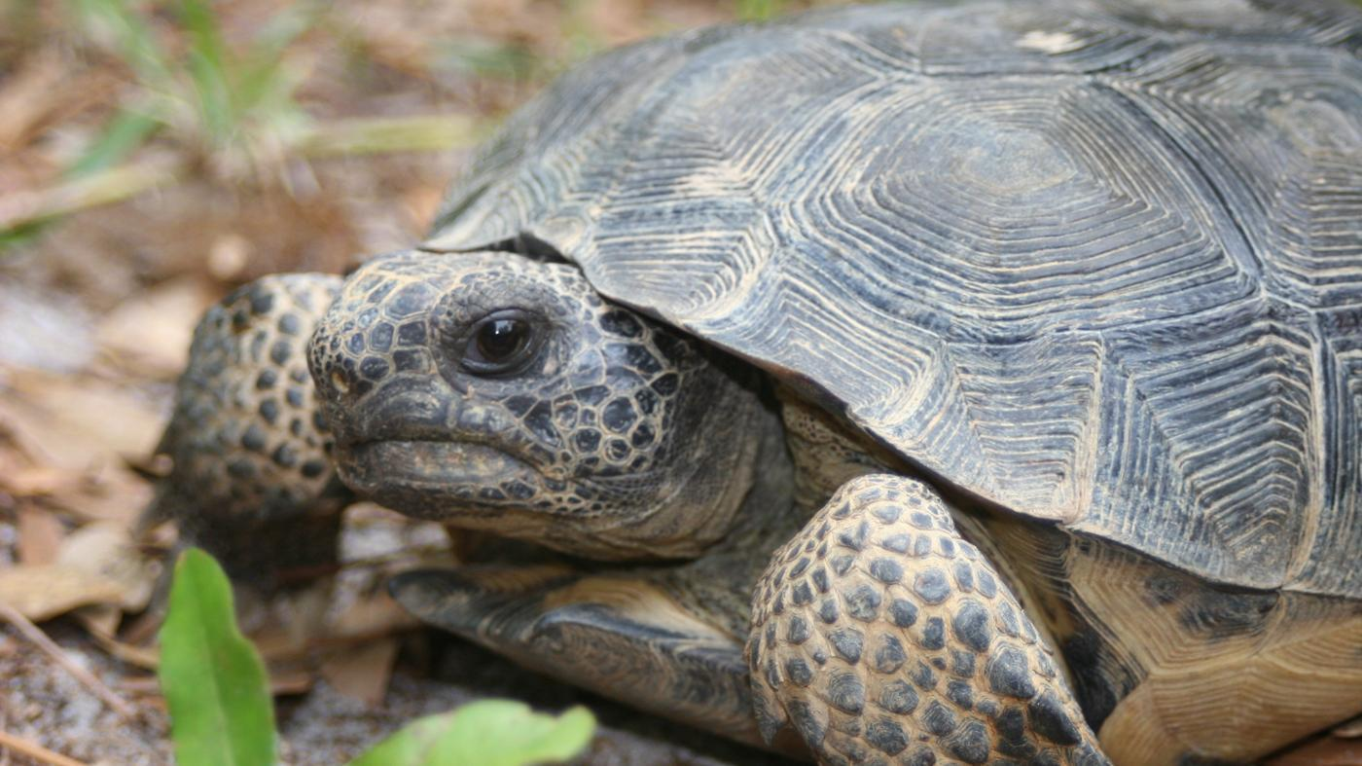

Slide 20

Conflict resolution strategies
Avoidance
  Repress emotions,
  Look the other way
  Run, quit, cool off, downplay
If the topic is trivial, you
can never win or costs too much
But: you might get ill….

Slide 21
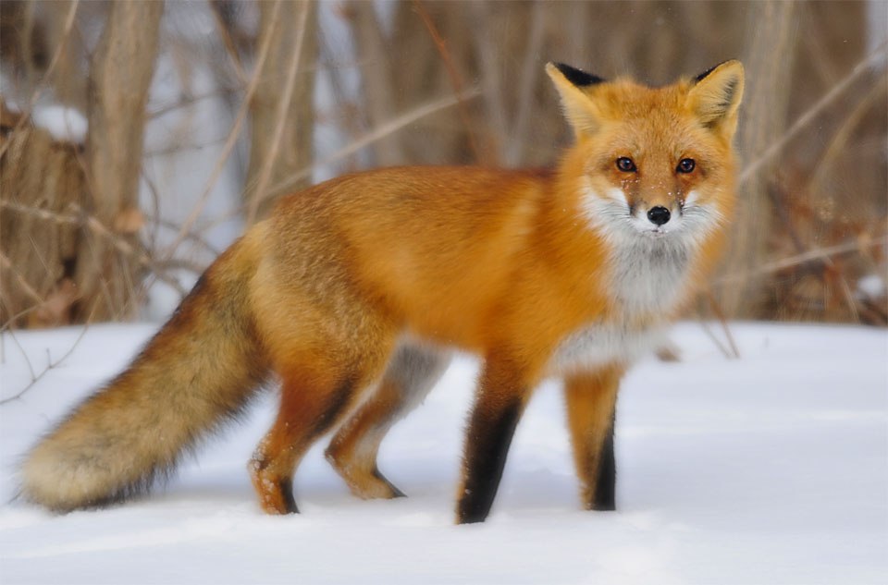

Slide 22
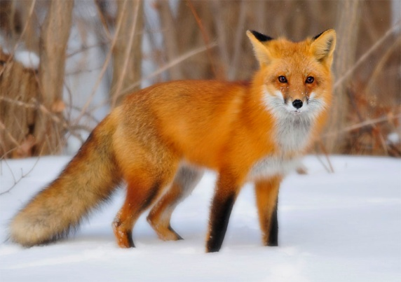
Conflict resolution strategies
Compromise (we both win a bit or we both loose)
  No one gets what he wants
  Everyone gives up something
  We agree to disagree
If you need a temporary
solution
But: may feel like a dead end

Slide 23
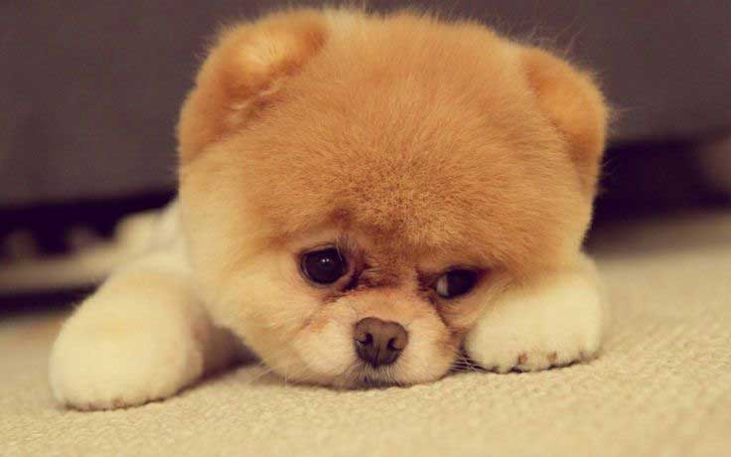

Slide 24
Conflict resolution strategies
Accomodation (you win, I loose)
  One gets what he wants
  One gives up all
If the issue is not important to the ‘loser’ or the other is the real expert, or you really value or need the relationship
But: I might feel bad I did not
fight

Slide 25
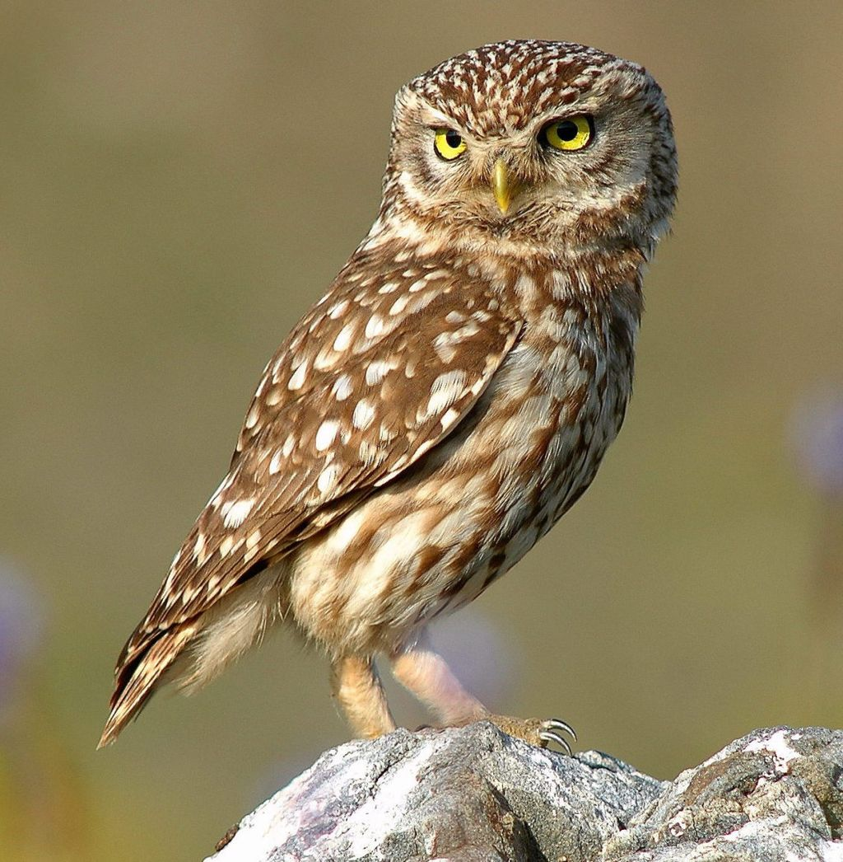


Slide 26

Conflict resolution strategies
Collaboration (we both win)
  Sit together
  Look for the problems behind the problem
  Find a solution that fits both/ win-win
If the situation is complex
But: hard to achieve,
requires trust

Slide 27

Walk in the Woods

Slide 28
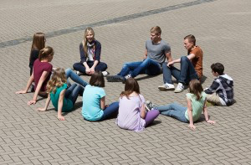
Four steps
0. Assemble representatives
of all stakeholders in the conflict
1. each stakeholder articulates their “self-interests” so that they are heard by the others.
2. look at where the overlap among these self-interests reveals agreement, what we call the “enlarged interests.)

Slide 29
3. collaborate to develop solutions to the remaining disagreements, or “enlightened interests.” This is the time for creative problem solving.
4. certify what has now become a larger set of agreements, or “aligned interests.” Any outstanding disagreements are held to the side for future negotiations.

Slide 30
St Maarten meetings
People have an opinion
Some people have a voice, not all
People like to voice their opinion, the meeting is vivid
People do not listen all the time,sometimes little respect for the other
They interrupt each other, they shout
There is little direction in the discussion
Nice discussion, but no decisions taken.

Slide 31
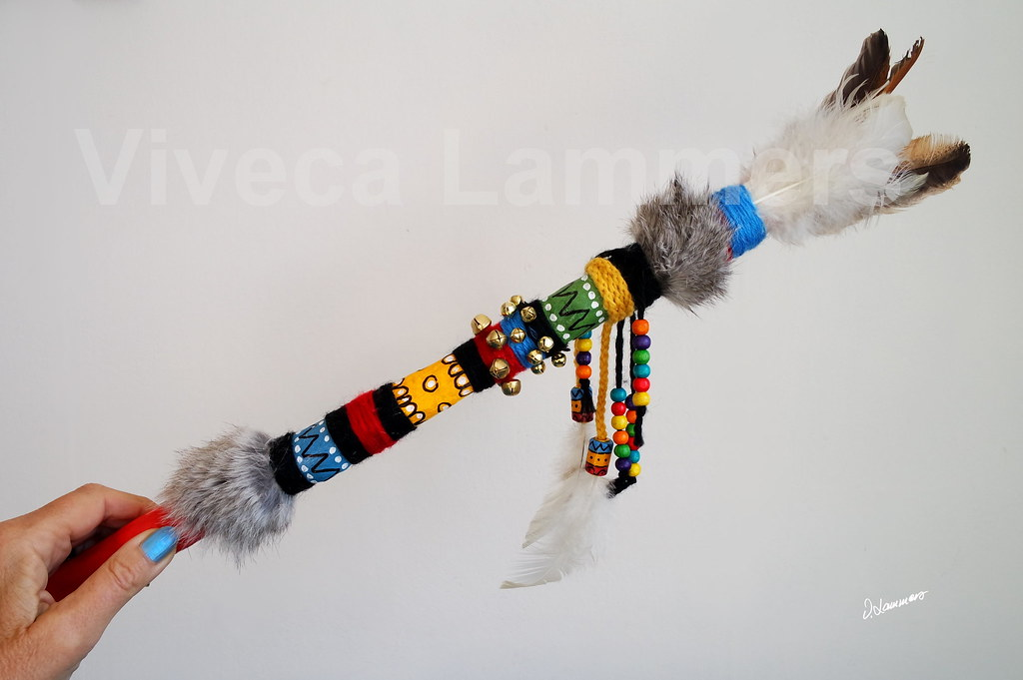
And what we can do about it?
Be the discussion leader
  Give people turns
  Demand respect for the other
  Summarize
  Direct the discussion towards a decision
  At the end (re)formulate the decision taken.

Slide 32
Evaluation
Certification

Slide 33
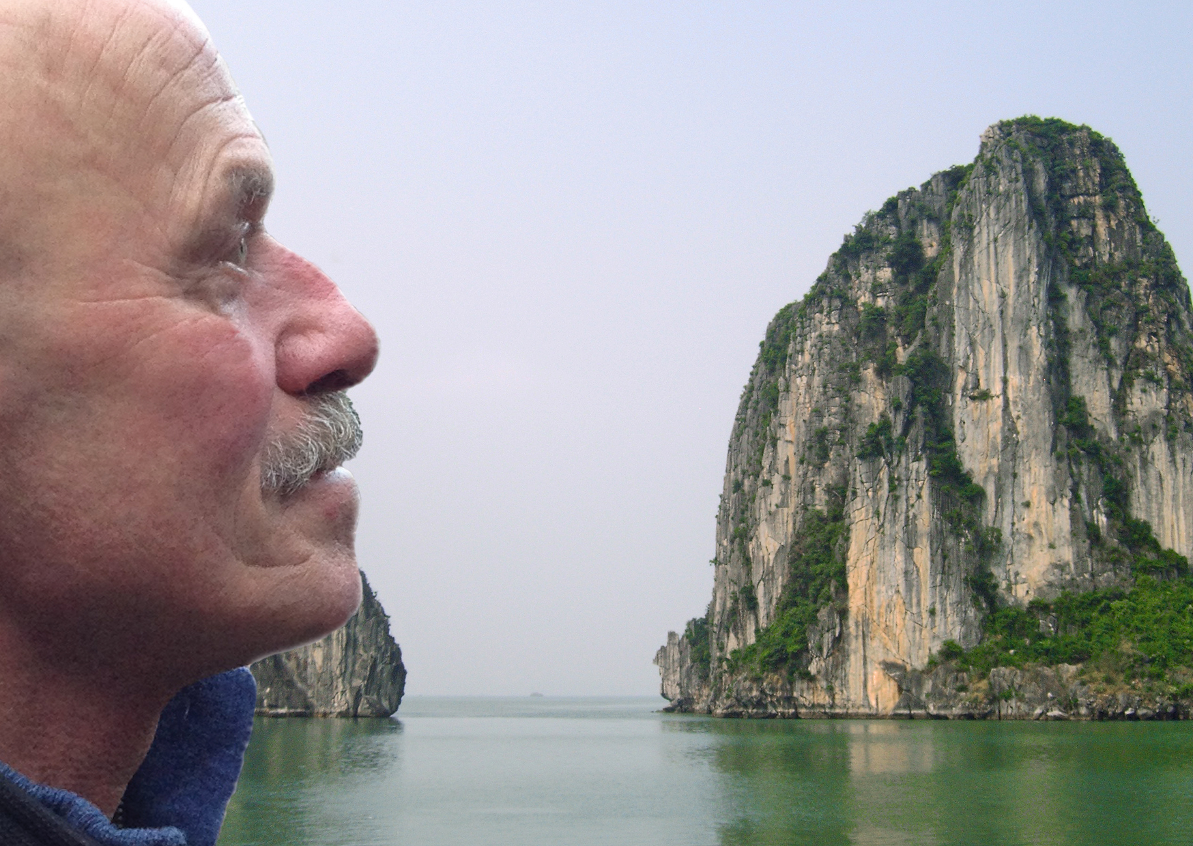
everard@onsnet.nu

