Slide 1
Resource management
5-S!
Notes:
Model, originally from Toyota, Japan.

Slide 2
5S
The way to success!
Sort
Shine
Sustain
Set
Standardise
Japanese |  | English
Seiri | (整理) | Sort
Seiton | (整頓) | Set
Seisō | (清掃) | Shine
Seiketsu | (清潔) | Standardise
Shitsuke | (躾) | Sustain
:
Notes:
This is a Japanese Quality Tool, called 5-S

Slide 3
5S
The way to success!
Sort
Shine
Stimulate
Set
Standardise
1. What unnecessary materials are in your department?
2. How can you set equipment to be fixed on the right place?
3. How can the environment be cleaned and maintained well?
4. What can you standardise (do all in the right way all the time)?
5. How can you stimulate the above to keep arranged?

Slide 4
Hospital tour
1. Damaged

Slide 5
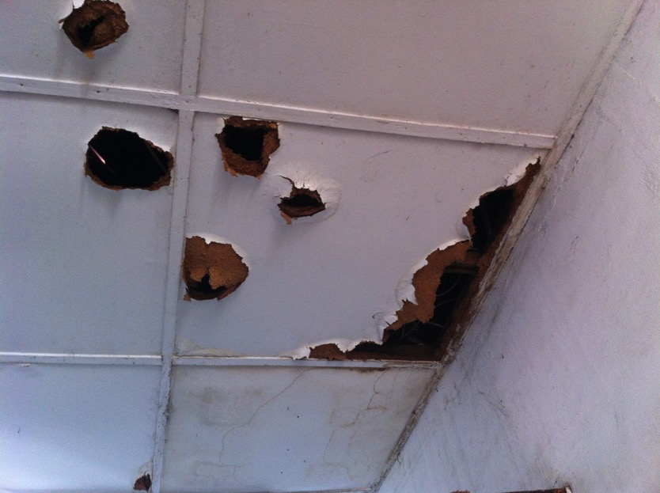
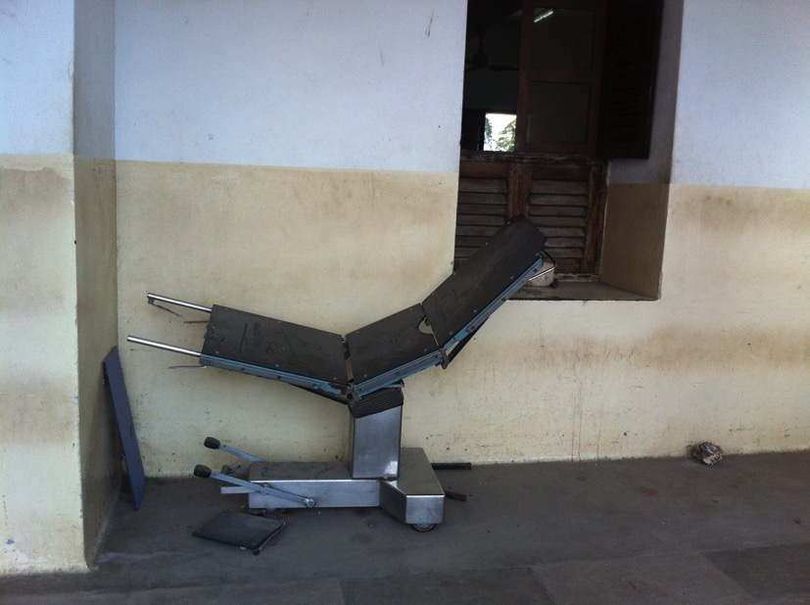

Slide 6
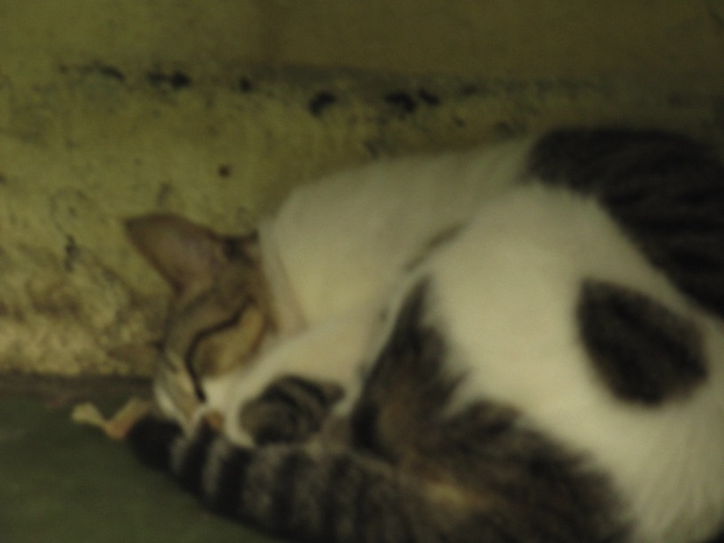
2. Garbage sort

Slide 7
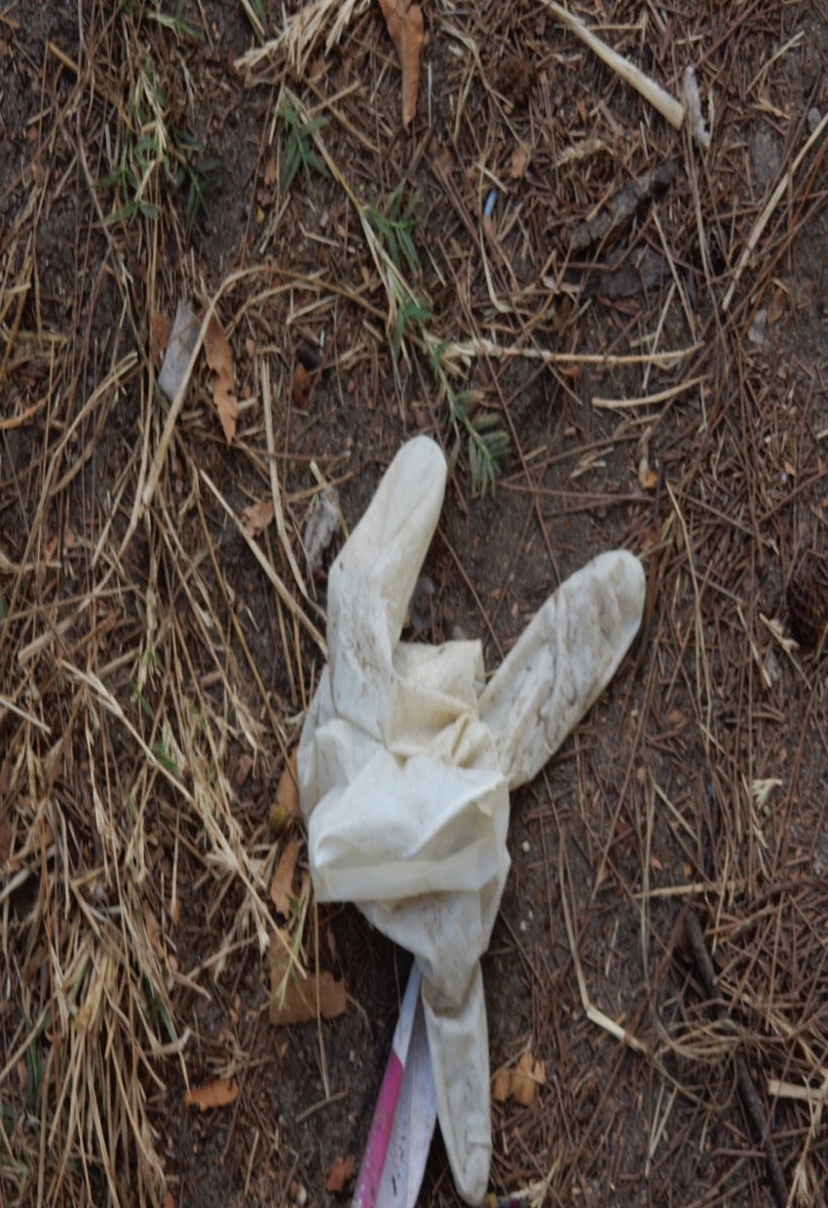
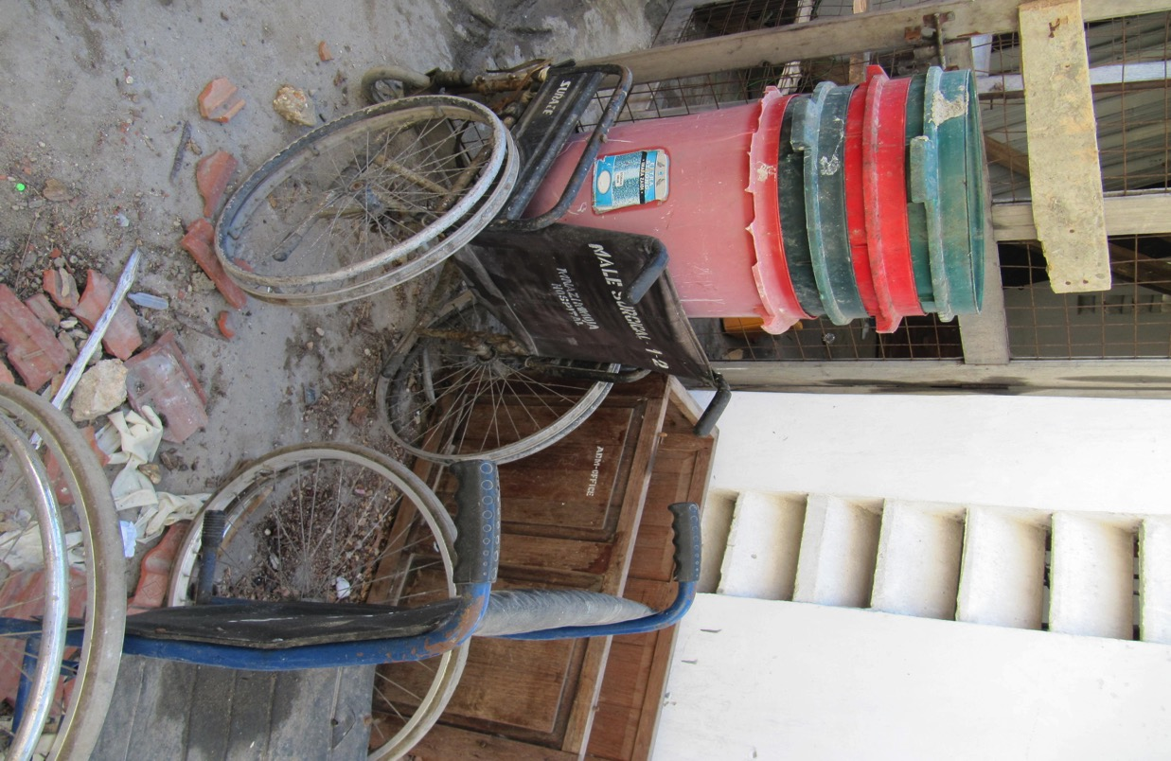

Slide 8
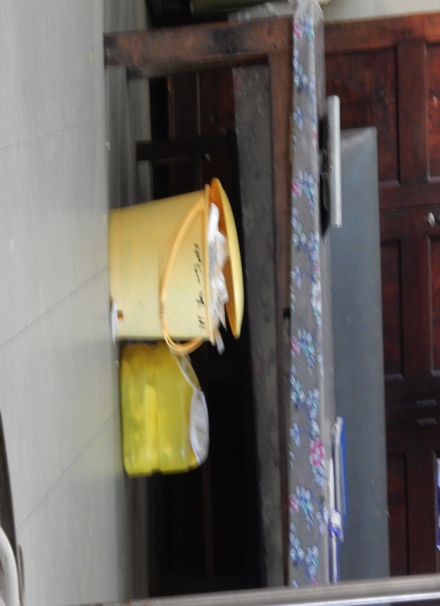
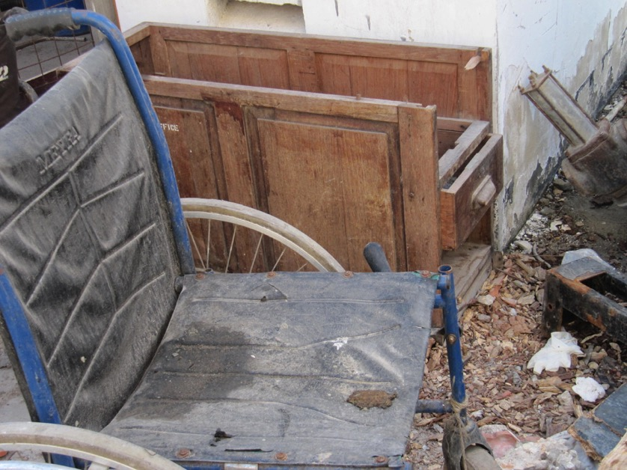
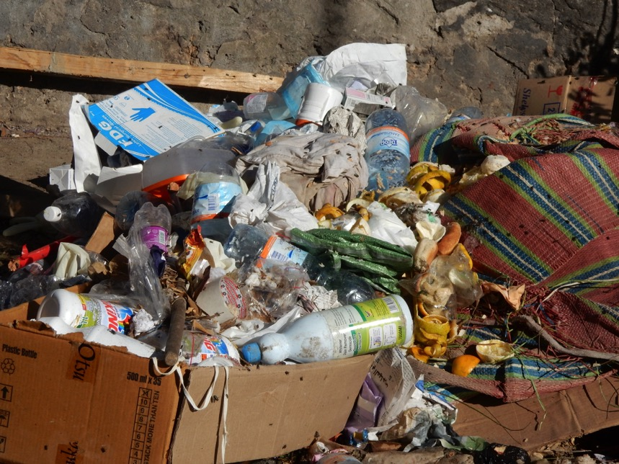
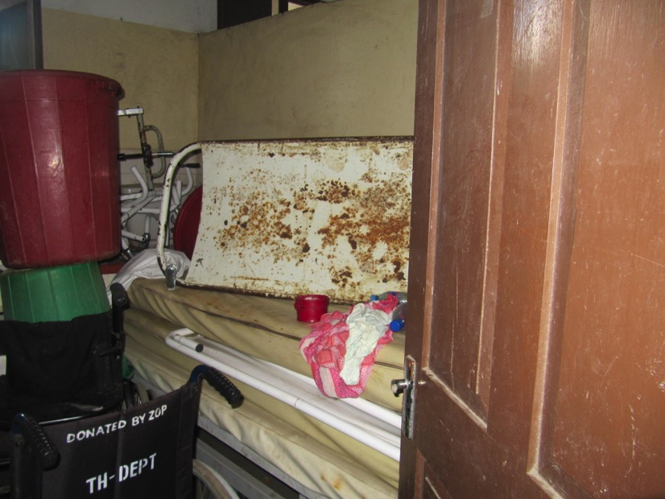

Slide 9
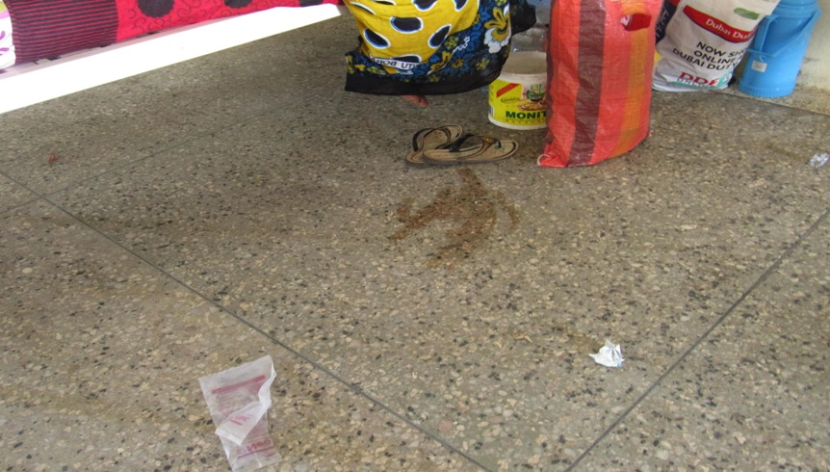
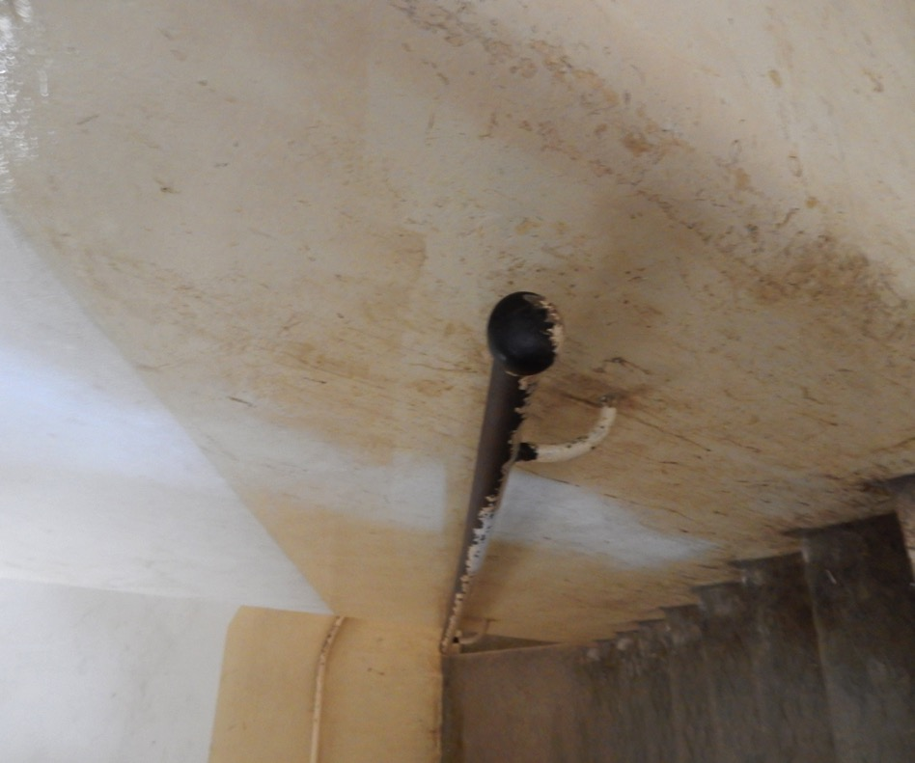
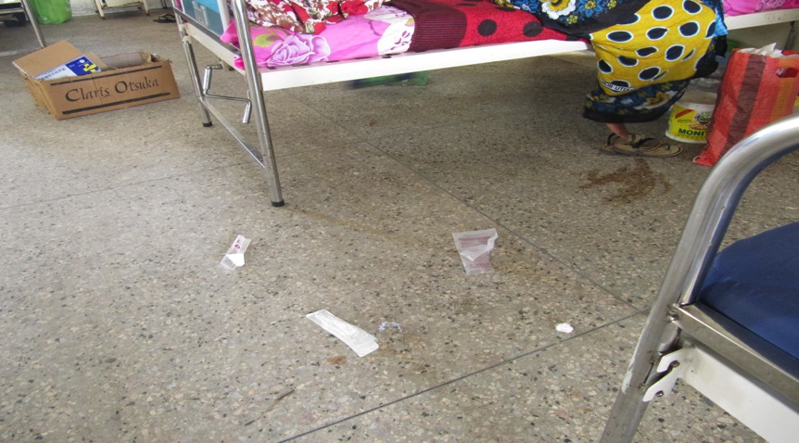
3. Dirt

Slide 10
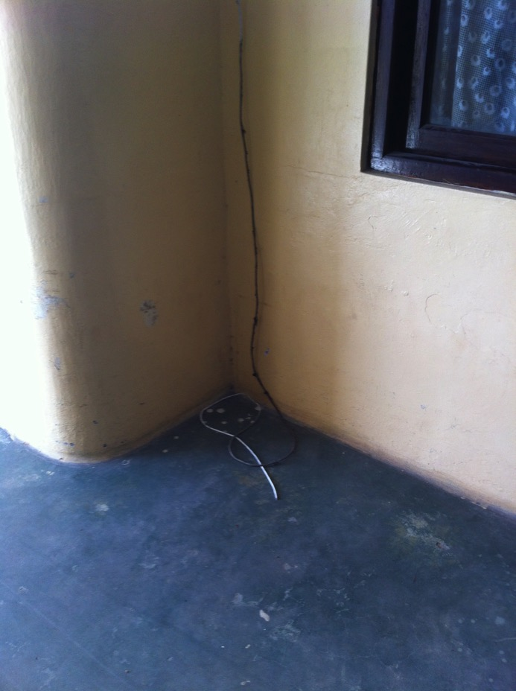
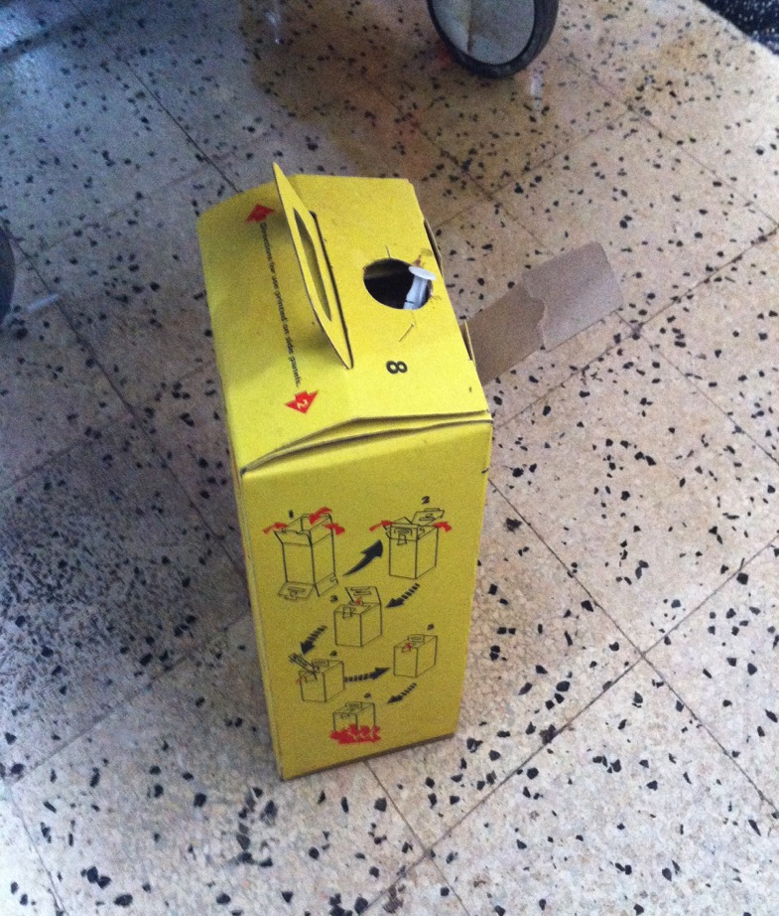
4. Dangerous

Slide 11
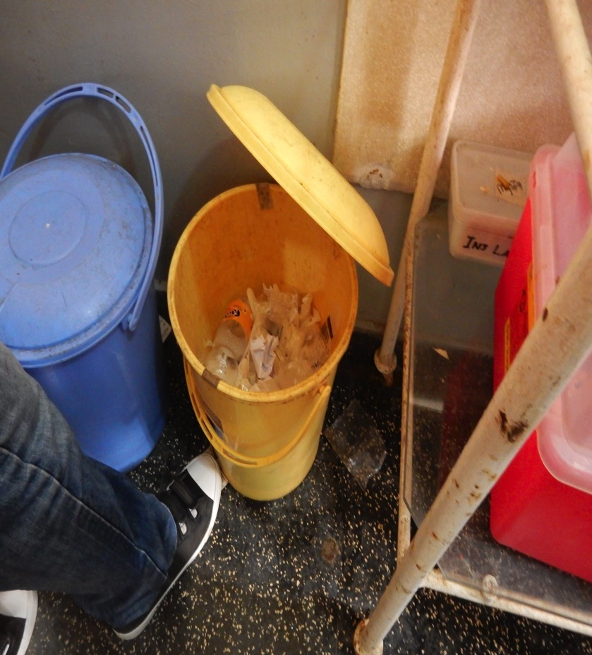
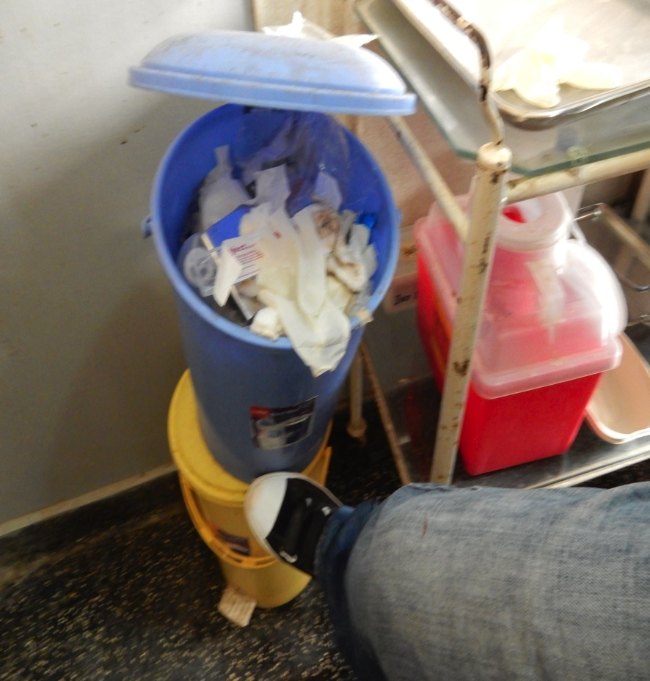
Notes:
Waste segregation? Both bins same stuff, infectuous and non-infectuous regardless the color.
Danger for cleaners!!!!

Slide 12
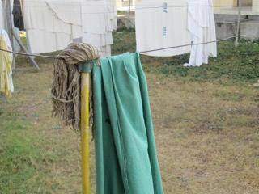
Notes:
Clean cloth, dirty mop

Slide 13
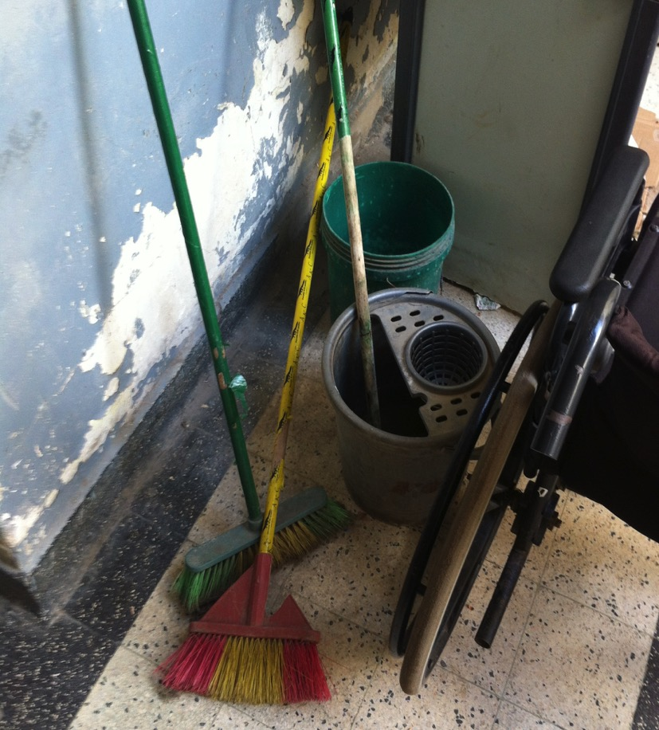
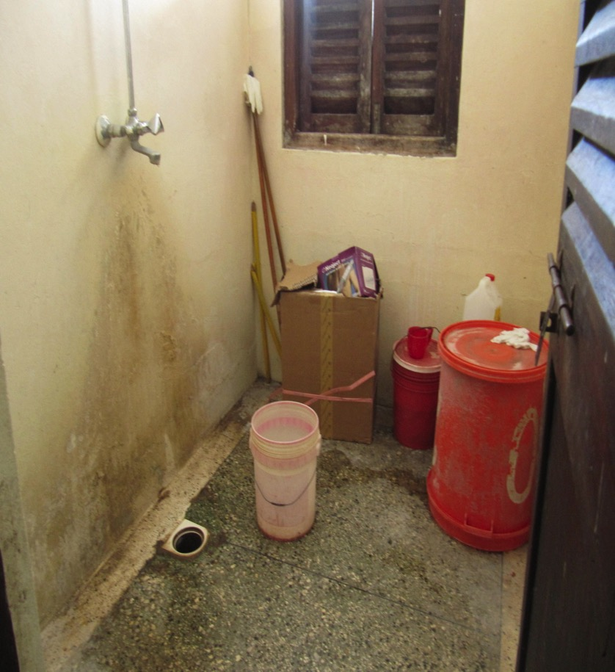
5. Storage set

Slide 14
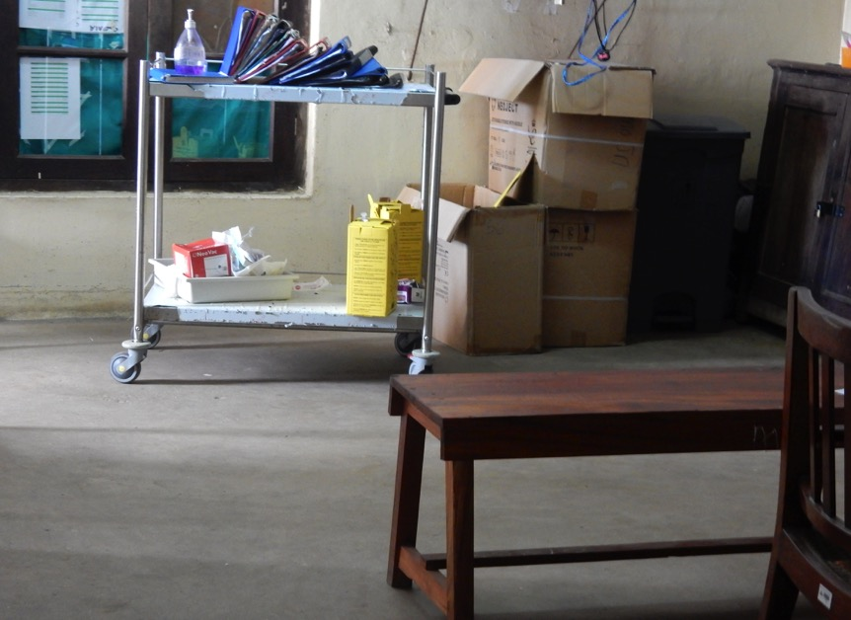
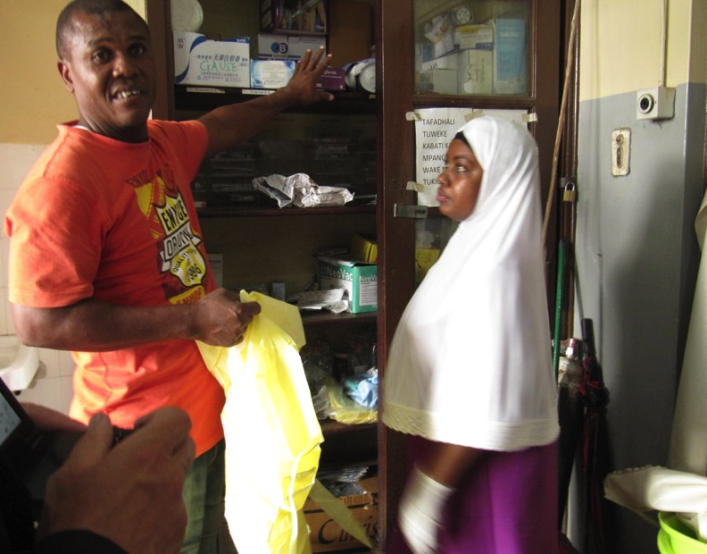
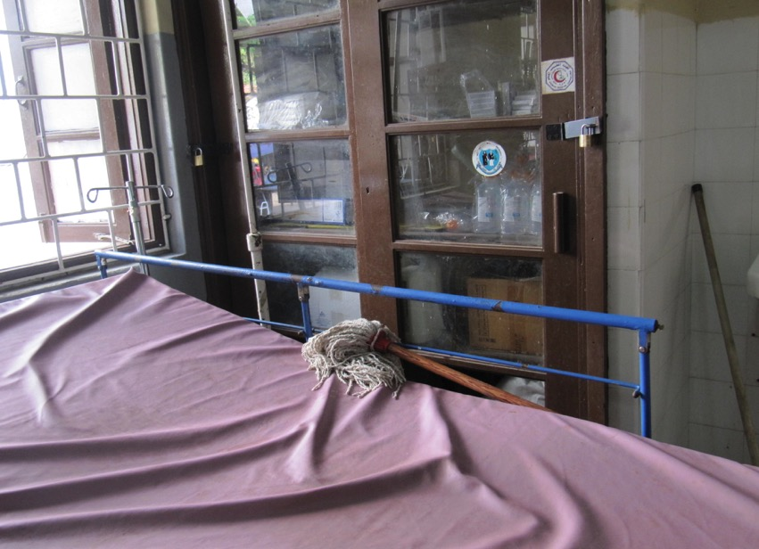
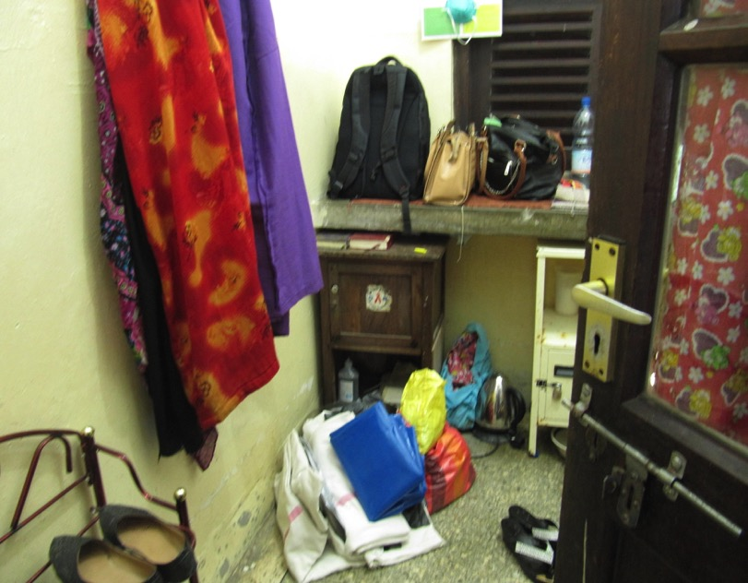

Slide 15
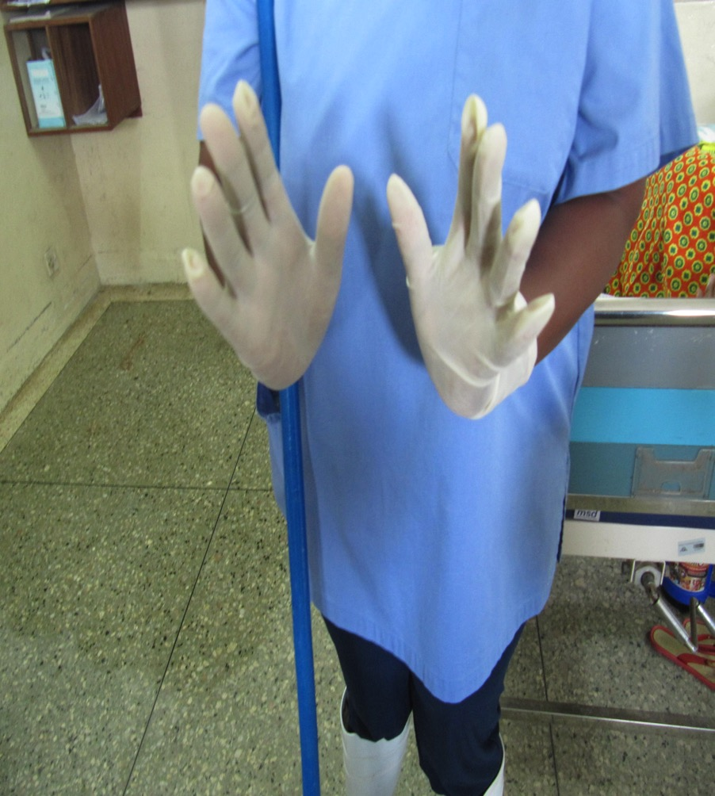
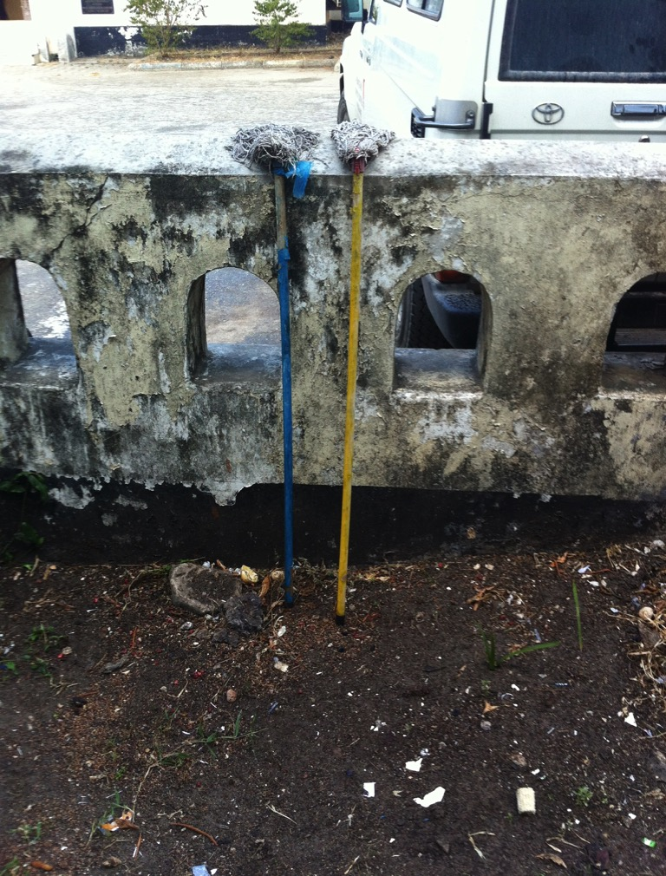
6. Materials
Notes:
Wrong gloves. Old materials.

Slide 16
NL as well

Slide 17
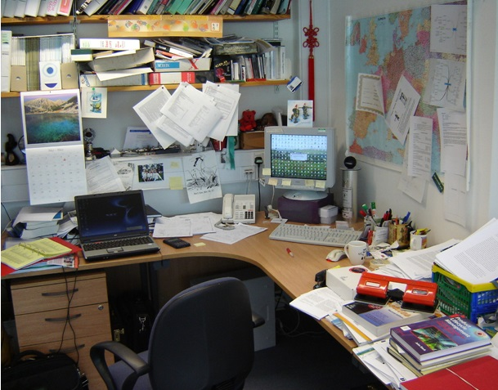
Do you waste time searching or moving?

Slide 18
Do workplaces look like this?
….

Slide 19
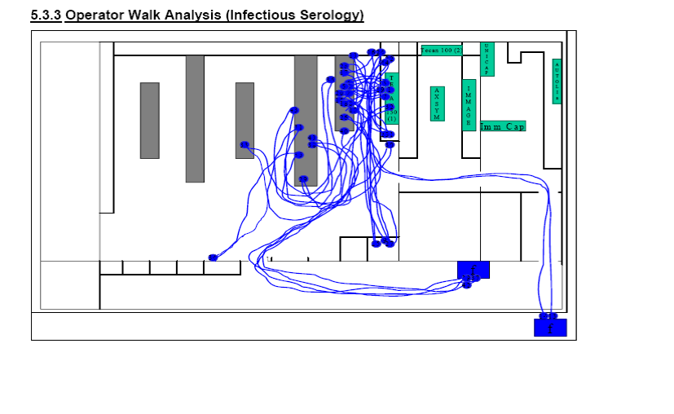
Do you waste time walking around?
You see someone working in the lab walking over 10 minutes in 1 hour. Nurses even walk about 20 minutes per hour. The two blue squares on the right are refrigerators

Slide 20
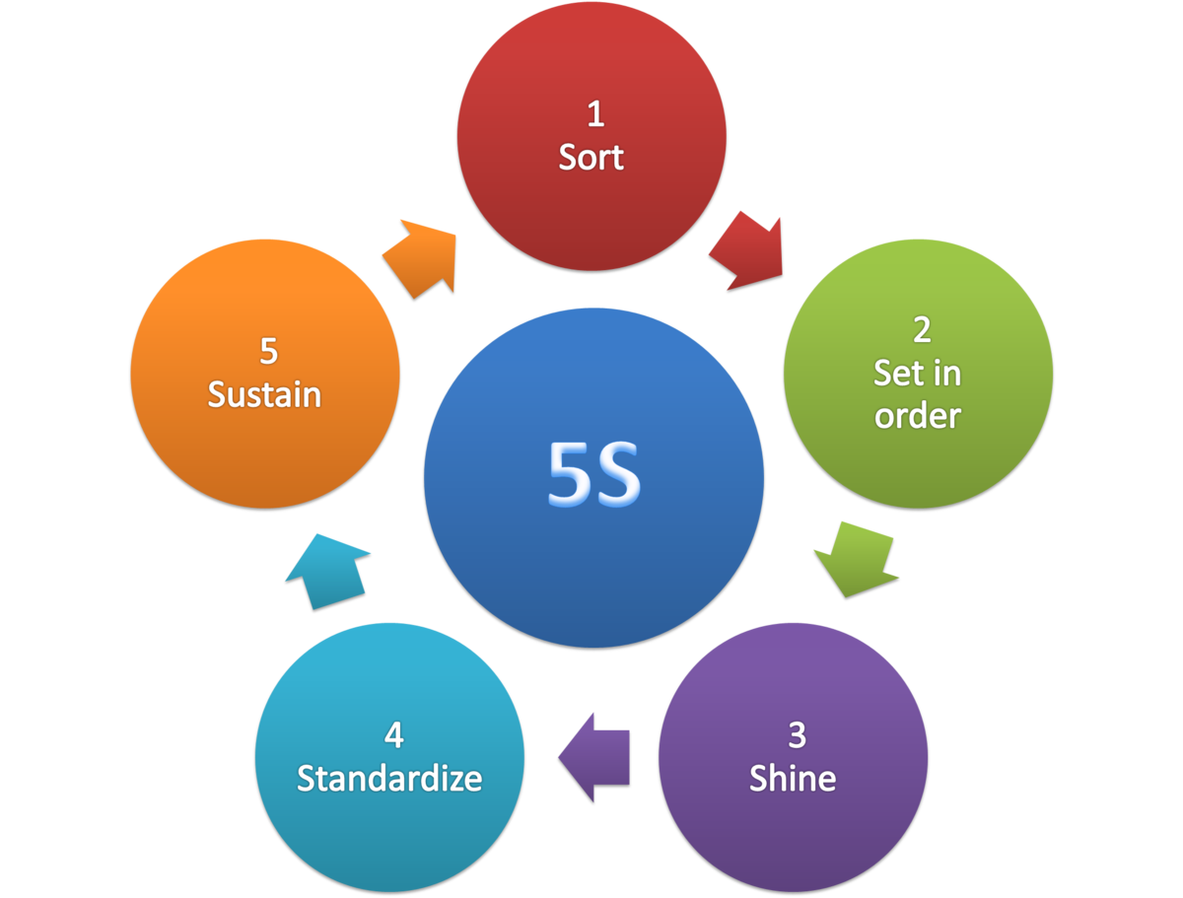
5S: 5 steps to improve physical workspaces

Slide 21
5S
The way to success!
Sort
Shine
Sustain
Set
Standardise
Seiri (整理) : Sort
Seiton (整頓) : Set
Seisō (清掃) : Shine
Seiketsu (清潔) : Standardise
Shitsuke (躾) : Sustain
Notes:
This is a Japanese Quality Tool, called 5-S

Slide 22
5S
1. Sort
What do you need and what is not necessary?
CHOOSE TOGETHER WITH POST ITS.
Remove what is not necessary like documents,
materials and personal belongings.
Keep only what you need for the job.

Slide 23
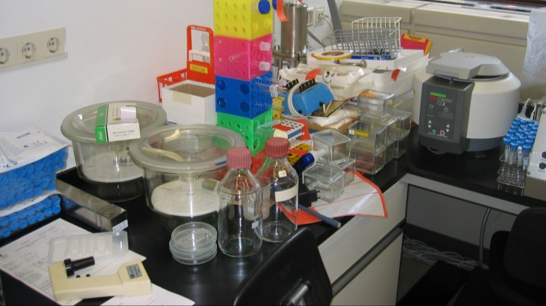
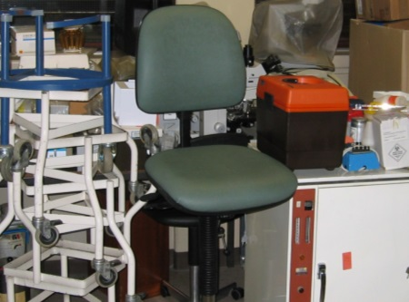
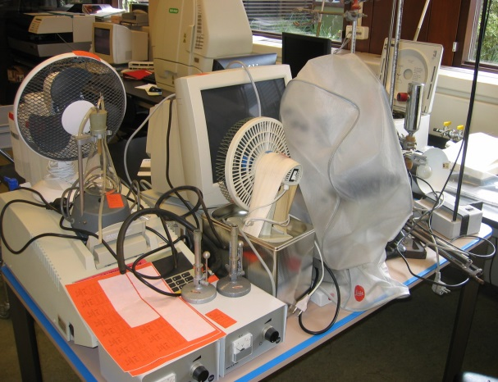
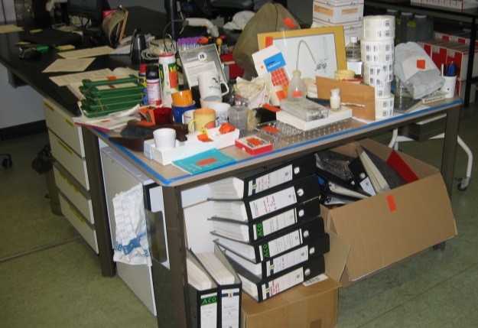
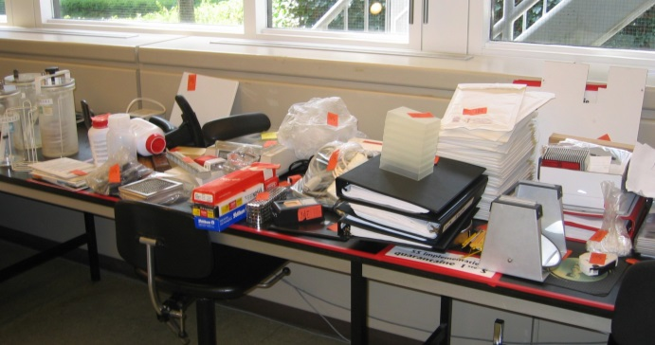
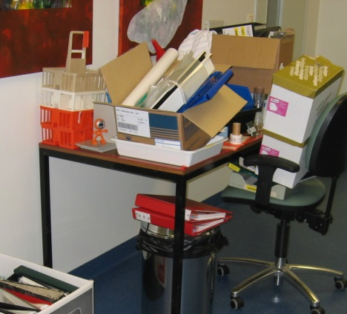
Step 1: sort out
The team removes everything that is not needed for daily work (this is often fun)
The pictures below are from one department

Slide 24
5S
2. Set
Put things in a logical place, close where you need it.
Make it a fixed place and decide on the amount of it needed.

Slide 25
What is “dirt”?
That is the presence of matter, in a location where it does not belong, and considered to be disturbing.
Notes:
Voordat we verder praten over het vak schoonmaken moeten we definiëren wat schoon is.
In de praktijk hebben we moeilijk heden met dit begrip. Volkomen schoon is praktisch onbereikbaar. Hoe goed we ook schoonmaken, we zullen steeds te maken hebben met vuilresten. Vaak zijn deze vuilresten onzichtbaar, en alleen met een microscoop waar te nemen, toch zijn ze er. Zelfs bij zeer zorgvuldig desinfecteren bereiken we geen 100% reinheid. Wat schoon is, is dus een moeilijk begrip. Men ervaart in de praktijk: wat de één schoon vindt, vindt de ander niet schoon. Om er toch achter te komen kunnen we het beter omdraaien en kijken naar: wat is vuil?
Vuil is de aanwezigheid van iets, dat niet op die plaats thuis hoort, en als storend wordt ervaren. Vanuit deze definitie kunnen we nu ook ongeveer aangeven wat schoon is. Als er in een ruimte niets als storend wordt ervaren, dan zouden wij kunnen zeggen dat de ruimte schoon is. Vuil dat op een bepaalde plaats thuishoort, ervaren we meestal niet als storend en we beschouwen het dan als schoon.
Bijvoorbeeld zand op het strand en zand in het ziekenhuis.

Slide 26
How many balls and which color is least?
Notes:
Show this slide about 10 seconds
Make the screen black
Ask how many balls
And Ask which ball is missing?
Show the slide again if necessary
Let participants shout numbers and colours through the room
Then show next slide

Slide 27
How many balls and which color is least?
Notes:
36!!!
Visual order, hej… one green ball is missing!
Urge participants to use visual systems in year 4
Visual = you see at once / direct what is normal and what is not normal
Without asking

Slide 28
Everything has a place and is there

Slide 29
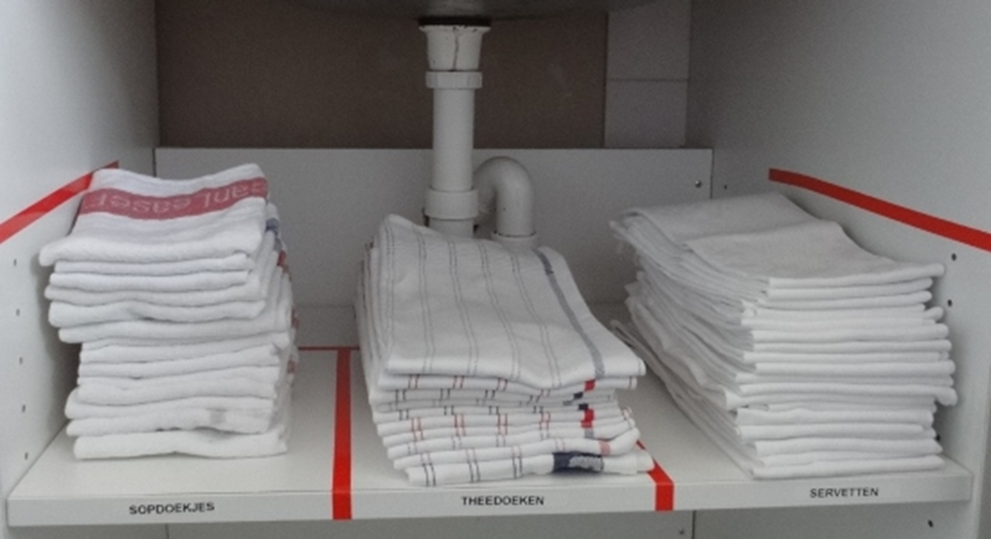
.

Slide 30
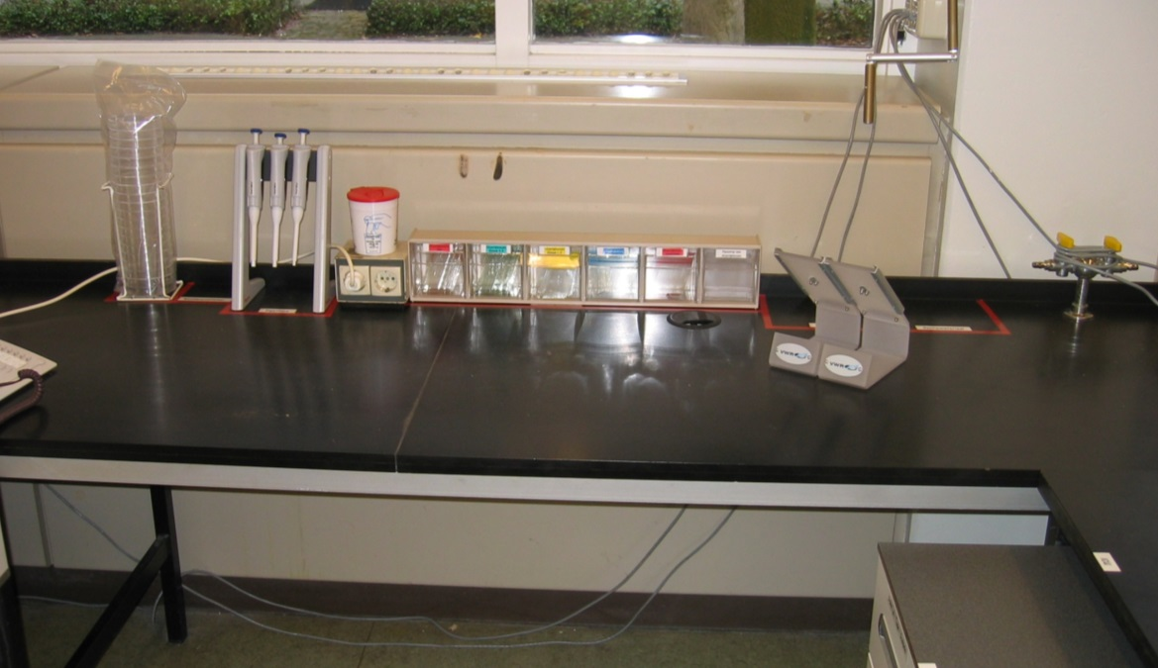
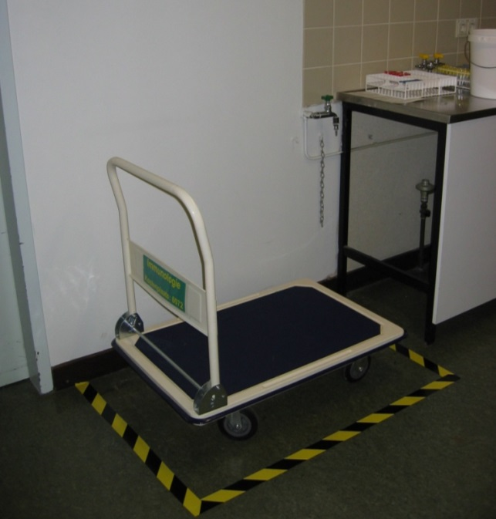
Step 2: set in order
The team decides how to change the layout of the workspace to work efficiently

Slide 31
5S
The way to success!
3. Shine
Remove garbage, dirt and waste.
Make materials, working places clean and keep them clean.
Is everything in good order and ready to use?

Slide 32
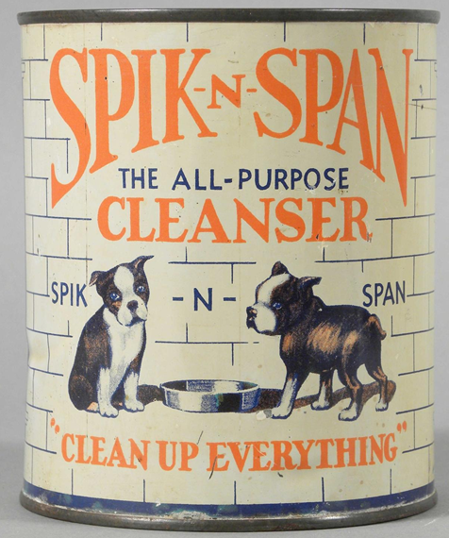
Step 3: shine
The team agrees how to keep the workspace clean

Slide 33
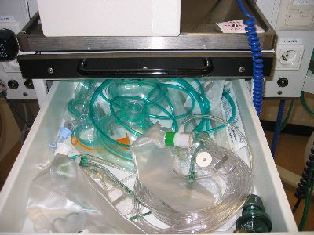
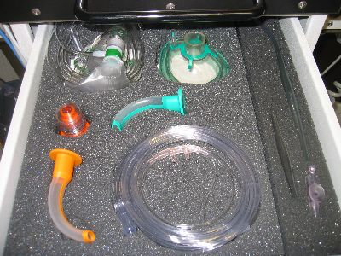
Step 4: Standardise
Visualy support the decided layout: it should be clear what belongs where

Slide 34
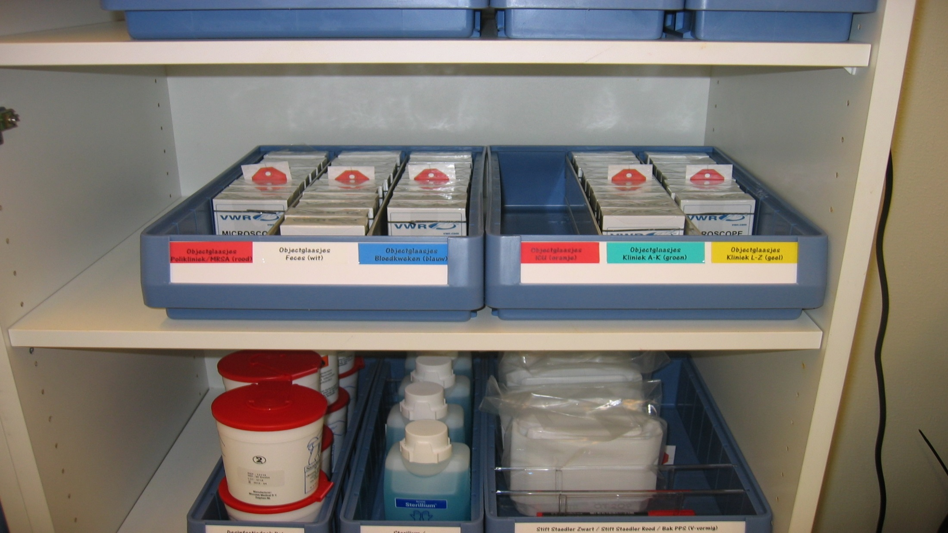

Slide 35
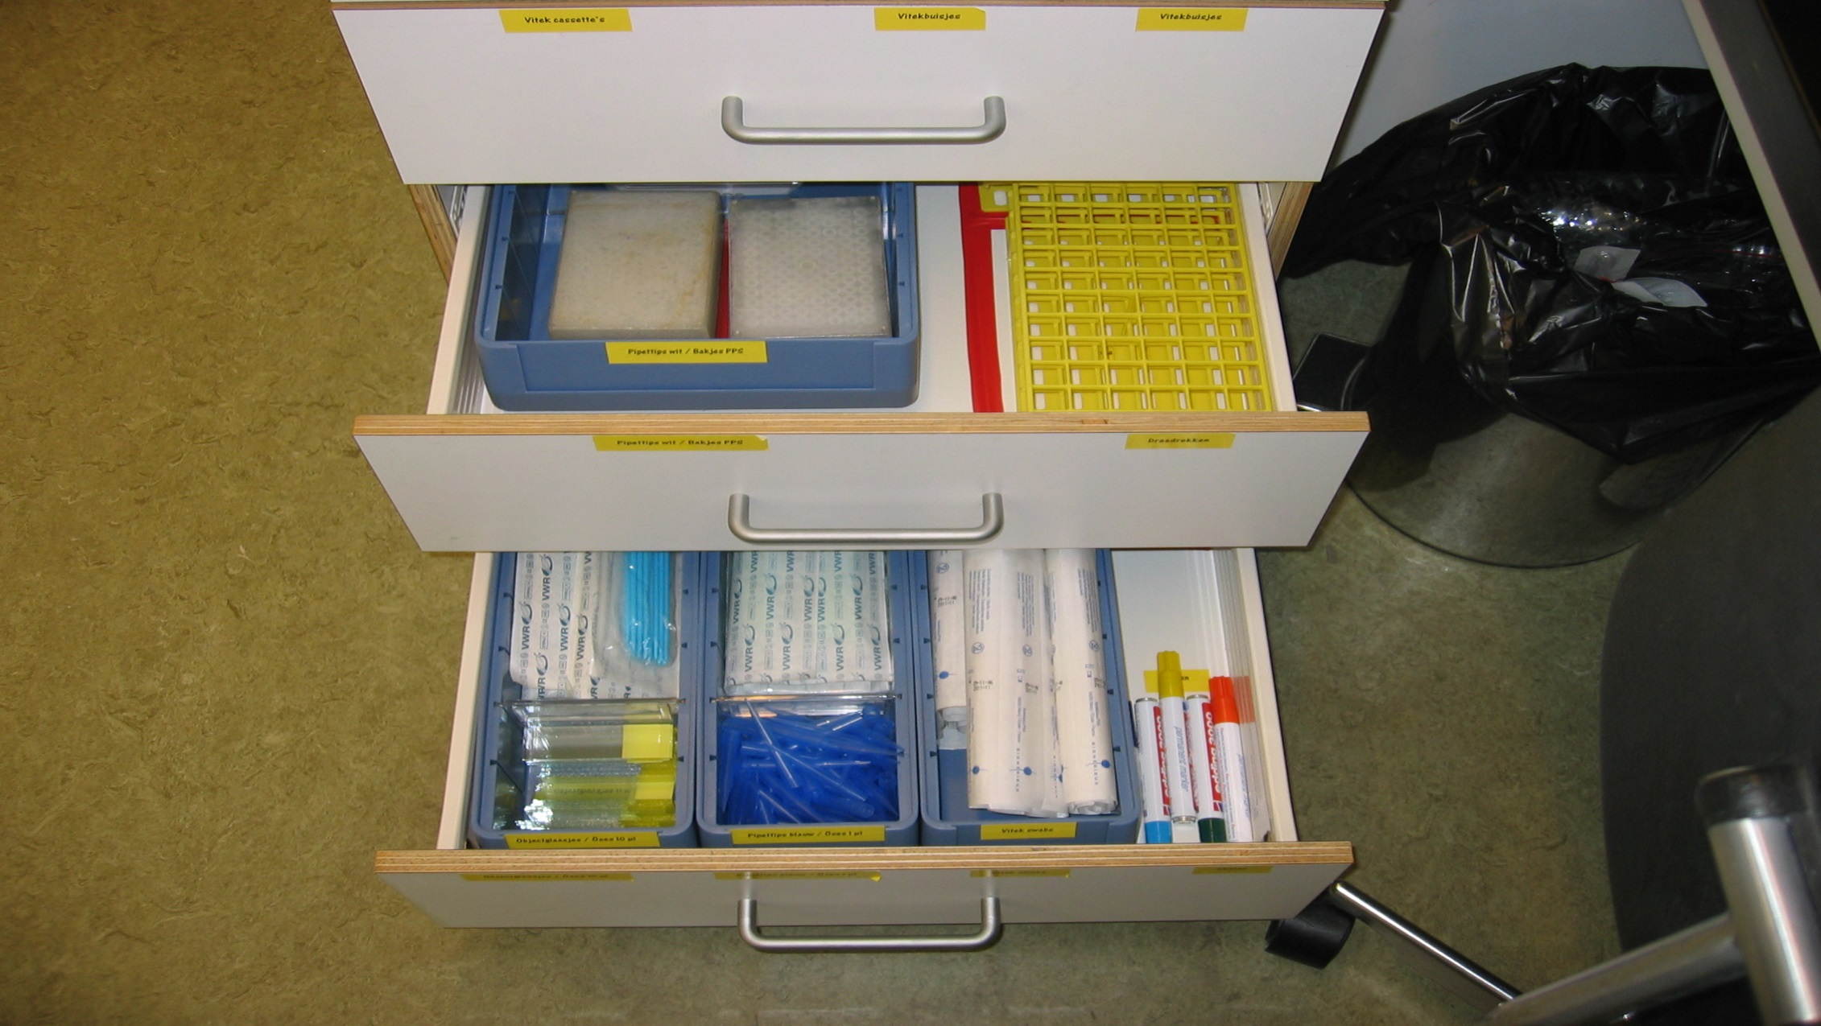

Slide 36
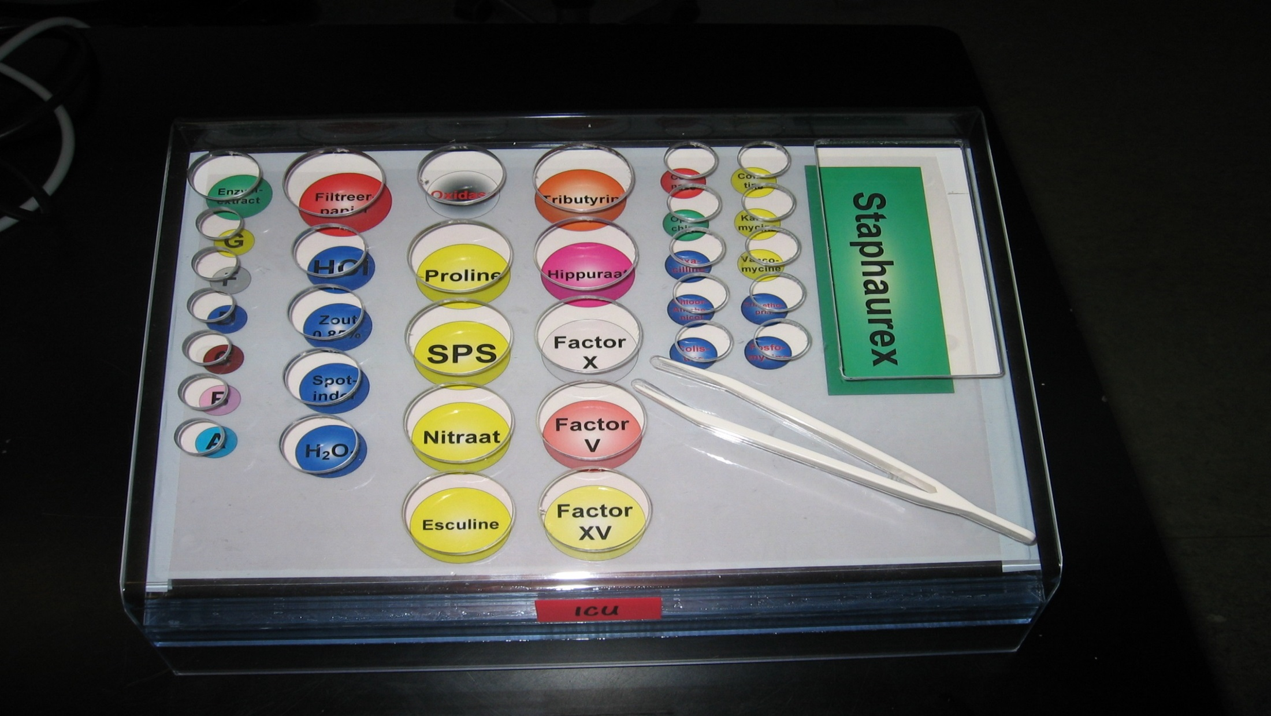

Slide 37
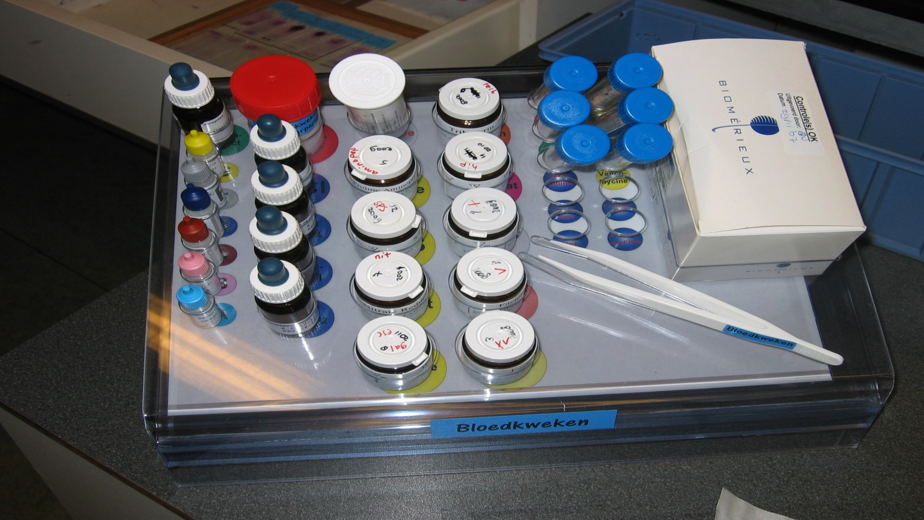

Slide 38
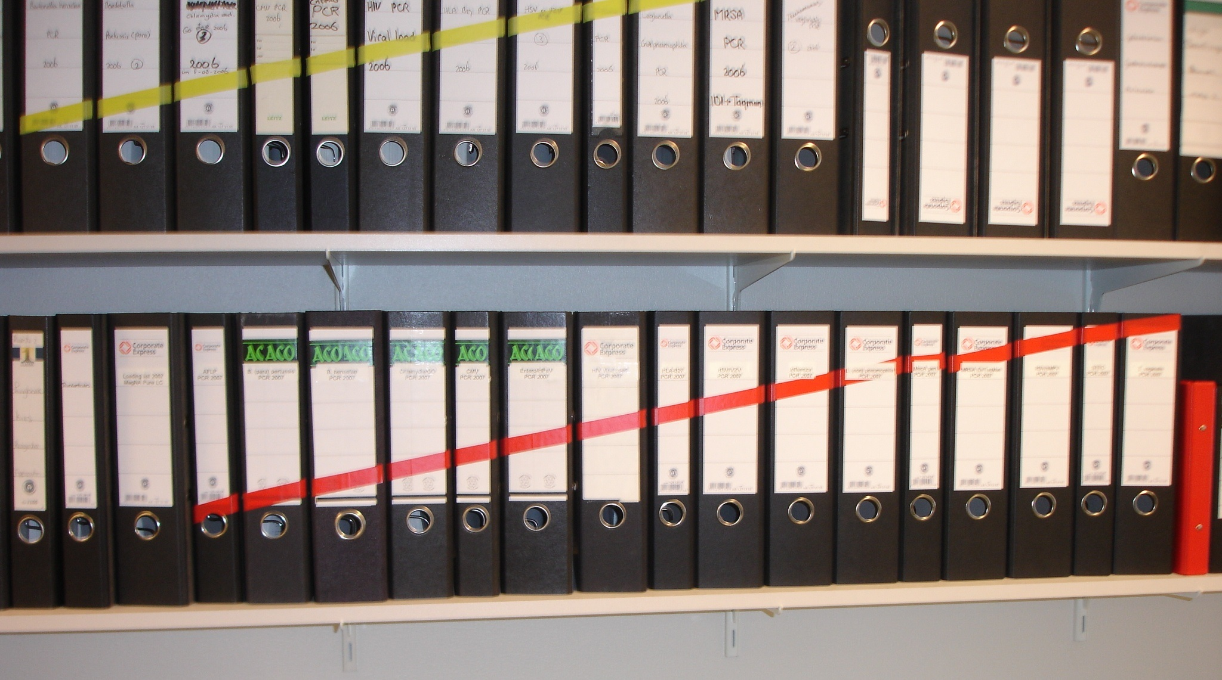
….

Slide 39
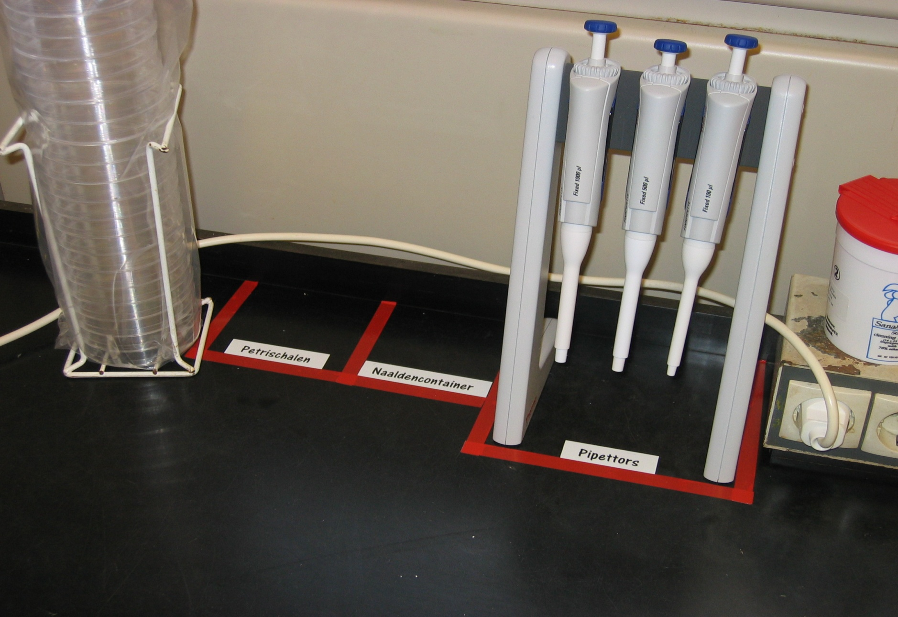

Slide 40
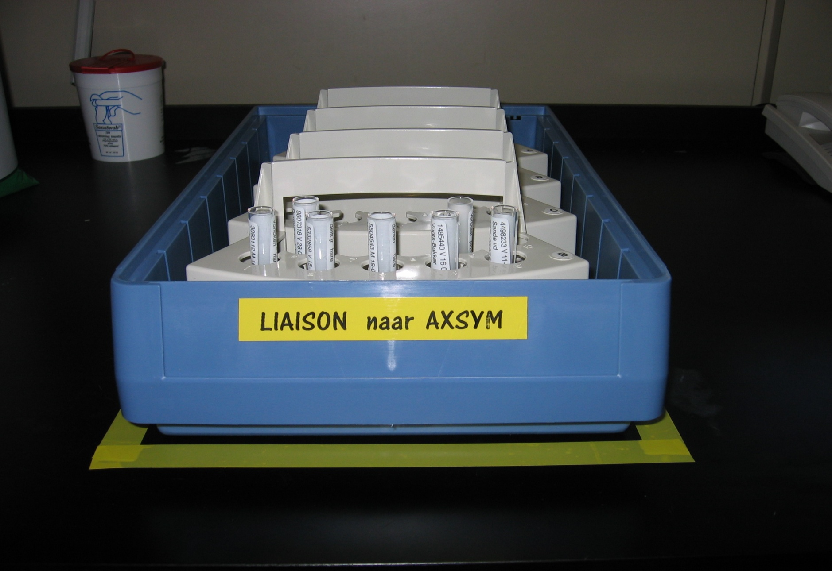
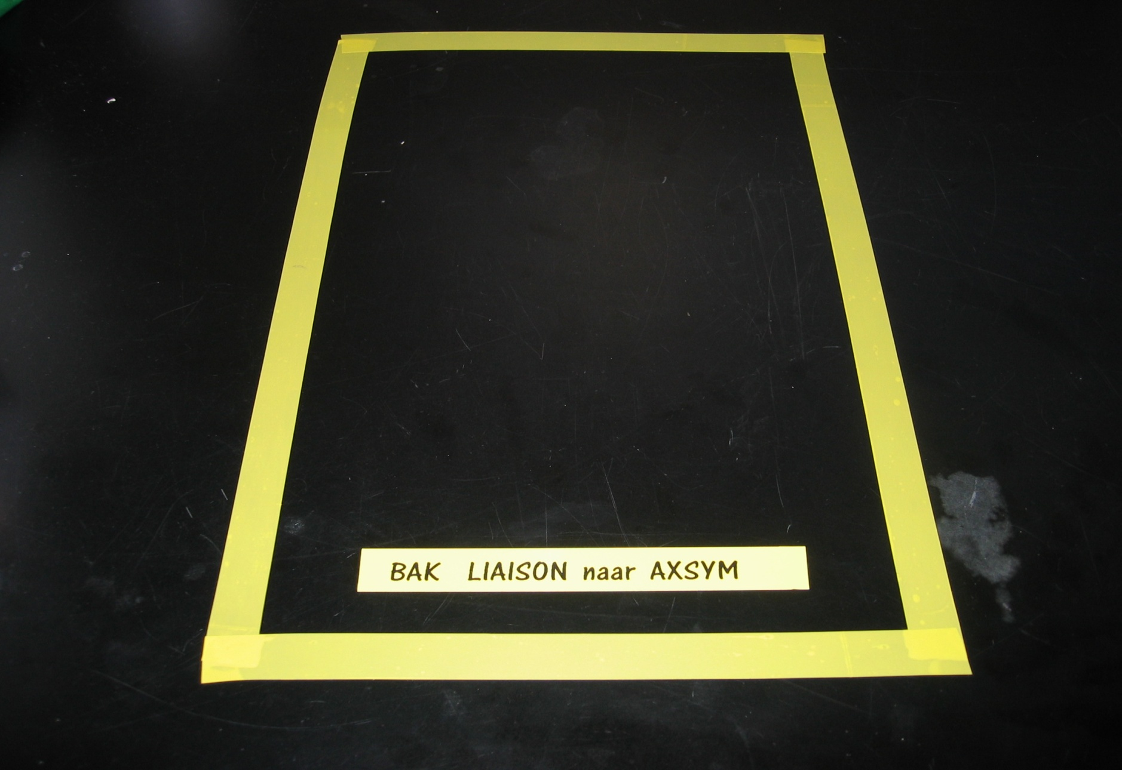

Slide 41
5S
The way to success!
4. Standardise
Design standardised procedures.
Use checklists.
Make arrangements with all team members to do it like that.
Train them to do it like that.

Slide 42
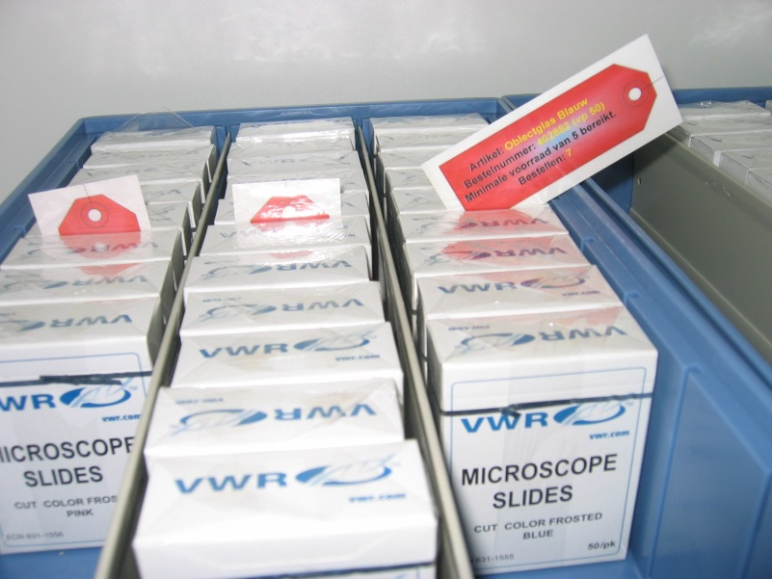
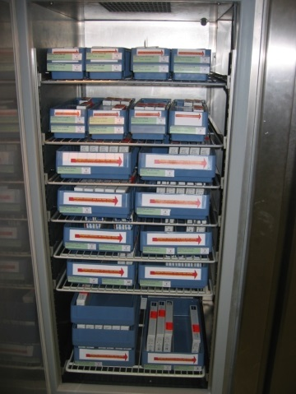

Step 4: standardise also supply management
Determine the order point and place an order card.
When you take the last item before the card, you put the card in a seperate basket
Someone is responsible for ordering and empties the basket daily. The card says exactly what to order, where it belongs and where to replace the card again
The order point is chosen that it’s never empty, but with minimum supply

Slide 43

A different 5S example: task management
A card is a routine task. Each row is a returning task per day / week / month / quarter
The card is first red and states the task. When performed it is turned around to green
The team decides who is responsible for which task today / this week
The end of the day / week / leadership evaluates the red tasks with the team

Slide 44

Daystart including task management

Slide 45
5S
The way to success!
5. Sustain
Be a critical friend to your peers
Party on your successes

Slide 46

Step 5: sustain
Make team members responsible for sustaining the areas
Regularly repeat step 1 to 4
Leadership audits areas together with the responsible team members

Slide 47
5S
The way to success!
1. Sort
3. Shine
5. Sustain
2. Set
4. Standardise
What unnecessary materials are in your department?
How can you sort equipment to be fixed on the right place?
How can the environment be cleaned and maintained well?
What can you standardise?
How can you stimulate the above to keep arranged?

Slide 48
5S: 5 steps to improve physical workspaces

Slide 49
STRIVE FOR PERFECTION:
ORGANIZE THE WORKPLACE
Notes:
49

Slide 50

Why?
You do not have to search for information, materials.
You work more safely and efficient.
It shows how you relate to your work.

Slide 51


Slide 52
What ideas did you came up with for the action plan?
Notes:
How can you use the 5-S ideas?
In the whole hospital?
As cleaning staff.

Slide 53

Motto of today:
DO NOT RISK YOURSELF!!!!!

Slide 54

Notes:
“Dry” repetition of hand wash procedure

