Slide 1
360 Degrees Feedback

Slide 2

What is 360 degrees feedback?
A 360 Feedback Survey is an assessment that collects responses from different perspectives including self, supervisor (manager), peers (colleagues), direct reports (subordinates), and others. The information is combined into a report showing strengths and weaknesses of the individual being assessed.

Slide 3
Compared to
0 degrees: self evaluation
90 degrees: self and one other person
180 degrees: self and one group of other persons
360 degrees: several groups of people

Slide 4
Why?
360 degree feedback offers a more complete picture of the employee's performance. This feedback can provide guidance on skills that an employee may need to develop.

Slide 5
What is 360 feedback good for?
A 360-degree evaluation needs to be anonymous, but it shouldn’t turn into a chance to snipe at a colleague. Those managing the process need to make it clear to everyone taking the survey that the goal is to discover strengths as well as weaknesses.
Another important point is that 360 reviews should only be used to help team members as a development tool: Providing feedback that helps people grow in their careers.

Slide 6
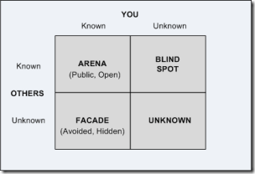
Johari window

Slide 7
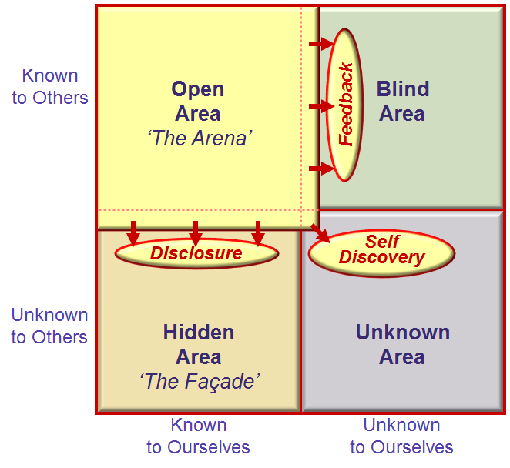

Slide 8
How????

Slide 9
How?
Install working group (dir, HR, middle management, staff member)
Develop questionnaire
Ensure confidentiality, build up
Inform staff
Administer and analyse data
Develop and distribute results

Slide 10
1. Working group
Procedure
Who gets results, how answered? How long stored?
Who has the right to see results?
Who selects feedback givers (no nepotism)
Equal questions for everybody
How often? When?
Who gathers the information?
What is the relation with interview-cycle?
Start small, pilot; start positive

Slide 11

Pilot
Start with those who volunteer and ask for feedback!!!!
Top manager too! Sit in the hot chair yourself first!!!!

Slide 12
2. Develop Q
Based on competences
Put in to questions
Open or closed?
Decide on answering possibilities
(Likert-scale totally agree, agree, sometimes, not
agree, totally disagree, not applicable)
Use valid and reliable questions
No consequences for salary (yet)

Slide 13
Possible questions to ask
How would you describe me?
Where, do you think, are my strenghts?
What do you value in my way of communicating?
Can you describe a moment where I was in my element?
If would recommend me for a job or assignment, what would you say?
For what do you address me?
What is my added value in the team?
Where do you see room for improvement or development? What would you like me to see doing?

Slide 14
Such questions could be:
• What would the person need to stop doing in order to be effective as a staff member?
• What would the person need to start doing in order to be effective as a staff member?
• What should the person continue doing in order to be effective as a staff member?
• What other feedback would you like to provide to this individual?
• Does the person have any particular strengths that might be overplayed at times? If so, please describe these and the impact they have when over-used.
• Do you have any further comments that you would like to add?
• If you could ask this person to do one thing (do more of, or do differently) in order to support you and enable you to do your job to the best of your ability, what would that be?

Slide 15
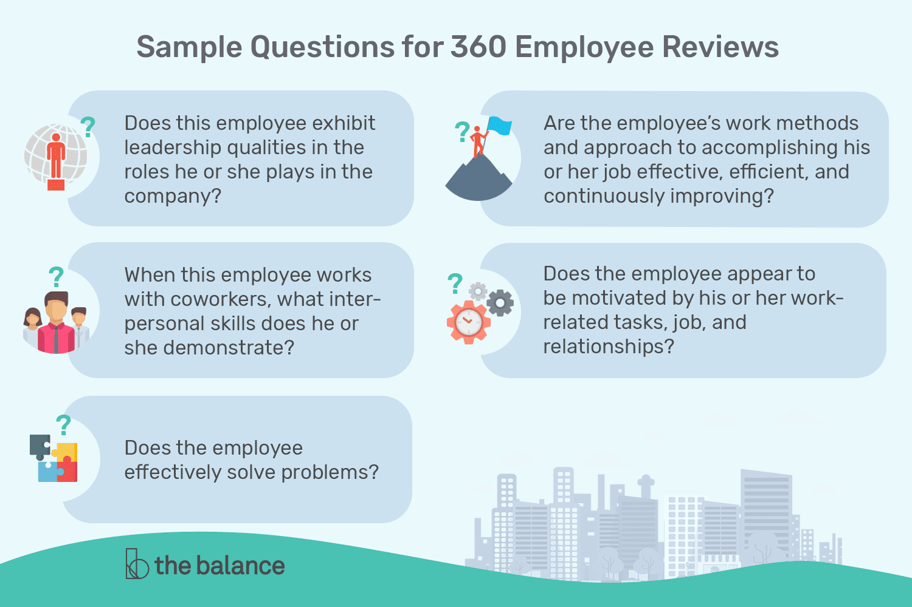

Slide 16
Leadership
Does this employee exhibit leadership qualities?
If so, can you provide examples of how he positively contributes through his leadership?
If not, how can the employee improve his leadership?
Interpersonal Skills
When this employee works with coworkers, what interpersonal skills does he demonstrate? Does the employee express empathy to co-workers and patients?
Have you experienced any problems with him interpersonally?
How would you recommend that the employee improves his interpersonal and relationship building skills?

Slide 17
Problem Solving
Does the employee effectively solve problems? If so, what are the skills that he has demonstrated in solving problems and arriving at solutions and improvements? If less than proficient in problem solving, in what areas of problem-solving would you recommend that the employee work to be able to improve his skills?
Motivation
Does the employee appear to be motivated by his work? How does the employee demonstrate that he is motivated and committed to success in the company? Have you experienced any difficulties with the level of the employee’s motivation?

Slide 18
Efficiency
Are the employee’s work methods and approach to accomplishing his job effective, efficient, and continuously improving?
Are there areas of improvement that you would recommend for this employee that would help him accomplish his work more effectively? Or, are there areas of improvement that would help you accomplish your work more effectively?

Slide 19
What would be your questions?

Slide 20
3. Ensure confidentiality
In small groups do not ask for ages, function, gender
Option: Build up
0 degrees, 90 degrees positive,
180 degrees, 360 degrees.

Slide 21
4. Inform staff
Up-front, involve them in the process, make them co-owner
Draft questions together e.g.

Slide 22
5. Administer and analyse
Be aware of HALO and HORN-effect
He is… , so he will be also....
Be aware of
eye for an eye, tooth for a tooth
Software available

Slide 23
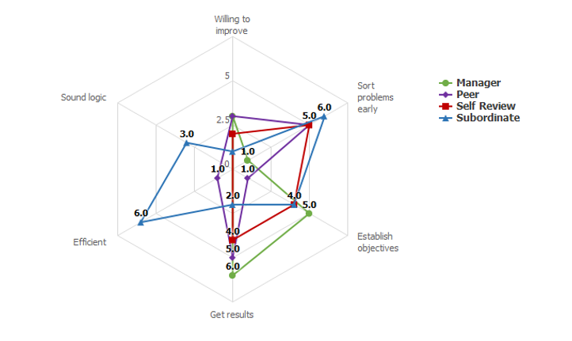
Use the spider

Slide 24
6.Distribute results
Evaluation with manager
Development plan
Public?

Slide 25
Role HR???

Slide 26
Role HR could be:
Time, every two years? Start up.
Selection of participants: different
Information session
Justice
After care: evaluation and development plan

Slide 27
Short tips presenting
Look at people
Use flip chart efficiently
Prepare
First convince yourself, then us.
Rehearse

Slide 28

Success

Slide 29
Evaluation

