Slide 1

van Kemenade
Audit Coaching Training
Designing effective quality training programs
November 14th 2024

Slide 2
Design
Target group
Training needs
Training goals
What do they need to know/ be able to?

Slide 3
Content
Training program?

Slide 4
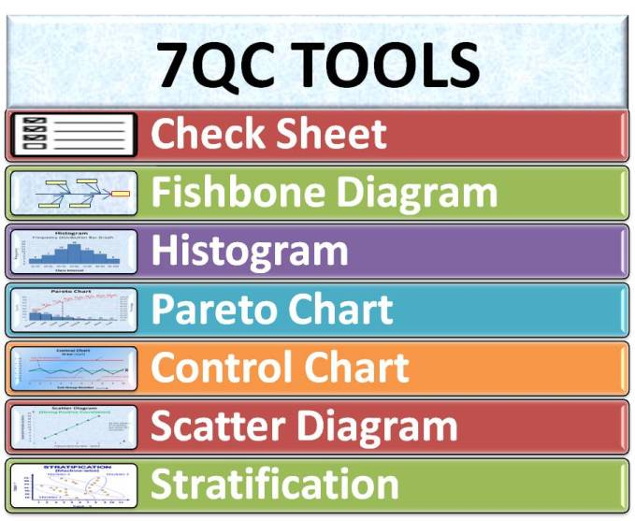
What we can learn from the empirical paradigm
1. Control
2. Key performance indicators
3. 7 tools of quality
4. Directive leadership
5. Management review

Slide 5
What can we learn from the reference paradigm?
1. Continuous improvement
2. PDCA cycle
3. new ISO
4. EFQM model
5. Customer delight
6. Quality structure
7. Coaching leadership

Slide 6
What can we learn from the reflective paradigm?
1. Professionalism
2. Dialogue
3. Auditing
4. Self study
5. Delegative leadership

Slide 7
What can we learn from the emergence paradigm?
Innovation
Co-creation
Emergence
Medusa principles
Emergent / participative leadership

Slide 8
Didactics
Active
Working on their issues
…..

Slide 9

everard@onsnet.nu

