Slide 1

van Kemenade
Audit Coaching Training
Looking back and forth
November 13th 2024

Slide 2
Questions
What do you want to know?
What do you want to learn?
What do you want from us?

Slide 3
Introduction (15 min)
Welcome and agenda for the morning session
Share a highlight of the past few months regarding quality

Slide 4
Looking back
Individual reflection
What goes well, what did you accomplish?
What does not, what did you learn from that?

Slide 5
Designing two days program
Thursday morning
  Student attrition / changing student needs
Thursday afternoon
  Designing quality training
  Quality and Innovation
Friday
  auditing

Slide 6
Break (15 min)

Slide 7
Look ahead
Quality Committee Action Plan (autumn)
  Manual
  Pre-accreditation

Slide 8
Look ahead
What challenges can we expect?
What road blocks can be on the way?
Which support can we get?
What resources do we need?
What does that mean for us?

Slide 9
Action Plan Suggestions
Post its

Slide 10
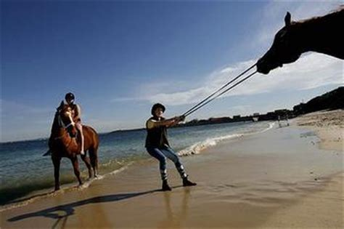
Input: impact

Slide 11
You can lead a horse to the water, but you cannot make it drink…
African proverb
Exercise

Slide 12
Impacttool
start
What are your resources?
What actions do you need to take?
What results are needed?
What is the school’s contribution to change?
What fundamental change do you want to contribute to?
INPUT
ACTIVITIES
OUTPUT
OUTCOME
IMPACT
Resources such as
Time
Money
Staff
Proceedings such as
Curriculum
Training
Practicum
Internship
Concrete results such as
Theses
Publications
Graduates
Concrete results such as
Changes in competences
Changes in behaviour
Longterm change
Employment gap <
Level of professionals >
Quality of professions >
Can be controlled
Direct influence
Indirect influence
check

Slide 13
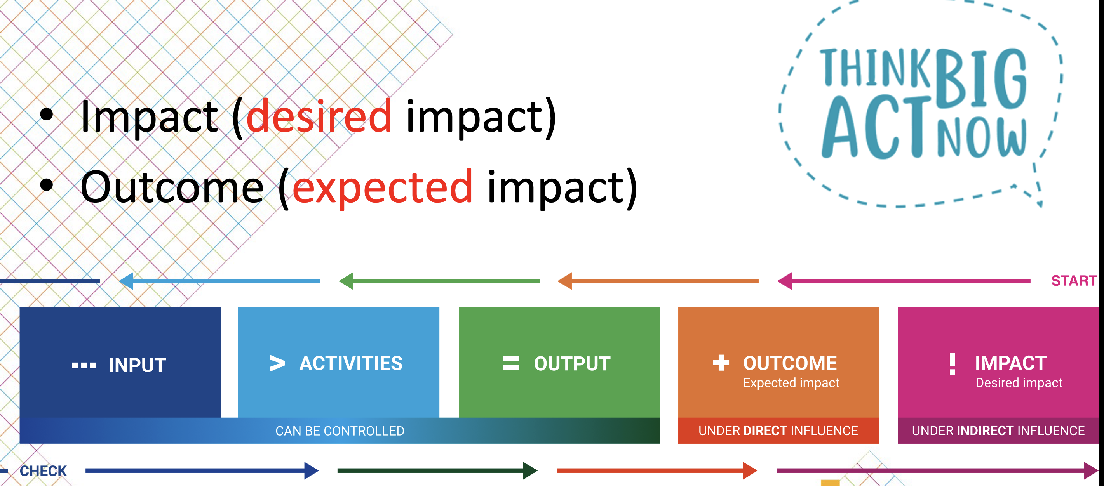

Slide 14
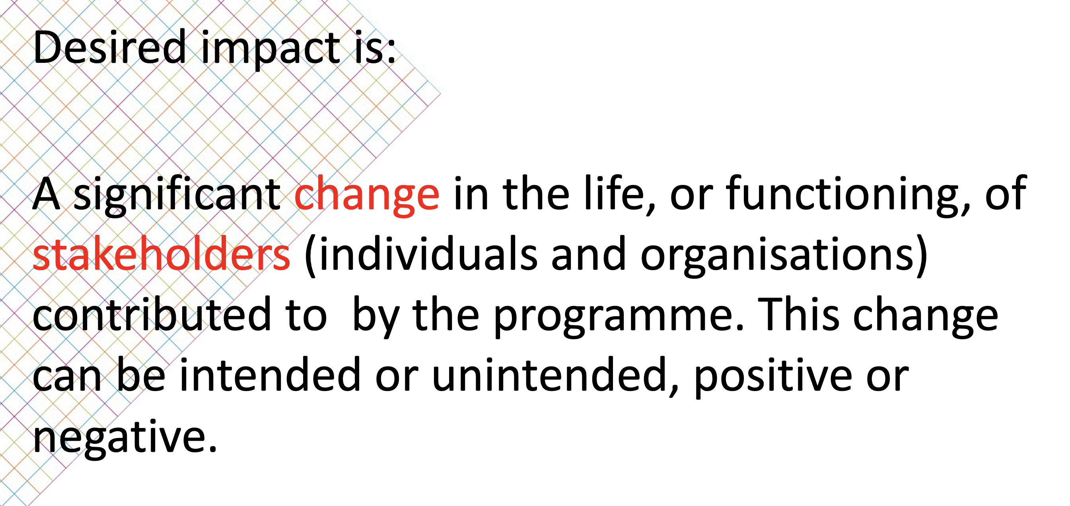
Desired impact

Slide 15
Closing down
What is your take away from this morning?
How did you experience this morning?

Slide 16
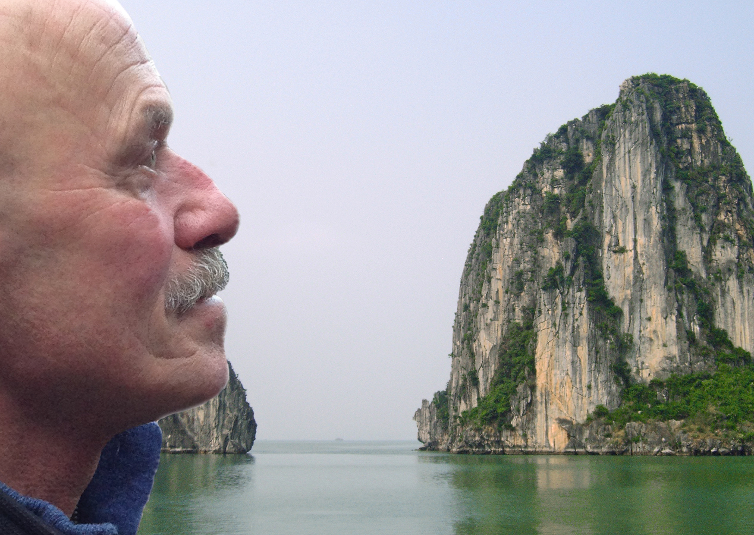
everard@onsnet.nu

