Slide 1

van Kemenade
Audit Coaching Training
Adapting to changing student needs
November 13th 2024

Slide 2
0. Discussion
Where does this question come from?
What are your experiences with changing student needs?
What is your main question for today?

Slide 3
Oak tree and the bamboo

Slide 4
1. Drop out
Causes
  Gen Z?

Slide 5
Student needs 2025
Gen Z
Ibrahim et al., 2022, Trends and Patterns of Needs Assessment in Technical and Vocational Education, International Journal of Evaluation and Research in Education (IJERE), Vol. 11, No. 1, pp. 88-98.
Examples
  3 ways medical schools are embracing gamification | American Medical Association (amaassn.org)
  Gamebased learning in medical education PMC (nih.gov)

Slide 6
Generation Z
(born 1996 - 2015)
Op dit moment behoren ruim 2,7 miljoen Nederlanders tot Gen Z. Ongeveer 16% is dus Gen Z.
Sint Maarten
  Leeftijdsopbouw:
  0-14 jaar: 18,45% (mannen 4.000/vrouwen 3.655)
  15-24 jaar: 15,26% (mannen 3.127/vrouwen 3.204)
  25-54 jaar: 42,6% (mannen 8.628/vrouwen 9.045)
  55-64 jaar: 15,37% (mannen 3.057/vrouwen 3.319)
  65 jaar and over: 8,32% (mannen 1.667/vrouwen 1.784) (2016 est.)

Slide 7
Digital natives
Generatie Z is opgegroeid in een onzekere wereld, economische crisis en terreuraanslagen.
  Laat zien waar je bedrijf voor staat (en zorg dat je het meent)
  Van bezit naar toegang

Slide 8
Discussion
What use can we make of:
    Social media
    Games
    Quizzes
    Khan Academy
    Escape room
    Flash cards
    AI

Slide 9
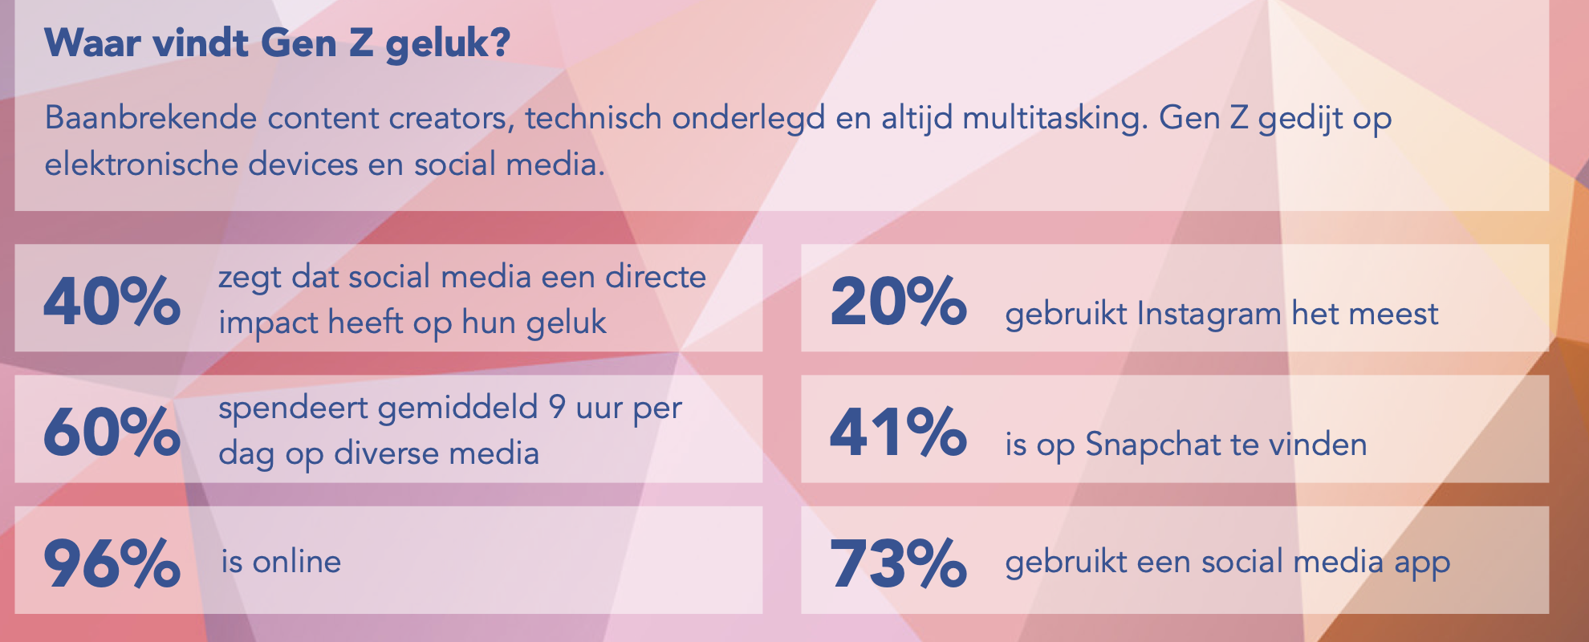
Happiness

Slide 10

Prejudices

Slide 11
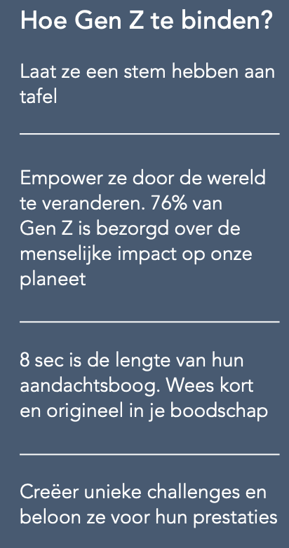
Do
Invest in autonomy.
Cooperate beyond borders
3. Listen to the under current

Slide 12
2. Drop out
Gap
  What is the gap?
Solutions
  Discussion: what can we do better?
  How can we monitor and measure the effect?

Slide 13
Assessing changing needs
Involve students in the process, involve alumni
Foster a culture of collaboration among educators and students
Give both access to resources
Student centered learning

Slide 14
Assessing changing needs
Formal
    Surveys
    Focus groups
    Interviews
Informal
How do you currently gather feedback at NIPA?

Slide 15
Assessing changing needs
Measure successes (kpi?)
Follow up assessments

Slide 16
Summary

Slide 17
References
Sutcliffe J., 2021, Strategies for Engaging Students with Different Learning Needs, Digital Matters, 27th of May 2021

Slide 18
Annex: Student differences
Each class will be different;
Each student will be different;
And factors that influence student needs will change over time.

Slide 19
Introduction in the topic
Giving students choices in their learning; optimizing authentic, participatory and experiental learning and creating a supportive learning environment that minimizes distraction and unnecessary stressors will make it easier to gain and keep their attention (Sutcliffe, 2021)

Slide 20
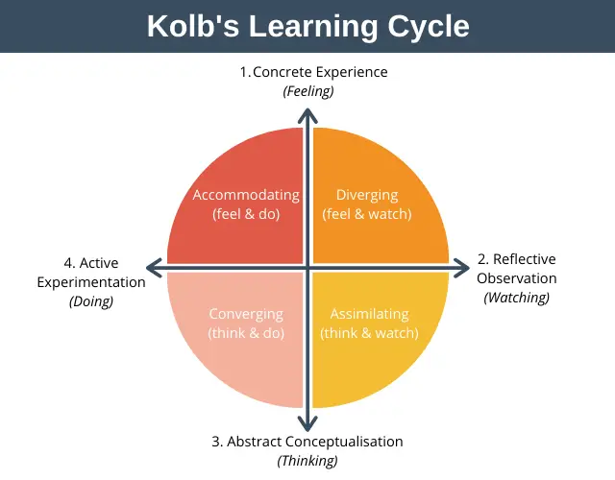
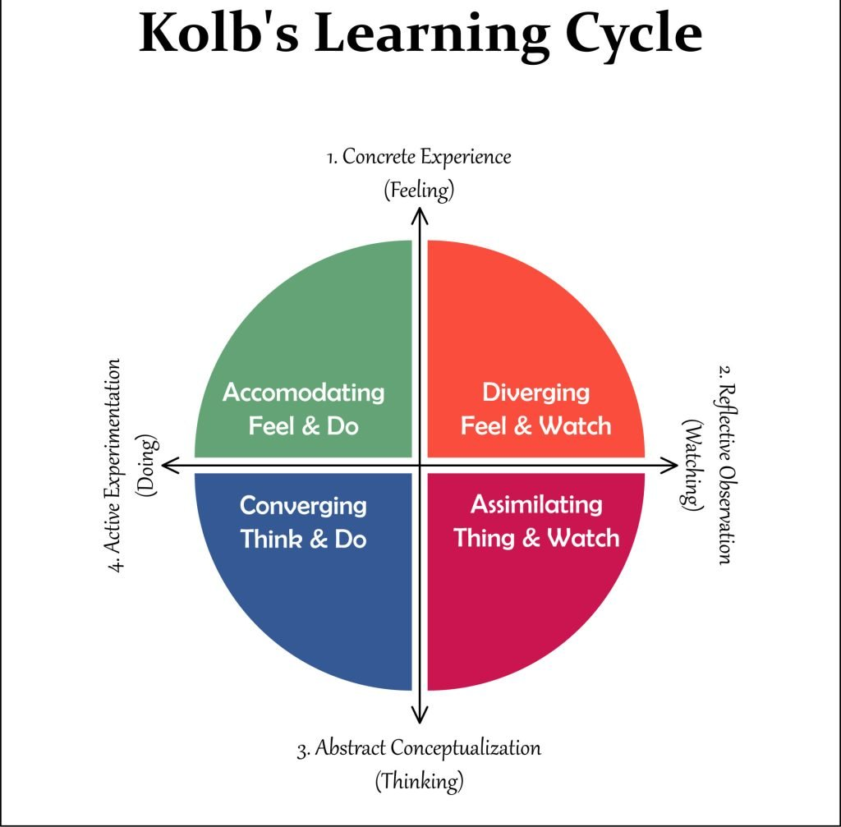
Types of learners

Slide 21
Types of learners
VAK
  Visual
  Auditive
  Kinesthetic

Slide 22
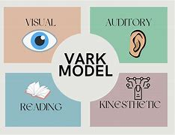
Types of learners

Slide 23

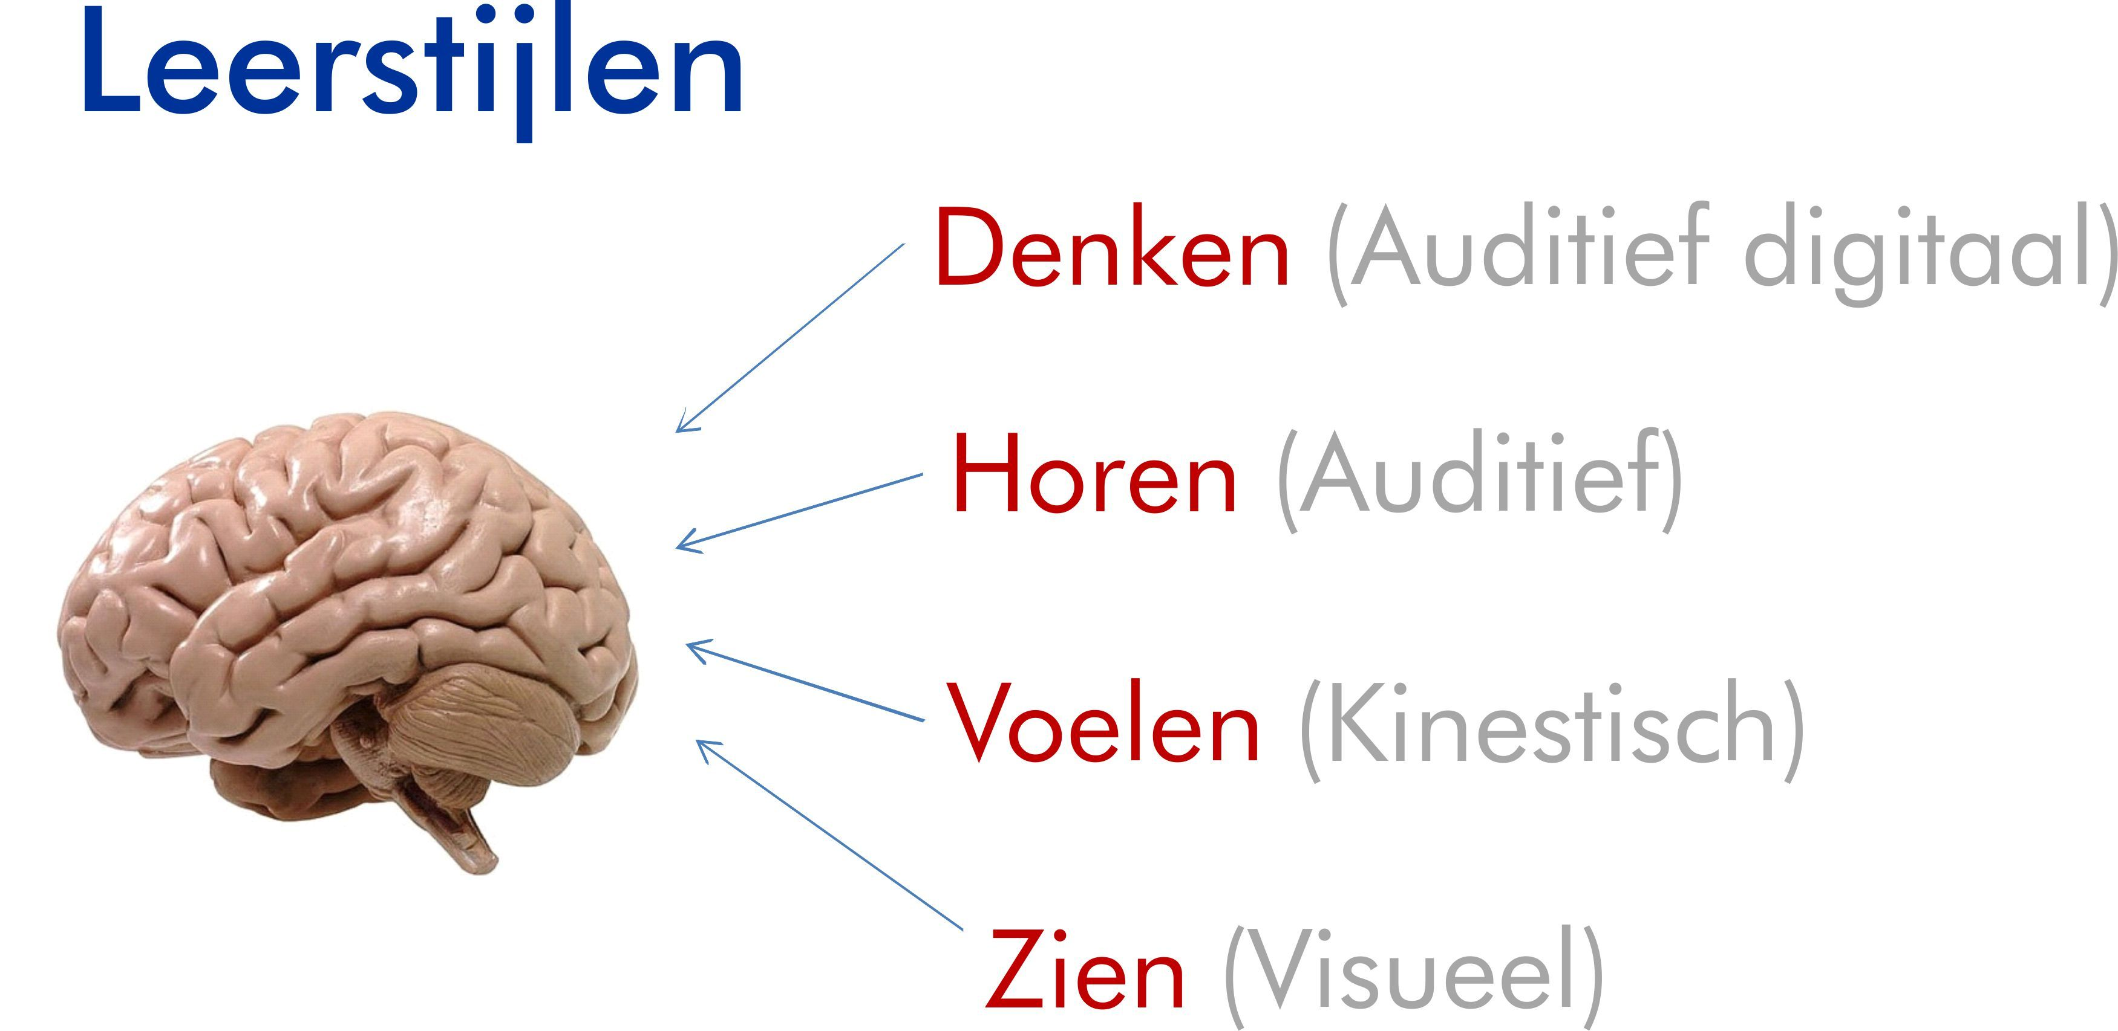
VARK and VAKD
Overview of VARK Learning Styles: Definition and Types (verywellmind.com)
Questionnaire learning styles
  Visual
  Auditive
  Kinesthetic
  Auditive Digital
  (inner dialogue)

Slide 24
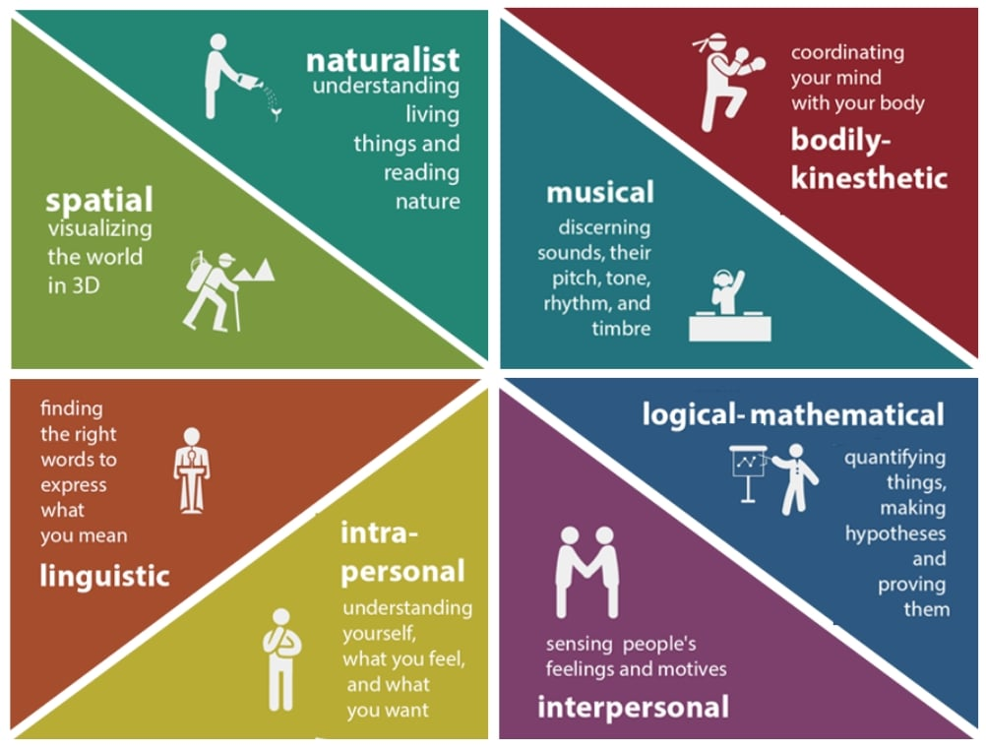
Gardner's Theory Of
Multiple Intelligences (simplypsychology.org)

Slide 25
1. Visual learners
Learn best through images, diagrams, charts, and other visual aids. They often remember information by visualizing it in their minds.
Tips: Use mind maps, flow charts, and color-coded notes. Watching videos or using flashcards can be particularly effective.

Slide 26
2. Auditory Learners (Aural)
Prefer to learn through listening. They benefit from discussions, lectures, and audio materials like podcasts.
Tips: Recording lectures, discussing material with others, and listening to audio recordings can help them retain information.

Slide 27
3. Reading/Writing Learners
Learn best through reading and writing activities. They like to read textbooks, take extensive notes, and benefit from lists, essays, and written explanations.
Tips: Writing summaries, reading books, and making detailed notes are effective strategies for these learners.

Slide 28
4. Kinesthetic Learners (Physical)
Prefer a hands-on approach to learning. They learn best by doing, touching, and using their physical senses to engage with material.
Tips: Engaging in role-playing, using models, building physical representations, or participating in simulations helps them understand complex concepts.

Slide 29
5. Logical/Mathematical Learners
Excel in reasoning, recognizing patterns, and logically analyzing problems. They enjoy working with numbers, formulas, and systems.
Tips: Solving puzzles, working through problem sets, and organizing information into charts or lists can be beneficial.

Slide 30
6. Social Learners (Interpersonal)
Prefer to work in groups or with others. They learn best through discussion, social interaction, and collaborative activities.
Tips: Group study sessions, peer tutoring, and participating in study groups or collaborative projects are ideal for social learners.

Slide 31
7. Solitary Learners (Intrapersonal)
Prefer to study alone and work independently. They are self-motivated and often reflect deeply on topics.
Tips: Creating self-study plans, setting personal goals, and using introspective techniques like journaling are effective for these learners.
Cfr. Auditive digital: inner dialogue

Slide 32
8. Naturalistic Learners
Have a strong affinity for the natural world. They learn best when they can connect concepts to nature and the environment.
Tips: Using outdoor activities, nature-based examples, and environmental studies can enhance their learning experience.

Slide 33

everard@onsnet.nu

