Slide 1
van Kemenade
Audit Coaching Training
Feedback culture:
Open up your mind to feedback
Everard van Kemenade
Ph.D.

Slide 2
But first: You
Name, function
Expectations
Fears
What is the best feedback you ever had from a colleague or supervisor?

Slide 3

Feedback Culture

Slide 4
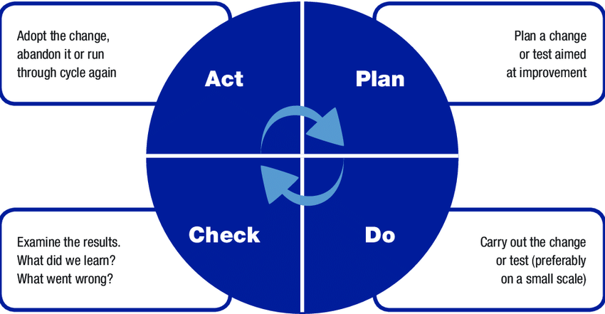
Check = Feedback = a way to improve

Slide 5
Agenda
An open mind and Growth mindset
What is feedback and how to do it?
A feedback culture in your team
  Current
  Desired
Follow up
  Individual
  Team
  Organisation / system
Evaluation: my feedback

Slide 6
1. Growth mindset
In a growth mindset, people believe that their most basic abilities can be developed through dedication and hard work.
This view creates a love of learning and a resilience that is essential for a feedback culture.

Slide 7
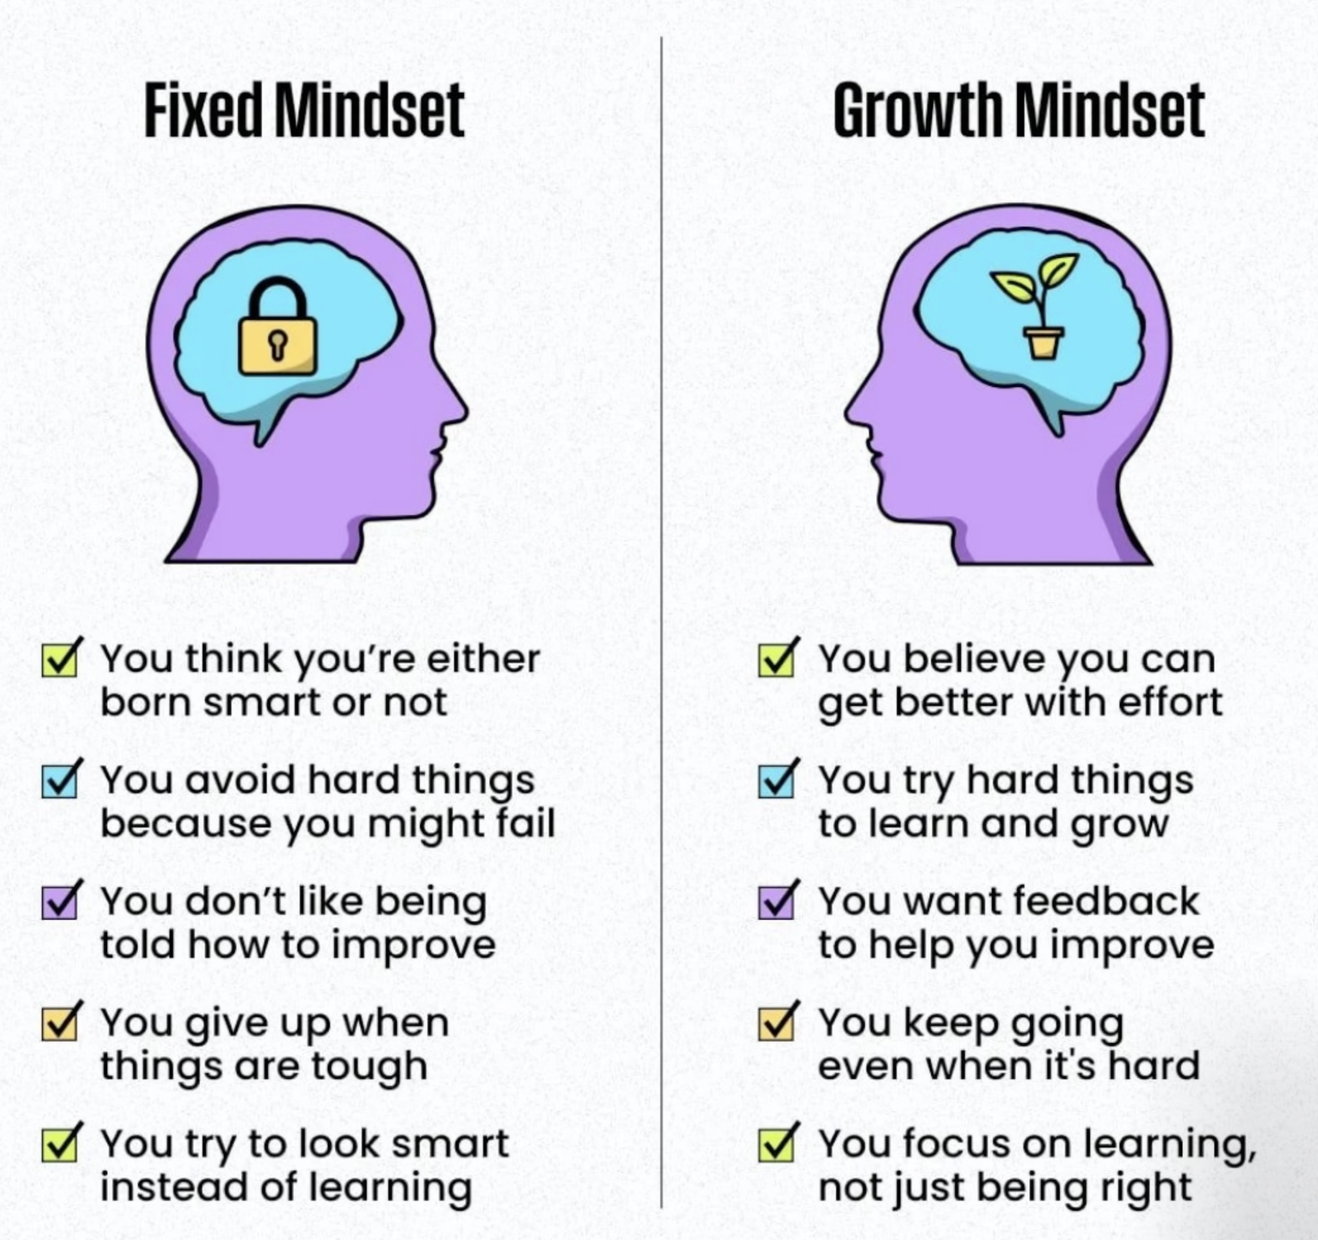


Slide 8
Feedback opens up

Slide 9
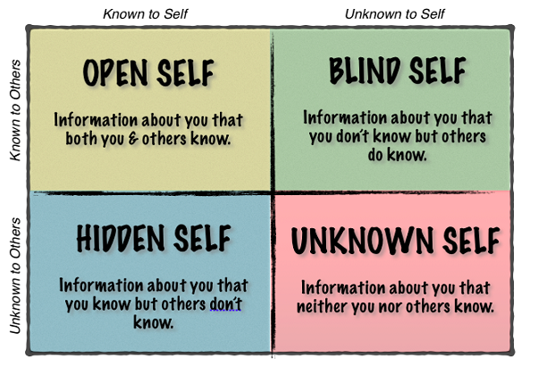
Johari Window
(Joseph Luft and Harry Ingham, 1955)
Notes:
Model can help develop
Self awareness (knowing and understanding your behavior, attitudes, tendencies and how the affect others) (no one is always the same, we are all growing)
Team that is good a self awareness→ drives continuous improvement
Some of us are uncomfortable with feedback; does not come naturally, tools helps us to know where to start.
You can not change what you don’t know

Slide 10
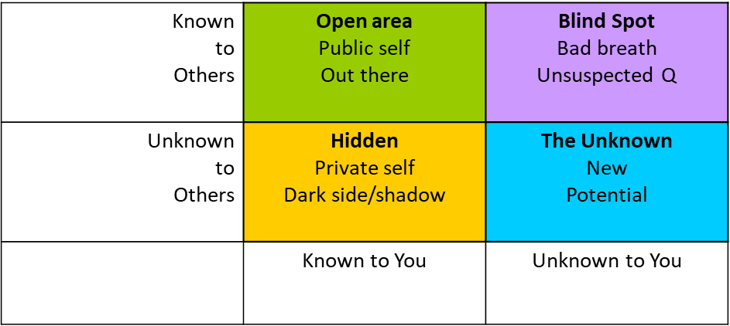
The Johari window
Jess is an RN whose best friend recently convinced her to join art classes to destress. Though she loves her job and is told all the time by her colleagues that she is fun to work with because of her humour; she unfortunately has had issues with a few of her colleagues. What Jess does not know is that while some colleagues do like her humour, others feels she goes too far at times. Jess has always wanted to be manager, though she has never shared that with anyone. Her evaluation is coming up tomorrow, so she is very happy to have an art class tonight!

Slide 11
How to use this knowledge?
You can reinforce your strengths!
You can make the blind spot smaller by asking feedback!
You can make the hidden self smaller by opening up!
Positive feedback culture→ more openness→ hidden treasures
Notes:
Getting feedback on what is open can reinforce your strengths!
In a comfortable environment where we open up, things that are hidden can become strengths or learning opportunities

Slide 12
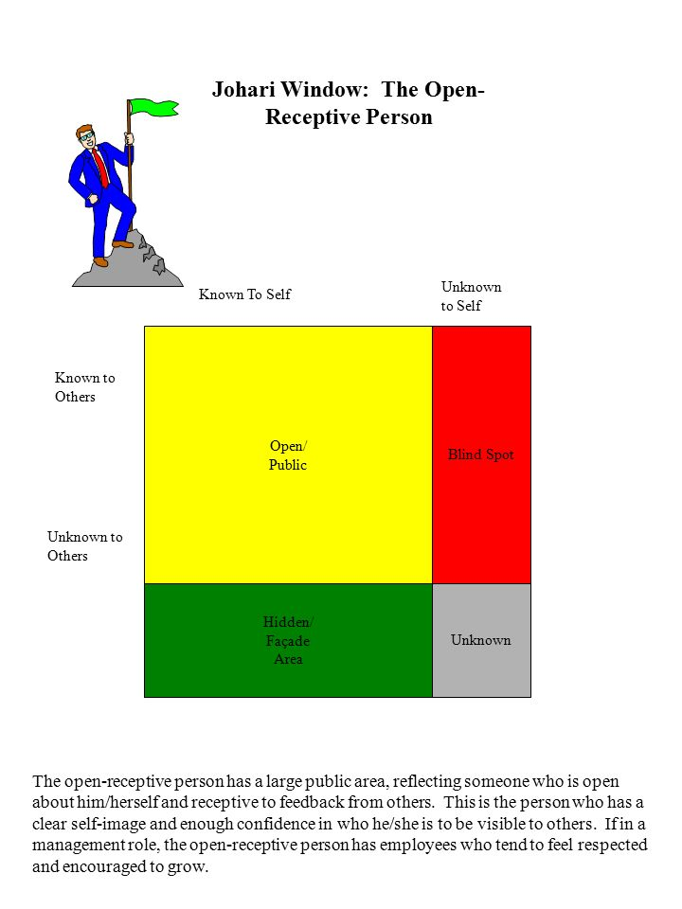
The more developed our open area, the more comfortable and successful we are.

Slide 13
So… : Even ask feedback
Asking feedback is a powerful tool for getting to know yourself and improve; an important prerequisite for a feedback culture.
Ask your team members regularly:
What do you value in cooperating with me?
What do you sometimes dislike in cooperating
with me?

Slide 14
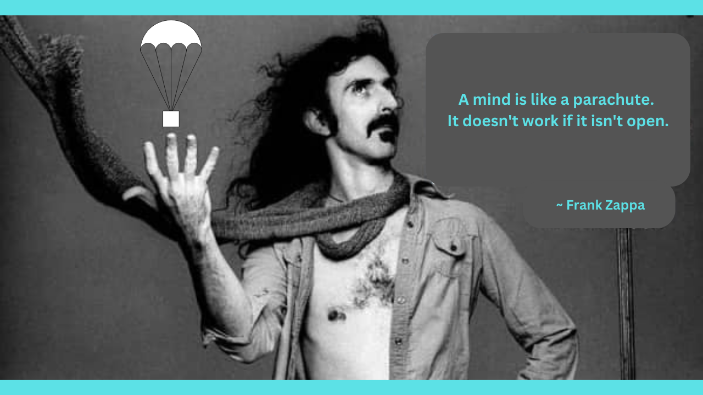
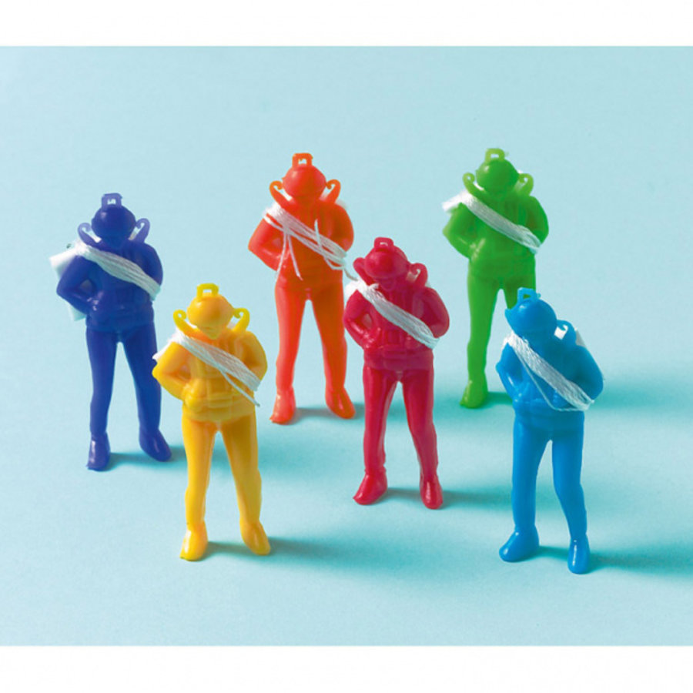
In the words of Frank Zappa
Notes:
Everard takes over

Slide 15
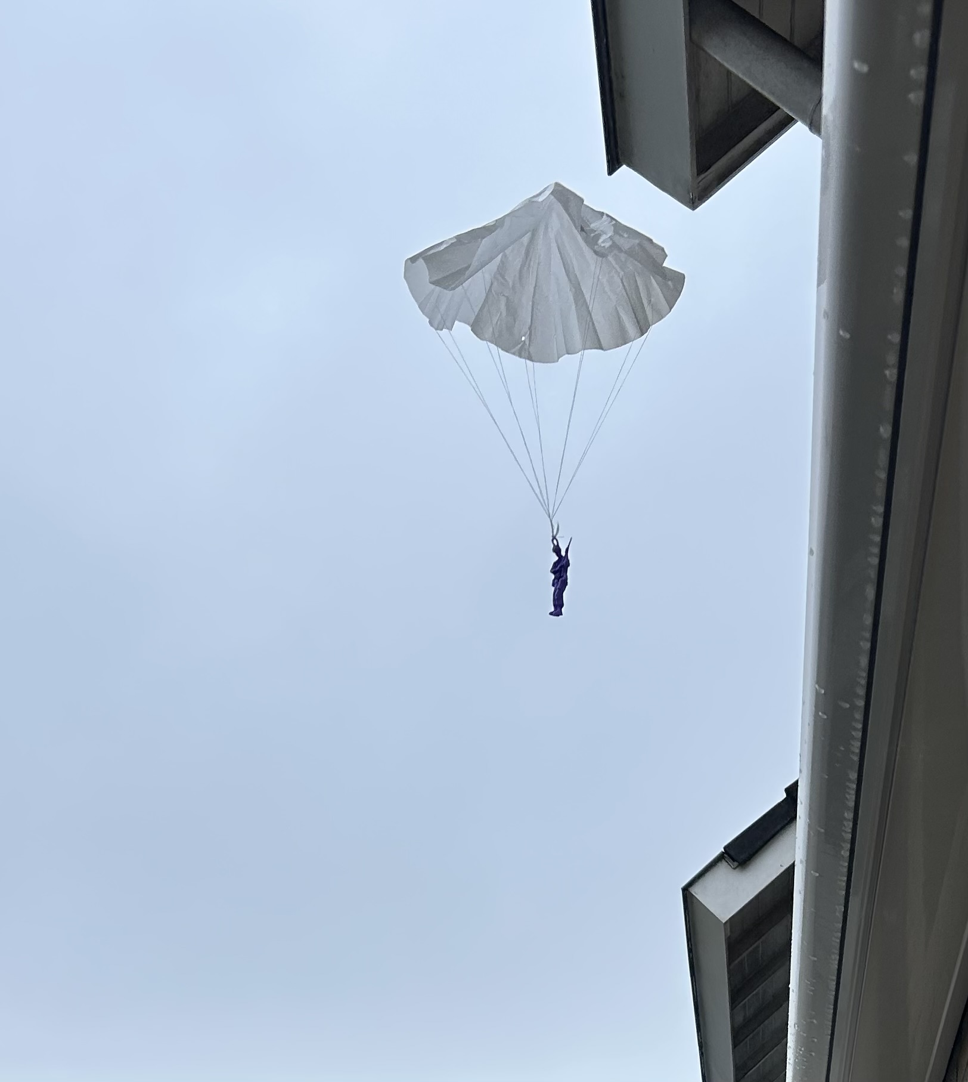

Slide 16
Frunobulax: the artist and the auditor
I need a volunteer artist and three judges that give feedback.
The artist is requested to draw a “Frunobulax” in 5 minutes max.

Slide 17
Judgment
The feedback givers judge the quality of the drawing on four criteria (on score sheet, 0-25) and gives a total score (0-100):
  Technique
  Use of colours
  Creativity
  Emotional value

Slide 18
Presentation
The feedback givers presents his or her findings to the artist.
How did this feel?
  Criteria clear ???
  Circumstances ???

Slide 19
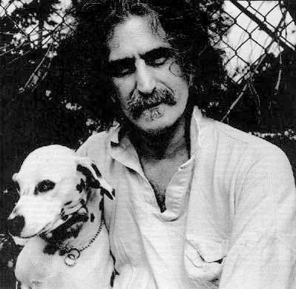
P.s. Frunobulax
Frunobulax is mentioned in a song called “Cheepnis” about monster movies by Frank Zappa (American composer, 1940-1993). The monster is named after Zappa’s pet dog Fruney.

Slide 20

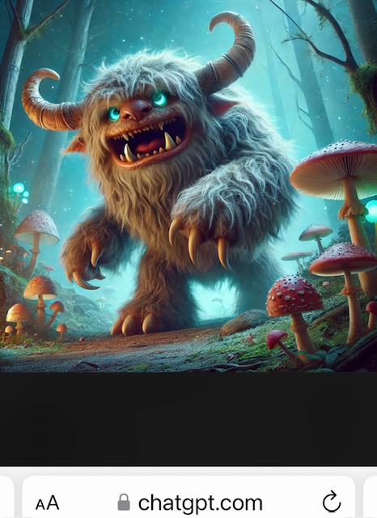

How ChatGPT draws the Frunobulax

Slide 21
The take away?
Create the circumstances for quality;
Be clear about the criteria for what is right and wrong.

Slide 22
The take away?
Often not the individual is to blame,but the system / the organisation.
But from now, we focus on person-to-person feedback

Slide 23
2. What is feedback and how to?
2.1. What is feedback
2.2. How to?
2.2.1. Do’s and don’t’s giving
2.2.2. Two feedback instruments
2.2.3. Do’s and don’t’s receiving

Slide 24

2.1. What is feedback?

Slide 25
What is feedback?
Feedback is the information sent to an individual or a group about its prior behavior so that the one may adjust its current and future behavior to achieve the desired result.
The objective is for the other to learn!!!!
For the sake of ‘growth’.
Not blame, punish, harass….

Slide 26
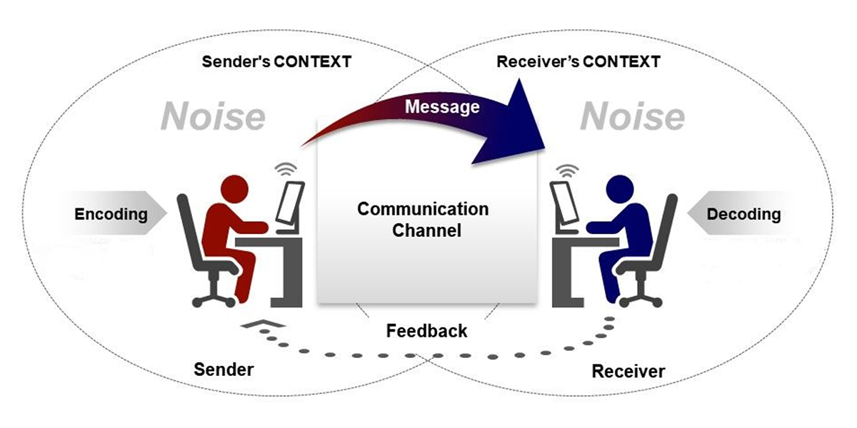
P to P feedback = Communication

Slide 27


Context
Message
Content and Relationship

Slide 28
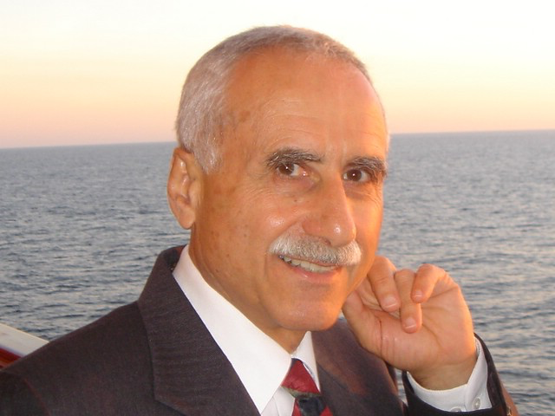
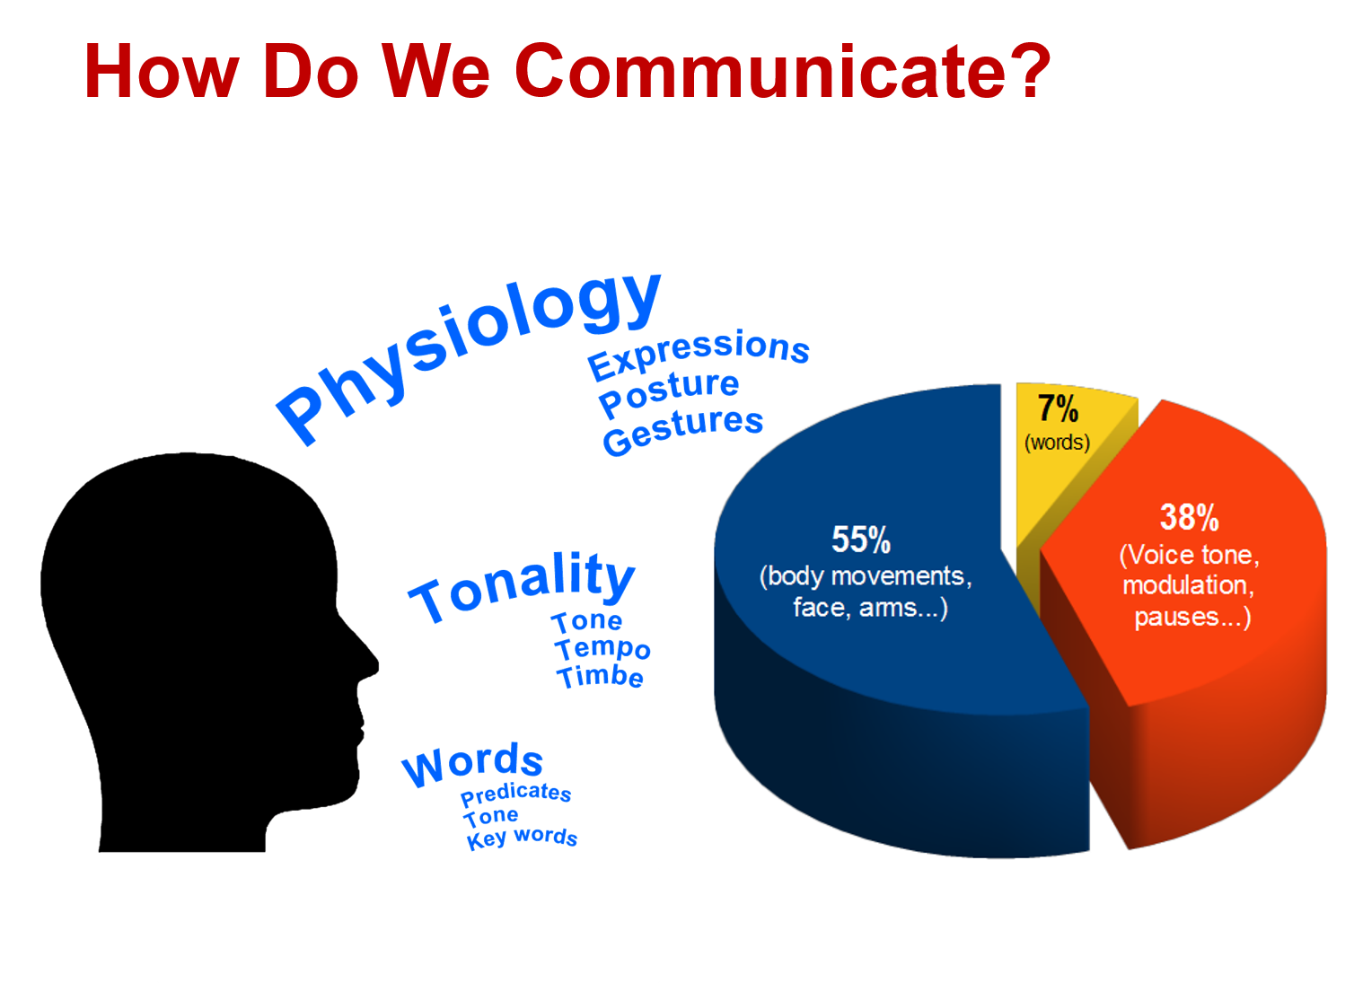
Albert Mehrabian
(1971)

Slide 29
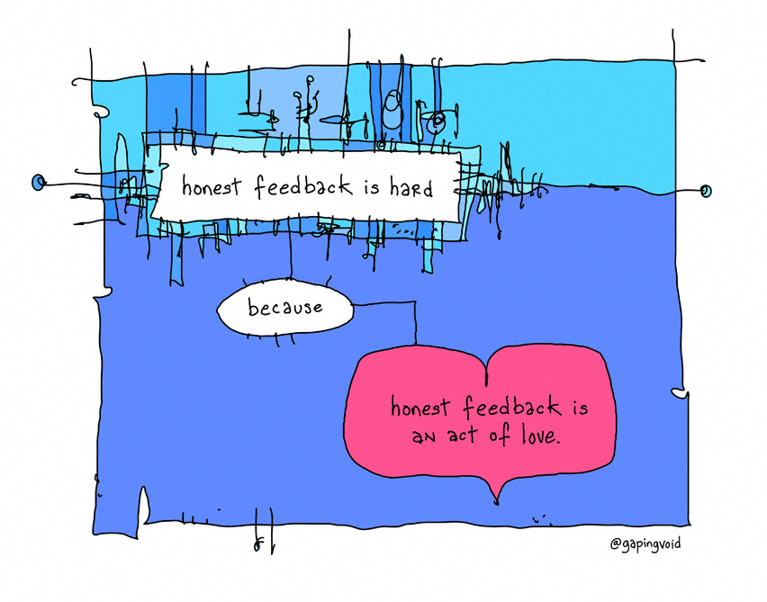
Feedback is a gift

Slide 30
Sorts of feedback
Positive and ‘negative’ /critical
Personal and System feedback
Verbal and non verbal
Visual
Photo feedback: A picture says more than a 1,000 words
Video feedback: Seeing is believing
Informal, formal, every day or yearly
Written feedback: Remember the power of the pen

Slide 31
(In)formal
0° feedback means you give feedback to yourself.
90° feedback means that only the supervisor provides
feedback.
In the case of 180° feedback, in addition to the supervisor,
the employee also provides feedback (two-way
feedback).
360° feedback involves supervisor, employee and
colleagues and even clients.

Slide 32

GOSSIP TOO ?

Slide 33
So: TPN
Are you sure, it is True
Is it Positive / beneficial?
Is it Necessary ?
Cfr Statia national parcs
Cfr Rotary

Slide 34
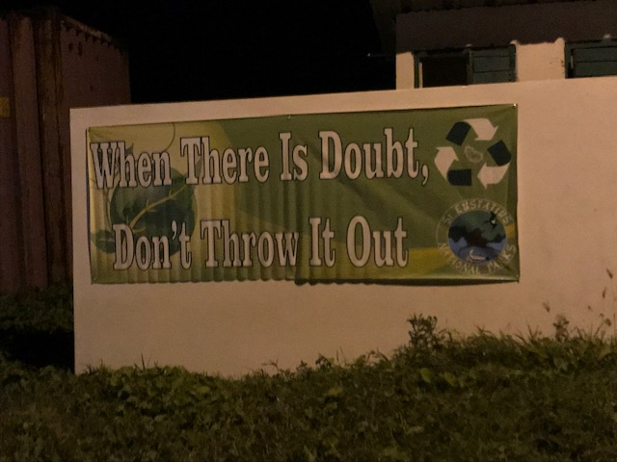

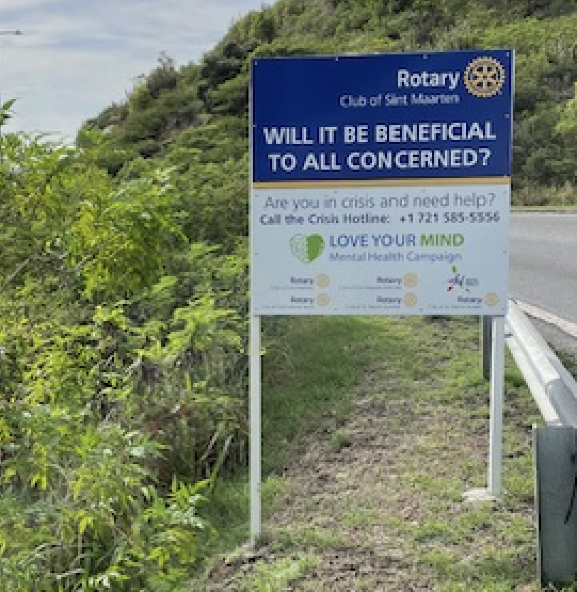

Slide 35
Take away?
Try not to gossip yourself.
Do not listen to gossip:
  Say, I do not want to hear this;
  Go, tell the other person…

Slide 36
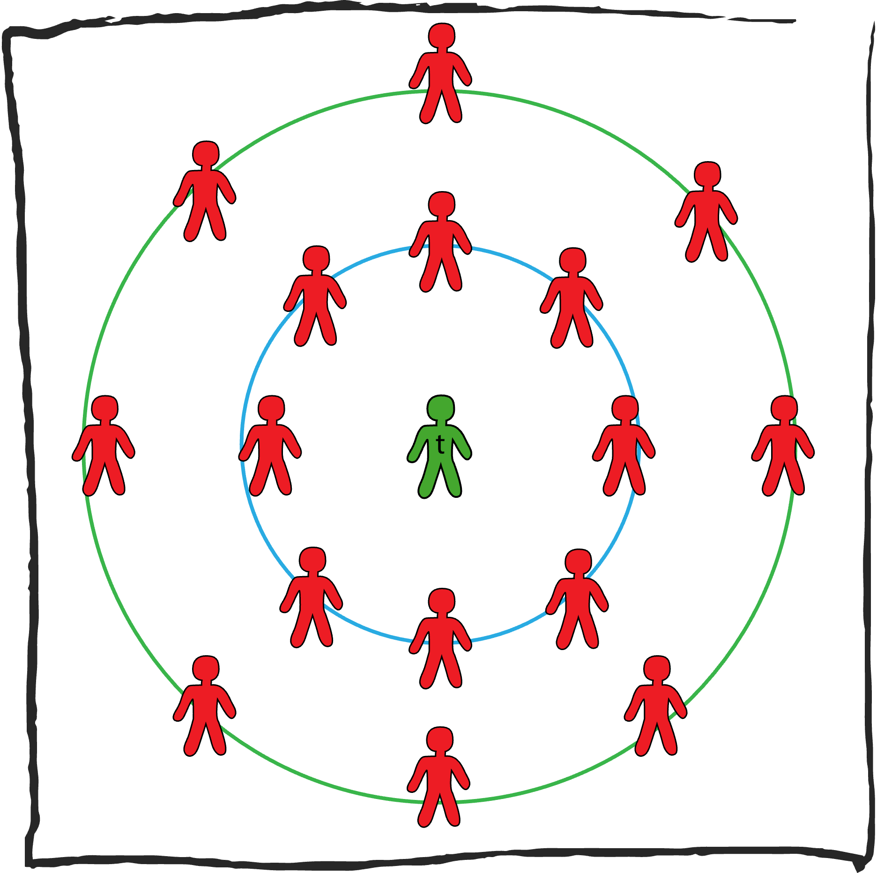
Let us do the Carroussel exercise 60”

Slide 37
Preparation Step by step
Two groups (inside/outside circle)
5 short talks of 5 minutes
Inside circles moves a chair

Slide 38
1. Observe
The rounds
observe each other 1 min
give back what you saw 2 min
(difference between what you
see and interpretation)

Slide 39
2. Ask
One poses questions to the other about anything
The rounds

Slide 40
3. Ask about yourself
One poses questions to the other about herself…
(what do you think of my……..)
The rounds

Slide 41
4. Give a compliment
The rounds
(e.g. what you are very good at is…. what I enjoy is, when you…)
(receiving a compliment)

Slide 42
5. Critical friend
The rounds
Give a critical feedback
(play the ball, not the person)

Slide 43
Plenary
One group:
What surprised you?
What did you learn?
What made it difficult / easy?
How could you use this in practice?

Slide 44
2.2. How to????
What do you already know about HOW to give feedback?
Let us make an inventory of your Do’s and Don’t’s

Slide 45
Exercise
Group activity on poster
Goal: effective feedback rules
Activity
Step 1: everyone writes a do or don’t in giving feedback individually
white: do not
green: do
Step 2: stick on flap-over, cluster,
Step 3: Then what? Criteria for effective feedback on paper
Step 4: Put on the wall and add.
Notes:
Johanna introduces and guides the exercise

Slide 46
2.2.1. Do’s and dont’s for giving feedback
Circumstances
1. Create safety!!!! (privately!!!!!)
2. Give feedback as soon as possible (5 min)
3. Feedback only makes sense when the other wants/is able
to receive feedback (choose a good moment/ walk/ break).
Ask intro : „Are you open to get some feedback from me?“

Slide 47
Do’s and dont’s for giving feedback
The way you do it
4. Standing in her shoes…
5. Give short feedback and room for a reaction (dialogue/open).
6. Make your feedback specific: then I saw you doing this over there… (not what others told you!!!), based on criteria.
7. Play the ball, not the person. Be hard and clear on content, sweet and friendly on the relationship.
8. Give a so called I-message.
9. First you and the other! Do not go to a team leader alone to
complain about someone else. If you cannot come to a solution go to the teamleader together.
10. Feedback uses checks: “Is it right that....”

Slide 48
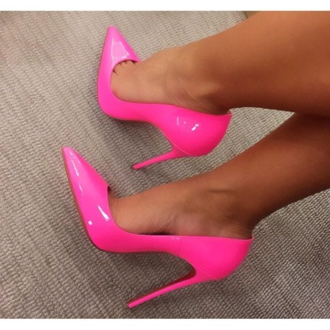
What if you were she
What would you think?
How would that feel?
What would you do?

Slide 49
2.2.2. Two feedback instruments
Sandwich
2. Interaction feedback
Eight steps formula
The core is: three plus three

Slide 50
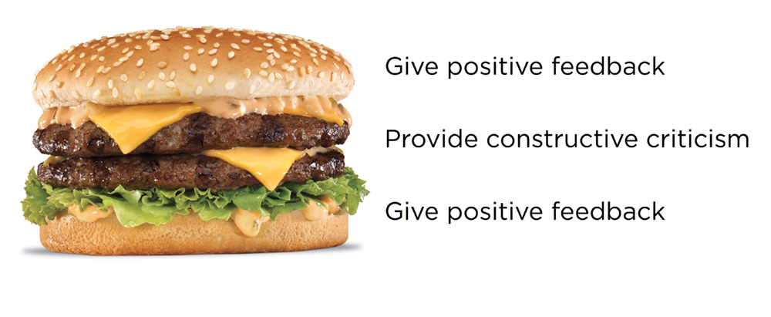
Sandwich
1. What does the person do well? (present tense)
2. What needs improvement, can be done better?
3. Positive end: In general I think you did ... well

Slide 51
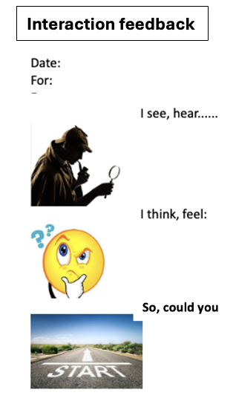
Interaction plus 3 + 3
1. INTRO: Can I speak to you for a minute?
2. I noticed….. I heard, I saw……
3. The impact (on me, clients, colleagues) of it is…….
4. REACTION: What do you think about it?
5. So, could you (suggestion)
END: Thank you.

Slide 52
Interaction in six
1. INTRO
2. NOTICE
3. IMPACT
4. REACTION
5. SUGGESTION
6. THANK YOU

Slide 53
EXERCISE ISSUES
Groups of two
  Select issues
  Exercise 6 step.
  Walk outside

Slide 54

Fear ?

Slide 55
2.2.3. Do’s and dont’s for receiving feedback
  Listen carefully to the feedback you get: these are actually gifts!!!!
      When we receive harsh feedback, the brain
      is triggered. We might want to fight or flight So, stop at the first sign that a "Yes . . . but!" or "You're wrong" response starts bubbling up. Tamp it down. Don't react to the feedback. Do not defend yourself nor get angry or aggressive. Rather say, thank you!!
  2. Summarize what you heard.
  3. Ask for clarification, examples.
  4. Gather information from others about the same topics

Slide 56
Do’s and dont’s for receiving feedback
5. Use the feedback to become better!!
6. Look for the 10 percent grain of truth
  Evaluate for yourself the usefulness of the feedback
  you got and look for the (10?)% that is of use!!!!
7. Seek out the pattern.
  Have you ever received this feedback before?
  How about something similar?

Slide 57
3. Co-creating a feedback culture is the next organisation wide movement.

Slide 58
3.1. Current Feedback culture
What is the current feedback culture in your team?
  How is feedback given? When? By whom? How?
  Formal ? HR-process / Informal ?
  Is the atmosphere safe / trustfull?
  Choose an animal to represent your team (in giving feedback now).

Slide 59
3.2. Desired feedback culture
Individual questionnaire on desired feedback.
Add country of birth.
Staff divided in teams seek together an answer to the question:
“ What is the desired feedback culture in our team”?
“ Choose an animal for the group: What would the ideal animal group be?”
START-STOP-CONTINUE

Slide 60
Desired feedback culture
Plenary presentations and discussion
Is there a common image?
What is the specific feedback behaviour that is desired?
How can we achieve this?

Slide 61
4. Follow up
INDIVIDUALLY
put into practice
TEAM
meeting discussion feedback culture now and desired
ORGANISATION (HR)
follow up training
team functioning

Slide 62
A WYCCF movement together
People are trained in effective feedback.
Policies are being implemented and enforced.
All management gives the example.
All HR systems (appraisal system, reward systems)
support the feedback culture.
The quality management system supports the feedback
culture.
An environment of safety and trust is created, wherein
openness is possible.
6. Everybody: Stop the gossip: TPN!!!!
7. A feedback culture campaign supports the movement!

Slide 63

5. Evaluation: my feedback to me

Slide 64

everard@onsnet.nu
http://www.vankemenade-act.nl

Slide 65
Annex 1:Tips for effective feedback
Circumstances
1. Create safety!!!! (privately!!!!!)
2. Give feedback as soon as possible (5 min)
3. Feedback only makes sense when the other wants/is able
to receive feedback (choose a good moment/ walk/ break).
Ask intro : „Are you open to get some feedback from me?“
4. Early in the morning, maybe not by email (unless...).

Slide 66
Tips for effective feedback
The way you do it
5. Give short feedback and room for a reaction (dialogue/open).
6. Make your feedback specific: then I saw you doing this over there… (not what others told you!!!), based on criteria.
7. Play the ball, not the person. Be hard and clear on content, sweet and friendly on the relationship.
8. Give a so called I-message.
9. First you and the other! Do not go to a team leader alone to
complain about someone else. If you cannot come to a solution go to the teamleader together.
10. Feedback uses checks: “Is it right that....”

Slide 67
Ad 5. Short
Limit the feedback to one issue at the time.
Exercise to assigned people:
Give feedback on a colleague that shouted to a client,
in just two sentences.

Slide 68
Ad 6. Specific feedback
Do not say: “You are not doing it right”.
Say: “I saw you did not mention this happening
in the patient record”.
Exercise in group of two
Think of four more examples of this,
what you should not say and what you should.

Slide 69
Ad 6. Specific
Specify words like:
It: what exactly?
Always: when, where, what?
Never: sure? not once???

Slide 70
Ad 7. The ball, not the person
Do not say: “You are a sloppy person”
Say: “I did not like the mess I saw”.
Plenary exercise:
Give some more examples….

Slide 71
Ad 8. I-message
Do not say:
“You did not ask the client, what she wanted…”
”I saw you taking the client outside. I got the feeling
that the client wanted to stay in her room”.
Individually write down two examples.
Plenary

Slide 72
Annex 2 examples
Als er bij Jan iets misgaat, begint hij onmiddellijk te vloeken. Hij heeft nogal een luide stem en anderen klagen dan ook wel eens over zijn taalgebruik. Je hoort net dat Jan iets uit zijn handen laat vallen, en ja hoor, hij begint weer te vloeken.
Bij groepswerken functioneert Tom prima, maar er is één probleem: hij komt nooit op tijd. Dat geeft telkens problemen op woensdagmiddag. Hij heeft met jou afgesproken dat hij voortaan zal proberen op tijd zal komen. Hij komt nu net weer binnengewandeld, ruim drie kwartier te laat.
Nicolien maakt overal snel een rommel van. Ze laat alles slingeren en ook aan het eind van de dag ruimt ze haar rommel niet op.. Het is bijna kwart na vier en ze maakt nog geen aanstalten om de rommel op te ruimen.
Suzan heeft de gewoonte om scherp en onvriendelijk te praten tegen haar collega’s. Als ze haar iets vragen noemt ze hen ‘stom’. Je hebt net gehoord hoe ze uitviel tegen een stagiare.
Erik komt met een dranklucht na de middagpauze binnen. Hij loopt waggelend en geeft luid en brutaal commentaar aan anderen. Sommige collega’s deinzen achteruit.

Slide 73
Annex 3 Gen Z
Let's take a look at the unique feedback preferences of each working generation:
Baby Boomers (Born Between 1946 And 1964)
Appreciate formal and structured feedback, such as annual performance reviews.
Value recognition and respect for their achievements and seniority.
May not be comfortable with receiving feedback from younger generations or using technology for feedback.

Slide 74
Generation X (Born Between 1965 And 1980)
Prefer direct and honest feedback, such as face-to-face conversations.
Value autonomy and independence in their work.
May not appreciate feedback that is too frequent or too vague.
May also be skeptical of feedback that is not backed by facts or evidence.

Slide 75
Millennials (Born Between 1981 And 1996)
Prefer frequent and constructive feedback, such as real-time feedback or coaching.
Value Learning and Development opportunities in their work.
May not respond well to feedback that is too harsh or too generic.
May also expect feedback to be personalized and tailored to their goals and interests.

Slide 76
Generation Z (Born After 1997)
Prefer instant and interactive feedback, such as feedback via digital platforms or gamification.
Value creativity and innovation in their work.
May not tolerate feedback that is too slow or too boring.
May also seek feedback from multiple sources and perspectives.
69% weekly or even more!
Need trust and fairness.

