Slide 1
Communication for leaders Everard van Kemenade

Slide 2
Agenda
What is communication?
What are the communication issues?
What is your communication style.
Tips for effective communication.

Slide 3
What is communication?
Who are you?
Who am I?

Slide 4
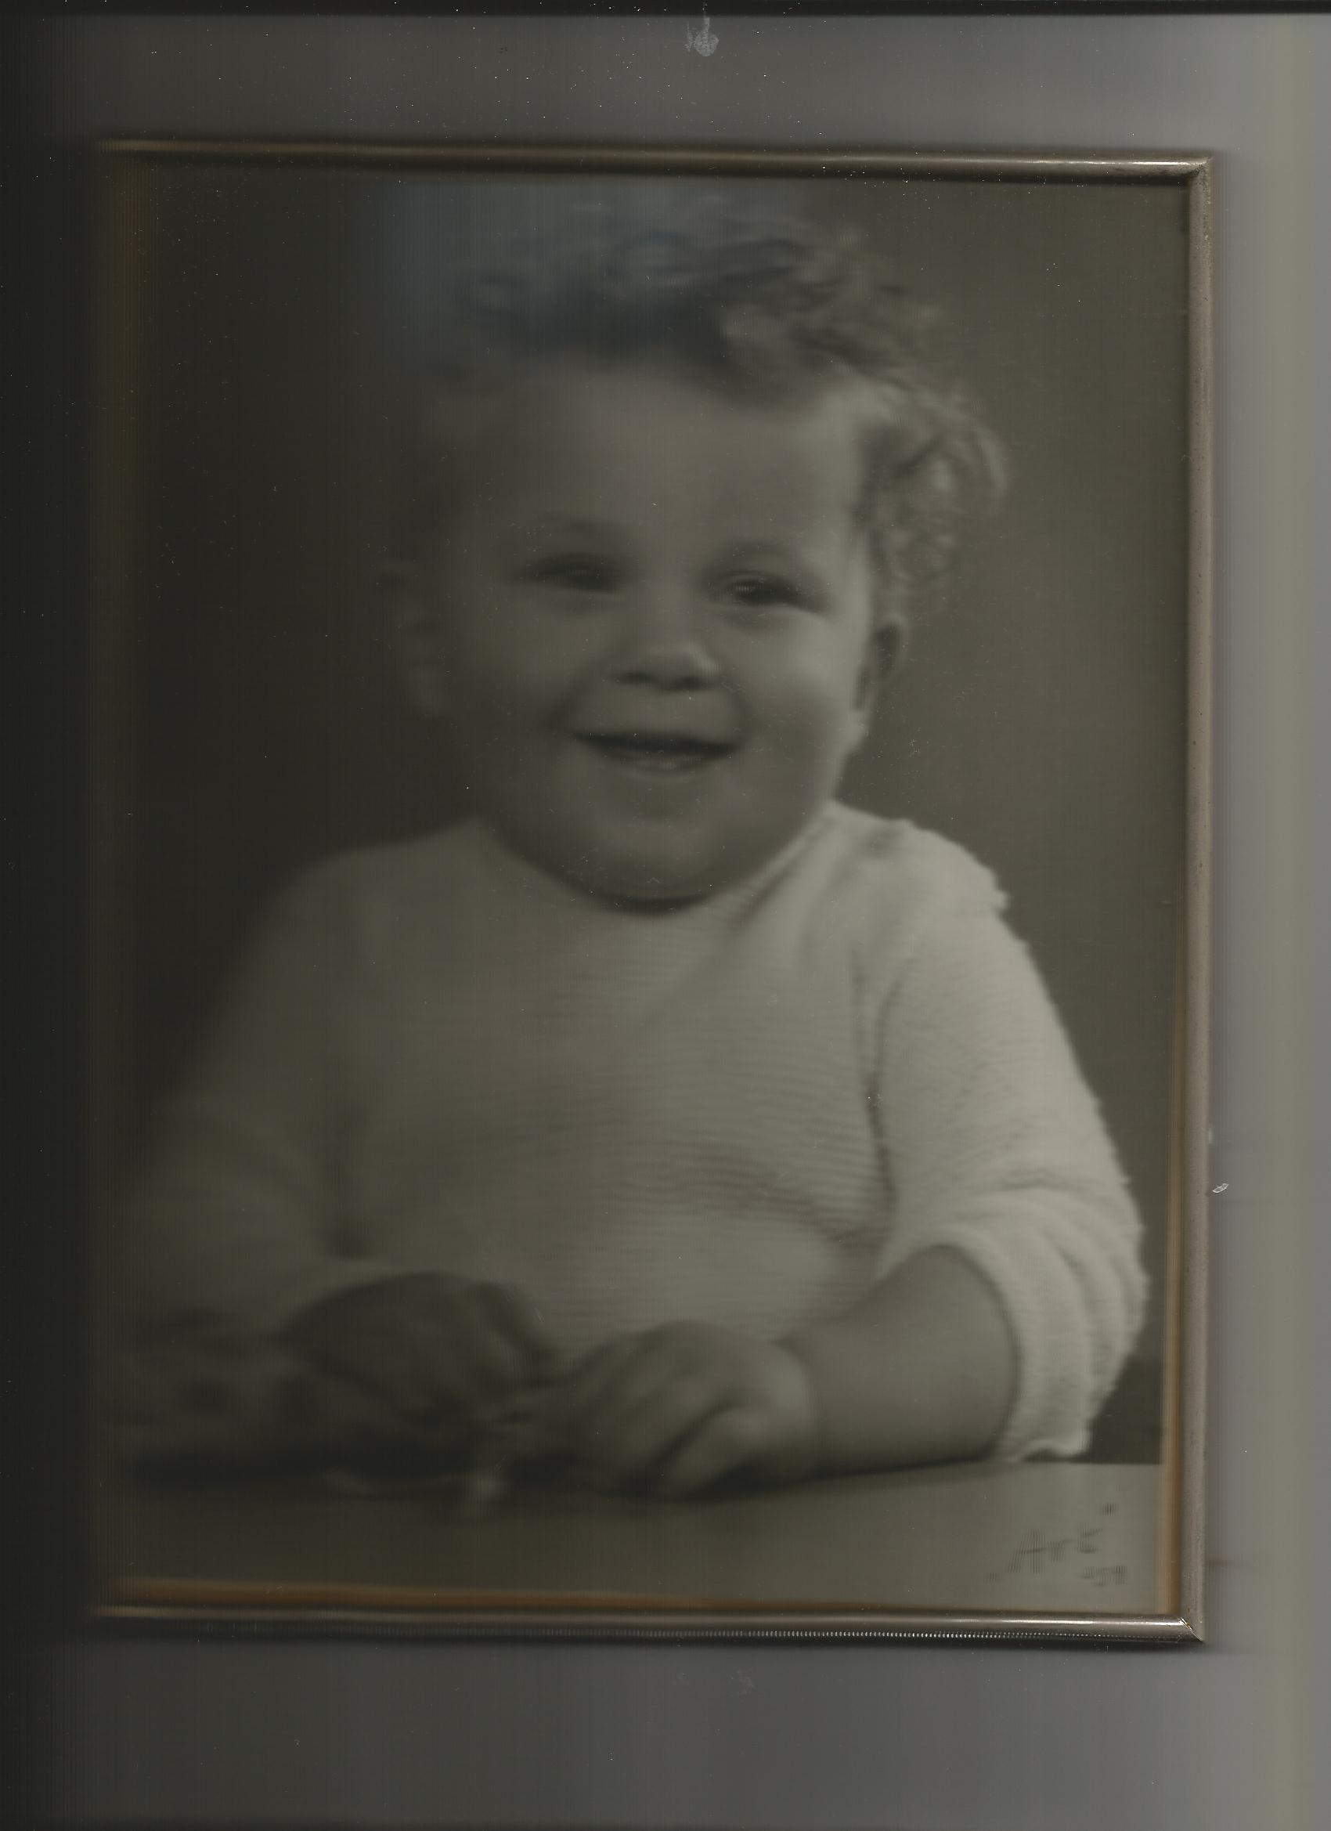
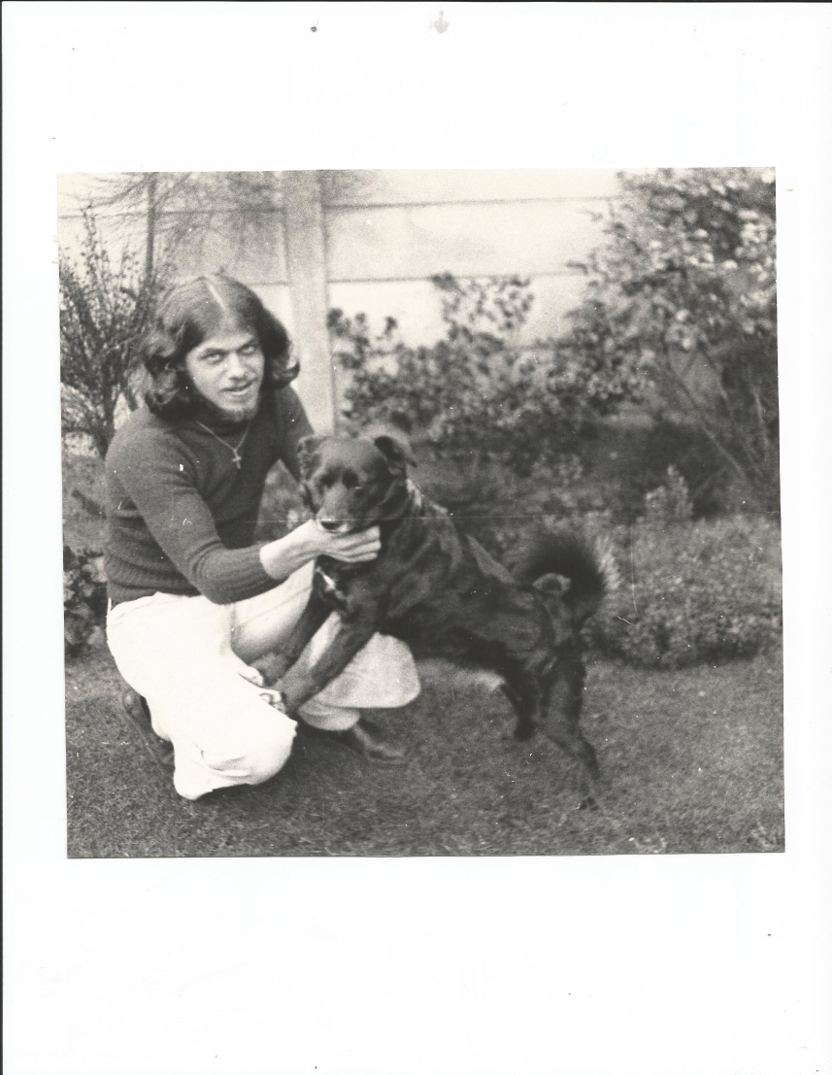
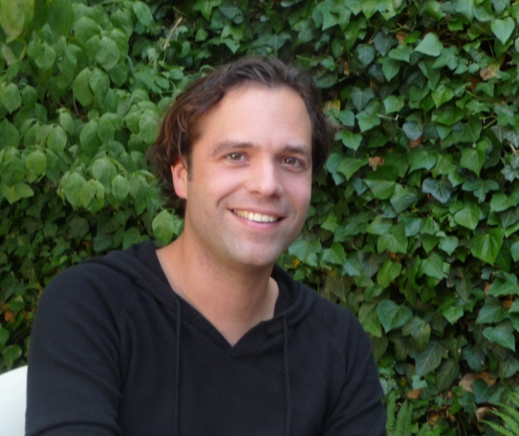
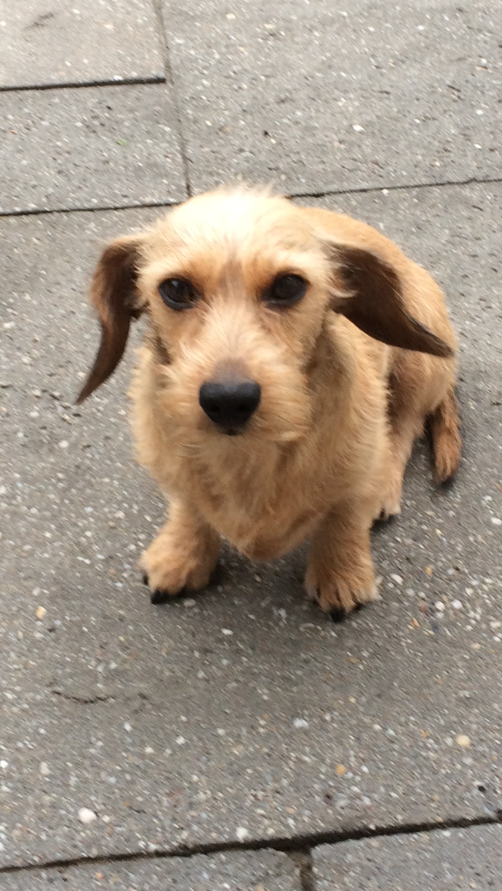
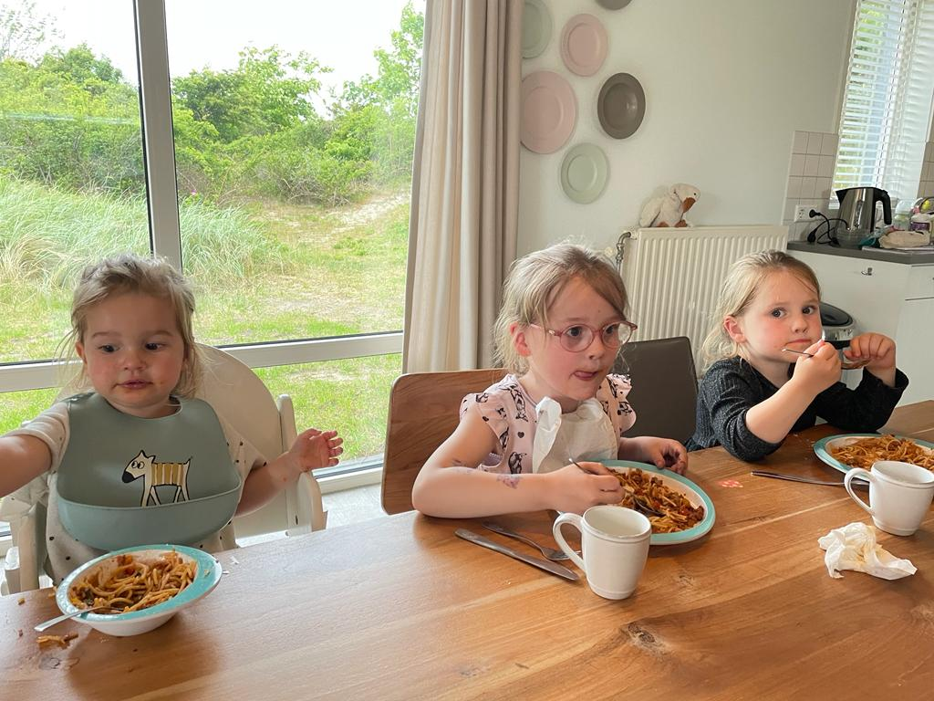
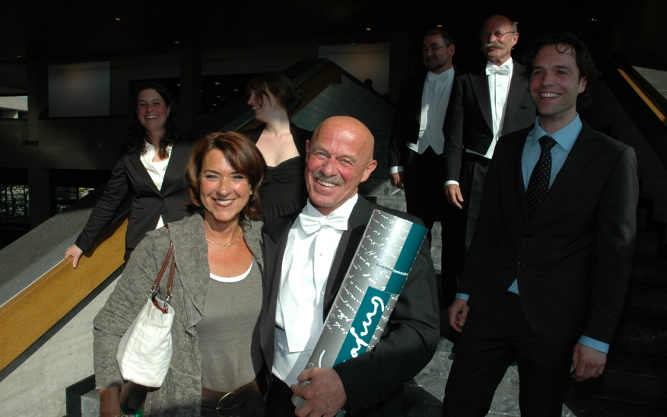
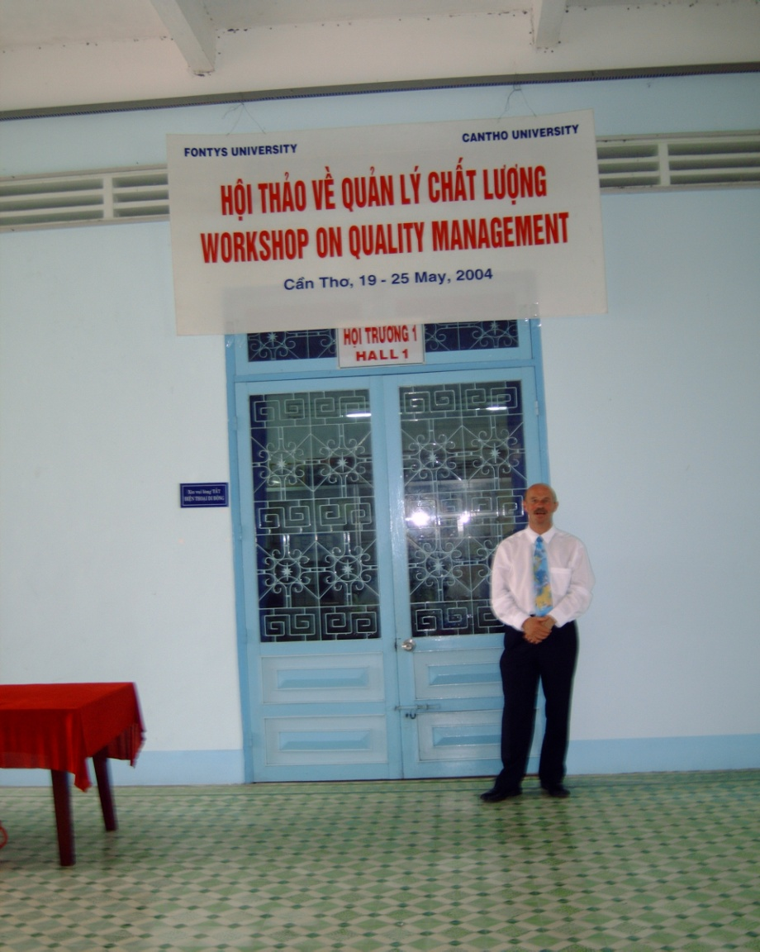
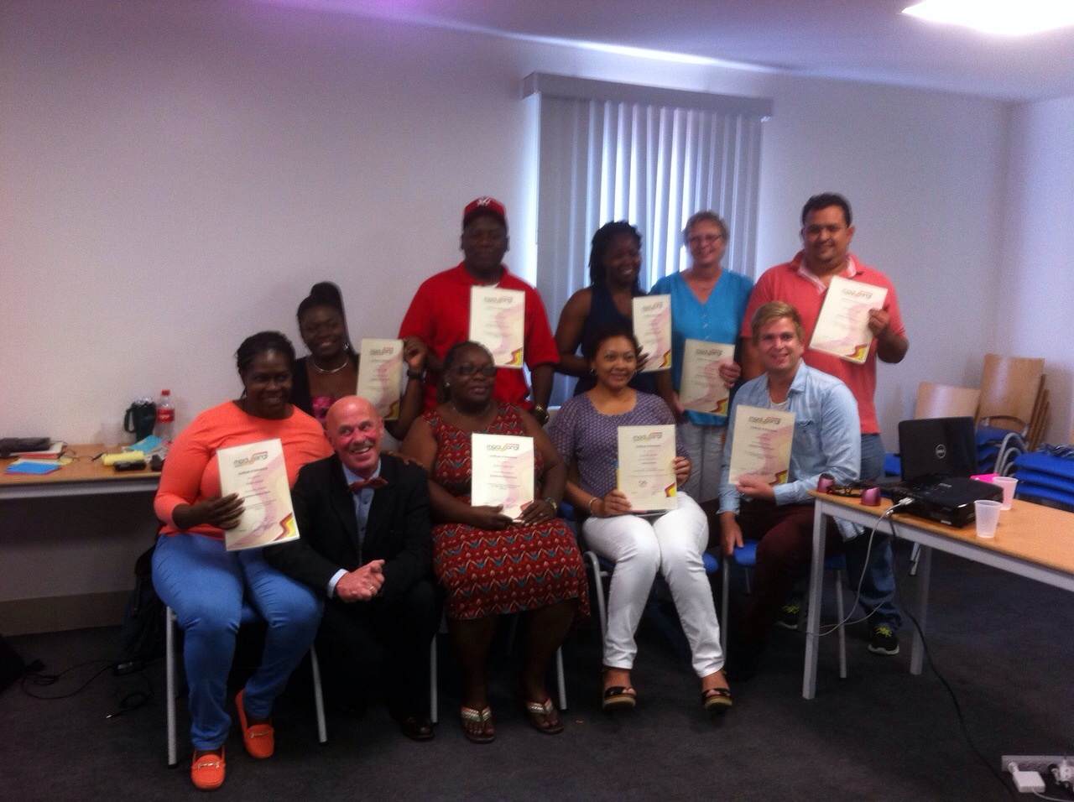

Slide 5
Slides
My website
Course materials

Slide 6
What is communication?

Slide 7
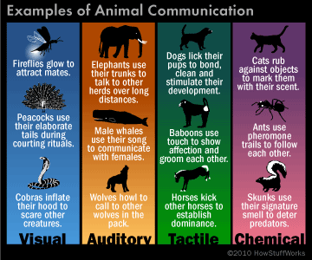
Animals communicate.

Slide 8
Communication

Slide 9
Context
Message
Content and Relationship

Slide 10
Watzlawick
Communication has a content and a relationship level.

Slide 11
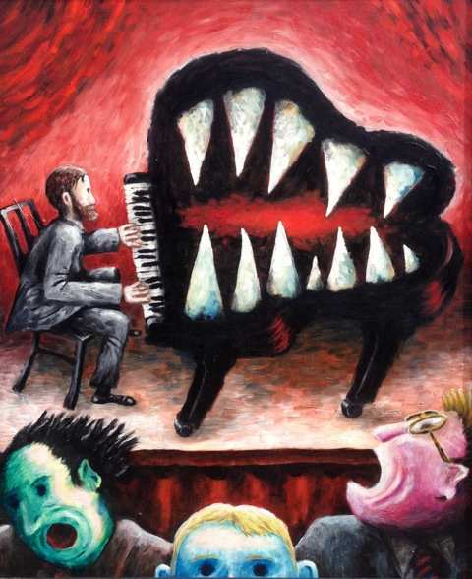
C’est le ton qui fait la musique….

Slide 12
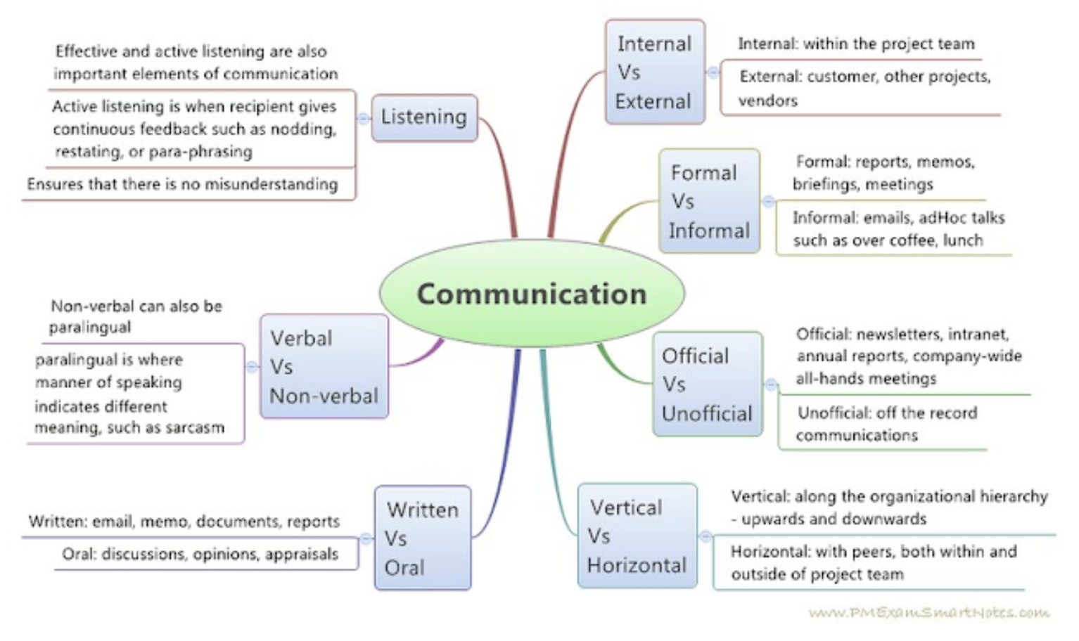
What is communication?

Slide 13
Sorts
Internal versus external
Formal versus informal
Official versus unofficial
Vertical versus horizontal
Written versus oral

Slide 14
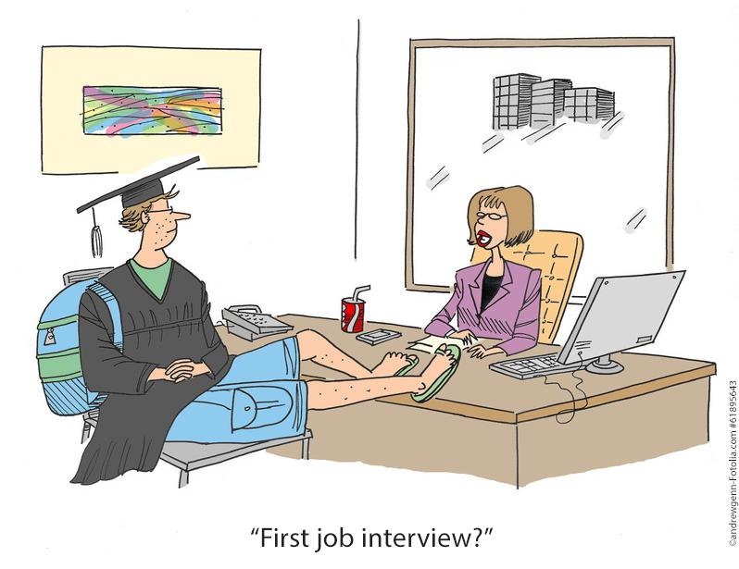
Watzlawick
You cannot not-communicate.

Slide 15
Verbal versus non-verbal

Slide 16
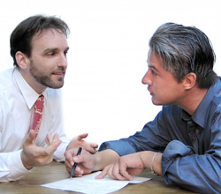
Verbal communication
Can be written (a letter or a mail) but mostly spoken
The content is the most important thing.

Slide 17
Non verbal communication
What people do
Body language
Voice volume (whisper/shout)
Facial expression (frightened/crying)
Sometimes more direct than verbal communication (arm over shoulder)
Relationship is very important

Slide 18
Non verbal communication

Slide 19
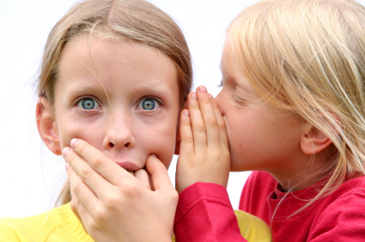
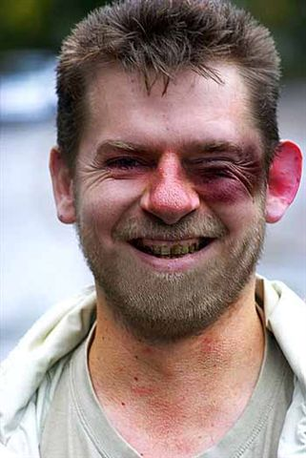
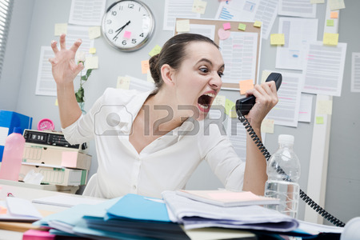
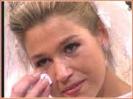

Slide 20
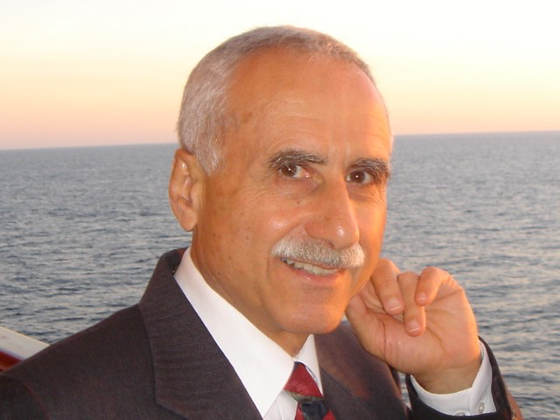
Albert Mehrabian (1971)

Slide 21
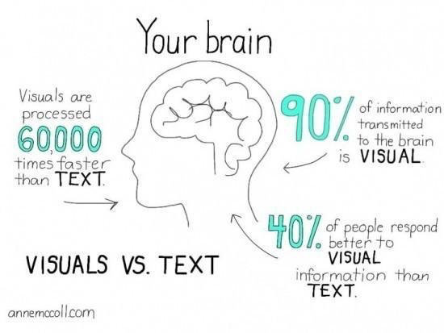

Slide 22
Social media
X formally known as Twitter
Facebook
Instagram
Linkedin
E-mail
Personal
Work

Slide 23
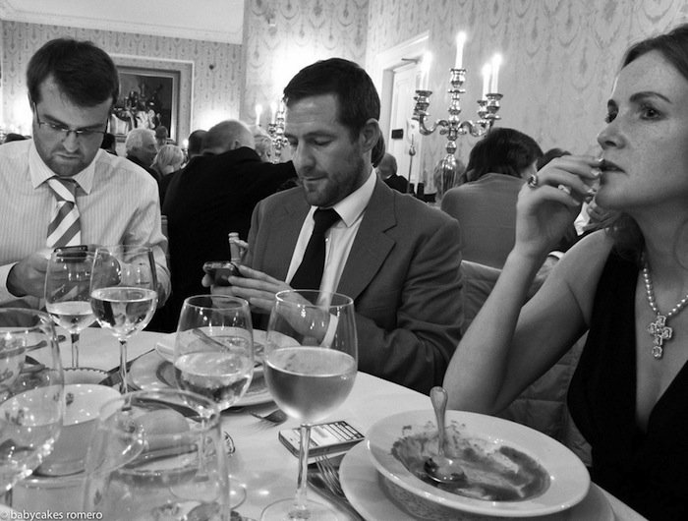
The death of communication

Slide 24
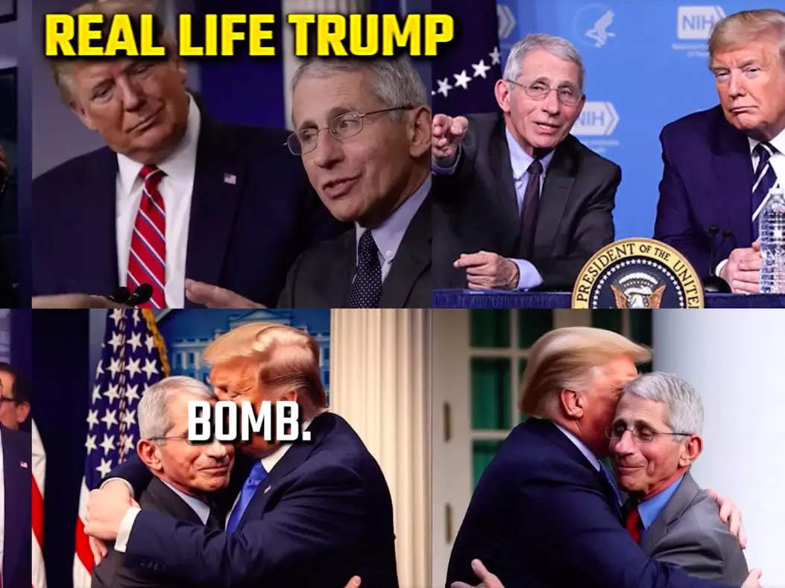
Risks

Slide 25
2. Communication issues

Slide 26
Examples in music
Beatles: “We can work it out”
Madonna: “You are frozen” (when your heart is not open)
Lady Gaga: (he cannot read my) “Poker face”
Rolling Stones: “You can’t always get what you want” (but if you try sometime)

Slide 27
SILENCE
Everything's gonna be alright tonight Everything's gonna be alright tonight No one moves, no one grooves No one talks, no one walks tonight

Slide 28
Your issues
Examples on post-its
Play out

Slide 30
Reactions

Slide 31
3. Communication styles
You!
Questionnaire communication styles
Based on three dimensions
Assertive / subassertive
Warm / cool
Tense / relaxed

Slide 32
Eight styles / wavelenghts
Hesitant
Extravert
Controlling
Cool
5. Strained
6. Friendly
7. Anxious / afraid of other people
8. Incomprehensable

Slide 33
relaxed
distant
distant
distant
incomprehensable
cool
warm
warm
friendly
extravert
assertive
sub-assertive
strained
hesitant
warm
warm
anxious
controlling
distant
distant
tense

Slide 34
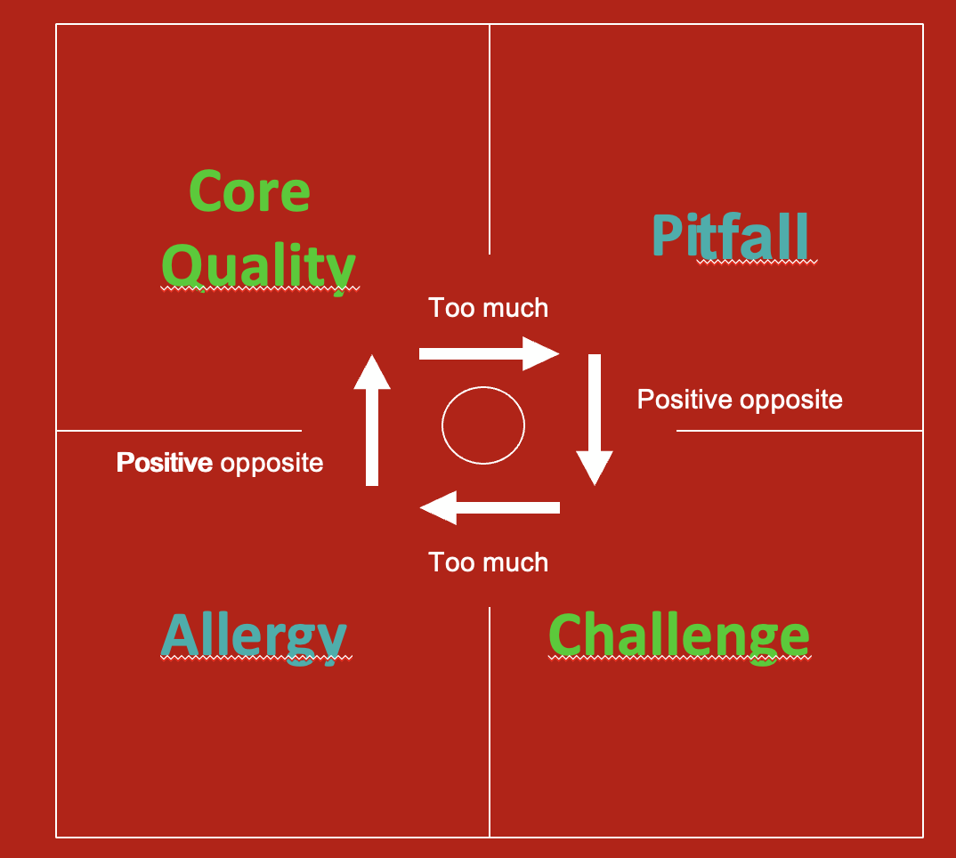
Be aware!
All have their strengths and weaknesses
Offman: strenghts, weaknesses, allergy and challenge

Slide 35
1. Hesitant
Warm
Assertive
Tense
Your pitfalls:
Insecure, worried about what others think, bossy, ‘musturbation’
8% 3%

Slide 36
Hesitant challenges
Forget that everyone should like you.
Become more indifferent for criticism.
Distract yourself.
Focus on the other.
Learn from the
indifferent people.

Slide 37
2. Extravert
Warm
Assertive
Relaxed
Your pitfalls:
Talk too much, arrogance, bossy, pushy
23% 20%

Slide 38
Extravert challenges
Look well, how the other reacts to all that you are saying.
Listen.
Count to ten.
Learn from
passive, insecure
people.

Slide 39
3. Controlling
Distant
Assertive
Tense
Your pitfalls: being cold, too demanding, little attention to emotions
6% 9%

Slide 40
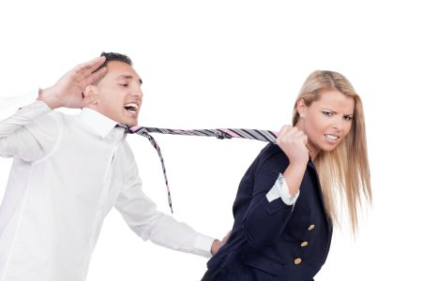
Controlling challenges
Let go
Accept that things can go wrong and people incl. you make mistakes.
Ask for help.
Learn from
emotional and
sloppy people.

Slide 41
4. Cool
Distant
Assertive
Relaxed
Your pitfalls: being cold, individualism, little attention to emotions
10% 23%

Slide 42
Cool challenges
Get in contact with your feelings.
Make time for people.
Give compliments
Learn from
the drama
queens.

Slide 43
5. Strained
Distant
Sub-assertive
Tense
Your pitfalls: disregard yourself, stressed, too self critical
16% 6%

Slide 44
Strained challenges
Become more gentle towards yourself.
Look at what goes well.
Take a dare.
Learn from
the egoist and
the indifferent.

Slide 45
6. Friendly
Warm
Sub-assertive
Relaxed
Your pitfalls: disregard yourself, don;’t strand up for yourself, patronising
9% 8%

Slide 46
Friendly challenges
Learn to say no.
Do it together.
Take.
Learn from
the egoist and
the indifferent.

Slide 47
7. Anxious
Distant
Sub-assertive
Tense
Your pitfalls: high demands to yourself, low self esteem, dependent position
20% 18-23 year-olds

Slide 48
Anxious challenges
Dare and ask for help.
Talk, speak out.
Work on your self-confidence.
Learn from
the pushy and
indifferent
people.

Slide 49
8. Incomprehensable
Distant
Sub-assertive
Relaxed
Your pitfalls: passive, sloppy, do your own thing
5% 9%

Slide 50
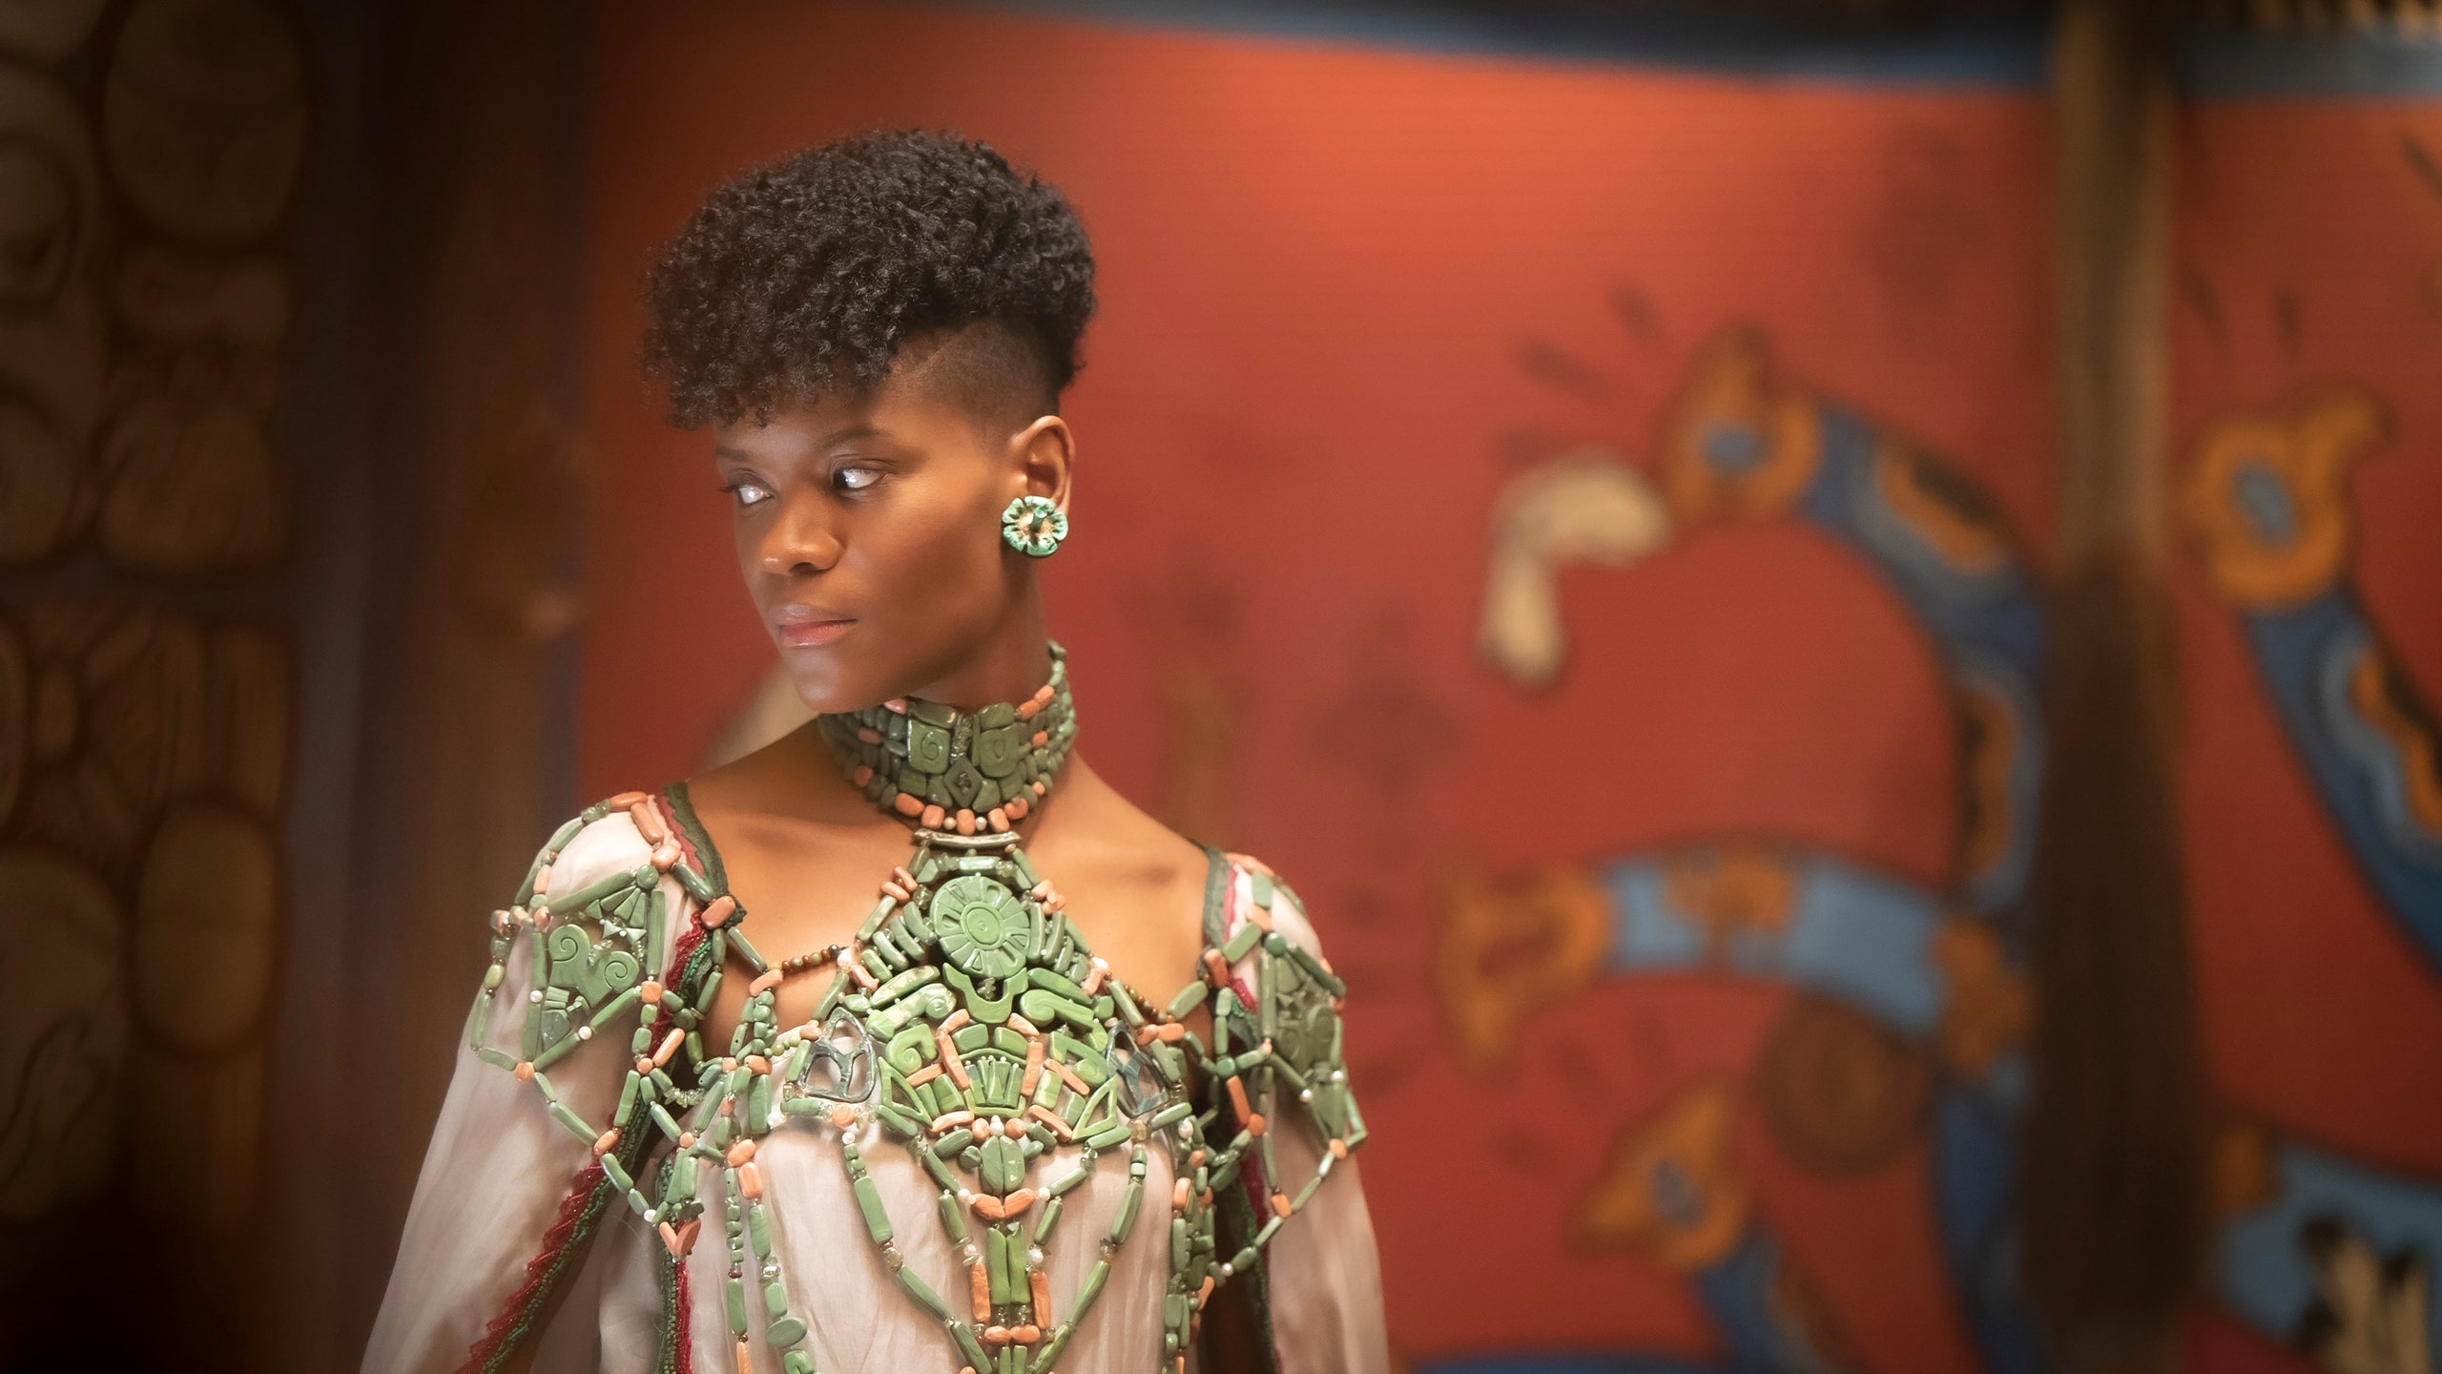
Incomprehensable challenges
Show who you are.
Be interested.
Invest in relations.
Learn from
the anxious and
the dependent
people.

Slide 51
Pieternel Dijkstra (2011)
Op dezelfde golflengte.
101 tips om soepeler te communiceren.

Slide 52
lunch
C O C O N U T

Slide 53
4. Tips

Slide 54
TEN TIPS for better communication
Give real attention.
Give positive feedback.
Express your emotions properly.
Leave aggressive people, if you can.
Touch selectively.

Slide 55
TEN TIPS for better communication
6. Think before you talk.
7. Metacommunicate (talk about the communciation).
8. Show respect.
9. Give an ‘I’-message. Not … you…
10. Gossip? Only the positive.

Slide 56
Exercise
Carroussel

Slide 57
Tip 11. Active listening
It’s a combined skill that’s made up of a number of techniques.
We try to be inviting to others, to show interest and try to understand and follow others.
The goal: to make the other feel comfortable.
To stimulate respectful communication.

Slide 58
The following techniques are involved in active listening
Asking questions:
The goal is to help the other person express their feelings in words and to explain the problem.

Slide 59
Two types of questions
Open questions
Closed questions

Slide 60
Open questions
Are called for when one wants to give the other space.
Starts mostly with: how, when, with whom, could you tell me more…. etc.
During answering you have time to think.

Slide 61
Examples of open questions
What happened?
How did the conversation go?
What do you think about the suggestion?
What is keeping you from doing that?
What makes you say that?

Slide 62
Closed questions
Can be used to check whether information has been correctly understood or to double check information.
It can be answered with yes or no.
The asking person is active, the answering person is passive.

Slide 63
Examples of closed questions
So there is nothing the matter?
Has somebody been with you?
So I do not have to look?
Are you the person responsible for…?

Slide 64
Suggestive questions
Often look like closed questions.
Directs the other person in a direction.
Starts often with: why….
It contains a judgment.
The answer is often defensive.
Can be confusing and irritating and can inhibit communication.

Slide 65
Example
Why were you late at work this morning?
I was late
And that was not ok.

Slide 66
Example
Do you still hit other people?
I hit other people
I do that often
That is not ok.

Slide 67
Late
I noticed you were not on time this morning.
That makes me worry.
What is the matter?

Slide 68
Paraphrasing
Means in your own words, summing up the most important parts the other person has said.
It sums up the essence of the message
Has to be asked as a question.
LSD: Listen, Sum up, Do ask through

Slide 69
Example
Do I understand you well, that you feel alone in your team?
Are you saying you do not like this part of your work?
Do u
You mean to say, that it is impossible for you to be on time?

Slide 70
Ask through
How exactly do you mean??
Do you know how this could have happened??
What is your view of the situation?
Can you indicate how you came to this choice?

Slide 71
TEST AGAIN
 | Always, often, regularly, sometimes, never
If I do not understand, I ask the other to explain again
I can listen without judging.
I can sum up without adding.
I'm not too quick to assume I know what another person means.
I someone tells a story, I quickly propose the solution.
I do not mind silence in a conversation.
I am easily distracted, when the story does not interest me.
MY ACTIVE LISTENING SKILLS

Slide 72
 | Always, often, regularly, sometimes, never
If get irritated, if the other person does not understand me.
I focus more on how it is said than on the content.
I feel insecure talking to someone else.
I maintain eye contact talking to someone.
I take time to talk to someone.

Slide 73
Lets practice
Does anyone has a case?
Trio
We try to help you ☺

Slide 74
Not.. BUT
I would like to help you but…….
I am sorry but…..
Try to bring it in a other way
Suggestions?

Slide 75
Not: WHY
Avoid:
Why did you do so?
Accusation
Rephrase
WHAT MADE YOU DO THIS……

Slide 76
Annex 1: Assignment
Be Specific; about what are talking and what not: WHAT DO I EXPECT FROM YOU?
WHAT IS YOUR WEEK PLAN?
Be Measurable: what exactly do you want to see
Make it Acceptable
Make it Realistic
Set a Time / deadline

Slide 77
FOLLOW UP

Slide 78
Annexs 2: Delegation
What is delegating?
When you delegate, you put another one in place to achieve your results.
You trust a task with its powers and resources to another party.
What you do is retain overall responsibility for the result!

Slide 79
Advantages of Delegation
You better do, because you're dealing with pressure and (eventually) save time.
You make better use of the qualities of others.
You motivate your employees.
You develop your staff.
You can concentrate on the tasks for you as a manager really matter, such as developing a vision.
The higher you get, the more important it is to delegate.

Slide 80
Convenient for Delegation
Whatever can be done by someone else
What can be done better by someone else
What others had to learn
What others like to do

Slide 81
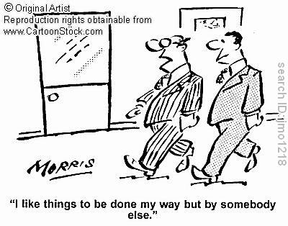

Slide 82
Inconvenient
What is sensitive: for example dismissal
issues, conflicts, etc.
Your core business as a leader: conducting assessment interviews or approval of annual plans.
Keeping the overview.
The ultimate responsibility for tasks you
have delegated.

Slide 83
How do you delegate?
Characteristic of good delegation is the care with which you delegate the work transfer.
You don’t give the first employee you see after a short chat about the weather, a quick job.

Slide 84
Delegation Meetings
- Make an appointment.
Prepare the interview very well.
You focus on content and on the relationship with the employee.
How exactly to delegate depends on every individual employee.
Make appointments about results that have to be achieved and about the process (SMART!)
After the delegation leave the employee as much as possible to do his own work.
Check when the work is finished. (Again: follow up / evaluate )

Slide 85
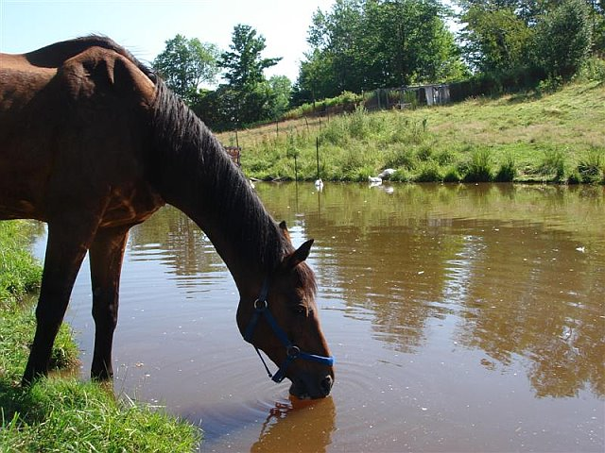
Annex 3: Motivate
We can take a horse to water but
can we force it to drink?

Slide 86
Motivate
Recognition
Autonomy
Mastery
Purpose

Slide 87
RAMP
What motivates people
- Recognition
- Recognition is about whether people feel see, heard, valued and respected, by the leader, the organisation and by one another.

Slide 88
What motivates people
Autonomy
Mastery:
Target those employees who will get a kick out of stepping up to a challenge, by inspiring them to solve a problem, develop a new idea, or suggest new ways of working.
Possibility to develop into a new role: Offer them the opportunity shadowing someone in a role they’d like to move up to.

Slide 89
What motivates people.
Purpose
A sense of belonging: Plan social get-togethers to create opportunities for your team to bond and collaborate.
Doing something meaningful.

Slide 90
The unmotivated
Get to the bottom of their demotivation. The root cause. Is it the workload? A colleague? A particular project? With this information, you can take steps to recover the employee and bring them back to motivation island.
Again, set clear expectations.
Provide regular feedback and recognition.
Encourage disengaged workers to buddy up with colleagues to create a more innovative and fun environment.
Encourage, Not Discourage
Offer learning and development options

Slide 91
Annex 3: be the leader

Slide 92
van Kemenade
Audit Coaching Training
Visionairy leadership
Liberating the corporate soul

Slide 93
Leadership
Leadership is the ability of an individual or a group of individuals to influence and guide followers or other members of an organization.

Slide 94
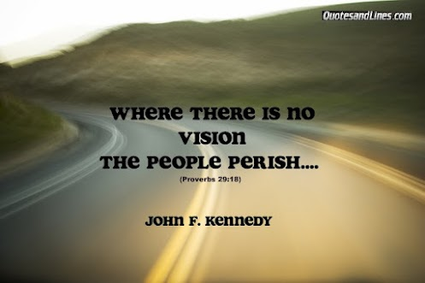
Vision

Slide 95
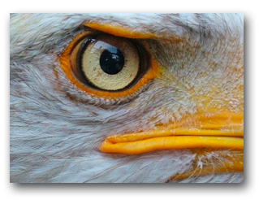
VISION!!!
Jicho la mkubwa ni jicho la tai. (Swahili)
The leader's eye is like an eagle's eye

Slide 96
Vision
From Latin: vidēre, to see, to look out for
What do we want to be/become?
The companies vision declares the intention with regards the future it desires to create.
What the company is striving to achieve.
The vision should create a long-term motivational alignment between employees and the organization and generate social goodwill.
The vision describes “the end”, the “desired state”.
What IMPACT will you have on the lives of others.........

Slide 97
Vision
Three elements (CIA):
Charisma: the direction we want to go for
for the clients, the vision should
appeal to all stakeholders
Inspiration: clear focus for the employees, it
should inspire and touch staff and
make them move and ready for change
Ambition: it should reflect the dreams, passion
and desires of people, long term
objective to strive for.

Slide 98
WYCCF Vision
Vision:
“The White and Yellow Cross Care Foundation strives to deliver sustainable trusted CARE. We
want to identify and fulfil prevention, cure and care needs on Sint Maarten, for our residents and
those of surrounding islands. This evolving and diverse environment offers career and personal
development opportunities to our committed employees.”
CIA? Direction for clients? Inspiration for staff? Ambitious?

Slide 99
Embed your vision
A vision becomes an instrument of change when it is understood and accepted by all stakeholders.

Slide 100
Conclusion
Having a vision is important for you as a leader.
Crucial is that the organisation has a shared vision,
that starts from within.

Slide 101
Vision and action

Slide 102
Vision and Action
Emergent
Brainstorm like; no agenda; interaction of different experts
Novelty, innovation; facilitator
Planned
Structure, PDCA, clear decision making: director / coach

Slide 104
EFQM
D
C
P
1 Leadership
3 People
management
5
Processes
7 People satisfaction
€
9 Key Performance
2 Policy and strategy
6 Customer satisfaction
4 Resources and partners
8 Impact on society
Enablers
Results
A
02-02-2024

Slide 105
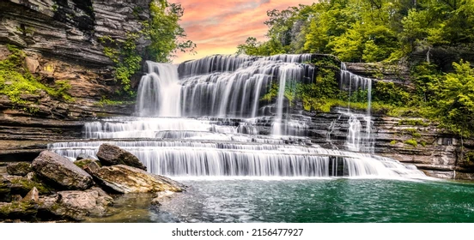
Cascade

Slide 106
ACTION PLANS at all levels
Nr | what | who | when | needs | Evidence of success
1.
2..

Slide 107
Measure

Slide 109
I wish you shining eyes around you
https://www.youtube.com/watch?v=6gt3VdSW5A8

