Slide 1
Communication for front office
Everard van Kemenade, PhD

Slide 2
AGENDA
Welcome
What is communication?
What are your issues?
What is your communication style?
Ten tips for more effective communication.
Lunch
5. Exercise

Slide 3
What is Communication?
Who are you?
Who am I?

Slide 4
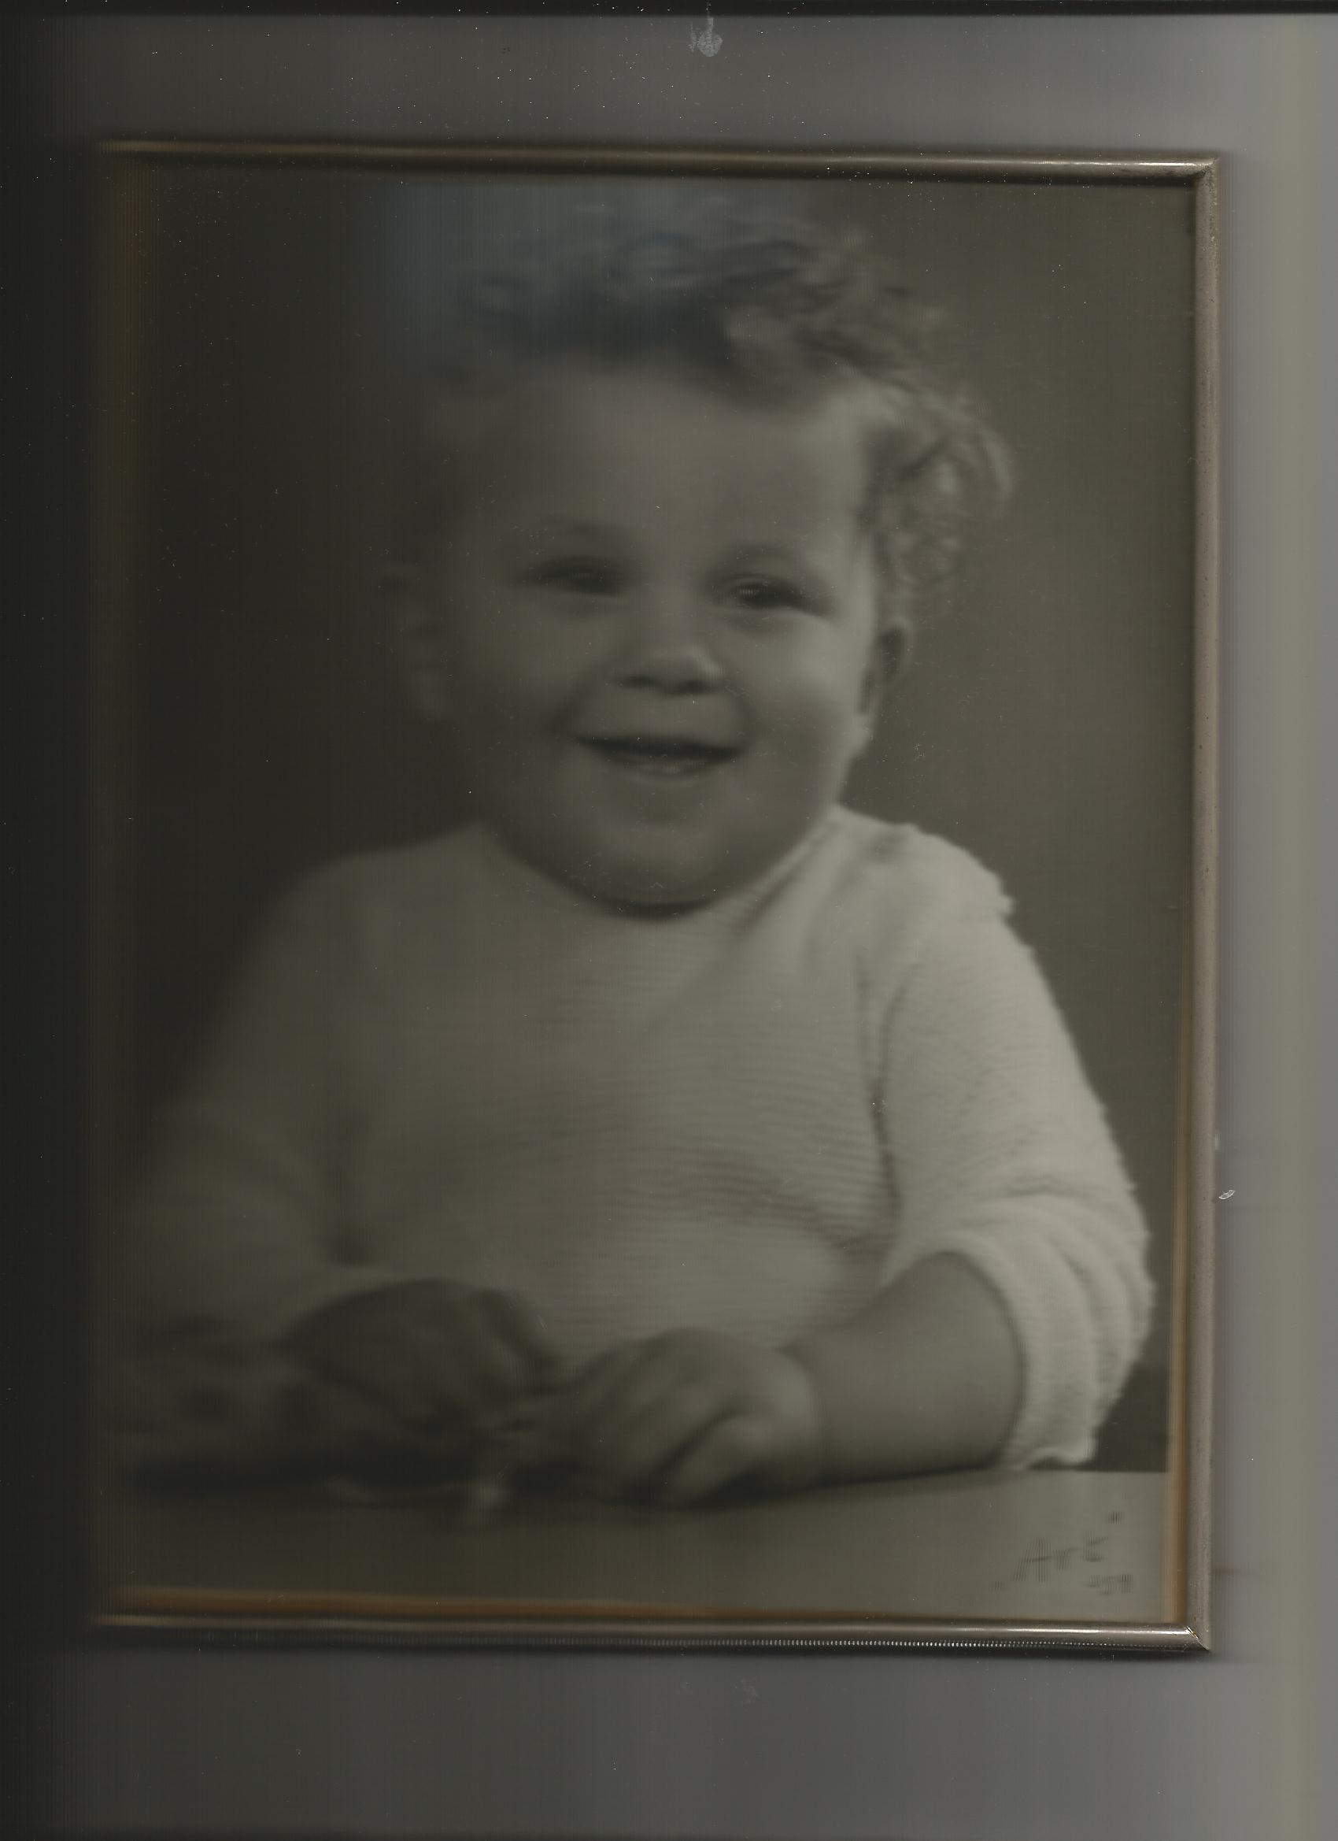
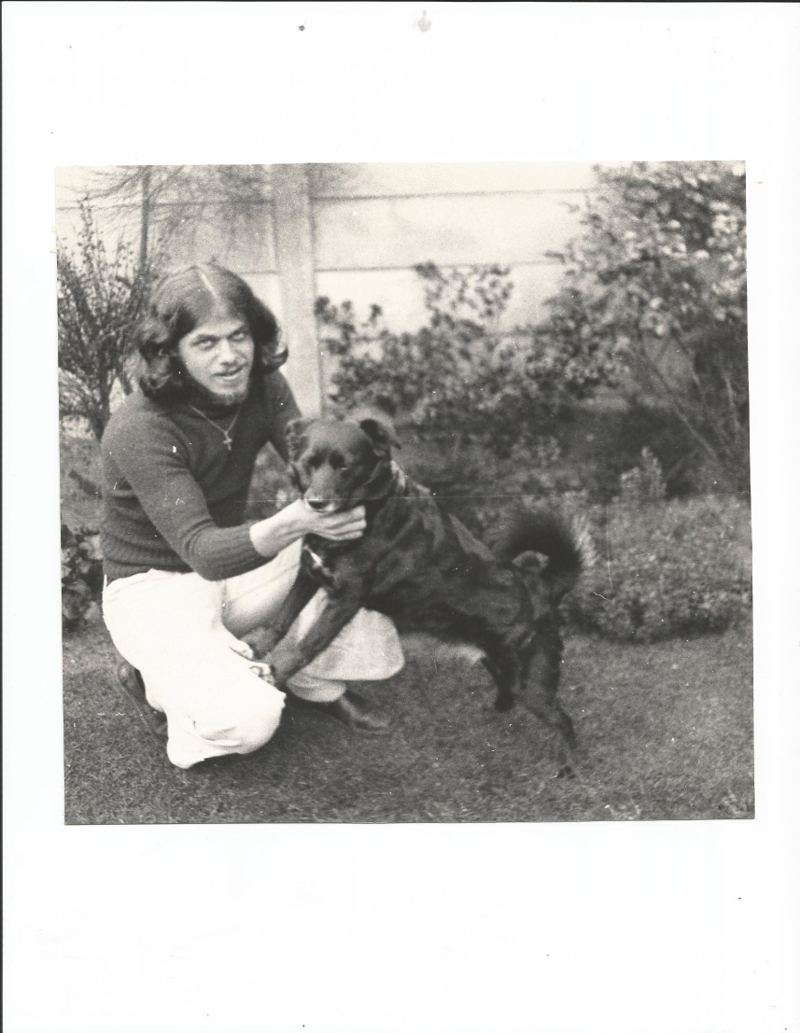
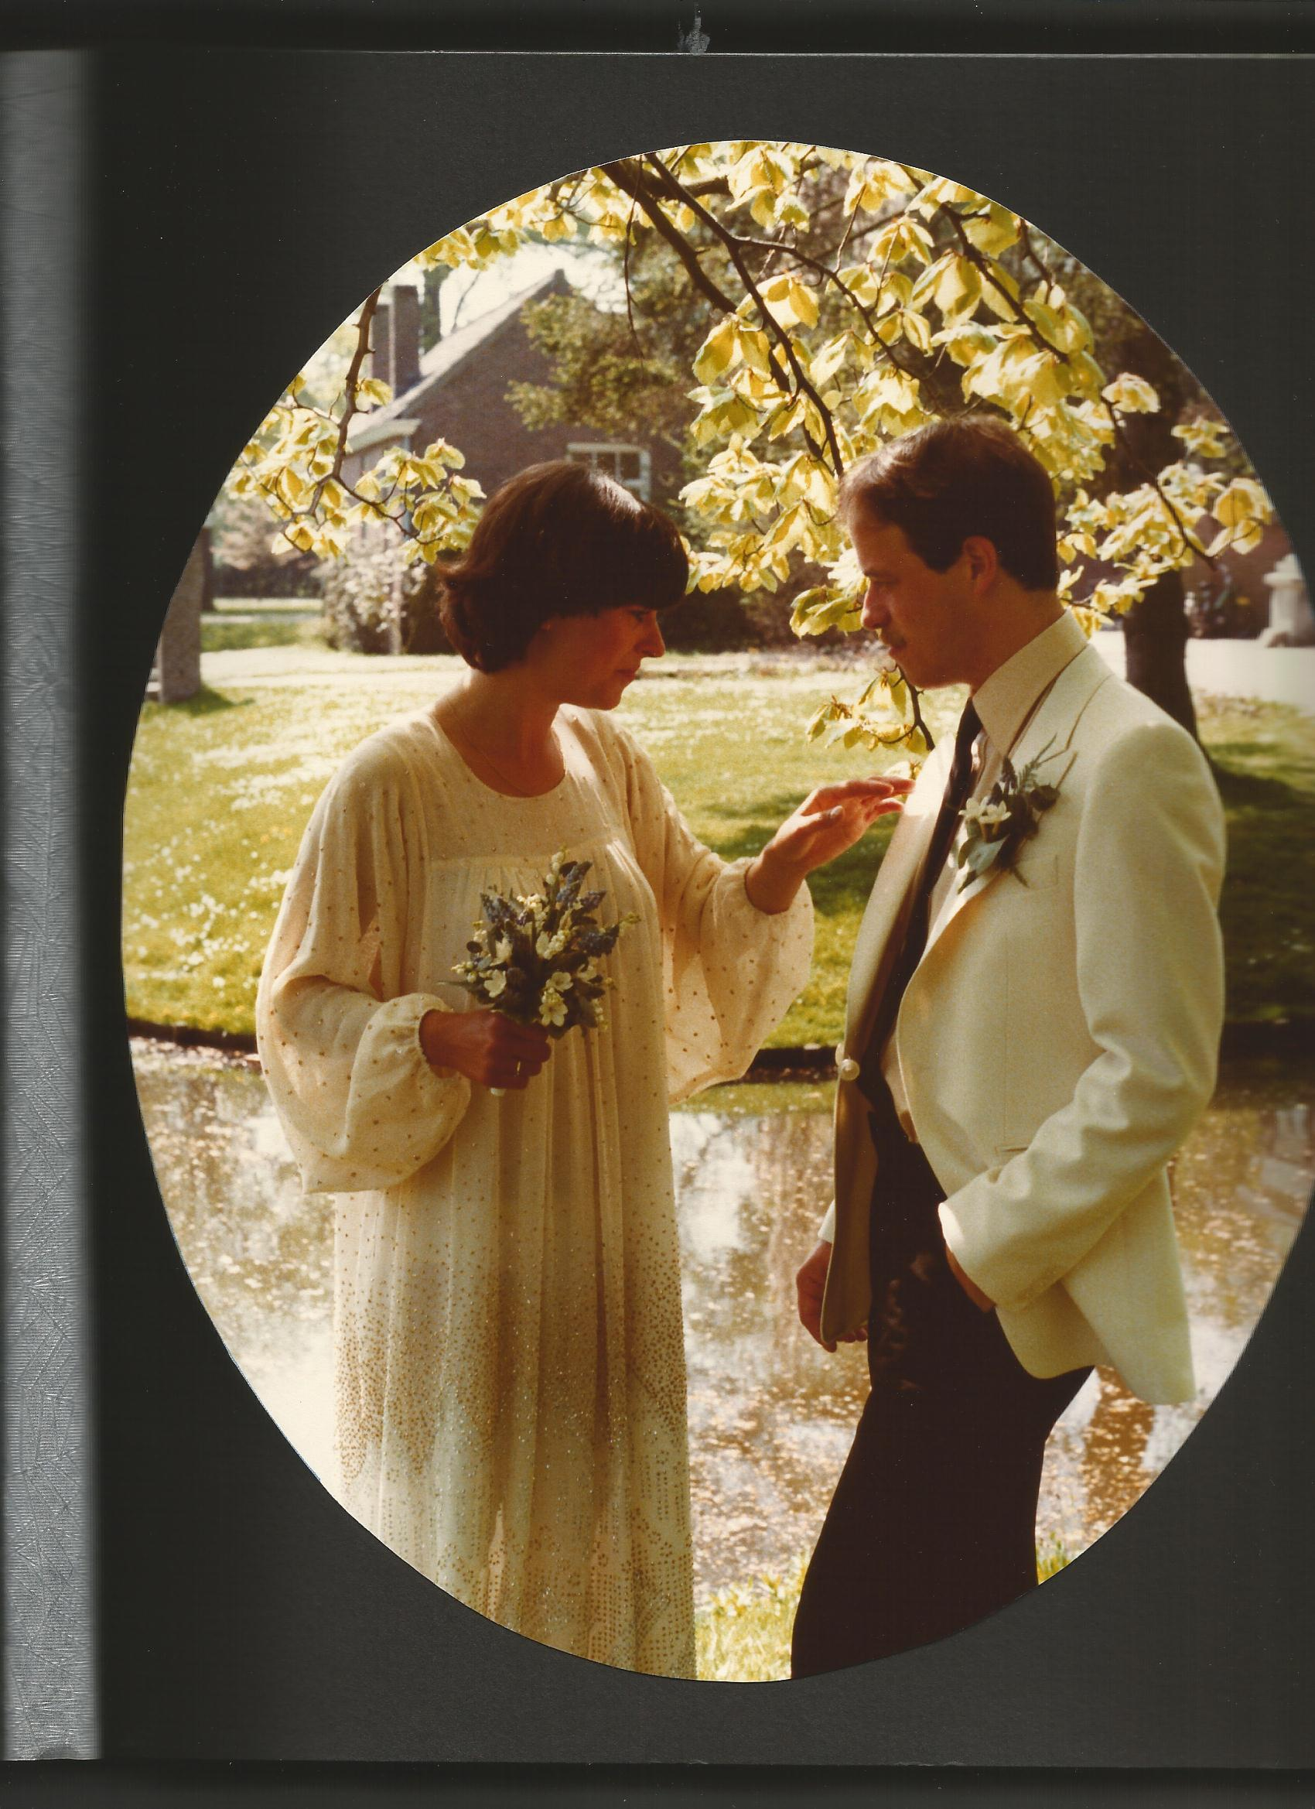
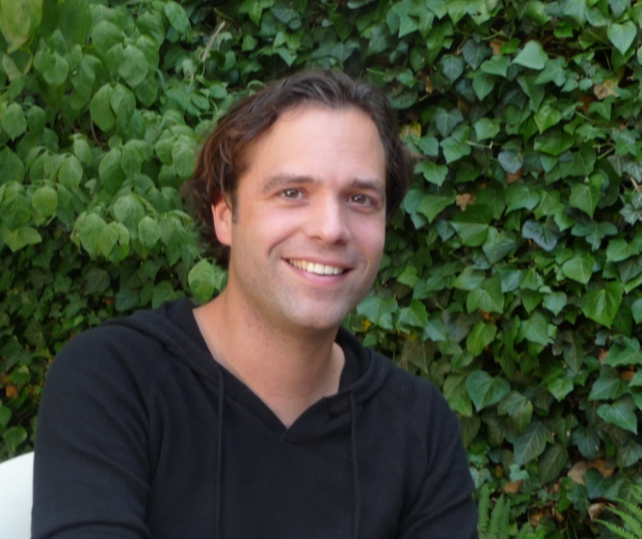
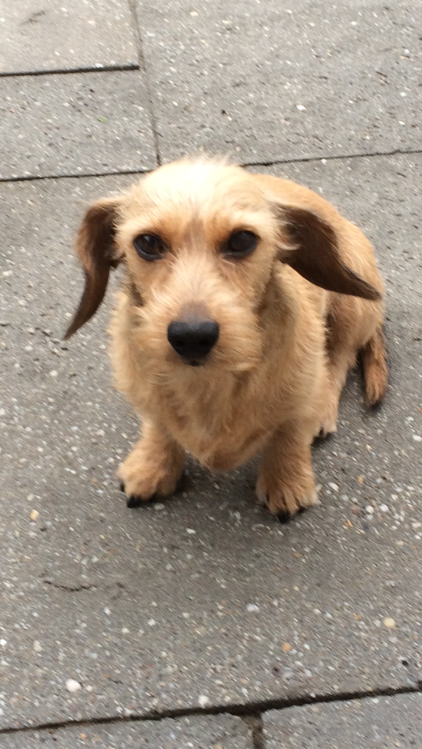
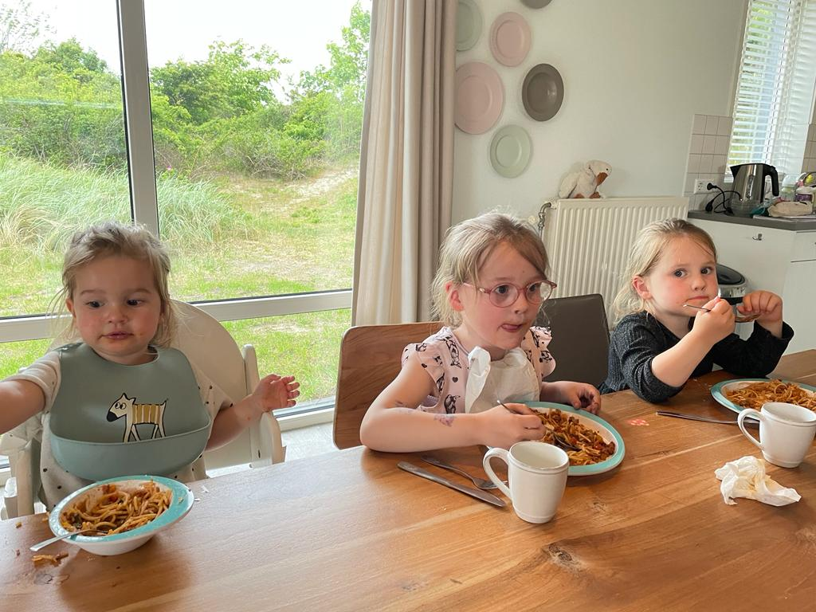
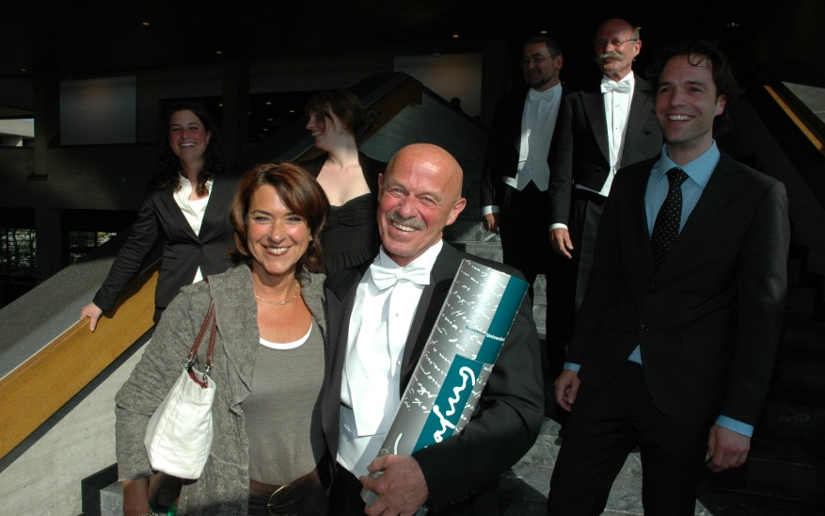
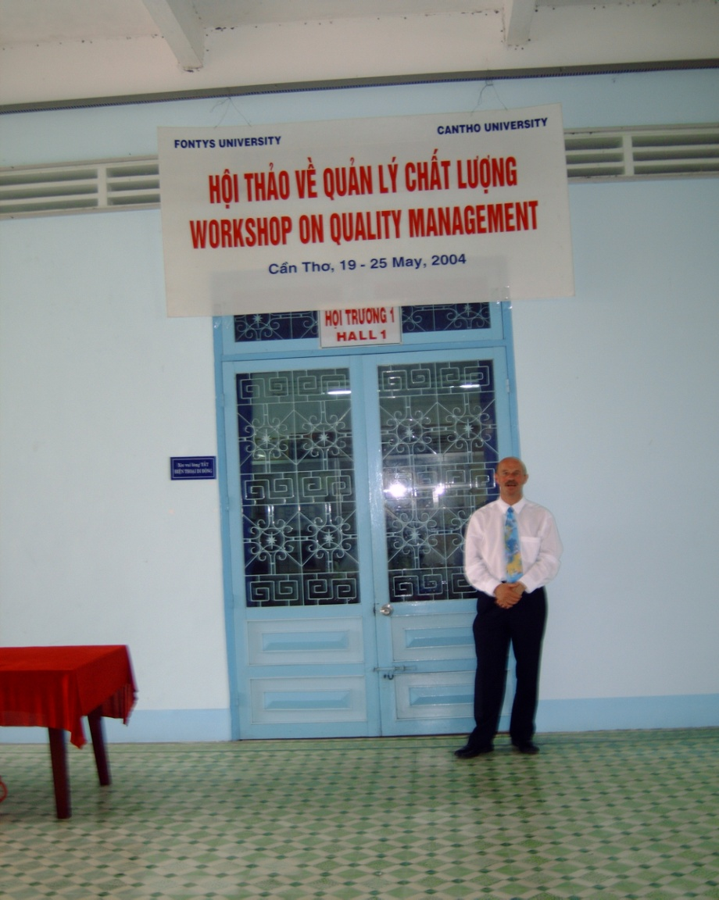
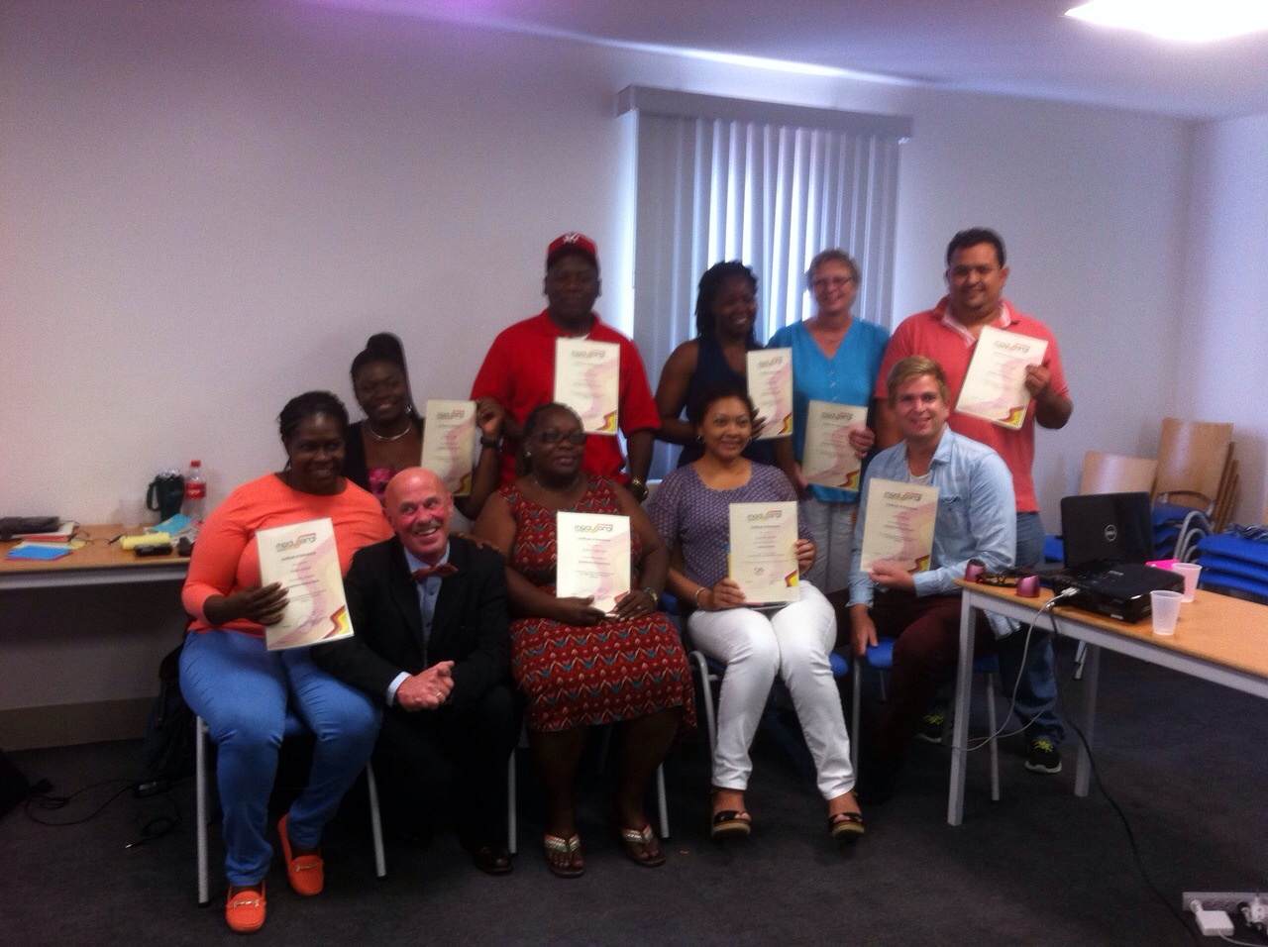

Slide 5
Slides
My website
Course materials

Slide 6
What is communication ?

Slide 7
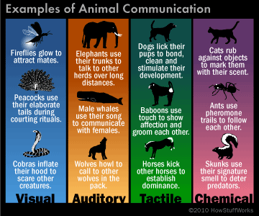
Animals communicate.

Slide 8
Communication

Slide 9
Context
Message
Content and Relationship

Slide 10
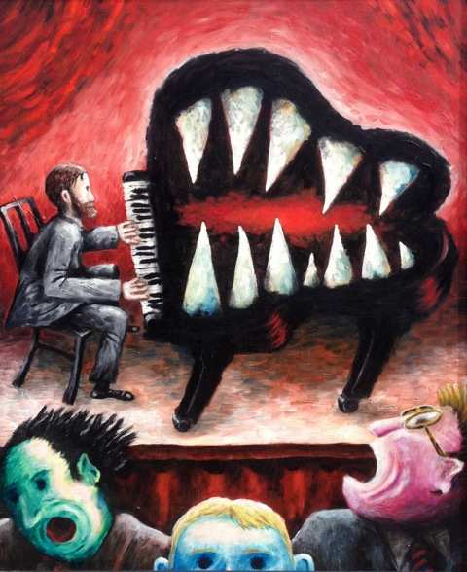
C’est le ton qui fait la musique….

Slide 11
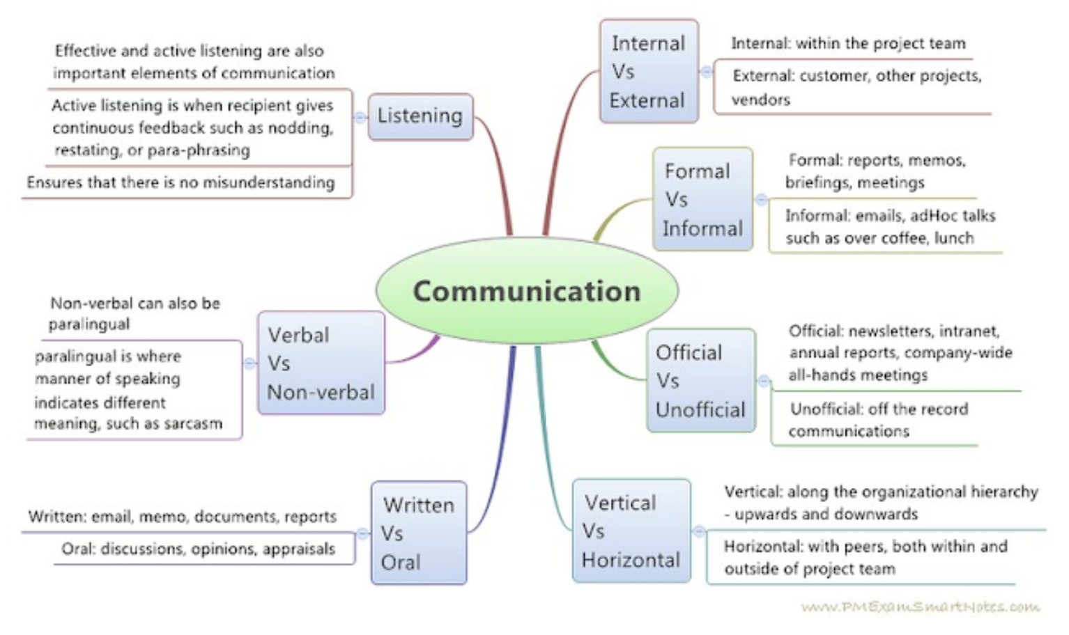
Sorts of messages
Communication can take place in different contexts, such as personal relationships, business settings, education, and entertainment.

Slide 12
Examples in music
Beatles: “We can work it out”
Madonna: “You are frozen” (when your heart is not open)
Lady Gaga: (he cannot read my) “Poker face”
Rolling Stones: “You can’t always get what you want” (but if you try sometime)

Slide 13
SILENCE
Everything's gonna be alright tonight Everything's gonna be alright tonight No one moves, no one grooves No one talks, no one walks tonight

Slide 15
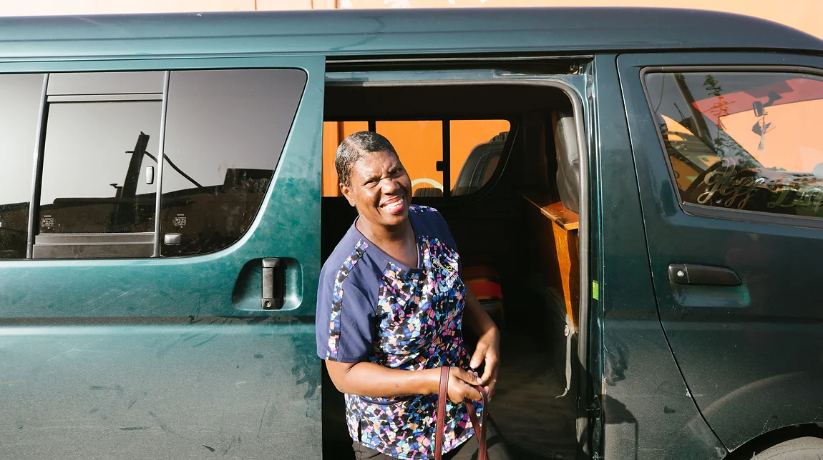
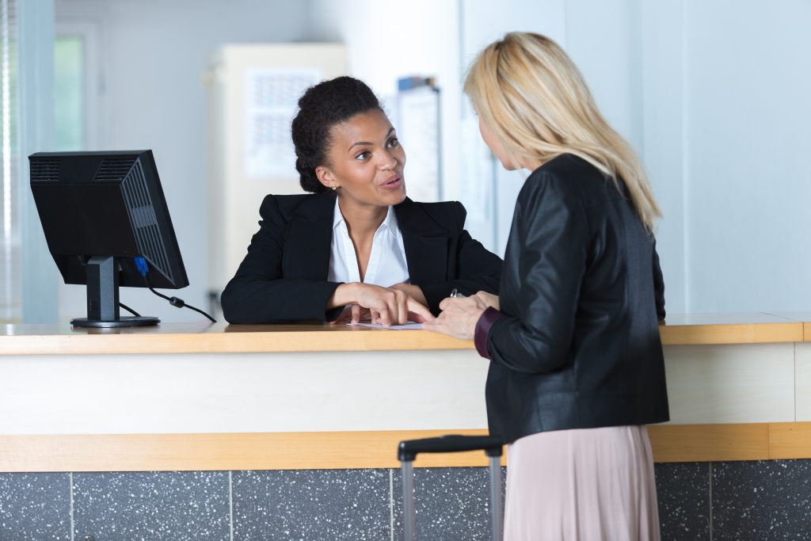
Your roles

Slide 16
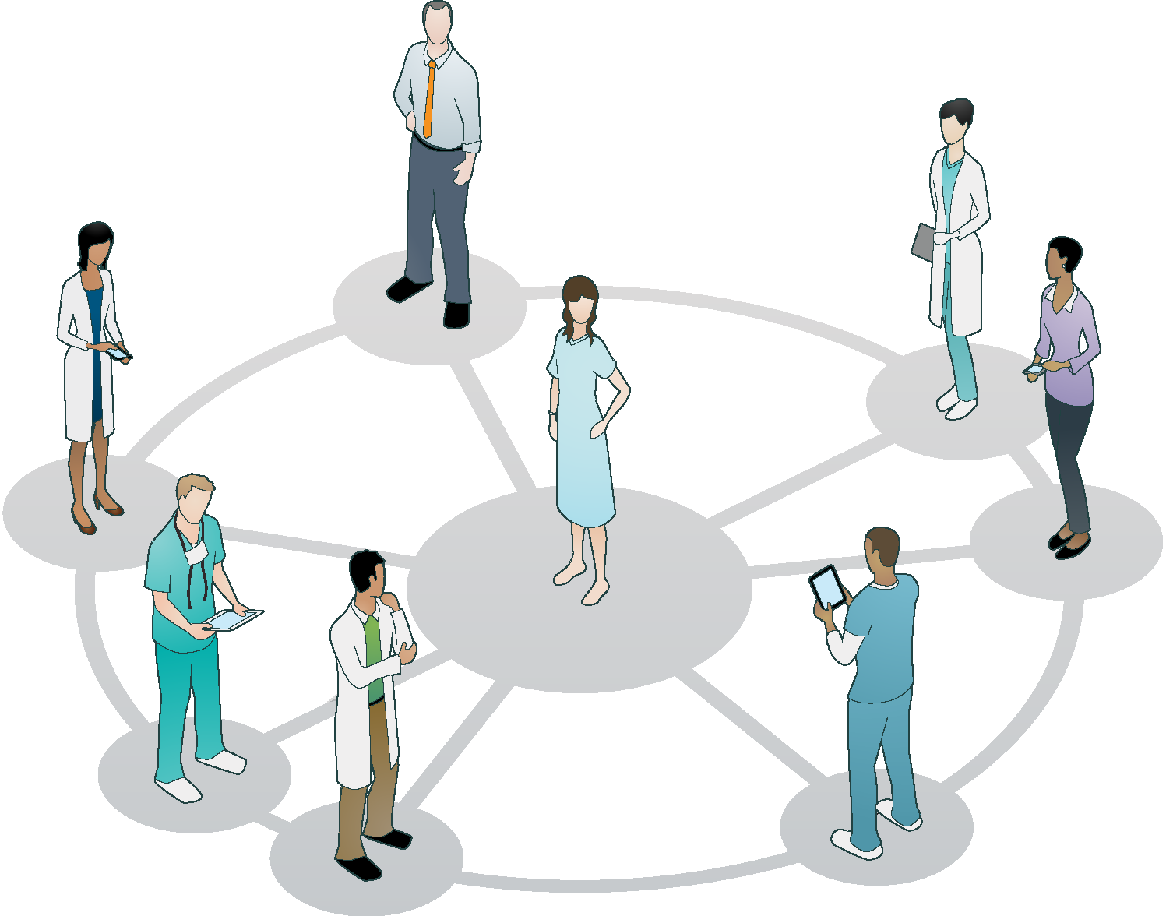
Stakeholders?
Internal customer
Patients
Staff (incl. students)
Management
Support staff.
External customer
Family
Other healthcare institutes
Suppliers
Government (local and national)

Slide 17
Always

Slide 18
KING
The customer provides a mirror.
Positive experiences are worth their weight in gold.
Word-of-mouth advertising.
Positive customer experience gets back to you!!!!

Slide 19
What does the KING mean to you?

Slide 20
What skills do you need?
Towards:
Clients / family
Other customers
Internal customers / staff

Slide 21
Clients/ family
What are the most important skills for a front office receptionist?
Communication skills
Adapt to the different people coming to you
Be kind / polite
Provide clear information
Organizational skills
Multi-tasking
Planning
Office space (neat and tidy)
Customer service skills
Empathy
Patience
Problem solving (aggression)
Complaint handling
Privacy

Slide 22
Clients/ family
What are the most important skills for a front office receptionist? (cont’d)
Teamwork skills
Collaborative
Flexible
Adaptive
Initiative skills
Confidence
Proactivity
Creativityt
Self motivation

Slide 23
Other health care profs
How do you communicate effectively with other health care professionals in the front office?
1 Know your role and scope
your responsibilities,
Limitations and expectations,
and communicate them clearly to others
2 Use appropriate tools and channels
use the appropriate tool and channel for the purpose and urgency of your communication
Follow protocols for documentation / communication
3 Be clear and concise
Relevant and sufficiewnt information / concise
Check, if it is understood
Note, what is needed
4 Listen actively and respectfully
Interested
Friendly

Slide 24
How do you communicate effectively with other health care professionals in the front office?
5 Give and receive feedback
focus on the behavior and outcome, not the person or intention,
use specific examples and suggestions.
also use positive feedback to reinforce good practices and behaviors
When receiving feedback, you should listen carefully, avoid defensiveness or excuses, and thank the giver for their input
6 Collaborate and cooperate
collaborate and cooperate with other health care professionals
support each other's goals and needs

Slide 25
Watzlawick
The message is verbal and non-verbal
( > 66%).
The message has a content and a relation level.

Slide 26
2. Your communication issues
Also see annexes

Slide 27
3. Communication styles
You!
Questionnaire communication styles
Based on three dimensions
Assertive / subassertive
Warm / cool
Tense / relaxed

Slide 28
Eight styles / wavelenghts
Hesitant
Extravert
Controlling
Cool
5. Strained
6. Friendly
7. Anxious / afraid of other people
8. Incomprehensable

Slide 29
relaxed
distant
distant
distant
incomprehensable
cool
warm
warm
friendly
extravert
assertive
sub-assertive
strained
hesitant
warm
warm
anxious
controlling
distant
distant
tense

Slide 30
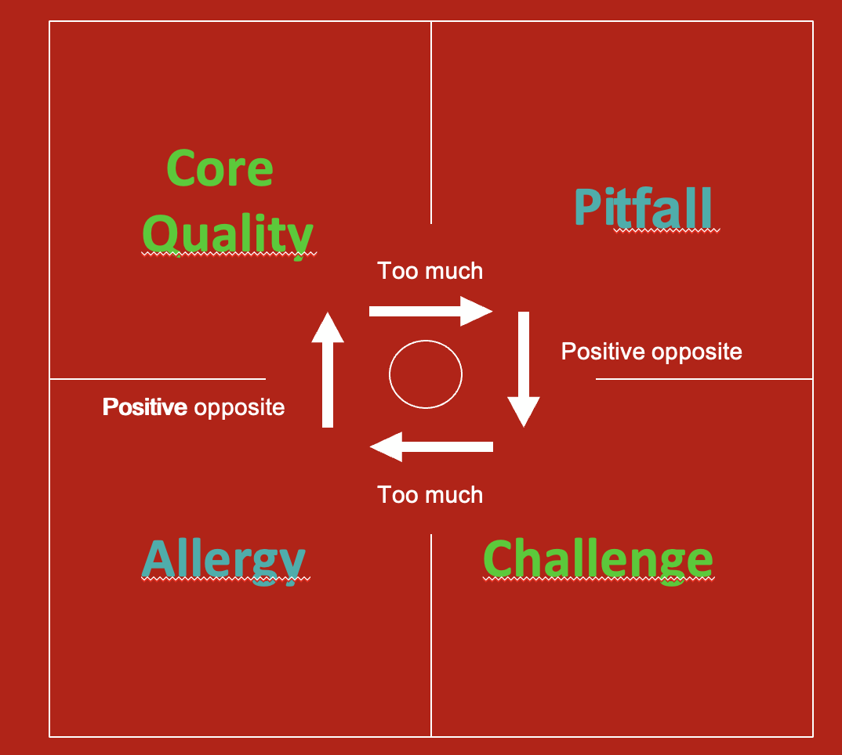
Be aware!
All have their strengths and weaknesses
Offman: strenghts, weaknesses, allergy and challenge

Slide 31
1. Hesitant
Warm
Assertive
Tense
Your pitfalls:
Insecure, worried about what others think, bossy, ‘musturbation’
8% 3%

Slide 32
Hesitant challenges
Forget that everyone should like you.
Become more indifferent for criticism.
Distract yourself.
Focus on the other.
Learn from the
indifferent people.

Slide 33
2. Extravert
Warm
Assertive
Relaxed
Your pitfalls:
Talk too much, arrogance, bossy, pushy
23% 20%

Slide 34
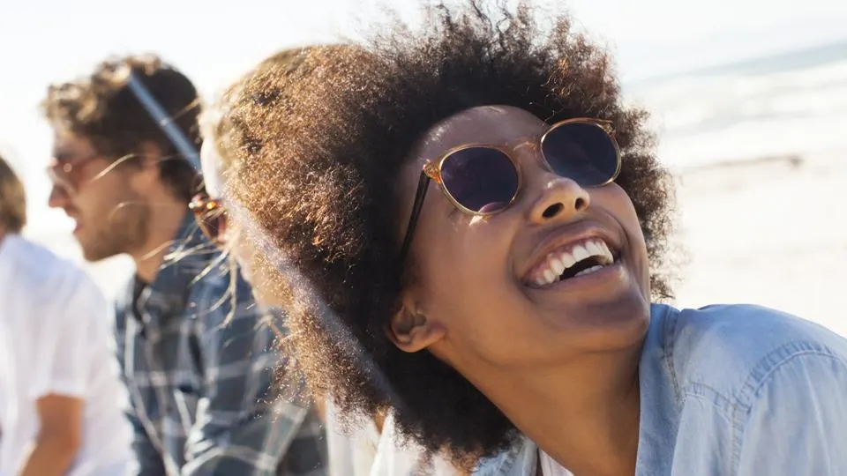
Extravert challenges
Look well, how the other reacts to all that you are saying.
Listen.
Count to ten.
Learn from
passive, insecure
people.

Slide 35
3. Controlling
Distant
Assertive
Tense
Your pitfalls: being cold, too demanding, little attention to emotions
6% 9%

Slide 36
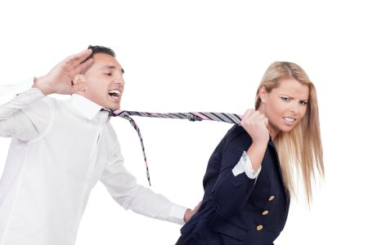
Controlling challenges
Let go
Accept that things can go wrong and people incl. you make mistakes.
Ask for help.
Learn from
emotional and
sloppy people.

Slide 37
4. Cool
Distant
Assertive
Relaxed
Your pitfalls: being cold, individualism, little attention to emotions
10% 23%

Slide 38
Cool challenges
Get in contact with your feelings.
Make time for people.
Give compliments
Learn from
the drama
queens.

Slide 39
5. Strained
Distant
Sub-assertive
Tense
Your pitfalls: disregard yourself, stressed, too self critical
16% 6%

Slide 40
Strained challenges
Become more gentle towards yourself.
Look at what goes well.
Take a dare.
Learn from
the egoist and
the indifferent.

Slide 41
6. Friendly
Warm
Sub-assertive
Relaxed
Your pitfalls: disregard yourself, don;’t strand up for yourself, patronising
9% 8%

Slide 42
Friendly challenges
Learn to say no.
Do it together.
Take.
Learn from
the egoist and
the indifferent.

Slide 43
7. Anxious
Distant
Sub-assertive
Tense
Your pitfalls: high demands to yourself, low self esteem, dependent position
20% 18-23 year-olds

Slide 44
Anxious challenges
Dare and ask for help.
Talk, speak out.
Work on your self-confidence.
Learn from
the pushy and
indifferent
people.

Slide 45
8. Incomprehensable
Distant
Sub-assertive
Relaxed
Your pitfalls: passive, sloppy, do your own thing
5% 9%

Slide 46
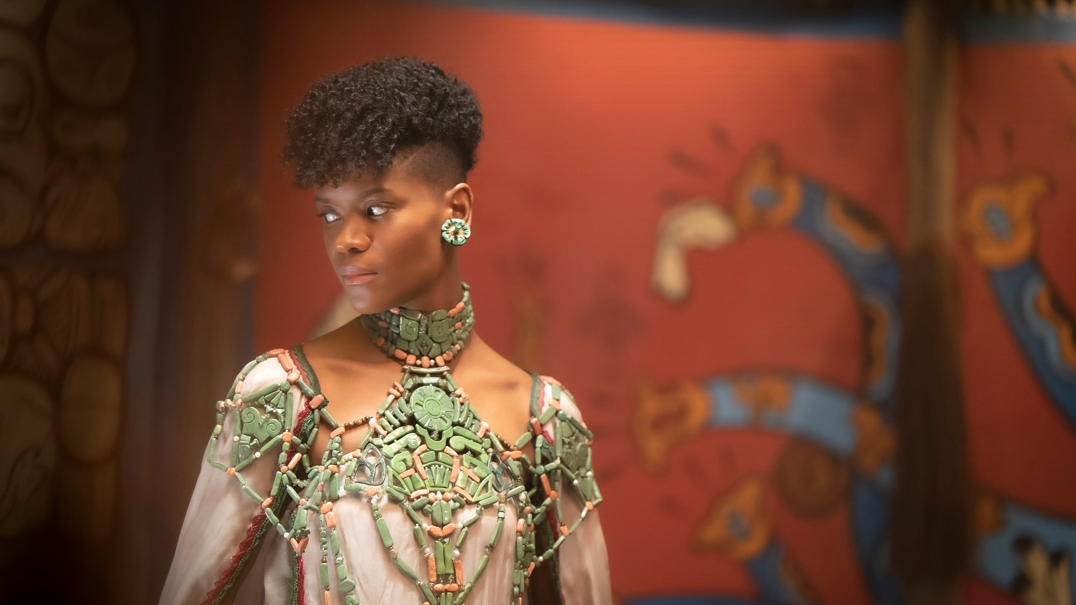
Incomprehensable challenges
Show who you are.
Be interested.
Invest in relations.
Learn from
the anxious and
the dependent
people.

Slide 47
Pieternel Dijkstra (2011)
Op dezelfde golflengte.
101 tips om soepeler te communiceren.

Slide 48
lunch
C O C O N U T

Slide 49
TEN TIPS for better communication
Give real attention
Give positive feedback
Express your emotions properly.
Leave aggressive people.
Touch selectively.

Slide 50
TEN TIPS for better communication
6. Think before you talk.
7. Metacommunicate (talk about the communication).
8. Show respect.
9. Give an ‘I’-message. Not … you…
10. Gossip? Only the positive.

Slide 51
5. Exercise
You all bring in cases and practise.

Slide 52
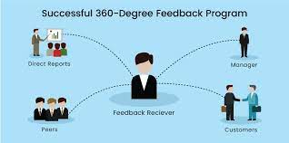
Measure
360 degrees feedback?

Slide 53
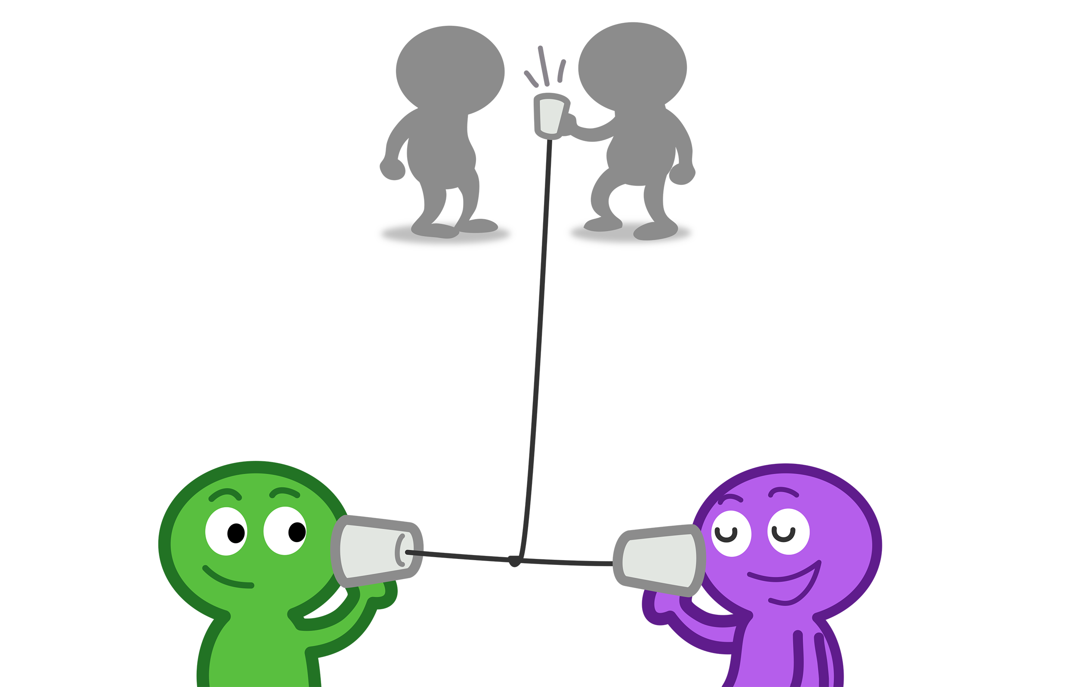
Annex 1: Confidentiality
Notice when things get personal and need privacy.
If possible provide a private space immediately and continue the conversation or ask someone else to help or make a new appointment.

Slide 54
Annex 2: Conflict
Example: family versus patient
Cultural differences (Arab/US)
Contradictory messages
Level of consciousness
Written documentation

Slide 55
Annex 3: “difficult customers”

Slide 56
1
Listen really to your customer and assess later
Ask more information if it is not clear for you
If there is a problem with the language try to find a interpreter to help you
Try to find out what is under sea level (remember the iceberg)

Slide 57
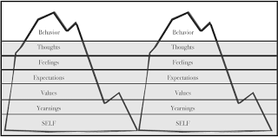

Slide 58
2
Try to think/look in the perspective of the customer (may be the customer had a bad day, angry disappointed,etc.)

Slide 59
3
Don’t take it personal
Keep distance (don’t make the customers issue your issue)
You are the receiver the customer is the amplifier

Slide 60
4
Try to find out the main problem
Remember its better to put out a great fire instead of thousends sparks

Slide 61
5
You have a point of no return!
Some customers are never satisfied!
Some customers like to have a conflict!
Try to keep it in a professional way and not personal!

