Slide 1
CCC for managers
Everard van Kemenade, PhD

Slide 2
AGENDA
Welcome
Introduction
Plan: presented by Bregje
Do: presented by project team and ambassadors
Study: presentation of the results
Study: analysis of the results
Act: what needs to be adjusted?
Lunch

Slide 3
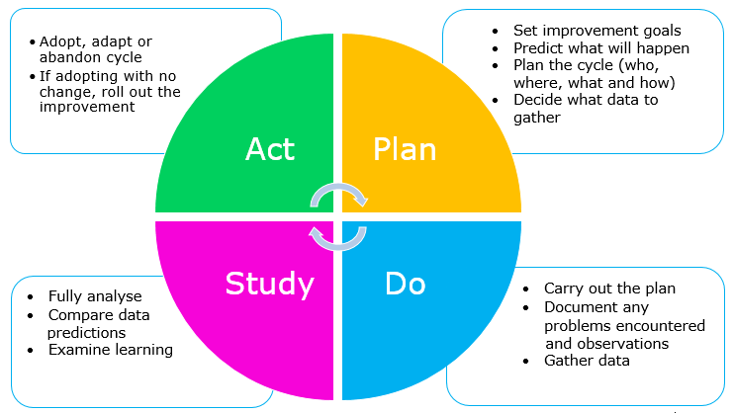
Introduction

Slide 4
Plan

Slide 5
Do

Slide 6
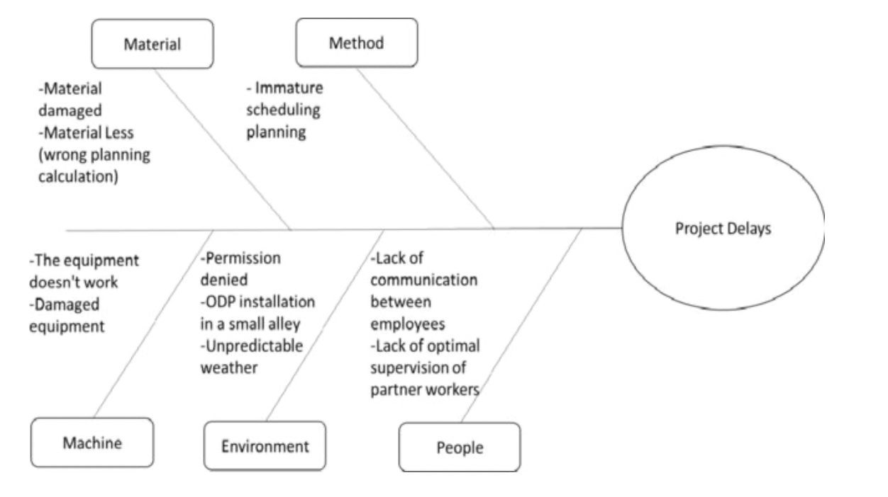
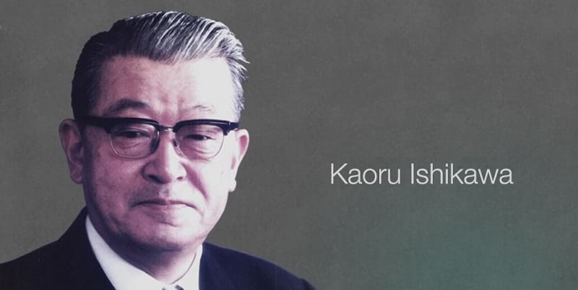
Study

Slide 7
Act

Slide 8
Action plan
What? | With whom? | When? Daadline | How? | Evidence of success
….

