Slide 1
van Kemenade
Audit Coaching Training
AUDITING
Marleen de Bruin en Everard van Kemenade

Slide 2
What is an audit?

Slide 3
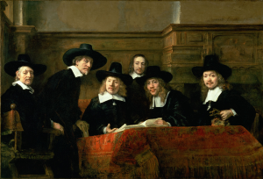
De staalmeesters

Slide 4
De staalmeesters is the name of the painting De waardijns van het Amsterdamse lakenbereidersgilde bekend staat. It was produced in 1662 by Rembrandt van Rijn.
It was meant for the building where these people audited the quality and color of the cloth.

Slide 5
Agenda
Part 1 Theory
0. What is an audit?
Document review
Interviews
Observation
Tracer
Report writing
Responding

Slide 6
What is an audit?
ISO 190011:2002
audit = systematic, independent and documented process for obtaining evidence and evaluating objectively to determine the extent to which criteria are fulfilled (or standards are met).

Slide 7
Positive and negative: internal audit
- Sufficient distance and objectivity?
- Enough expertise available?
+ Quite easy to organize
+ Less “threatening”
+ No external ‘’big brother is watching me’

Slide 8
Positive and negative: External audit
+ Objectivity and distance
+ Gives more input for improvement
+ Very experienced auditors
+ “Strange eyes” force you to improve
− More expensive

Slide 9

Not without controversy
Introduced by the Parents Music Resource Centre (PMRC)

Slide 10
Not without controversy
The ‘Parental Advisory Explicit Content’ logo can be shown on an audio CD if there is ‘strong language or depictions of violence, sex, or substance abuse to such an extent as to merit parental notification’ on the disc.
Originally: banned from sale
Wal-Mart in America sells only the ‘clean’ versions of albums.

Slide 11
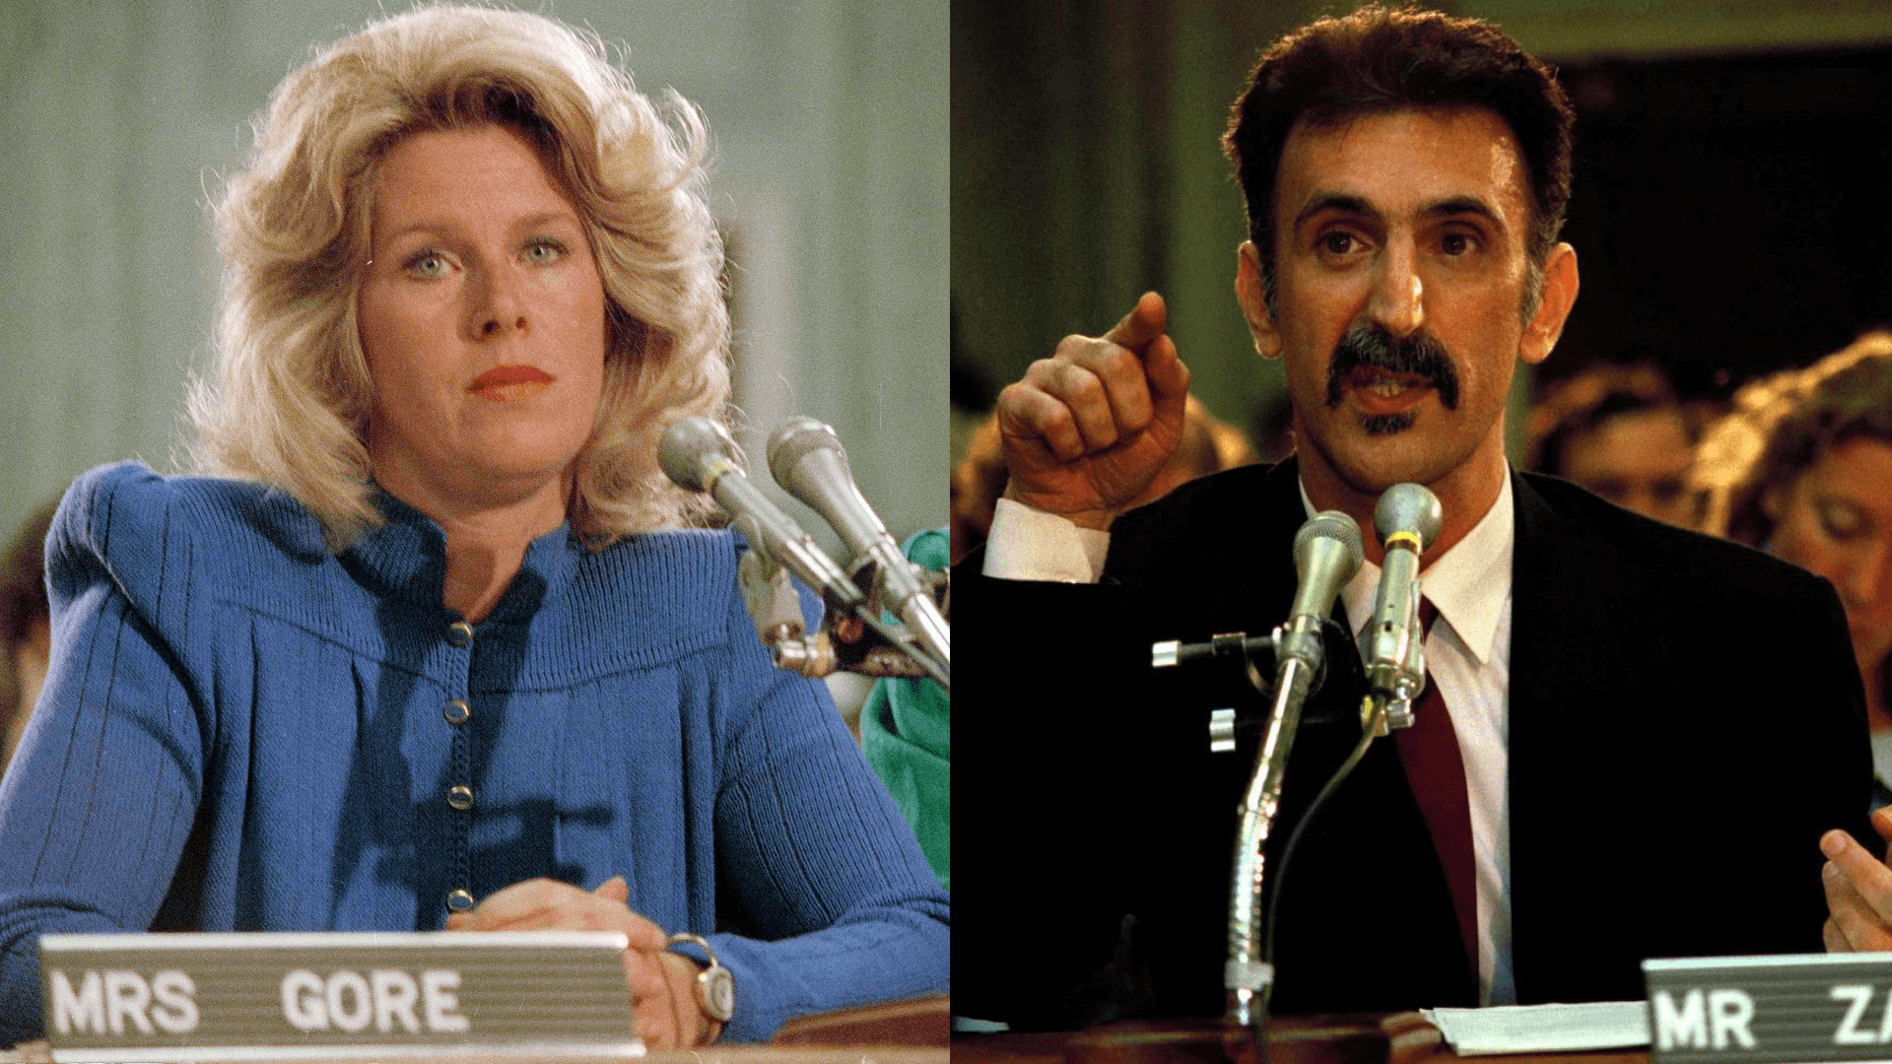
Zappa: “Censorship”
The committee is an “ill-conceived piece of
nonsense which fails to deliver any real benefits
to children, infringes the civil liberties of
people who are not children,
and promises to keep the courts busy for years
dealing with the interpretational and
enforcemental problems inherent
in the proposal’s design.”

Slide 12
Principles of auditing
a) Ethical conduct: the foundation of professionalism
b) Fair presentation: the obligation to report truthfully and accurately
c) Due professional care: the application of competence and judgement in auditing
d) Independence: the basis for the impartiality of the audit and objectivity of the audit conclusions
e) Evidence-based approach: the rational method for reaching reliable and reproducible audit conclusions in asystematic audit process

Slide 13
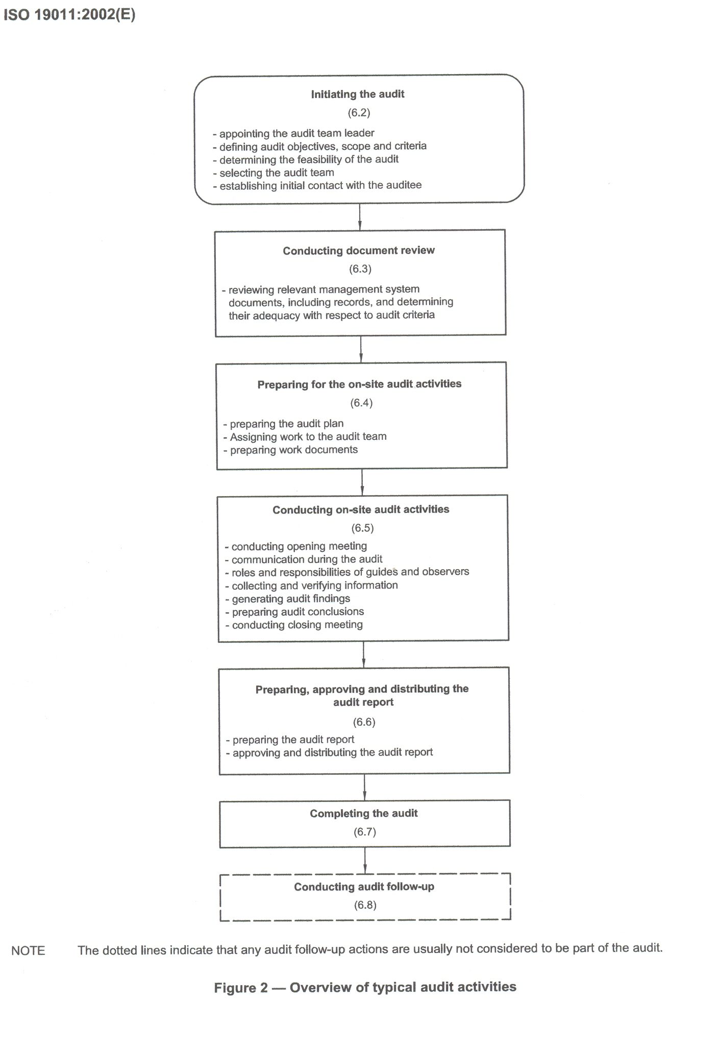
Audit activities
Initiating the audit
Conducting document review
Preparing on-site visit activity
Conducting on-site visit activity
Preparing, approving and
distributing the audit report
Completing the audit
Conducting the audit follow-up

Slide 14
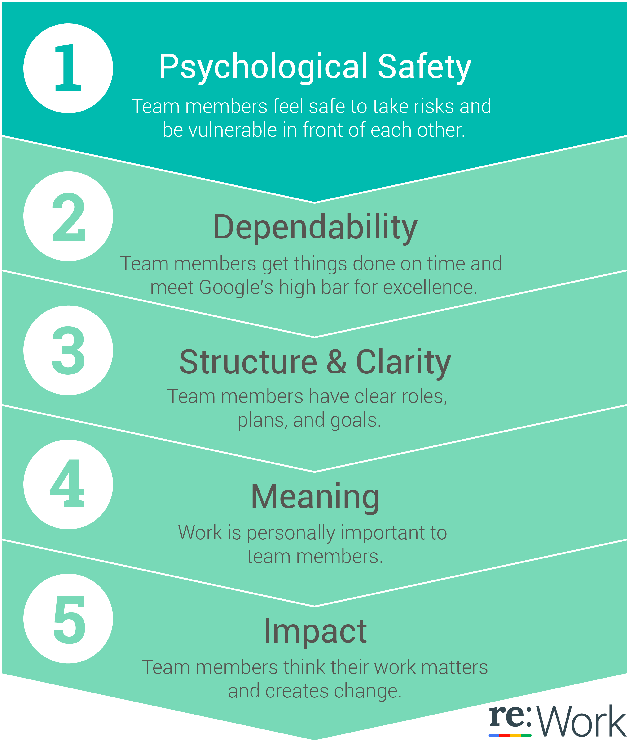
FIVE KEYS TO A SUCCESSFUL TEAM BY GOOGLE

Slide 15
Tips for a successful audit
Principle 1: Consider the one being audited (auditee) as a customer/ resident
1.1. Gotcha / Surprise
1.2. Their needs
1.3. not too detailed
Principle 2: Planning is the key to success
2.1. information date/purpose/location/scope
auditors/auditees

Slide 16
Tips for a successful audit
Principle 3 opinions never constitute non-conformities
3.1. Use facts
3.2. Also highlight positives

Slide 17
Tips for a successful audit
Principle 4 It is a form of feedbacxk
4.1. Needed for learning
4.2 Present!!!!
4.3. Specific
  I saw/heard you doing this
  4.4. Also positive
  4.5. Always respectful

Slide 18
How can I find an answer to the standard?
Document (P)
Interview
Observation
Tracer

Slide 20
1. Document review
Desk research
Get the right documents
Connect these to standards
Score

Slide 21
Preparation
Preparing audit plan:
  Who does what when
  What is done since the last audit?
Each auditor prepares working documents for the interviews

Slide 22
2. Interviews

Slide 23
STANDARD | QUESTION LABORATORY | RESULT |  |  | SUGGESTION
 |  | Met | Partly met | Not met
General AOP 5.11 | What documents do you have to show compliance to JCI-standards? E.g. Waste disposal policy?, Sample registration policy? Blood transfusion services?
AOP 5, ME 1 | How do you assure that the lab meets laws and regulations?
AOP 5.3 | What reports can you show me on the safety program? How often?
AOP 5.3, ME 4 | What proof do you have that lab staff receives education for new procedures or materials?
AOP 5.6 ME 1 and 5 | Essential reagents and supplies are identified? Can you show me how they are labeled?
AOP 5.9. | Seen many processes and procedures for QA. What is the quality program? What is done when by whom?
AOP 5.9. | What are your performance indicators? CVR only?
AOP 5.9.1 | Can you show me records of proficiency testing?
FMS 8 | Inventory. Example equipment in lab. Regular testing proof? Preventive maintenance?
IPSG 5 | Do you have hand hygiene guidelines for your staff? Look: Are materials available? Ask staff: how and when do you do hand hygiene?

Slide 24
From broad to narrow
Link to context
Information
Verification
Judgement
Why? What for?
What? When? Where? Who? How? How many?
Probe!
  Please say more…
  Where can I find that?
Do you agree if I put in the report…
Try to reach ‘closure’ for every issue on your list

Slide 25

Clear the MIST
May
I
See
That?

Slide 26
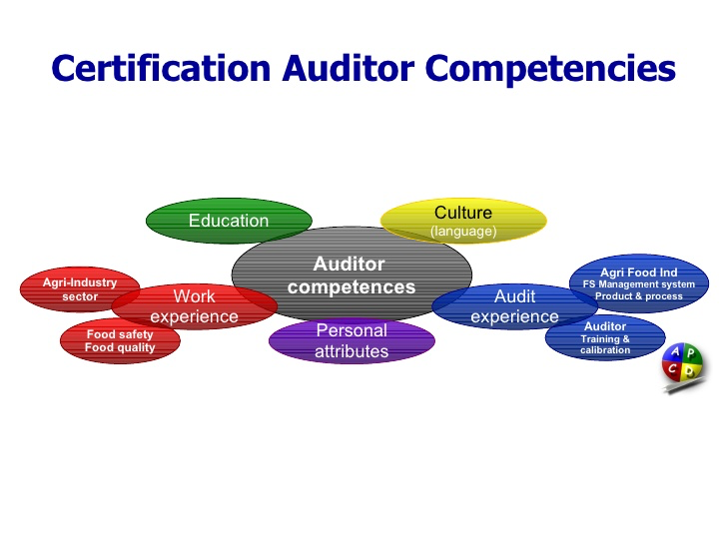
Competences of an auditor?

Slide 27
Auditor competences
questionnaire

Slide 28
(Do’s and) Don'ts (1)
Long questions
  All short questions start with Who/How/…?
Vague questions
Questions asking for two answers
  Then you get only one answer
Leading questions
  Don’t you agree that … ?
  Why did you not think of … ?

Slide 29
Do’s (and Don'ts)
Turn around the don’ts: questions are
  Direct
  Short and clear
  Single issue
  Open
  Know what you ask for (facts, opinions)
Positive body language
  Show attention
Speak clearly

Slide 30
Do’s (and Don'ts)
Be open to suggestions from the Institute
  For findings, recommendations,
  good practices
  =

Slide 31
Atmosphere during interviews (1)
Seating arrangements: be courteous
The interviewees are ‘your guests’, though this is their own Institute’
No one has the light in their face
The interviewees are not suspects, you are not police
Do not let interviewees wait: strict timekeeping

Slide 32
Atmosphere during interviews (2)
Be well prepared for an interview: decide before which panel members will put which questions in which interview
Let the interviewees speak, but tell them that time may be too short to really be courteous
Tell interviewees that the interview is not a conversation: your panel is looking for additional information and you have already read most documents

Slide 33
3. Observation
A picture says more than a thousand words..
Look at everything, everywhere, every time

Slide 34
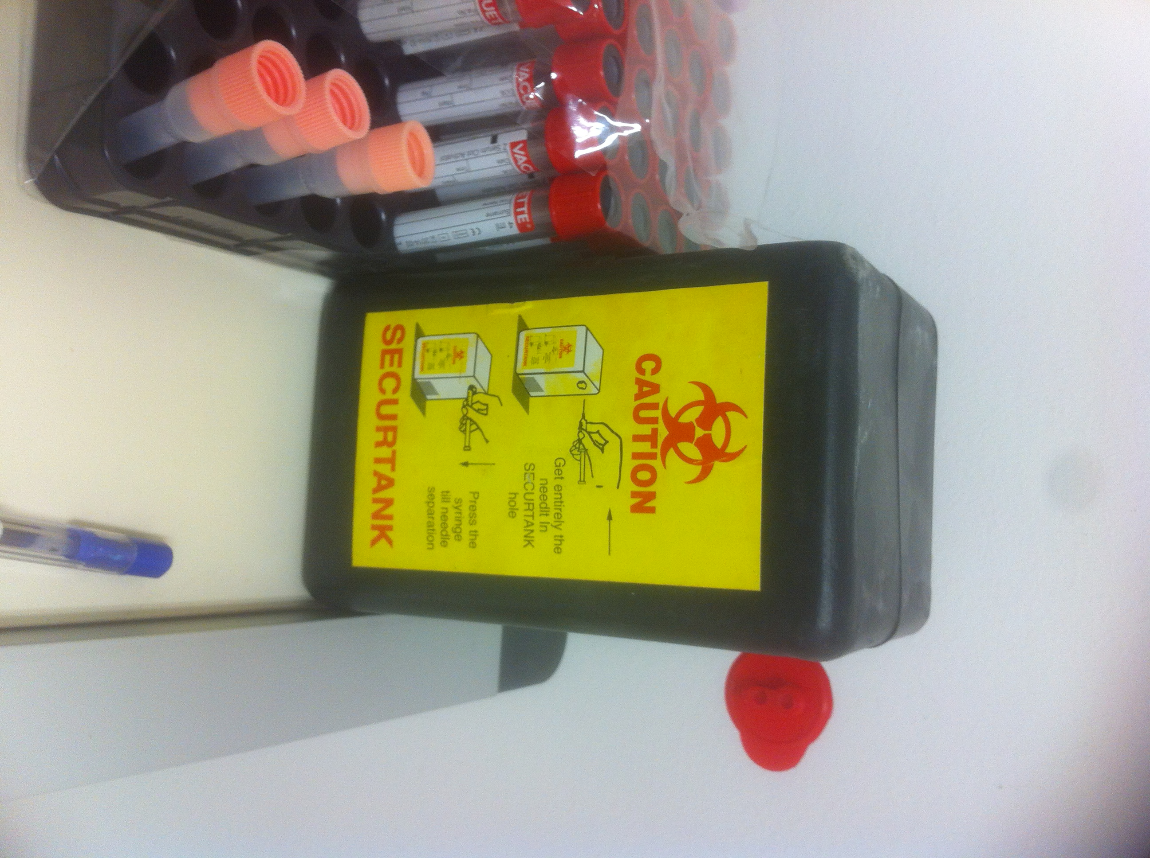
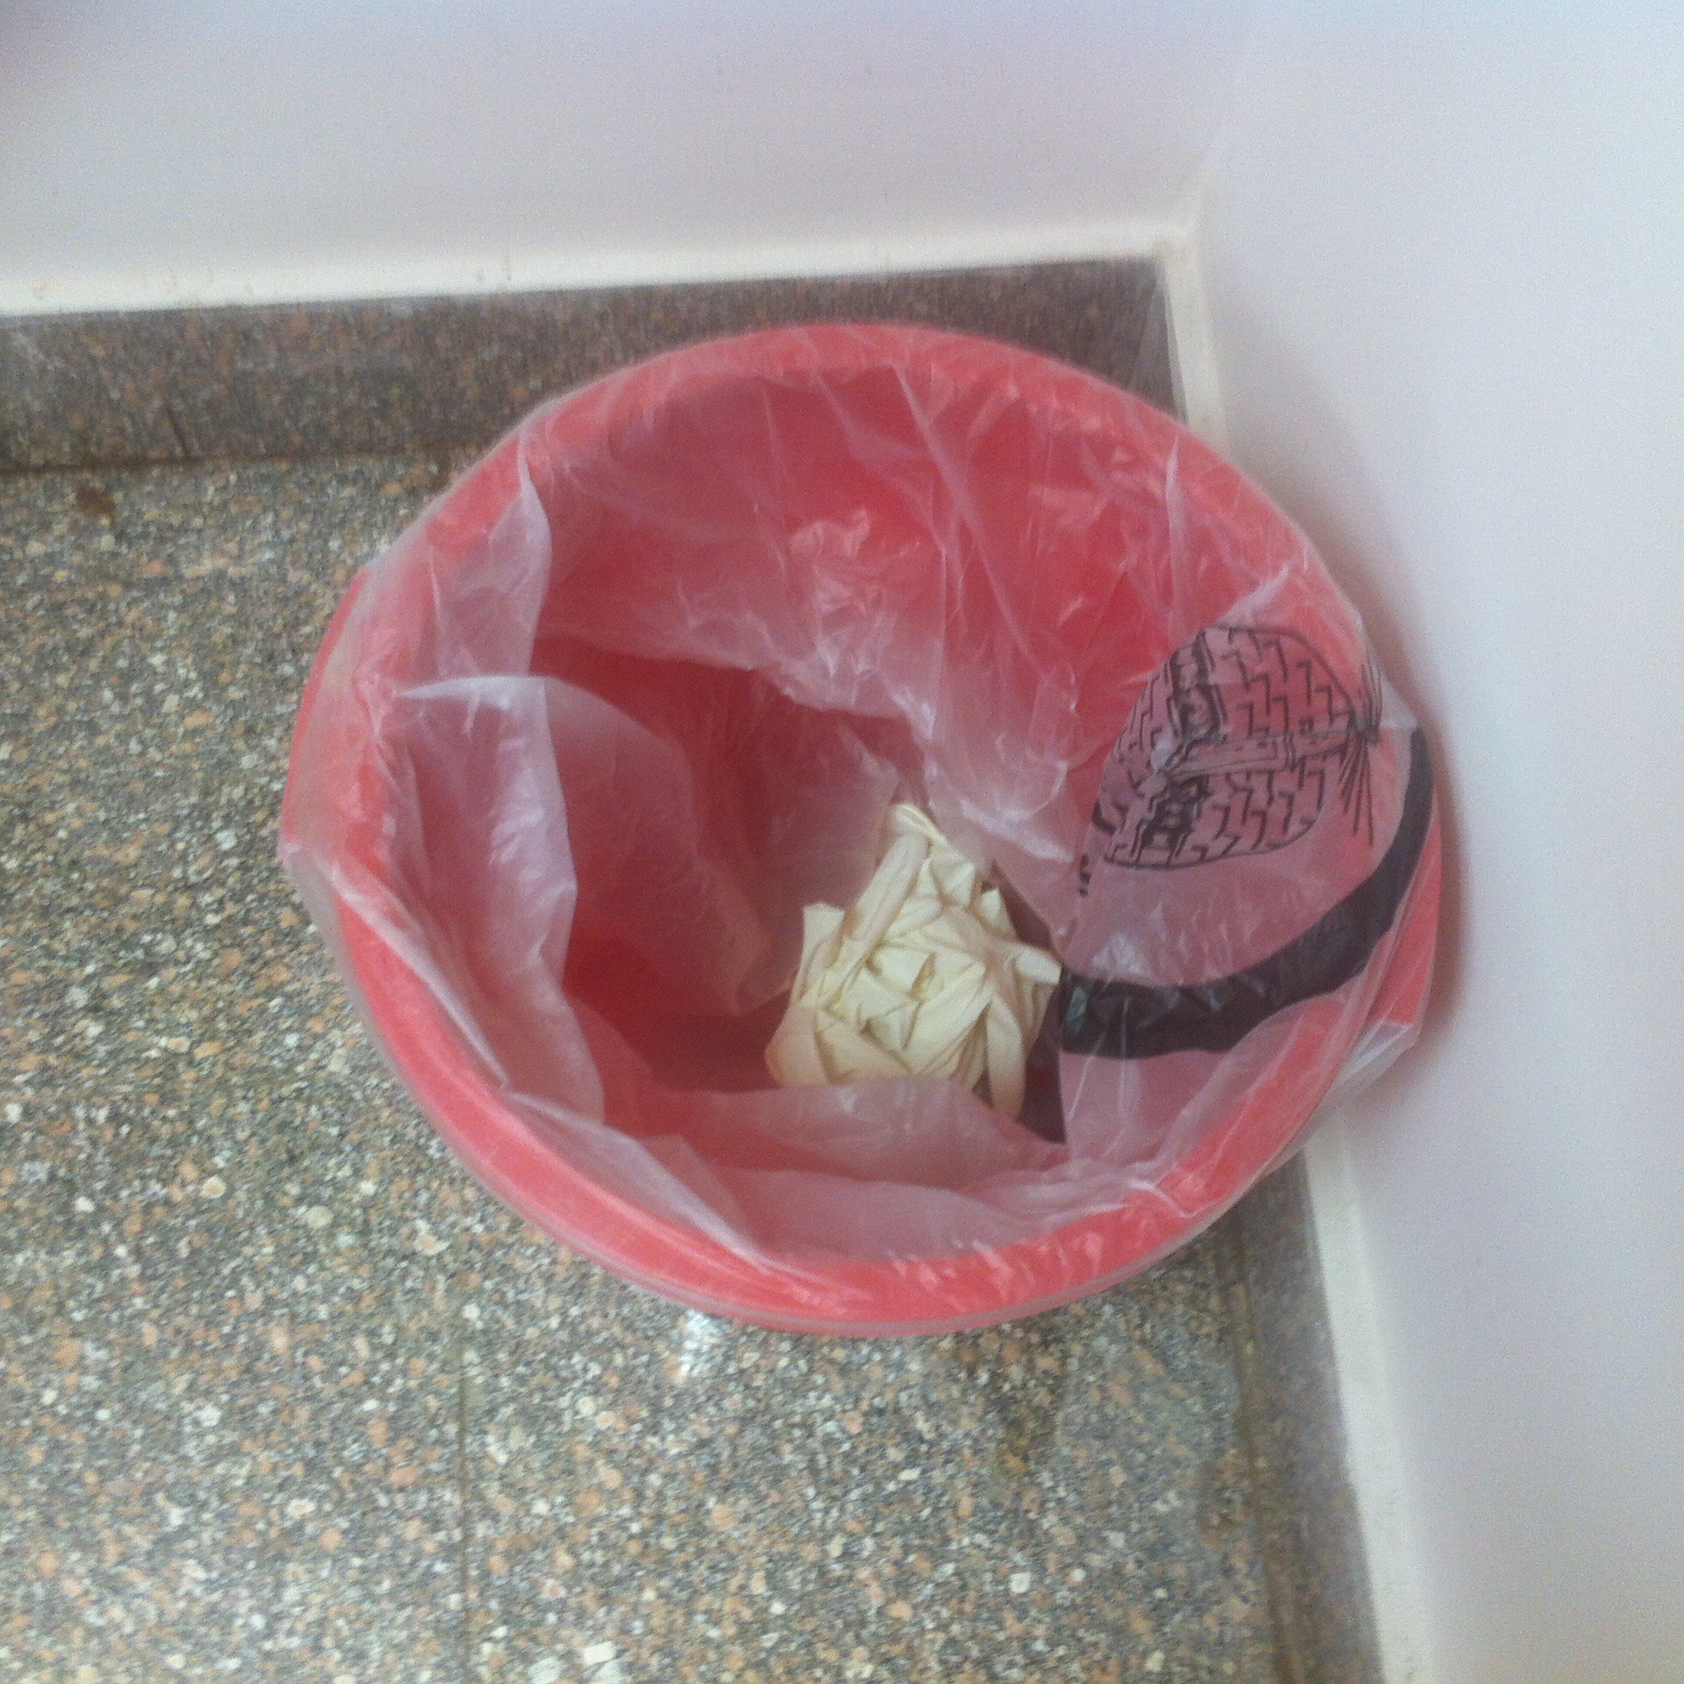
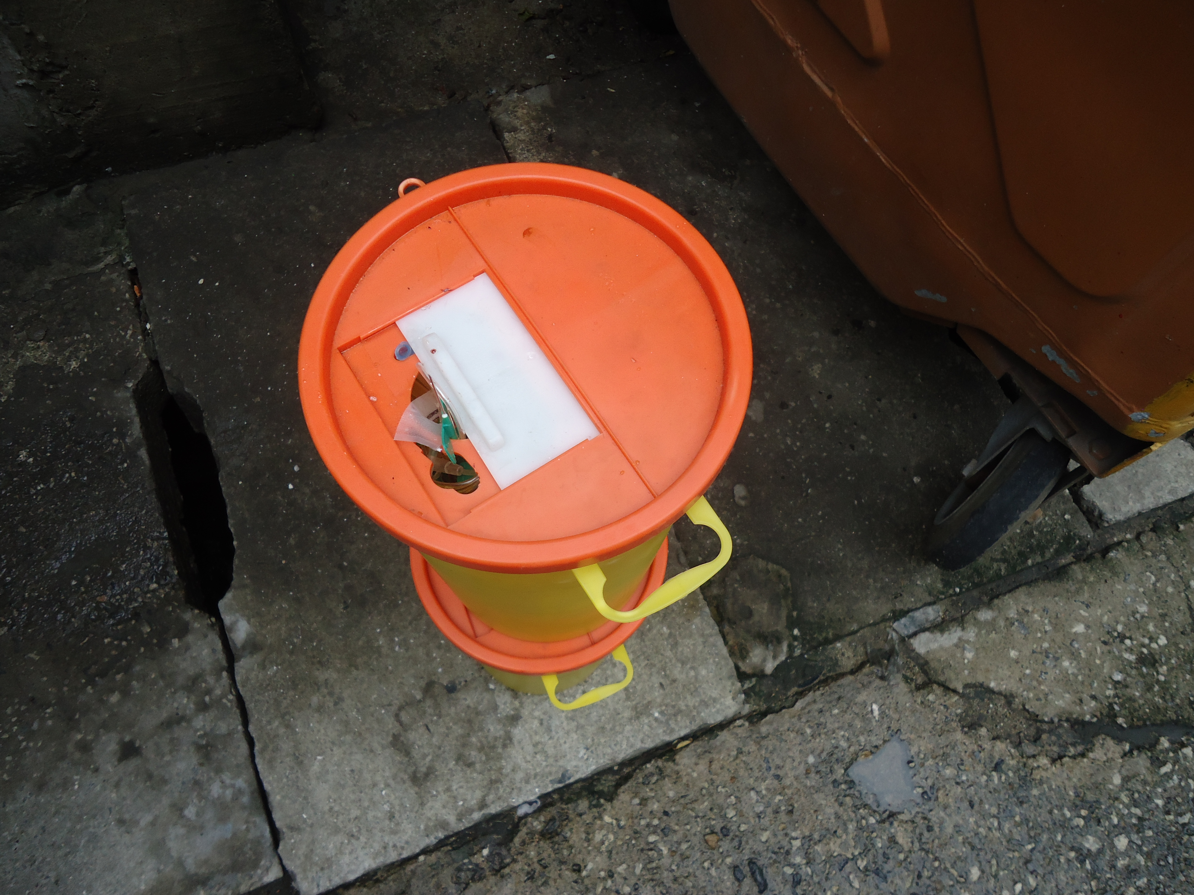

Slide 35
4. Tracer

Slide 36
5. Report writing
Make it easy for the editor
Presentation and report

Slide 37
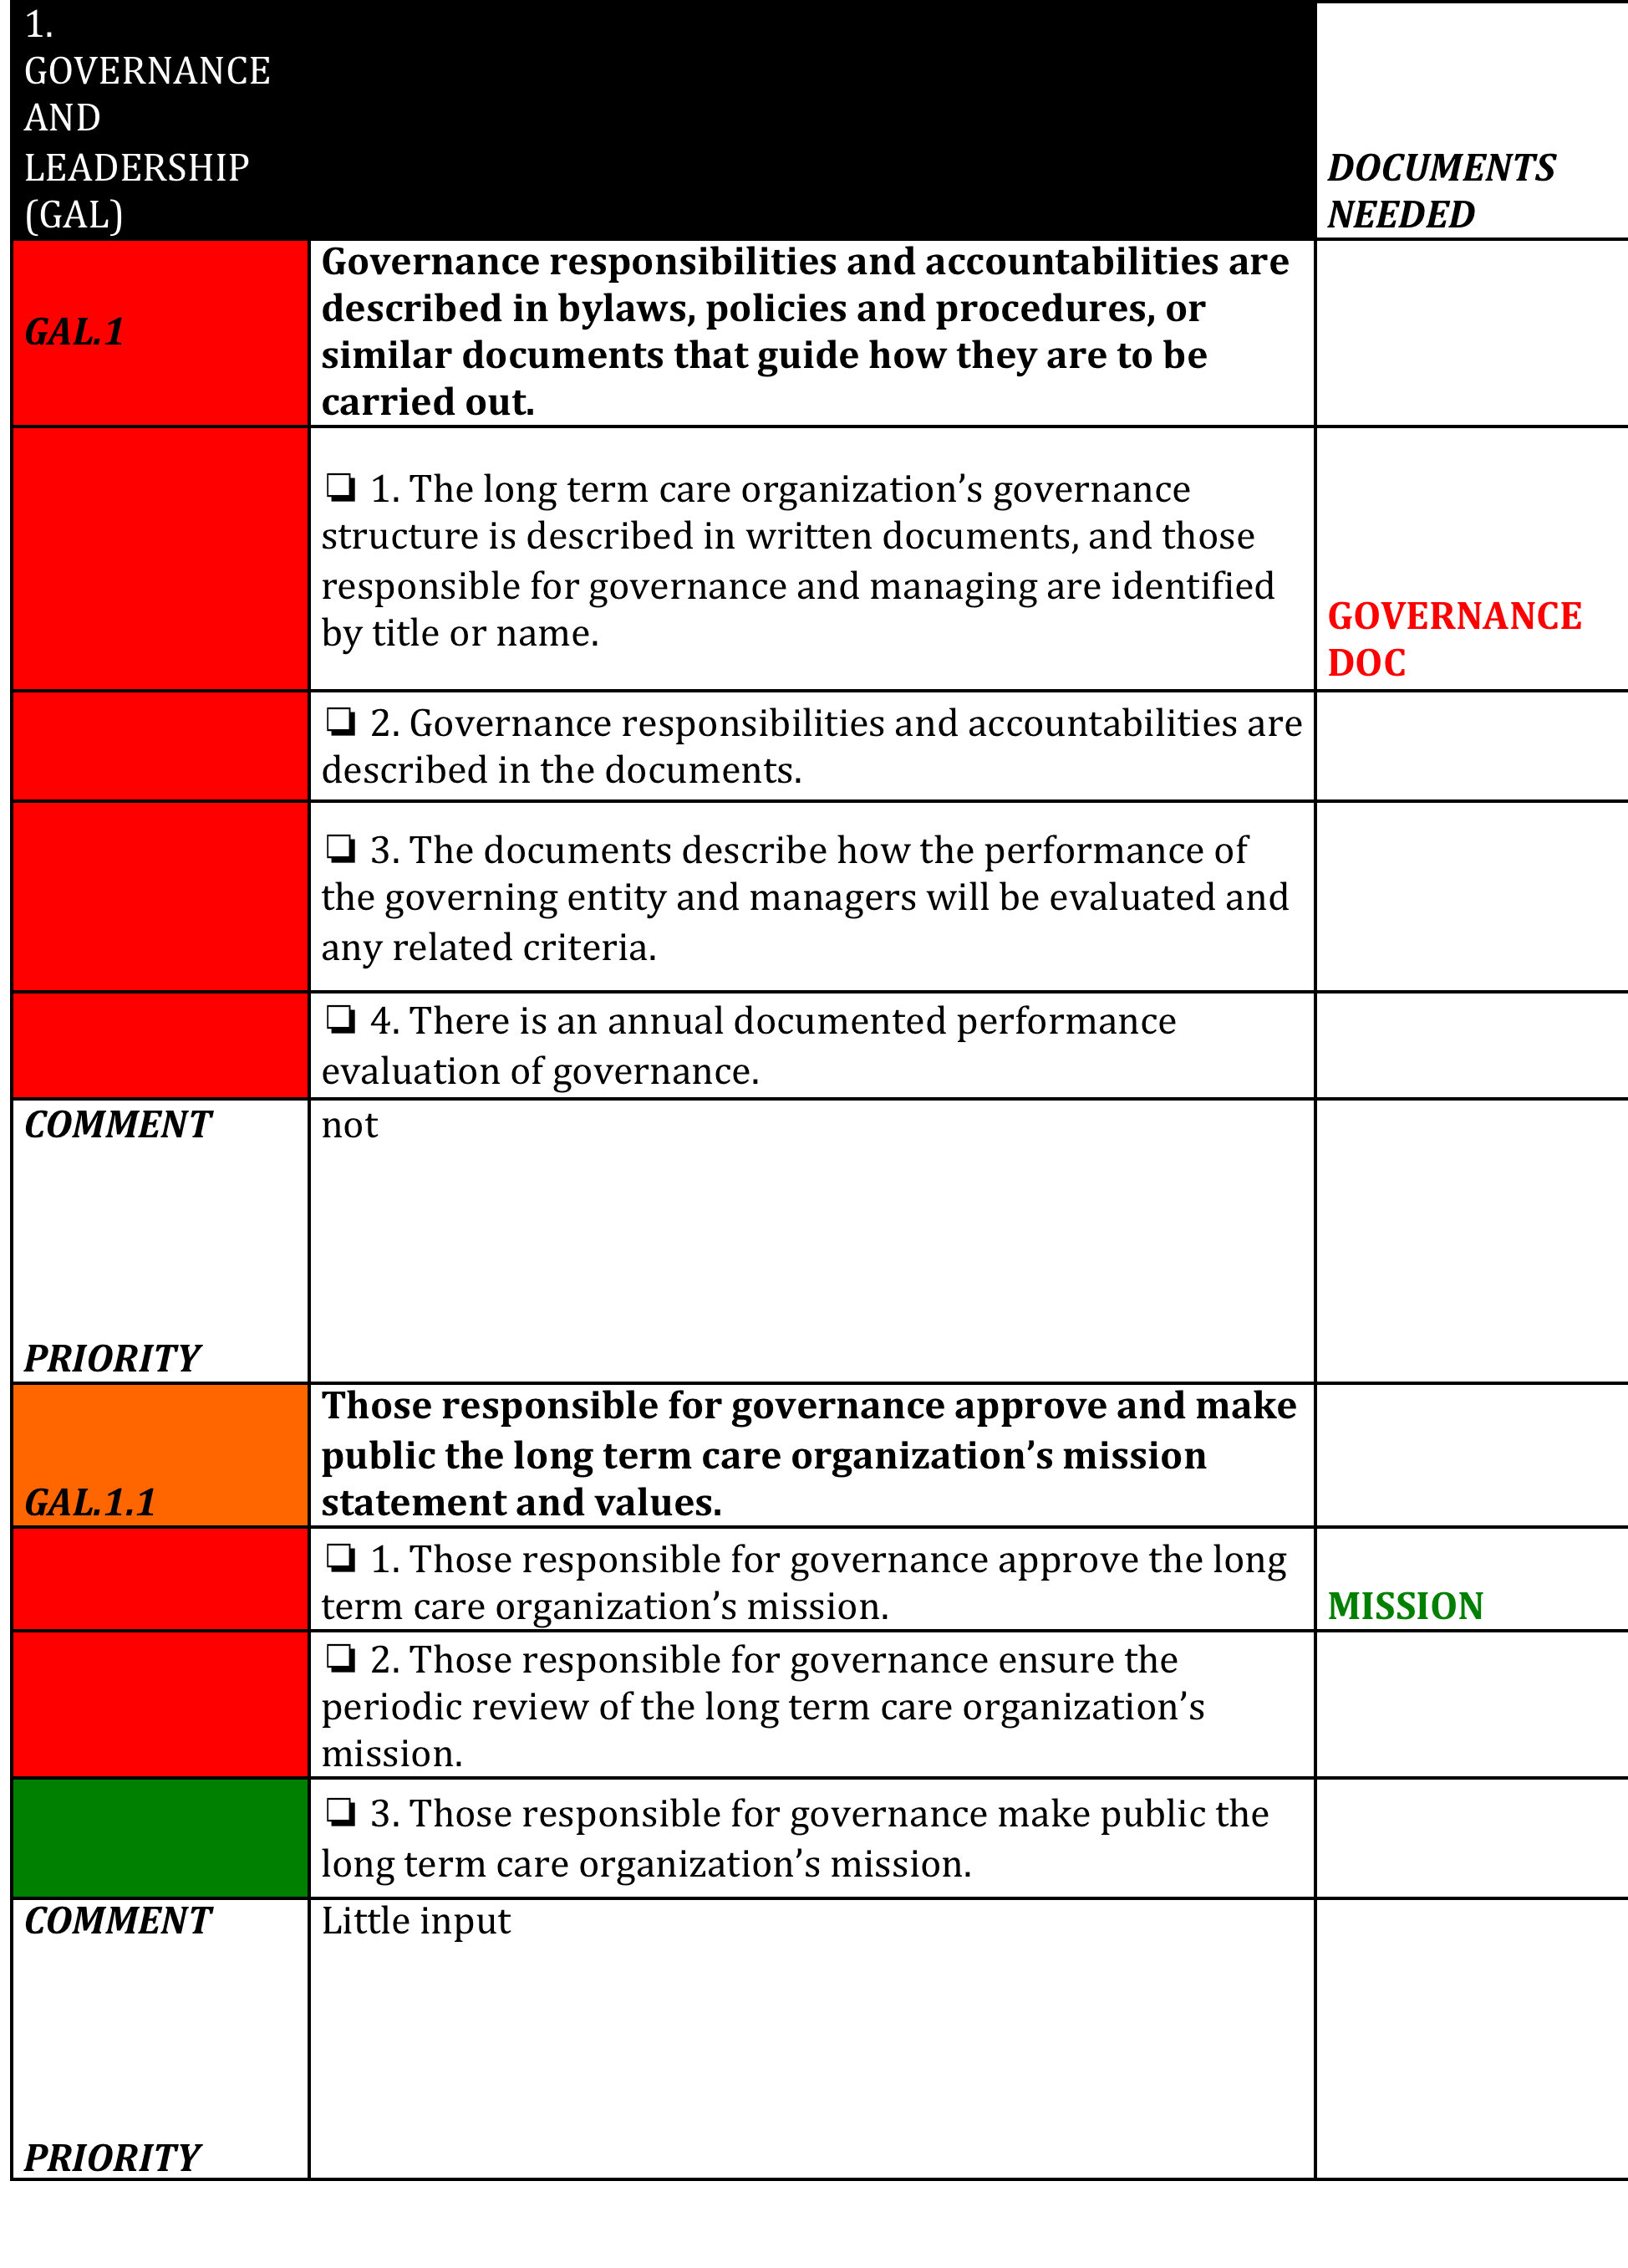

Slide 38
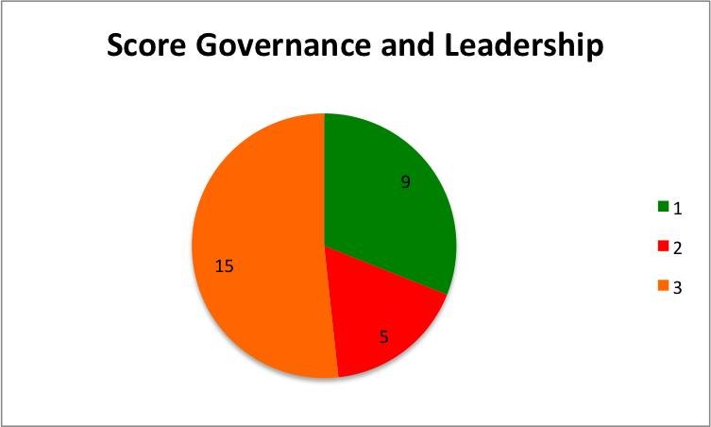
1. Governance and Leadership (GAL)
Total 29 standards

Slide 39
PEARLS
A clear process of joint development of
mission, values and vision has been
put in place.
A Strategic Plan has been developed
with great involvement of more
employees.

Slide 40
HOT TOPICS
1. Develop a governance document.
2. Formally evaluate the performance
of the Board and Operations Manager
yearly.
3. Develop a Quality Improvement Plan
(QIP)

Slide 41
6. Tips to respond to an internal audit
Be prepared for the audit ahead of time. The day of the audit is not the time to start collecting the documents on the list.
  Make it easy for auditors to find exactly what they're looking for. Document your policies and procedures, since documentation drives quality and compliance.
  Clean and organized records give auditors comfort

Slide 42
Tips to respond to an internal audit
2. Predict the auditor's questions.
3. Give the auditors the space they need.
4. Understand the standards/read guideline
5. Inform everyone on time / training???
6. Show your PDCA
7. Be open

Slide 43
Part 2
Exercises
  If you cannot find the answer
  If people contradict
  If someone is not cooperative / silent
  If…

Slide 44
van Kemenade
Audit Coaching Training
TRACER
Everard van Kemenade
Ph.D.
Saba Healthcare Foundation, 31st May 2017

Slide 45
Creating the Opportunity for Excellence in Patient Care

Slide 46
Objectives
Upon completion of this presentation, the participant should be able to:
Articulate an overview of the process used when tracing the care of a patient
Identify how to use tracers as a method of improving quality and patient safety within the organization
Articulate how to use tracers as a leadership tool in this organization

Slide 47
The hypothesis is: If we look at health care as a series of systems and subsystems, and identify the “defects” within the system(s), errors causing patients harm will be reduced

Slide 48
Method of identifying “broken” systems is through the use of tracers: the problem often occurs at the interfaces.

Slide 49
Systems
The new way of
thinking

Slide 50
What is a Tracer?

Slide 51
An individual patient tracer follows the experiences of a patient throughout the health care system.
An individual-based system tracer examines high-risk processes (medication management, infection control, data) across the organization

Slide 52
Using Tracer Methodology in the Survey Process

Slide 53
Gradual introduction into the survey process in 2006; official part of survey and accreditation decision process in 2007
Comments are positive – focus on the process of caring for the patient and their environment
Changes in survey process are not significant

Slide 54
Changes include:
New
Patient system focus
Patient is the center of activity – visits focus on the contacts the patient has or will have
Standards compliance based on review of systems and process – unified, relationship to the whole
Old
Department function focus
The departments is the focus – scheduled visits to each department
Standards compliance based on department functions without examining the relationship to the whole

Slide 55
Changes continued:
New
Patient system focus
Interviews focus on systems and processes (medication management, infection control, data/ quality, and competency)
Bottom line is how you care for your patients and their environment each day
Old
Department function focus
Interviews focus on questions and answers

Slide 56
Bottom-line Focus
How the care is delivered to the patients, and how their environment is maintained each day
You can learn more in 8 hours of tracing than in 20 hours of
chart review!

Slide 57
Tracer planning
Plan an tracer related to the status and importance of the issue.
Most important issues first.
A good planning is dynamic, can change.
What might help is to do a backward tracer:
  Start at the end of the process (students get the results of their exams)
  Go the way back to the development of the course.
Preparation is one third of the time

Slide 59
Who would you like to meet?

Slide 60
Internal Tracer team
Regularly an tracer team exists out of 4 members.
One of them is a senior tracer
All members should have been trained
Different expertise (in relation to the criteria, to the standards) should be represented in the team.
Manager, doctor, nurse and secretary from QA

Slide 61
Planning as a team
In a consensus session the reading of the dossiers is compared, differences are discussed and tentative conclusions are formulated.
Formulating the questions for the visit and deciding
with which representatives from the organization
interviews will taken place.

Slide 62
2 hour visit
About 8 interviews.
Aspects of the interview methods:
- Explain goal of the interview
- Use open questions
- Compare the answers
- Ask about improvements
- Give a summary of the given answers

Slide 63
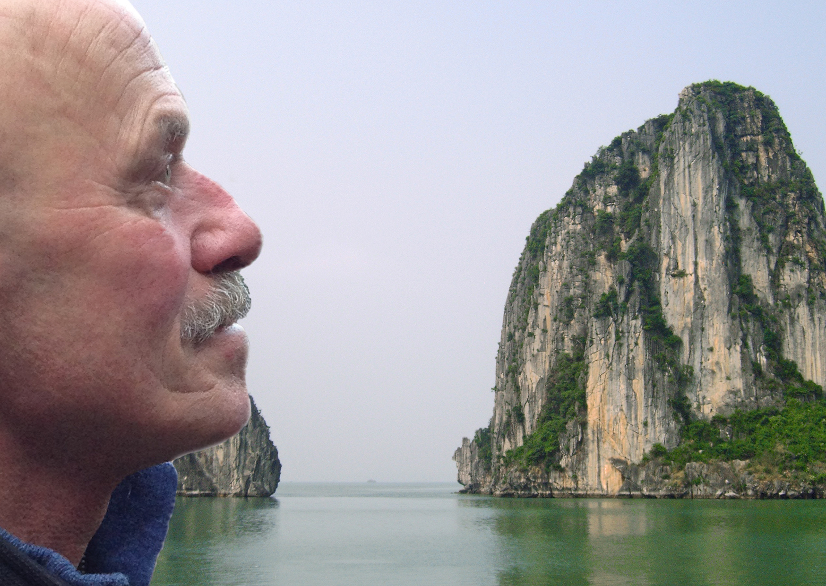
everard@onsnet.nu

