Slide 1
van Kemenade
Audit Coaching Training
Feedback
Everard van Kemenade
Ph.D.

Slide 2
Agenda
Introduction
Tips for Giving feedback
Tips for Receiving feedback
Tips for Asking feedback
Creating a feedback culture

Slide 3
Agenda
Introduction
1.1. You
1.2. What is feedback?
1.3. Feedback experiences
1.4. Daily talks
sandwich, interaction, 8 step formula
1.5. Feedback meetings

Slide 4
1.2. What is feedback?

Slide 5
1.2. What is feedback?
Feedback is the information sent to an individual or a group about its prior behavior so that the one may adjust its current and future behavior to achieve the desired result.
Read more: http://www.businessdictionary.com/definition/feedback.html
The objective is for the other to learn!!!!
Not blame, punish, harass….

Slide 6
There is no failure, only feedback.
Every result gives you important information.

Slide 7
Self feedback / evaluation
Task result
Has the task been performed well? (But: why??????)
Process
What did I do that lead to the result?
Level of self management
To what extent am I able to evaluate myself?
Personal
Less effective: about what task/process are we talking?
(Hattie & Timperley, 2007).

Slide 8
Sorts of feedback
Verbal
Photo feedback: A picture says a 1,000 words.
Video feedback: Seeing is believing
Written feedback: Remember the power of the pen
System feedback

Slide 9
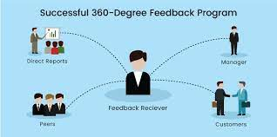
Sorts of feedback
0-degrees,
90 degrees,
180 degrees,
360 degrees

Slide 10
Sorts of feedback
FEED UP: Where do you have to go to?
What is the objective of the task?
FEED BACK: How are you doing?
FEED FORWARD: What is the next step towards the goal?
(Voerman & Faber, 2016).

Slide 11
Sorts of feedback
Positive
Critical

Slide 12
Situation
Employee feedback is the core of personal and professional growth. Feedback can help an employee get better at what they do, and surprisingly employees crave feedback. Most managers don't provide enough feedback, and when they do, they either make it too negative or are too vague while trying to keep it positive.

Slide 13
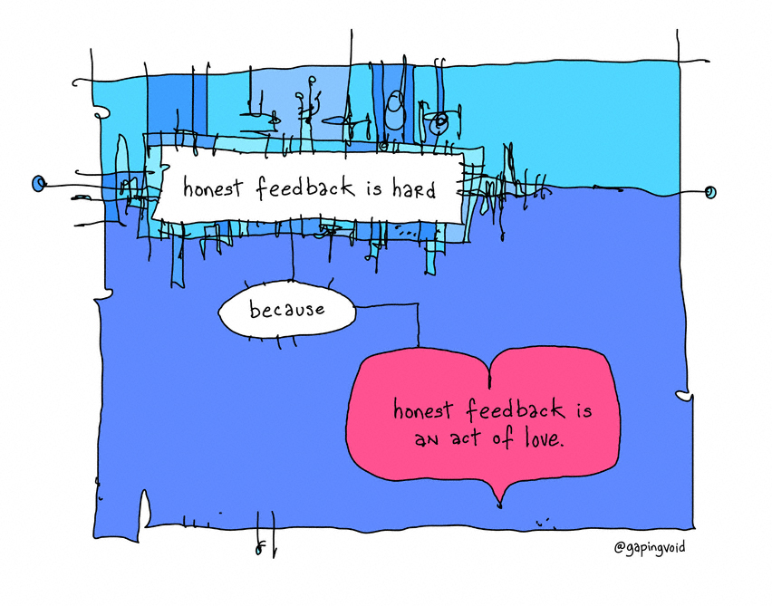
Feedback is a gift, but...

Slide 14
1.3. Feedback experiences
How is it done in your organisation?
How do you feel about giving feedback?
How do you feel about getting feedback?
Who did ever ask for feedback?

Slide 15
Fear ?

Slide 16
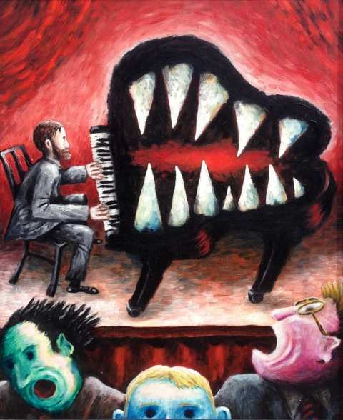
C’est le ton qui fait la musique….

Slide 17
Fear: do not….
Get aggressive
Stop listening
Doubt the motives of the feedback giver (he just got it in for me, there must be some other reason why she says this)
Doubt validity (this is not right, I’ve done my utmost)
Gossip or slander…......

Slide 19
Exercise
Red paper
Goal: effective feedback rules
Activity
Step 1: everyone writes a don’t in giving feedback
Step 2: Cluster, standup, group and stick on flap-over
Step 3: Then what? Criteria for effective feedback on green paper
Step 4: Put on the wall and add.

Slide 20
Exercise in three
A talks about a situation. How could I give feedback to X who did Y? B plays the role of X. C observes.
A gives feedback to B according to the feedback rules on her performance. A listens and tells what he or she learned from the feedback.
Train in sandwich feedback, short, open, specific. Give feedback (not advice) on process rather than content.
Change positions

Slide 21
1.4. Daily talks
1.4.1. Sandwich
1.4.2. Interaction feedback (super)
Eight steps formula
1.4.3. Interaction feedback (short)
1.4.4. Interaction feedback (extra)
1.4.5. Give compliments

Slide 22
Voerman et al.
Non-specific positive feedback (like giving a compliment without explanation) and non-specific negative feedback (like the red pencil) are the least effective ways of giving feedback.

Slide 23
In general
Feedback is the most effective when:
Specific
Positive
Right on time (as soon as possible after the act, at least within two days)
Desired
Useful
It is about assessment for learning rather than assessment of learning

Slide 24
1.4.1. Sandwich (positive)
SANDWICH
1. What does the person do well? (present tense)
2. What needs improvement, can be done better?
3. Positive end: In general I think

Slide 25
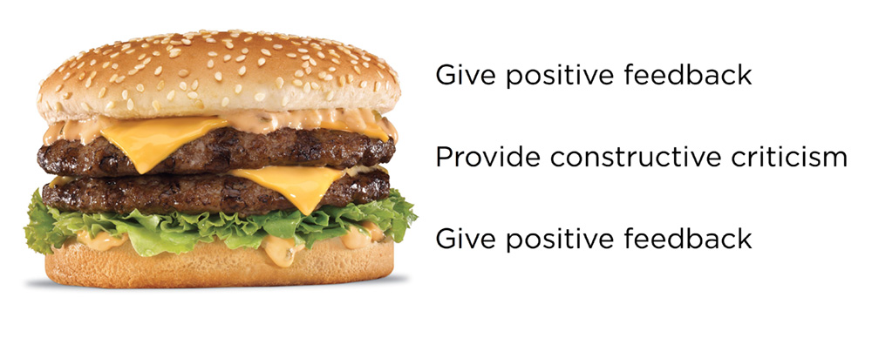
USE AT LEAST ONE CARD NOW…

Slide 26
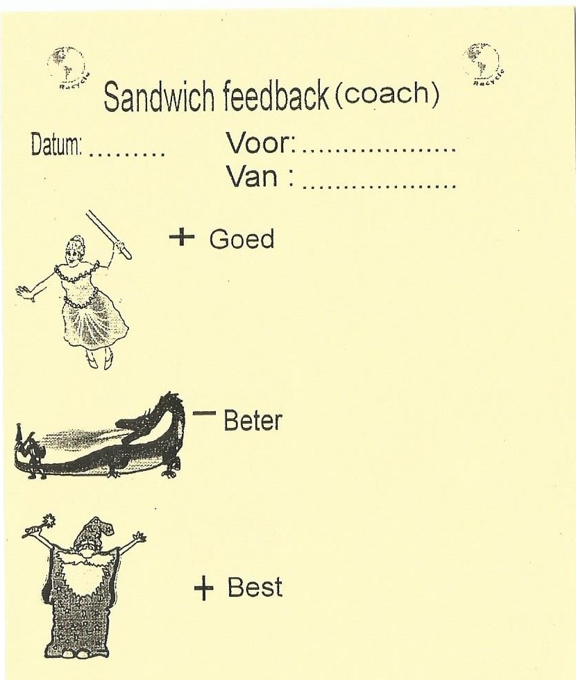

Slide 27
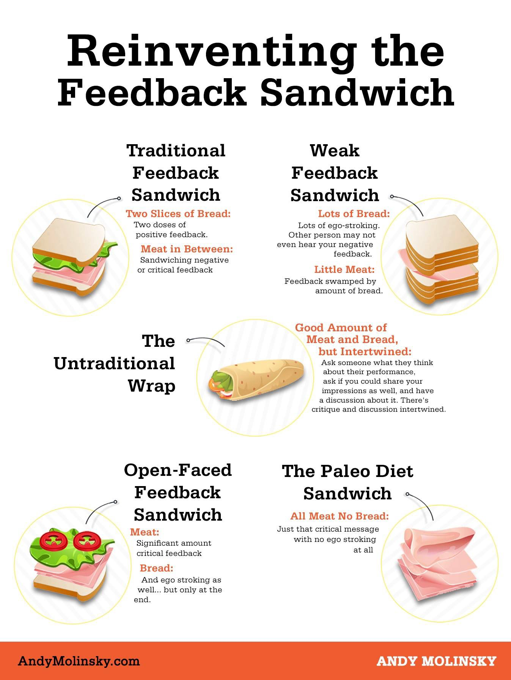

Slide 28
1.4.2. Interaction feedback (super)

Slide 29
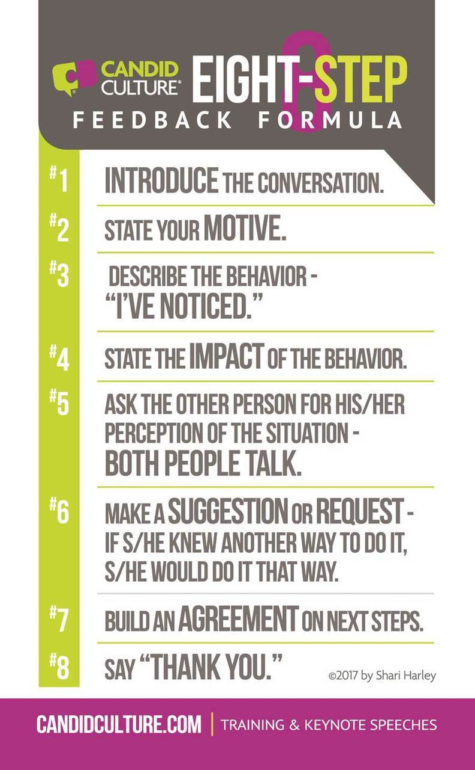

Slide 30
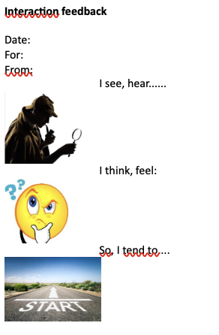
1.4.3. Interaction feedback (short)
Interact

Slide 32
Use I - message
If you want to give feedback, you’d better choose a personal perspective: I.
You mention the behaviour of the other.
Your own feeling about it and
the consequences the behaviour has for you.
Thomas Gordon: Active Listening
Feedback card 2

Slide 33
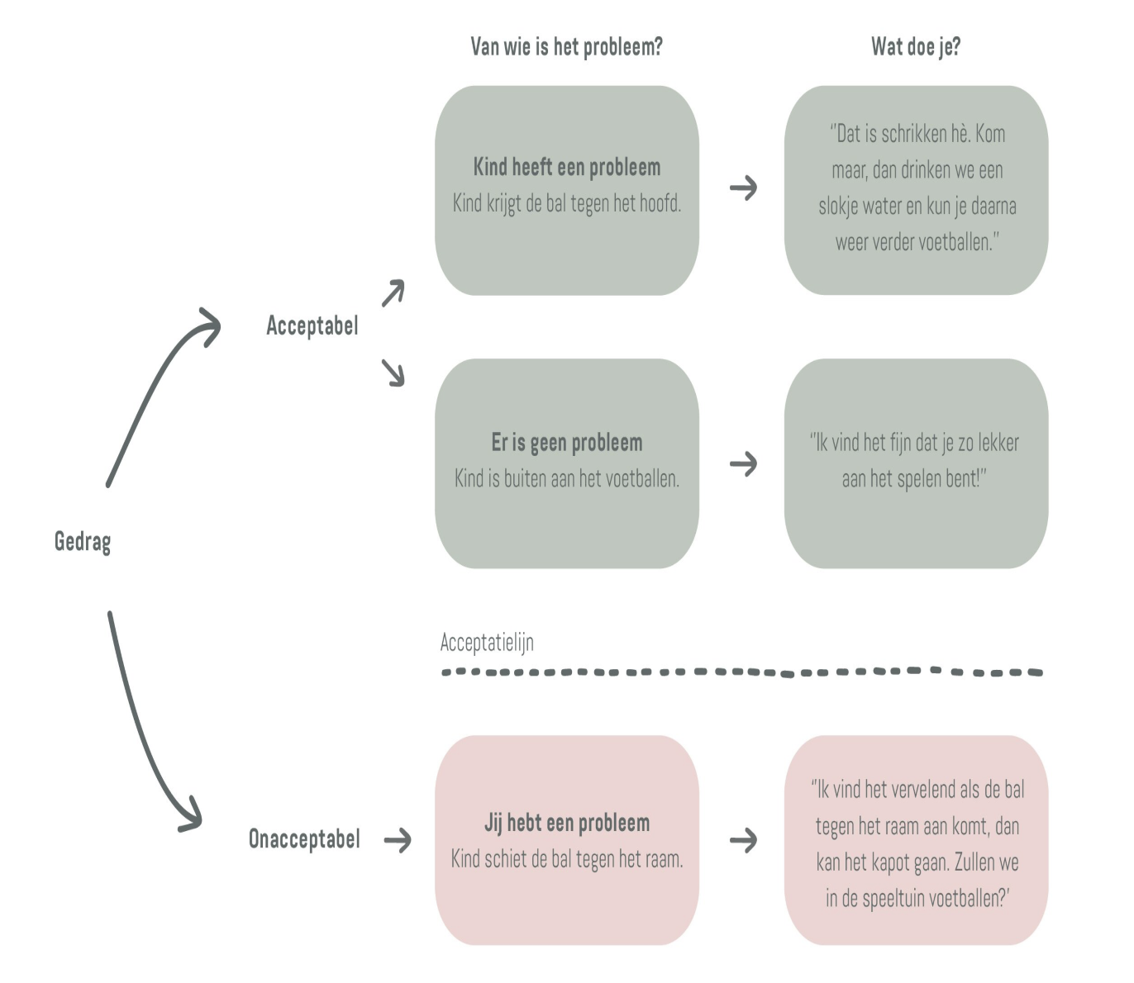
I-message (Gordon)

Slide 34
Examples
YOU-message:
“What a mess did you make of the patient-file”.
I message:
“I see that the patient file is incomplete,
that makes my work impossible,
I do not like that”.

Slide 35
Examples
YOU-message
“Why are you late again? You could have called to warn us. That is the umpteenth time now”.
I-message:
“You were not here at 8 as we have agreed. I was worried about you. Furthermore, I had to take over the care for Md X and I already have so many on my shoulders”.

Slide 36
Examples
You-message
”How annoying!!! Do you never stop looking at your telephone???”
I-message
”Therese, I’d like to finish my day at 16.00. I’d appreciate if you would help me to do what we need to do”.

Slide 37
Example
Set aside a specific time to meet and state upfront you are giving feedback. “Can we take 10 minutes of our 1:1 to discuss some feedback I want to share?”
Say the tl;dr. “When we are together in meetings, I feel you are not listening because you interrupt me to get your point across.”
Give a concrete example. “For example, during the meeting on Wednesday, I was talking about patient Sarah. You interrupted me and diverted the conversation twice to discuss the quality of the food.
Explain the impact. “It made me feel unheard, and I'm reluctant to speak up when you are in the room”. Give chance to react. What are your thoughts?
1. Too long, did not read

Slide 38
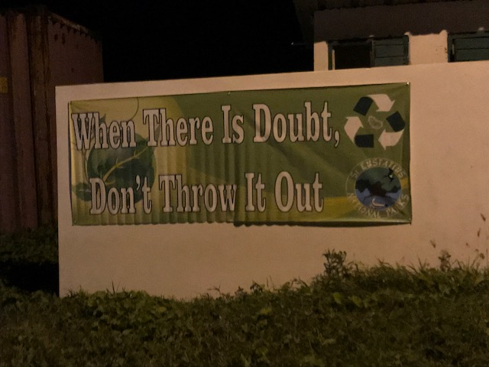

Slide 39
1.4.3. Interaction feedback (short)
Interact

Slide 40
Design four interactions

Slide 41
1.4.4. Interaction (extra)
INTERACTION
1. I see, hear….
2. I think, feel…. I tend to, that makes me…..
3. Could you...

Slide 42
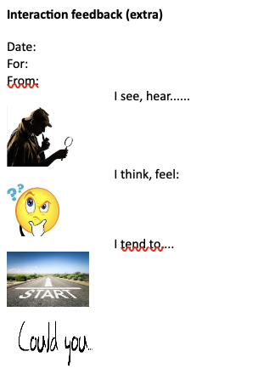
Choose one

Slide 43
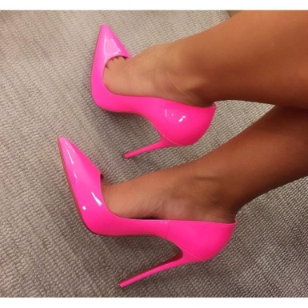
What if you were she
What would you think?
How would that feel?
What would you do?

Slide 44
1.4.5. Give compliments 4 simple steps to crafting a deep compliment Step 1 — Focus on a quality, value, or belief. We're not talking, “Nice job!”-level feedback here. ... Step 2— Include detail. Consider the specifics about the task, project, result, report, or collaboration. .. “You knew just what to say in that difficult situation”. “You are always there, when we need you”. Step 3— Choose great adjectives. ... “I gotto hand it to you” “I’m impressed” “I have a lot of respect” “I have to give you a lot of credit” Step 4— Deliver with warmth

Slide 45
Carrousel Two circles and move a chair

Slide 46
Carrousel
Introduction feedback
Make inside and outside circles. We have five short sessions of a few minutes each. After each session some reactions are given and the outside circle moves one place clockwise.
Session 1. Observe and give back
The two observe each other in silence. Concentrate. Give back what you saw. Stop after two minutes and collect some examples. Did we perceive or interpret?
SESSION 2. Questioning
Pose a question about whatever you like. It may be not easy to give open questions and ask
through. Have uninhibited attention to the other, and without judgment!
SESSION 3: QUESTIONING ME
In this session the one ask questions about him or herself. Do not be too blunt. Be specific and guide the other.

Slide 47
SESSION 4. GIVE A COMPLIMENT
I got to hand this to you....I am impressed... About .... (Be specific!) Dare to recieve the compliment!
SeSSION 5. CRITICAL feedback
This is the core of the training. I see, hear…. I think, feel…. I tend to, that makes me…..
Could you...
DISCUSSION
Back in the great circle.
What did you notice`? What did you learn? What made it easy / difficult? (How) could you do this in practice?

Slide 48
1.5. Feedback ‘meetings’

Slide 49
5.1 Structure in daily routine
5 minutes Check-in at the beginning of team meeting
Before we start, what is on everybody’s mind?
2. Evaluation at end of every team meeting (what went well/not?)
Plan a 15 minutes walk with every colleague once a month.
Professional gossip exercise

Slide 50
15-minutes walk

Slide 51
5.2. Give ownership
Let the staff member manage its own evaluation-dossier or
portfolio.
Portfolio = A collection of works or documents that are representative of a person's skills and accomplishments: a photographer's portfolio; an artist's portfolio of drawings.
It can include the Personal Development Plan.

Slide 52
5.3. Two-ways or more
Tradition: interview-cycle
Manager evaluates once a year the staff member
Better is to give room for mutual evaluation.
Better is to involve more stakeholders
0 degree only self-evaluation
90 degree only the supervisor
180 degree mutual
360 degree all stakeholders
(supervisor, colleagues, clients, family)

Slide 53
5.4. Create safety
e.g. : Start End gossip campaign

Slide 54
2. Tips for giving feedback
Create safety!!!! (privately!!!!!)
Give feedback as soon as possible (5 min)
Give short feedback and room for a reaction (dialogue).
Make your feedback specific: then I saw you doing this over there… (not what others told you!!!), based on criteria.
Feedback needs to be given in the direction of (new) behaviour.
Feedback should not not condemn someone, in a warm atmosphere.
Feedback only makes sense when the other wants/is able to receive feedback.
Feedback uses checks: “Is it right that....”
Early in the morning, preferably not by email.
Play the ball, not the person. Be hard and clear on content, sweet and friendly on the relationship.

Slide 55
Avoid Generalizations
Avoid phrases such as:
You always do ...
You never do ...
You need to ...
You have to ..

Slide 56
Avoid Comparisons of Co-Workers
Do not compare co-workers. Only compare the issue against your expectations, against standards set for earning rewards, against a person's stated goals, or against mutually set objectives

Slide 57
3. Tips for receiving feedback

Slide 58
Fear
Receiving feedback
Listen carefully to the feedback you get: these are actually gifts!!!!
Do not defend yourself nor get angry.
Summarize what you heard.
Ask for clarification, examples.
Evaluate for yourself the usefulness of the feedback you got and look for the (10?)% that is of use!!!!
Gather information from others about the same topics
Use the feedback to become better!!

Slide 59
Tips for receiving feedback
STOP
When we receive tough feedback, the amygdala in our brains
is triggered. This is the piece of our limbic system
responsible for the fight or flight response.
So, stop at the first sign that a "Yes . . . but!" or "You're wrong" response starts bubbling up. Tamp it down. Don't react to the feedback.
Instead, bide your time; listen to the whole message.

Slide 60
Tips for receiving feedback
2. Say “Thank you”.
A piece of feedback is a gift.
3. Look for the 1 percent grain of truth
First, write down the feedback that was shared. Then write everything that you believe is wrong with the feedback. Finally, write down what could possibly be true in the feedback.

Slide 61
Tips for receiving feedback
4. Seek out the pattern
Have you ever received this feedback before? How about something similar? If this is the first time you have ever had this feedback, then let it go.
If it sounds even vaguely familiar, then stop and listen up. One point of view has just turned into a pattern. And patterns can help or hinder you.

Slide 62
Exercise in two

Slide 63
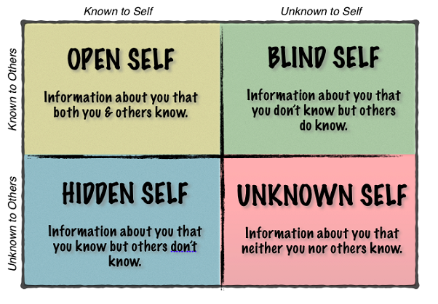
Johari Window (Joseph Luft and Harry Ingham, 1955)

Slide 64
The Johari Window
Known to Others | Open area Public self Out there | Blind Spot Bad breath Unsuspected Q
Unknown to Others | Hidden Private self Dark side/shadow | The Unknown New Potential
 | Known to You | Unknown to You

Slide 65
How to use this knowledge?
Make the blind spot smaller by asking feedback!
Make the hidden self smaller by opening up!

Slide 66
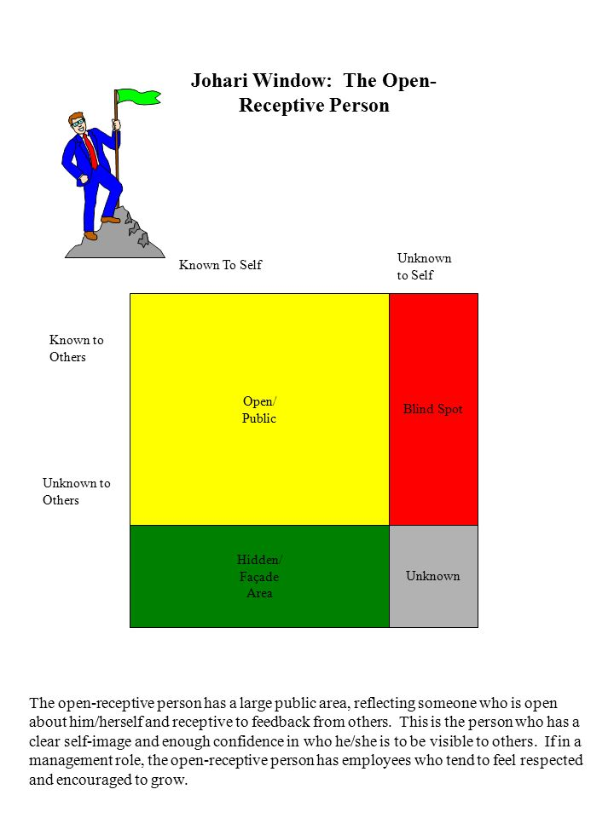
The more developed our open area, the more comfortable and succesful we are.

Slide 67
4. Tips for asking feedback
Ask insightful questions.
Having an open-door policy is great, but it doesn’t always motivate employees to come forward with their comments, suggestions or concerns. The key to bringing out truly honest feedback from employees is to take the time to meet with them in an informal, one-on-one setting. Asking questions such as these can help employers gain better insight:
If you were in my shoes, what would you change tomorrow? Why?
What are you hearing clients (or customers) say about our business?
What do you enjoy most about your job? Least?
How can I help you be more successful?

Slide 68
Follow up with employees.
Follow up
In the end, how employers elicit employee feedback is irrelevant if they don’t follow up with employees. When it comes to giving employers constructive feedback, the greatest motivator is to show employees their feedback is being considered or, better yet, applied.
Even if an idea or suggestion remains just that, follow up with employees and let them know that their feedback is always appreciated and encouraged.

Slide 69
Tips for Asking feedback
Managers asking feedback is a powerful tool
to create a feedback culture.
Ask your team members regularly:
What do you value in cooperating with me?
What do you sometimes dislike in cooperating
with me?

Slide 70
5. Creating a feedback culture

Slide 71
Exercise: Patterns
Goal: The team members name their current feedback behaviour,
the underlying beliefs that sustain these behaviors and the desired
feedback behaviors in the team.
Activity:
Step 1: Subgroups
Groups of 3 – 4 people think of an image, a metaphor that represents
how the team works with feedback. It needs to be possible to
physically portay the image by the people

Slide 72
Stap 2: Plenary
Each subgroup presents the image. Th others write down their associations.
Use the images and associations to name the team behaviour
as specific as possible. Which underlying beliefs that perpetuate
current feedback behaviors.

Slide 73
Stap 3: Subgroups again
Participants think of the ideal image of their feedback culture.
Stap 4: Plenary
The images are presented.
Is there a common image?
What is the specific feedback behaviour that is desired?
How can we achieve this?
What can I contribute?

Slide 74
Be the example
Leaders should ask!!!

Slide 75
Follow up with employees.
In the end, how employers elicit employee feedback is irrelevant if they don’t follow up with employees.

Slide 76
Change the system
What are barriers in the system???
No management support for effective feedback/
bad management examples
No staff evaluation procedure
Staff evaluation procedure not implemented
Staff evaluation procedure not well executed
(e.g. not enough training in giving/receiving
feedback)

Slide 77
OTHER FEEDBACK CULTURE SUGGESTIONS ????

Slide 78
everard@onsnet.nu

Slide 79
Annex 1 examples
Als er bij Jan iets misgaat, begint hij onmiddellijk te vloeken. Hij heeft nogal een luide stem en anderen klagen dan ook wel eens over zijn taalgebruik. Je hoort net dat Jan iets uit zijn handen laat vallen, en ja hoor, hij begint weer te vloeken. Bij groepswerken functioneert Tom prima, maar er is één probleem: hij komt nooit op tijd. Dat geeft telkens problemen op woensdagmiddag wanneer het project van Nederlands moet uitgewerkt worden. Hij heeft met jou afgesproken dat hij voortaan zal proberen op tijd zal komen. Hij komt nu net weer binnengewandeld, ruim drie kwartier te laat. Nicolien maakt overal snel een rommel van. Ze laat alles slingeren en ook aan het eind van de dag ruimt ze haar rommel niet op.. Het is bijna kwart na vier en ze maakt nog geen aanstalten om de rommel op te ruimen. Suzan heeft de gewoonte om scherp en onvriendelijk te praten tegen haar collega’s. Als ze haar iets vragen noemt ze hen ‘stom’. Je hebt net gehoord hoe ze uitviel tegen een stagiare. Erik komt met een dranklucht na de middagpauze terug de school binnen. Hij loopt waggelend en geeft luid en brutaal commentaar aan anderen. Sommige collega’s deinzen achteruit.

