Slide 1
Agenda Day 2
Day 1
Quality
Four paradigms
What we can learn from the empirical paradigm?
Day 2
4. What can we learn from the reference paradigm?
5. What can we learn from the reflective paradigm?

Slide 2
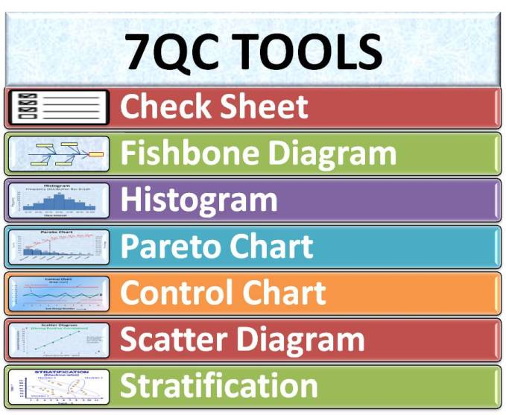
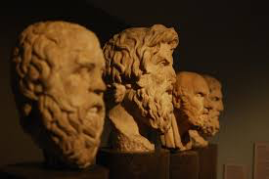


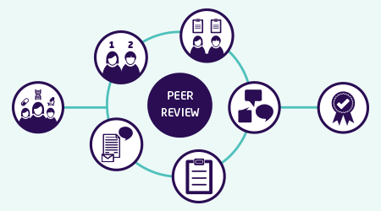






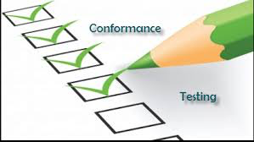




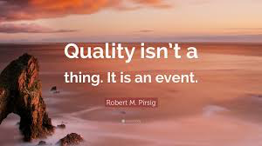
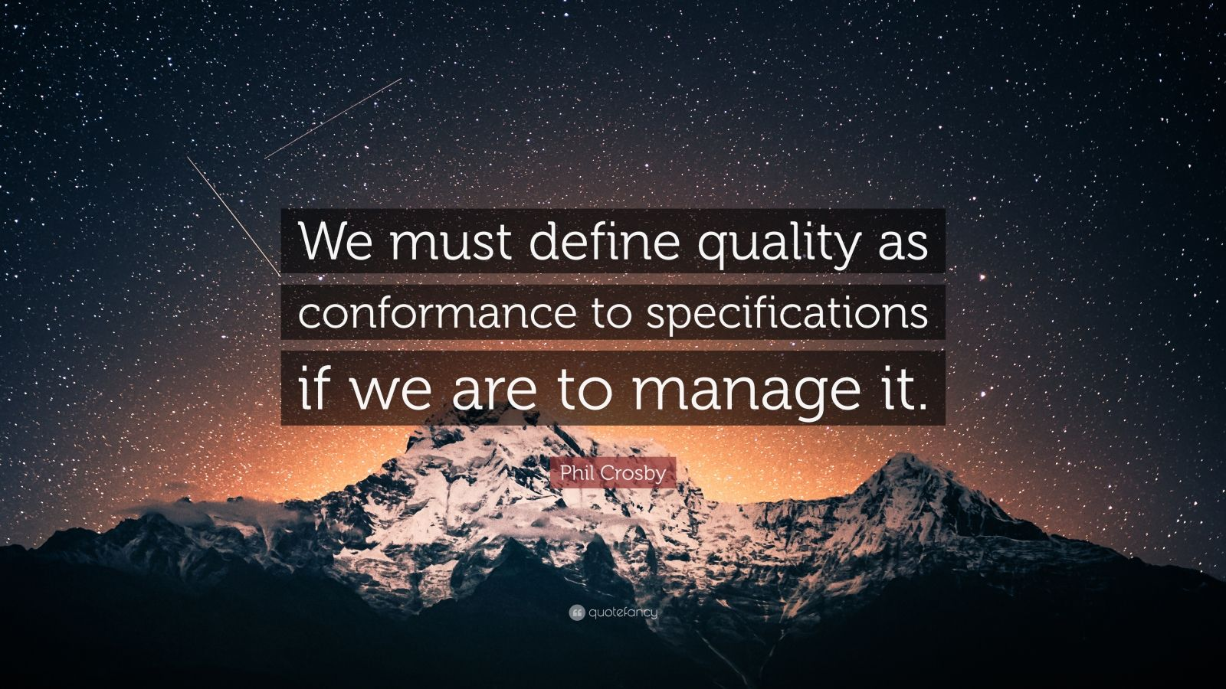



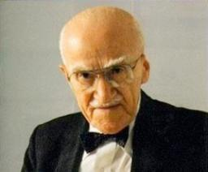
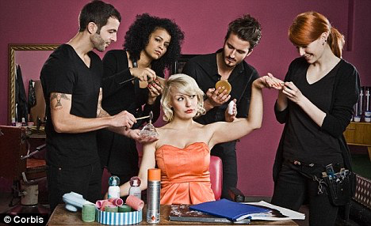
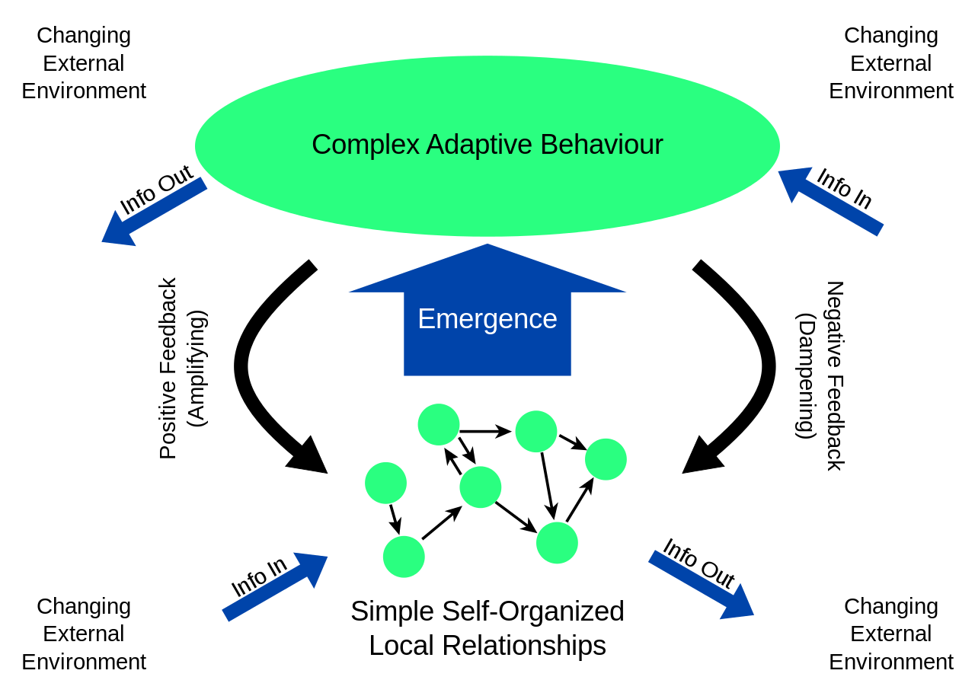
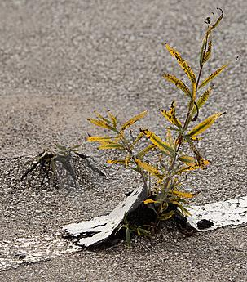

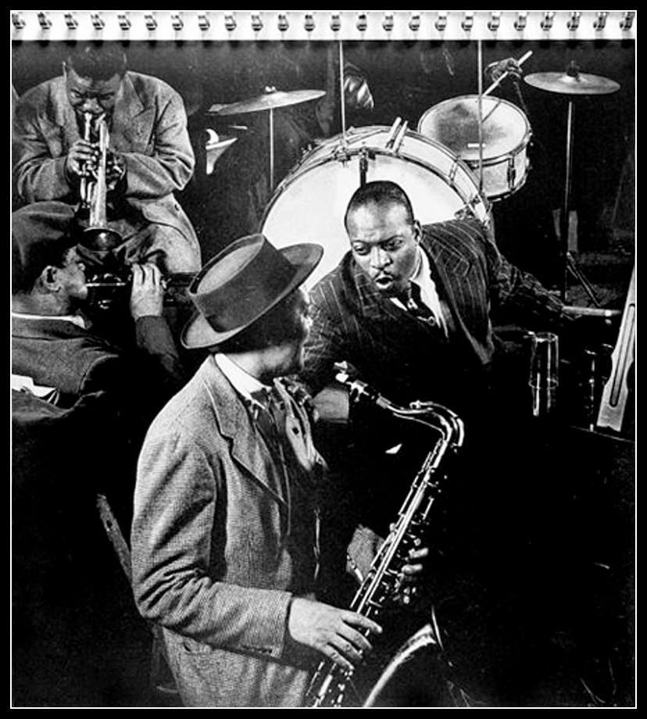
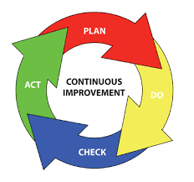


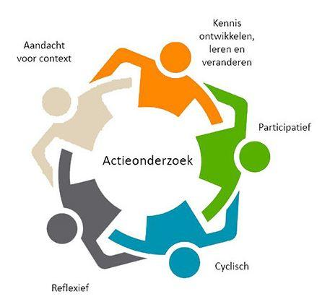
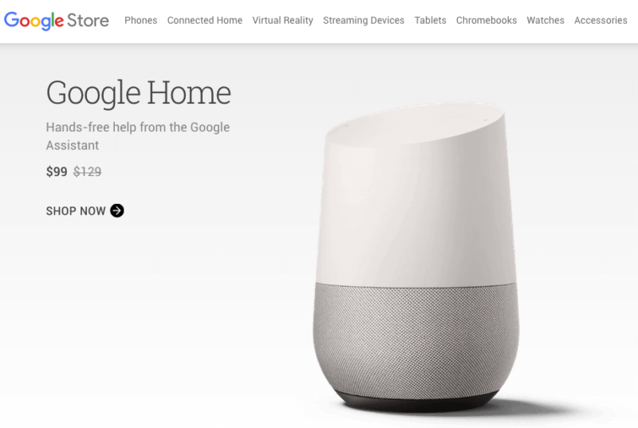



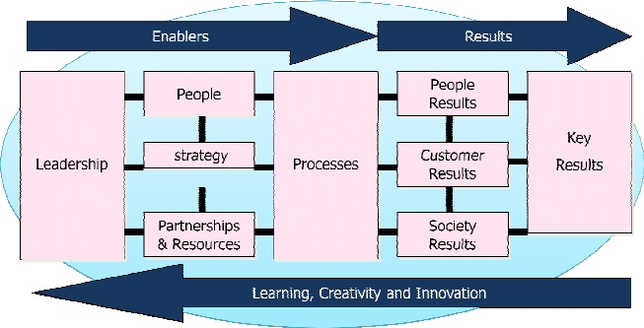
REFLECTIVE
EMPIRICAL
www.vankemenade-act.nl
reflective
empirical
“fitness for use”
emergence
reference
REFERENCE
EMERGENCE
Notes:
Quality: Decision: Values: Motto, Metaphor: Logic (Freidson): Leadership: Science: Risk: Leadership: Tools:

Slide 3
4. What can we learn from the reference paradigm?
4.1. Continous improvement
4.2. PDCA cycle
4.3. new ISO
4.4. EFQM model
4.5. Customer delight
4.6. Quality structure
4.7. Coaching leadership

Slide 4
What is Quality?
Quality is conformance to requirements (Crosby, 1979)
  de ‘preciezen’
Quality is fitness for use (Juran, 1992)
  The customer
Quality cannot be defined (Pirsig, 1972).
  de filosoof / professional
Quality is dynamic (Pirsig, 1991)
  De ‘rekkelijken’

Slide 5
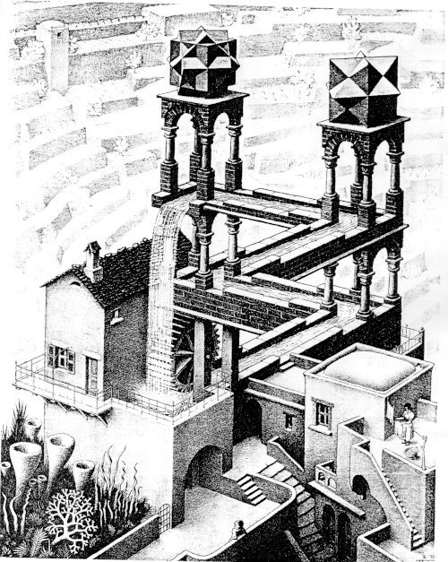
4.1. CONTINUOUS IMPROVEMENT
quality
time

Slide 6
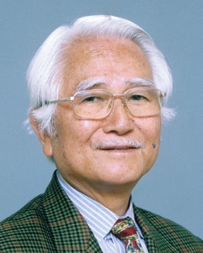
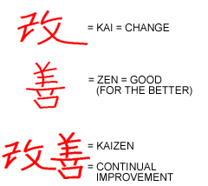
IMAI: KAIZEN

Slide 7

Continuous Improvement

Slide 8
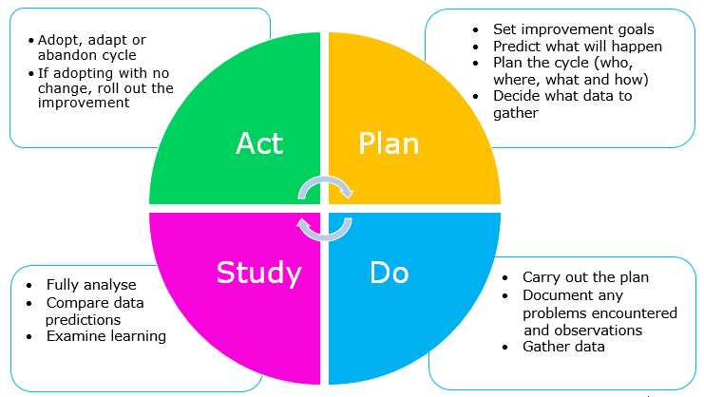
4.2. PDSA-circle
Shewhart / W.E. Deming

Slide 9
A
P
D
C
A
P
D
C
A
P
C
D
A
P
D
C
“learning and improving together systematically”

Slide 10
4.3. ISO
A Quality Management System is a set of internal rules that are defined by a collection of policies, processes, documented procedures, and records. This system defines how a company will achieve the creation and delivery of the products and services they provide to their customers.
Quality Manual

Slide 11
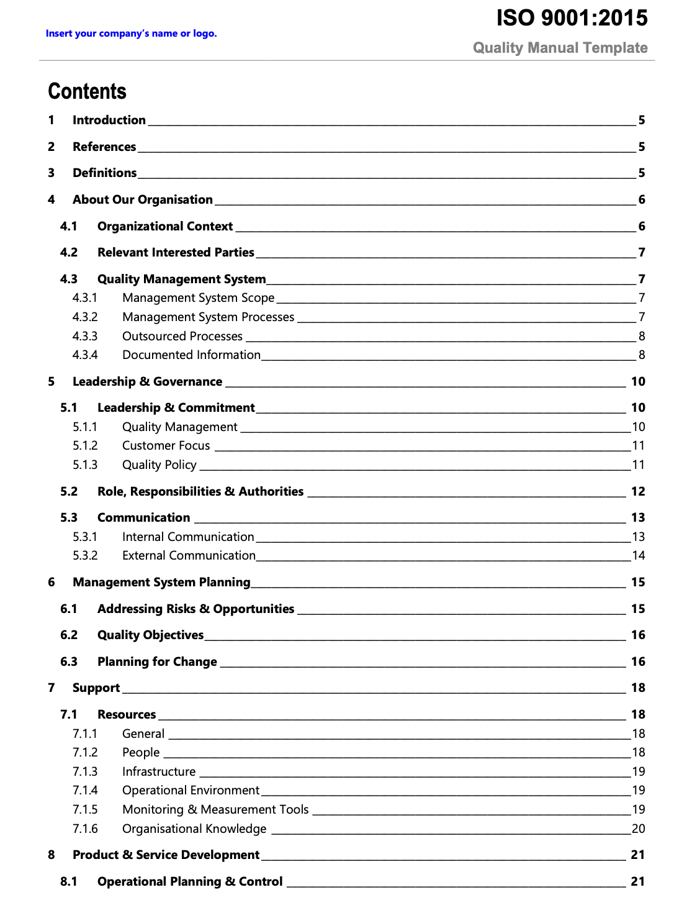
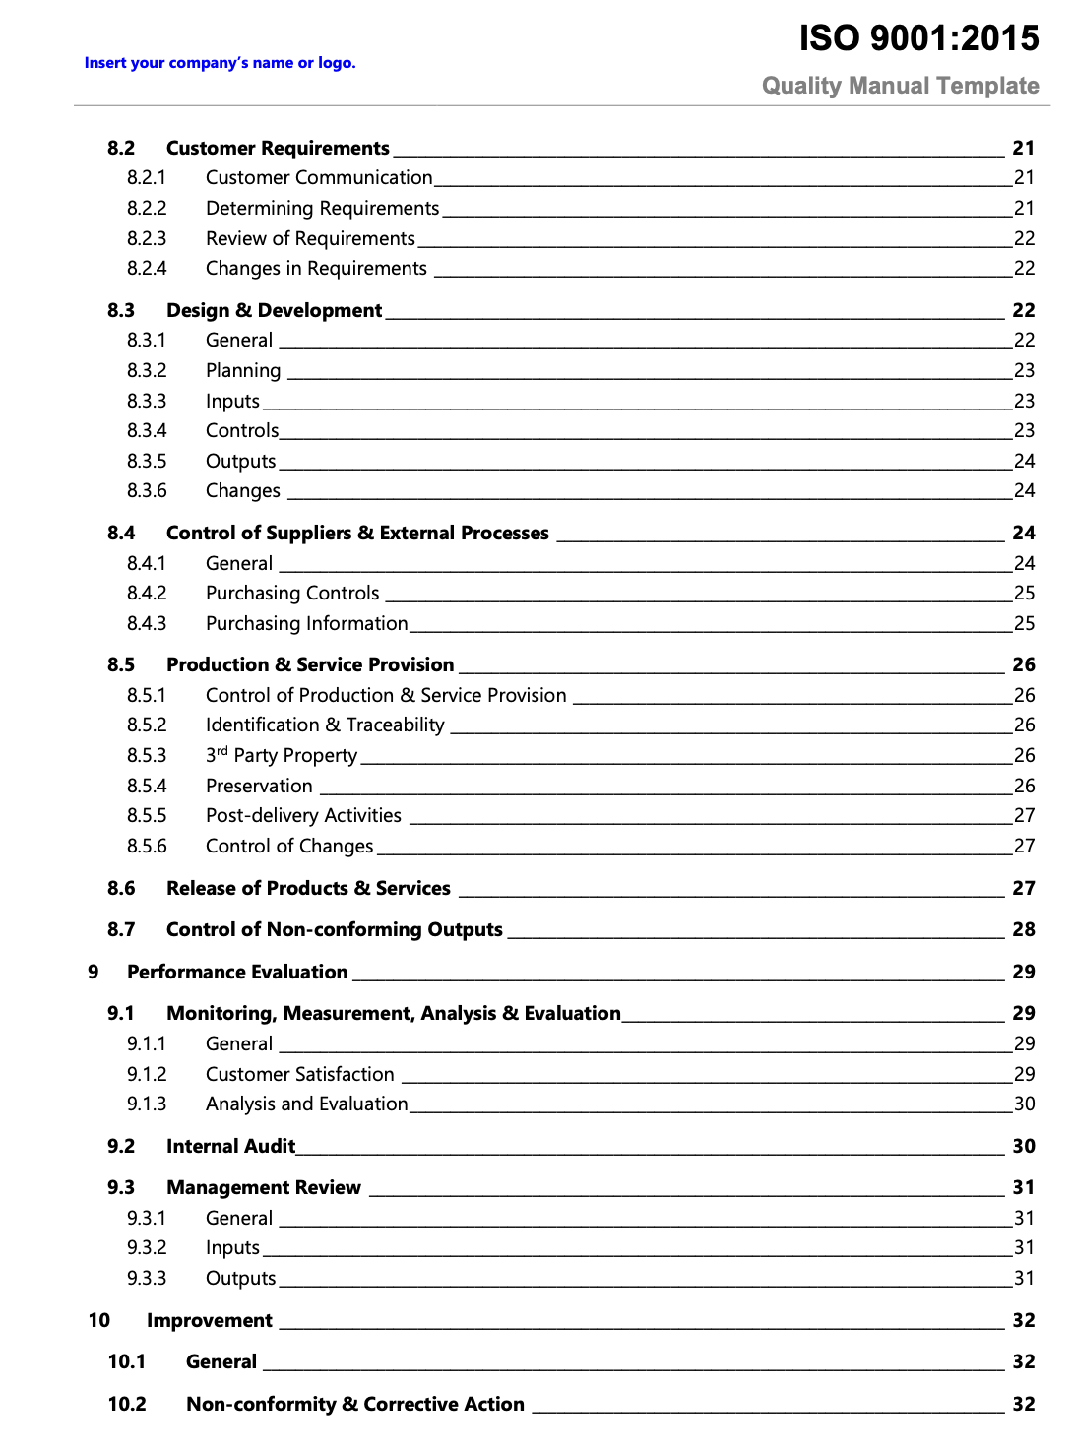
4.3.1. ISO Quality Manual

Slide 12
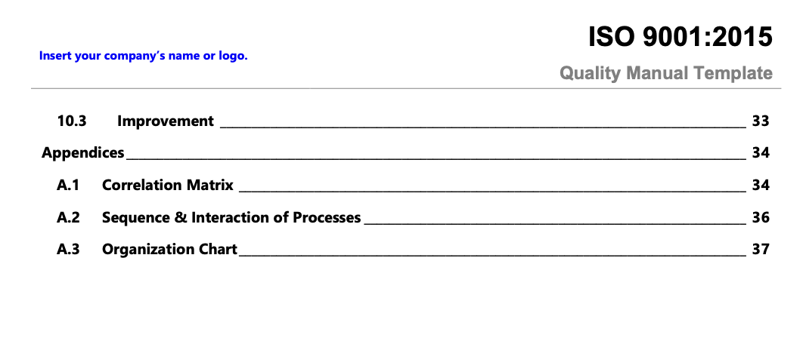
ISO Quality Manual cont’d

Slide 13

4.4. European Foundation for
Quality Management

Slide 14
QUALITY MANAGEMENT SYSTEM
P
D
C
1 Leader-
ship
3. People management
5
Processes/
services
7 People satisfaction
9 Key performance results
2 Policy and strategy
6 Stakeholder satisfaction
4 Resource
management
8 Impact on society
Enablers
Results
A

Slide 15
Enablers
Leadership
mission, vision
Strategy and Policy
strategic plan (Q!!!!)
People management
HCM, staff motivation
Partners and Resources
Finance management, facilities,knowledge

Slide 16
Results
Staff
Customer
Students
WoW
Government
Impact on society (at large)
Key performance results

Slide 17
4.5. Customer delight
A positive emotional and rational state of mind that leads the customer to enthusiasm about the institute.

Slide 18
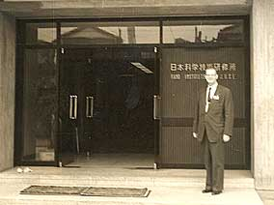
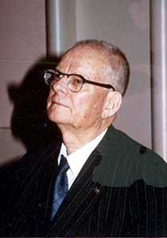
W. Edwards Deming:
“Meeting expectations is not enough”.

Slide 19
KANO-model
Must Be: The quality characteristic must be present
or the patient will go elsewhere.
Performance: The better we are at meeting these needs,
    the happier the patient is.
Delighter: Those qualities that the patient was not
expecting but received as a bonus.

Slide 20
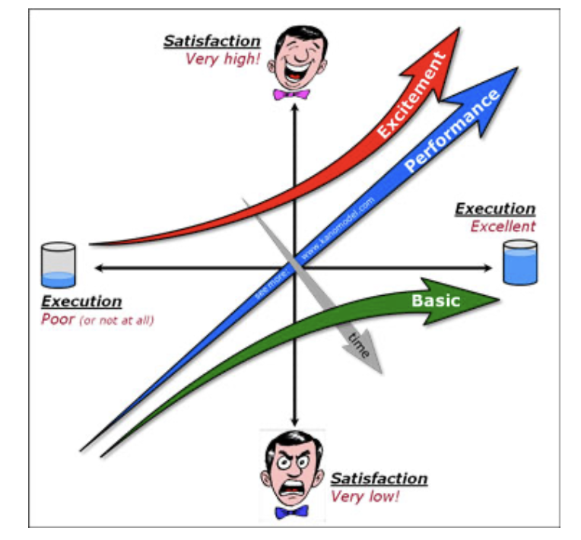
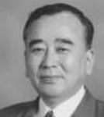

Slide 21
Example hotel
For a business guest
That I get a news paper is a Must Be
That I can have a tasty meal is Performance
That I can swim is a Delighter

Slide 22
Example hotel
For a tourist guest
That I get a swimming pool is a Must Be
That I can have a gym is Performance
That I can get a newspaper is a Delighter

Slide 23
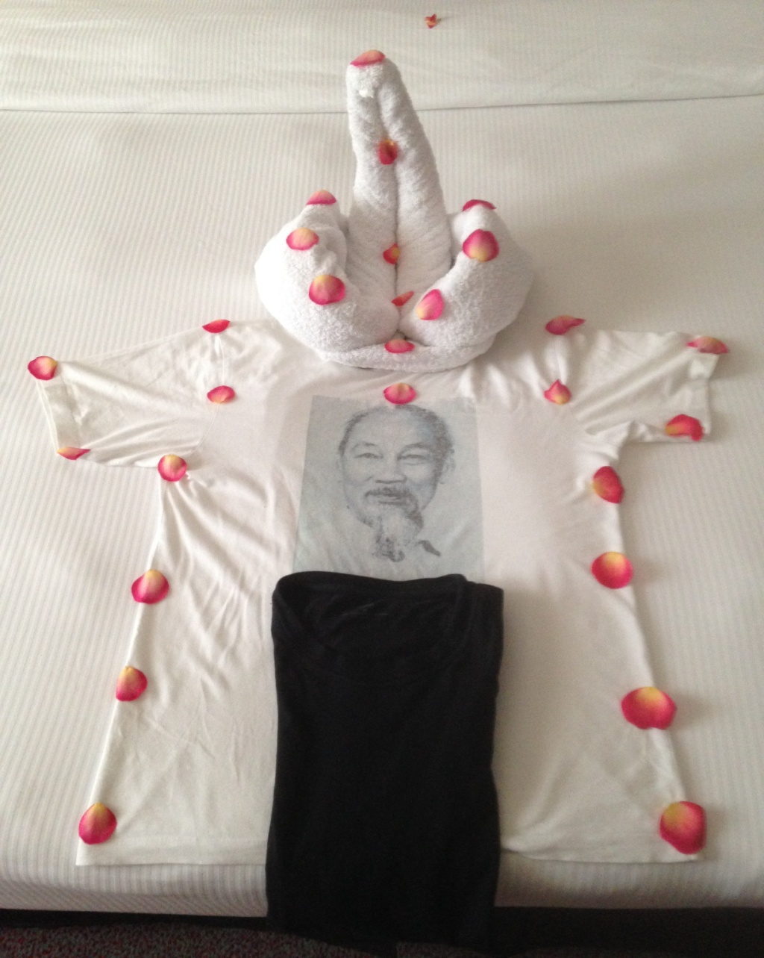

Slide 24
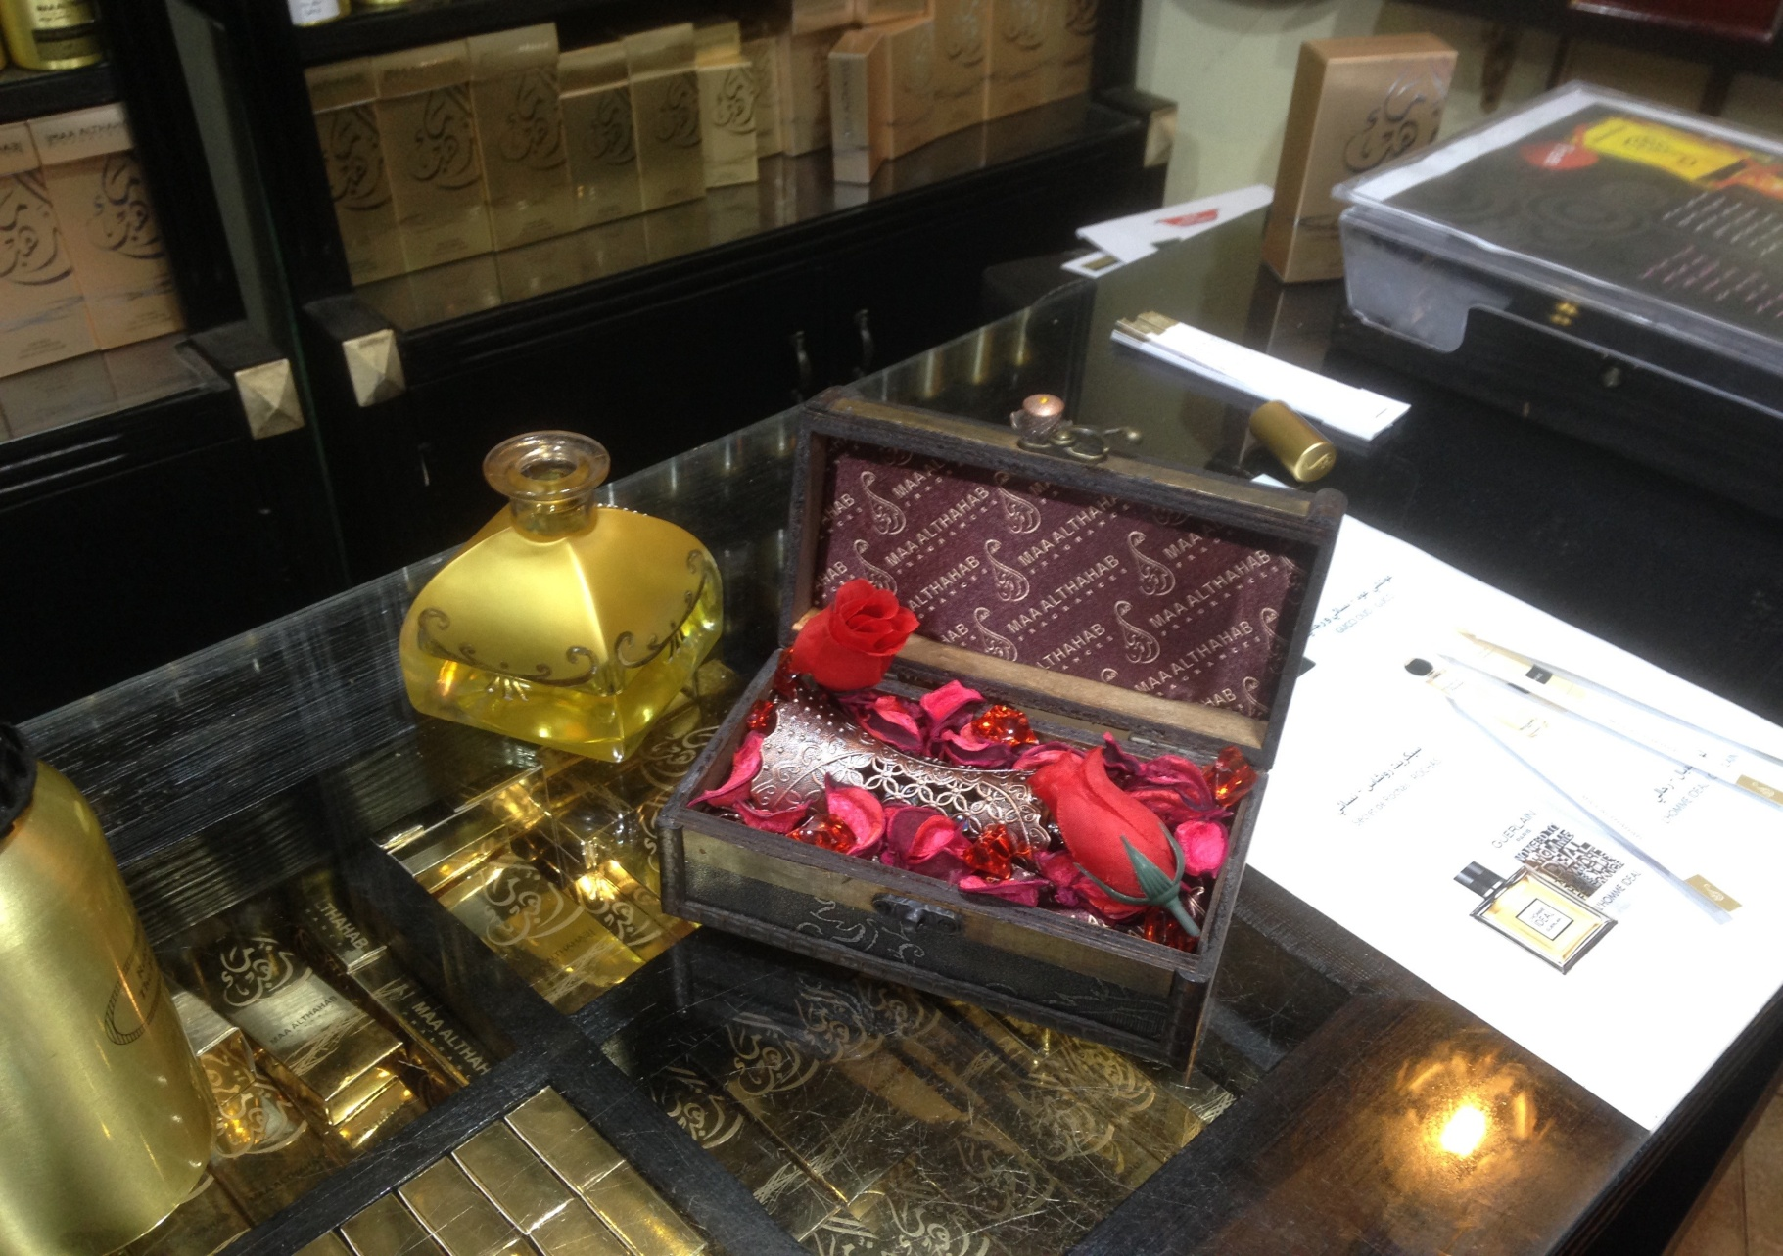

Slide 25
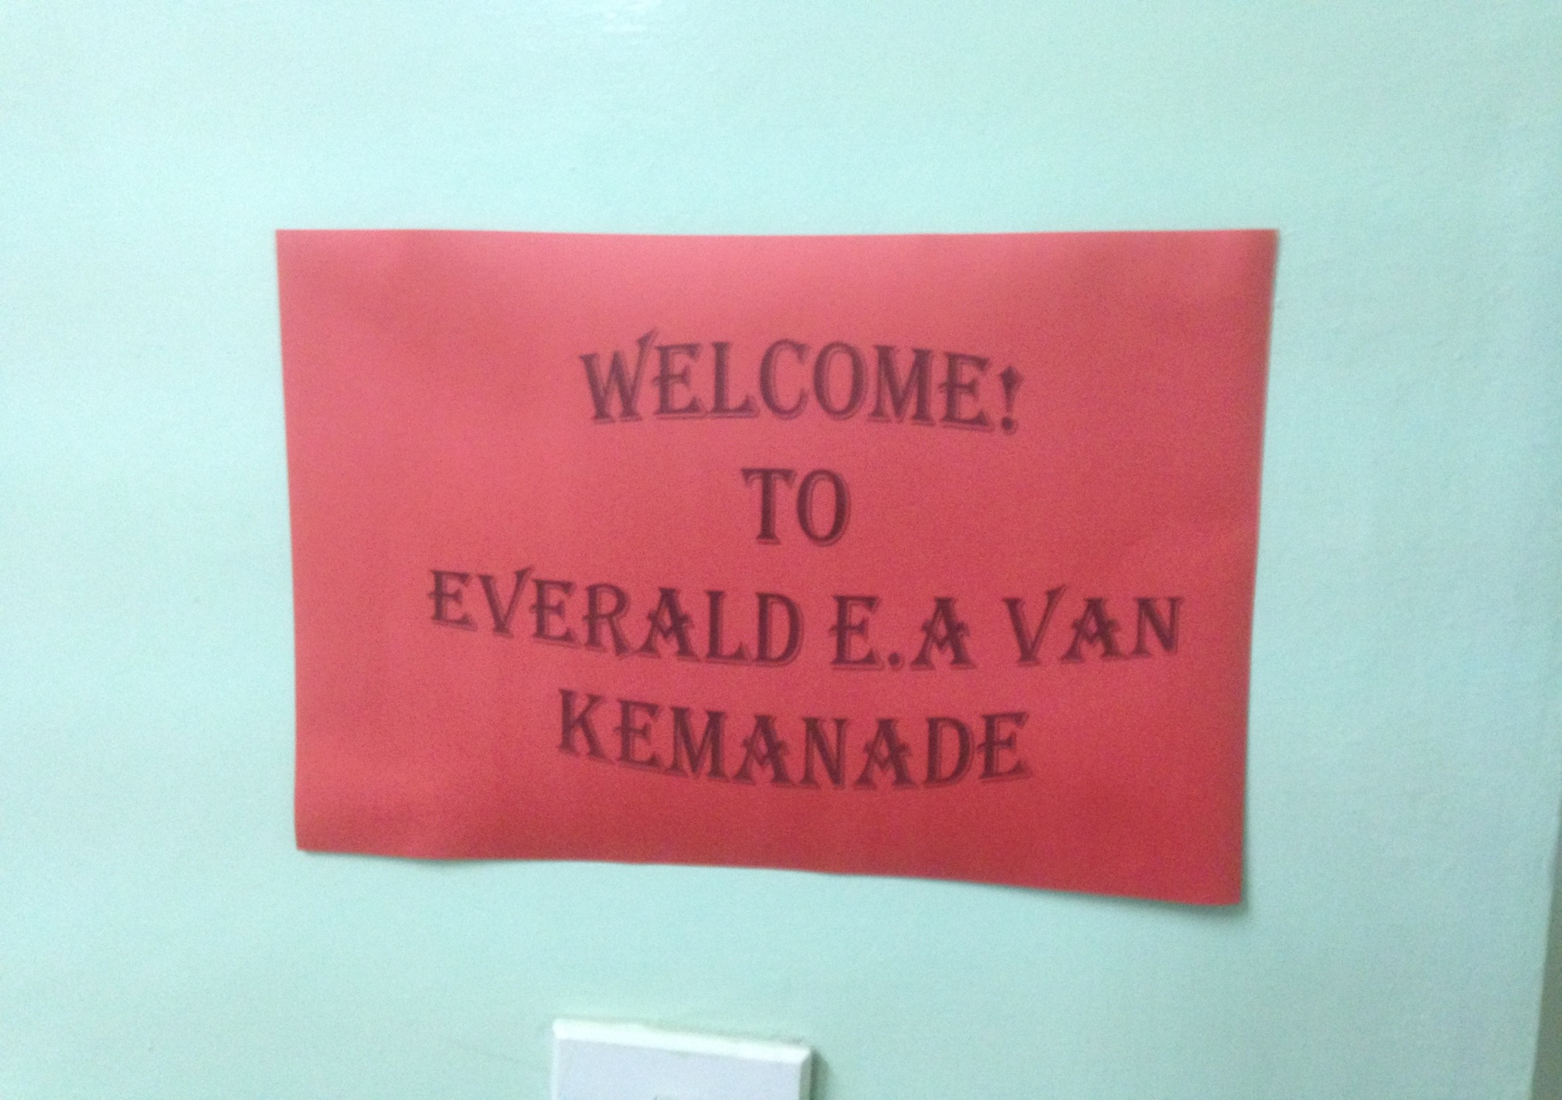

Slide 26
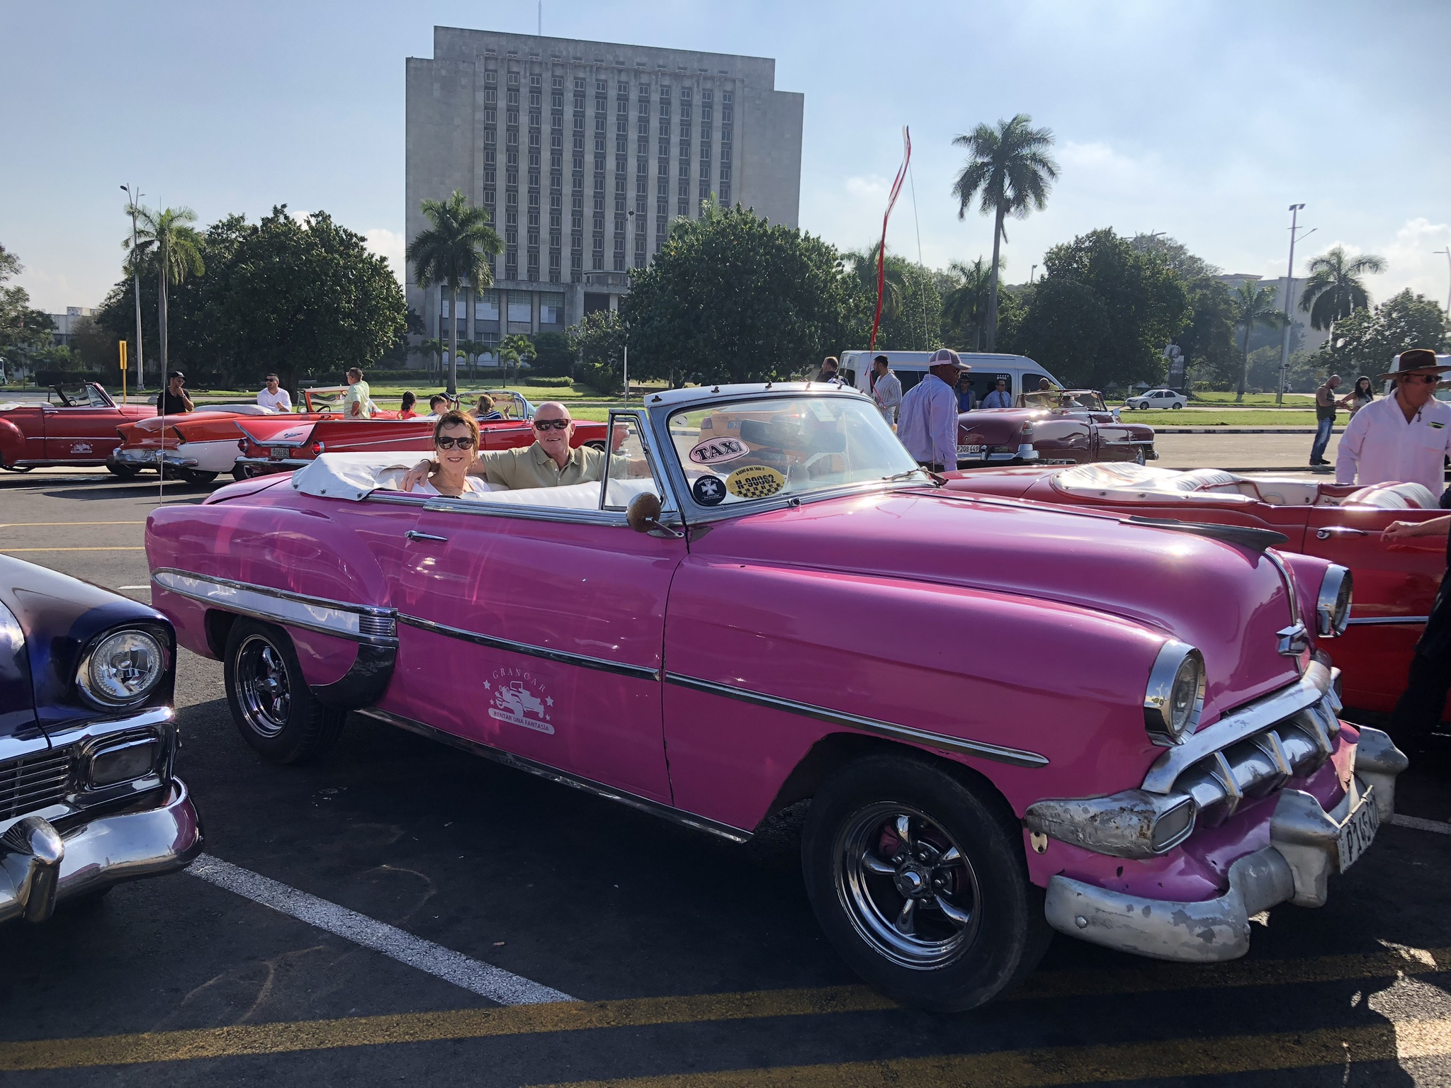
Where have I been?

Slide 27
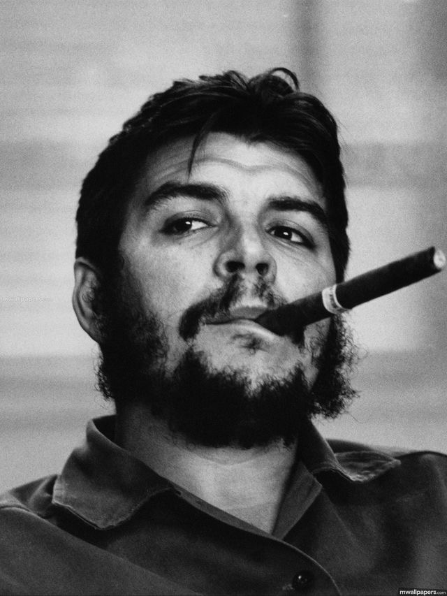
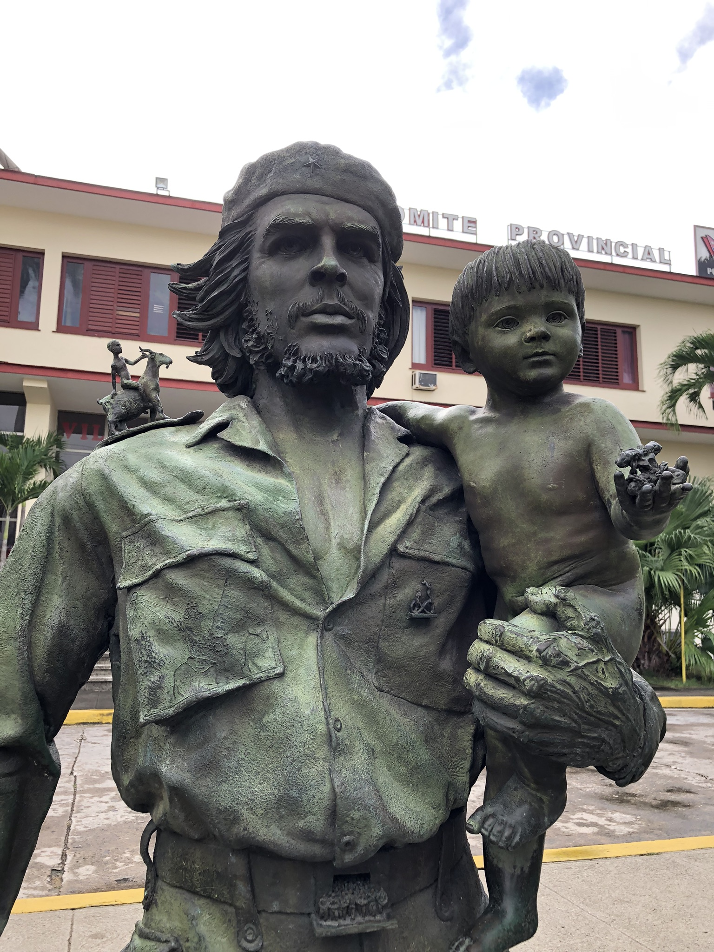

Slide 28
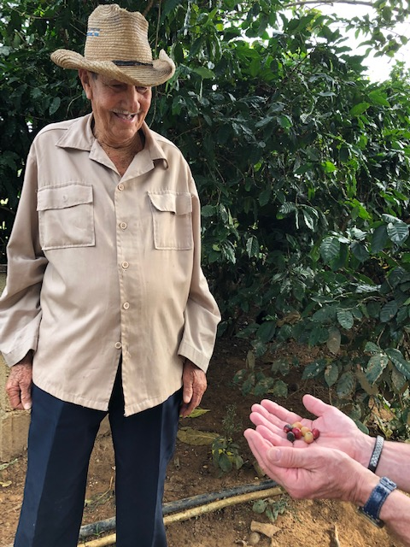
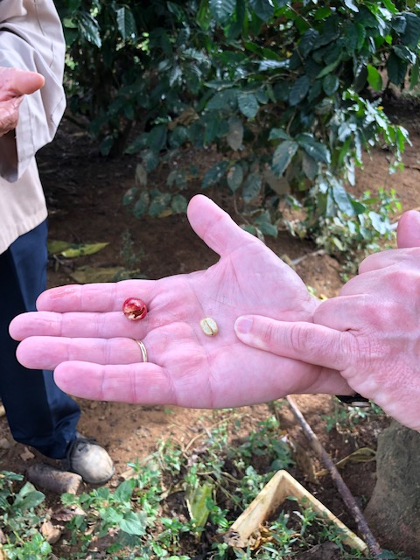

Slide 29

Cow bells and Coffee beans Henri Mancini (MioBi)

Slide 30
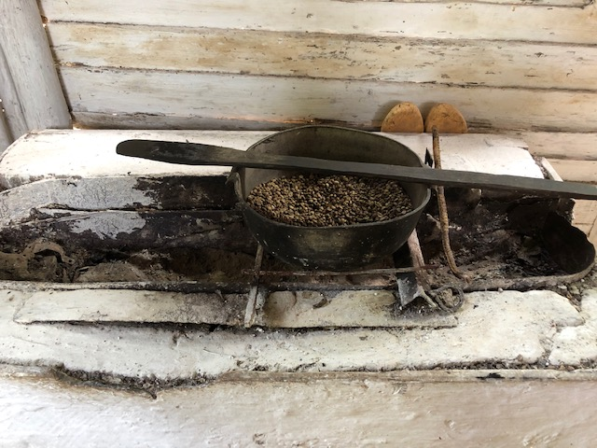
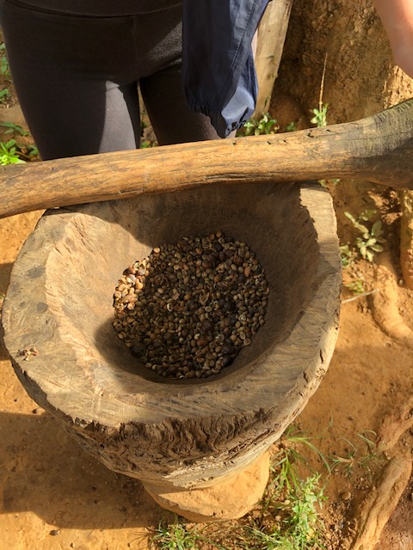

Slide 31
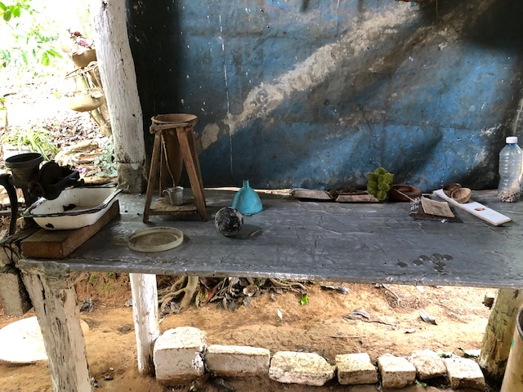
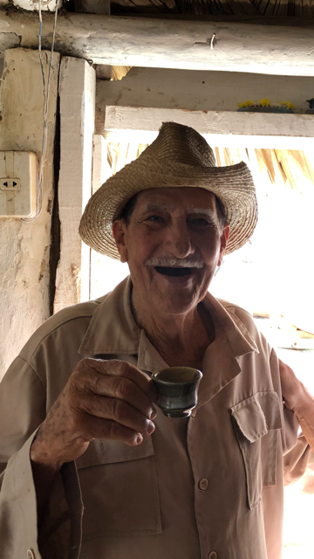

Slide 32



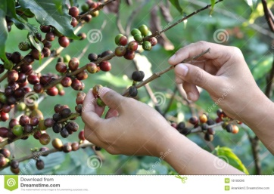
The Value of a cup of coffee
Experiences
3.00
Stage
Services
1.00
Deliver
Goods
.10
Make
Commodities
.02
Extract

Slide 33
Think in student experience, not service in an educational institute.

Slide 34
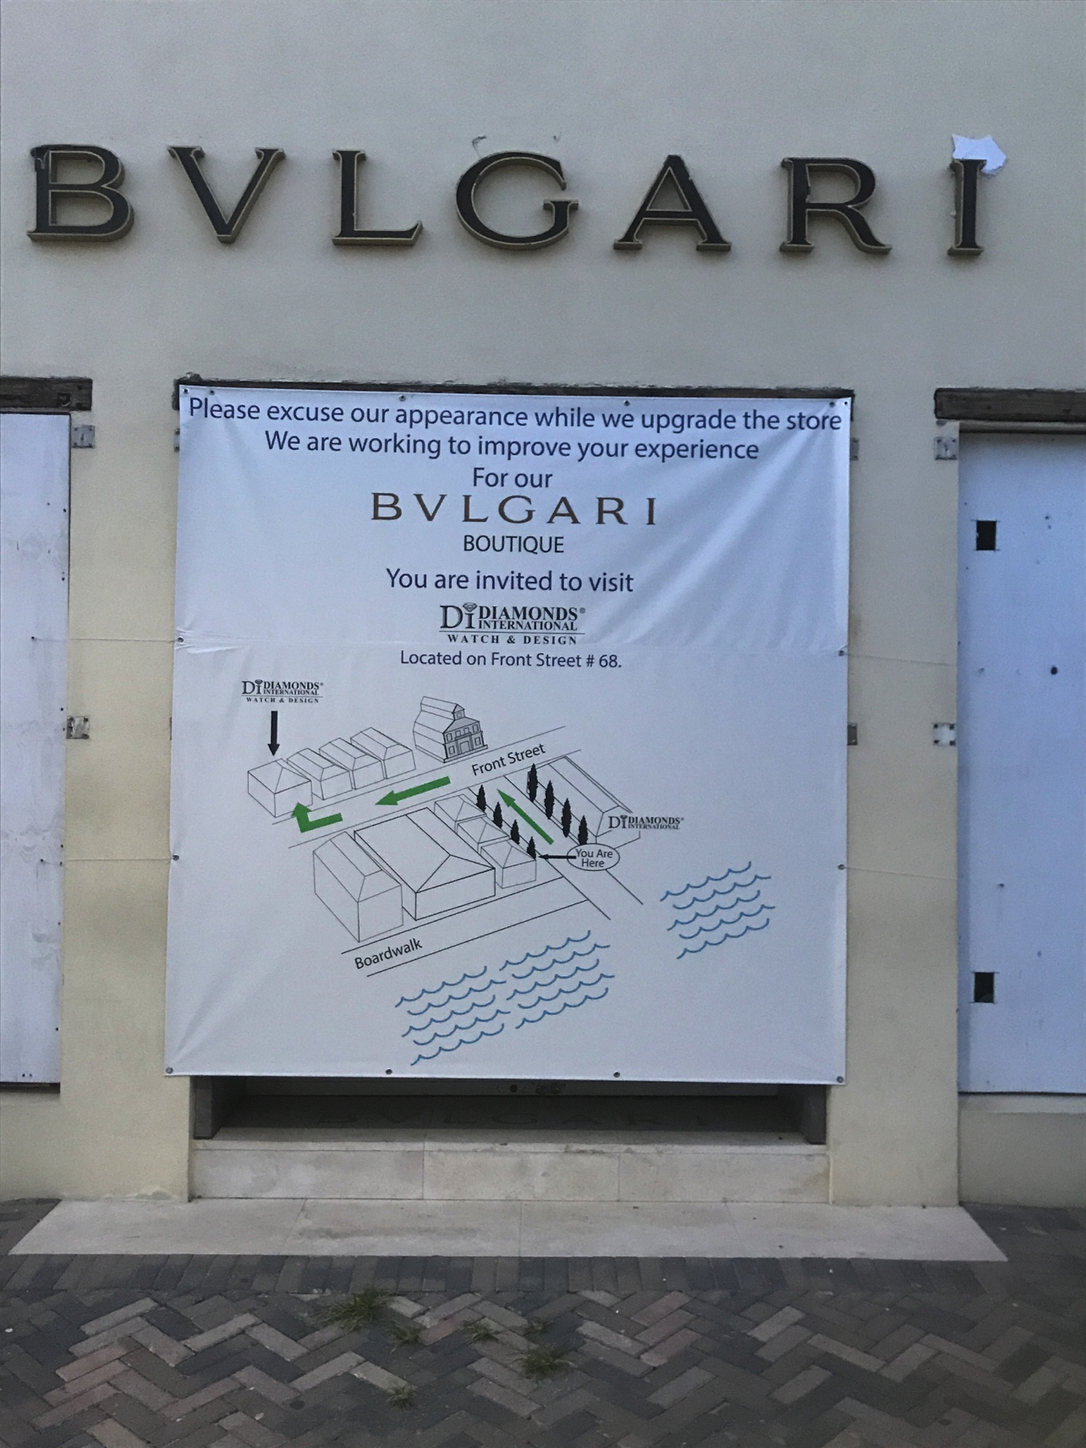

Slide 35


Slide 36

Disney

Slide 37
Patient Satisfaction is a fool’s gold
It’s the same as zero!
Neither good nor bad.

Slide 38
Measuring Loyalty
Most businesses measure loyalty
by repeat business.
Healthcare institutes and schools can measure
loyalty by word of mouth…those who sing
our praises.

Slide 39
Long term care: ambassadors!!!
Mouth-to-mouth 84%
(Mayo Clinics US)

Slide 40
Net promoter score:
How surely will you recommend us to a friend or colleague ?

Slide 41
Client Centered Care
creating PEACE
Participation of clients in their care
Client empowerment
Self-management
Prevention
Extra for all clients
Atmosphere of happiness
Coping
Extra for one client

Slide 42

Patch Adams

Slide 43

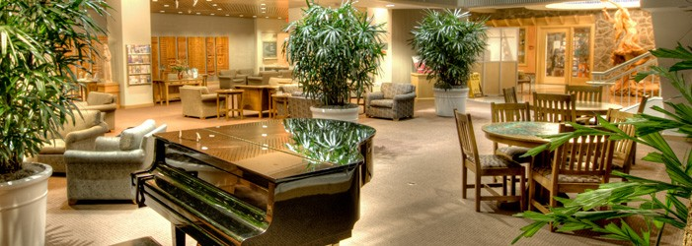
St. Charles, Oregon
To improve the health of those we serve in a spirit of love and compassion.

Slide 44
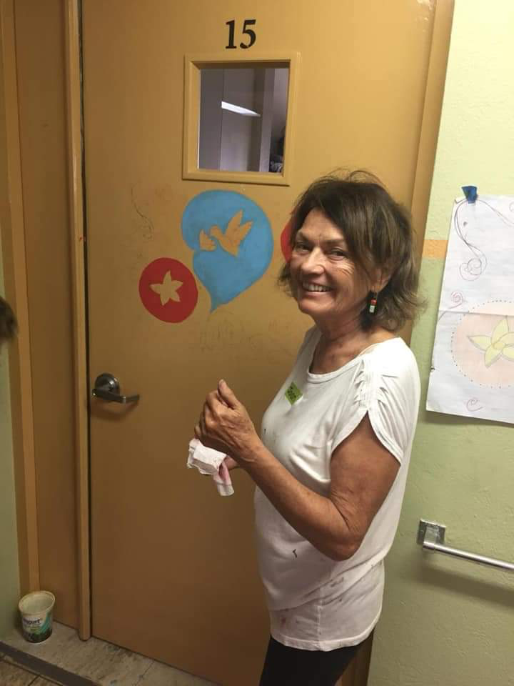
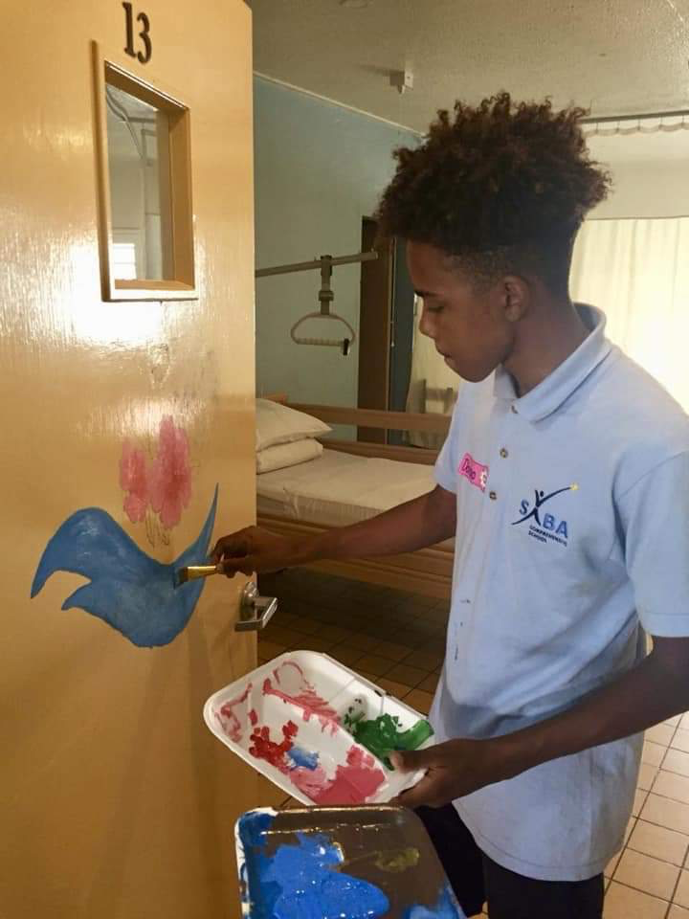

Slide 45
Home of Saba
Joan Bourque, artist
Students Saba Comprehensive School
Decorating client room doors with a painting chosen by the clients themselves

Slide 46
Group work
What is:
Must be,
Performance
Delight
For our students?

Slide 47
Example Education
That I get educational assignments is a Must Be
That the teachers are experienced is Performance
That I can borrow a laptop is a Delighter

Slide 48
4.6. Internal Quality assurance structure
Structure ?????
  Quality Manager; no “excuus Truus”
  Quality service committee
  Teams, quality responsible
  Internal auditors
Use partners for Benchmarking

Slide 49
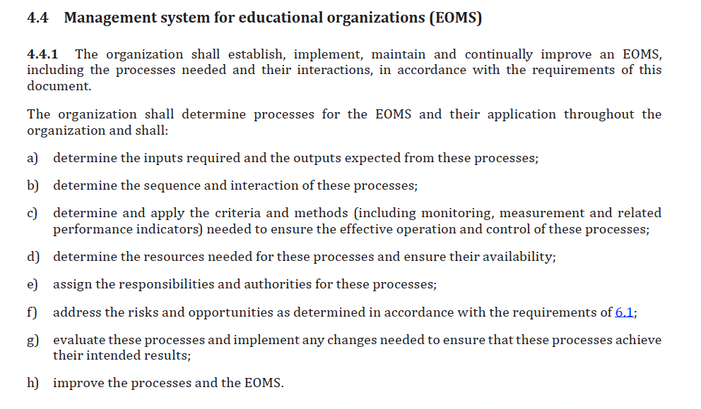

Slide 50
What do you have in place?

Slide 51
4.7. Coaching leadership
Let’s talk , but still the leader decides
High directive
High supportive

Slide 52
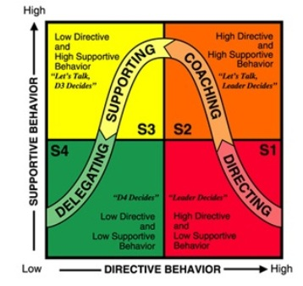
Situational Leadership
Principle: instruction and support tune with characteristics employee and job

Slide 53
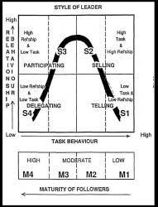
Situational leadership
Notes:
What kind of skills does this require from management?
Diagnosing maturity of followers?
Flexibility in style of leadership.

Slide 54
lunch
C O C O N U T

Slide 55
REFLECTIVE
EMPIRICAL
www.vankemenade-act.nl
reflective
empirical
“fitness for use”
emergence
reference
REFERENCE
EMERGENCE
Notes:
Quality: Decision: Values: Motto, Metaphor: Logic (Freidson): Leadership: Science: Risk: Leadership: Tools:

Slide 56
5. What can we learn from the reflective paradigm?
Professionalism
(Internal) auditing
Self study
Delegating leadership

Slide 57
What is Quality?
Quality is conformance to requirements (Crosby, 1979)
  de ‘preciezen’
Quality is fitness for use (Juran, 1992)
  de klant
Quality cannot be defined (Pirsig, 1972).
  de filosoof / professional
Quality is dynamic (Pirsig, 1991)
  De ‘rekkelijken’

Slide 58
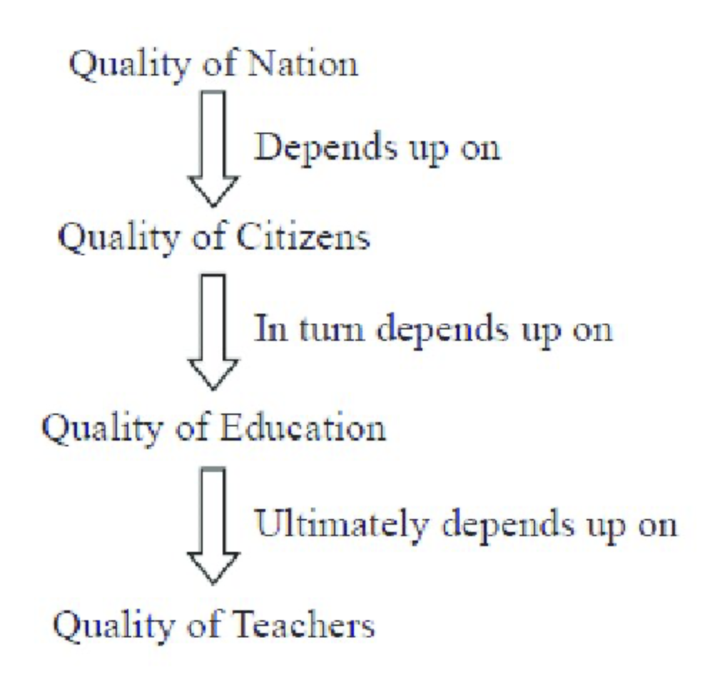
5.1. Professionalism

Slide 59

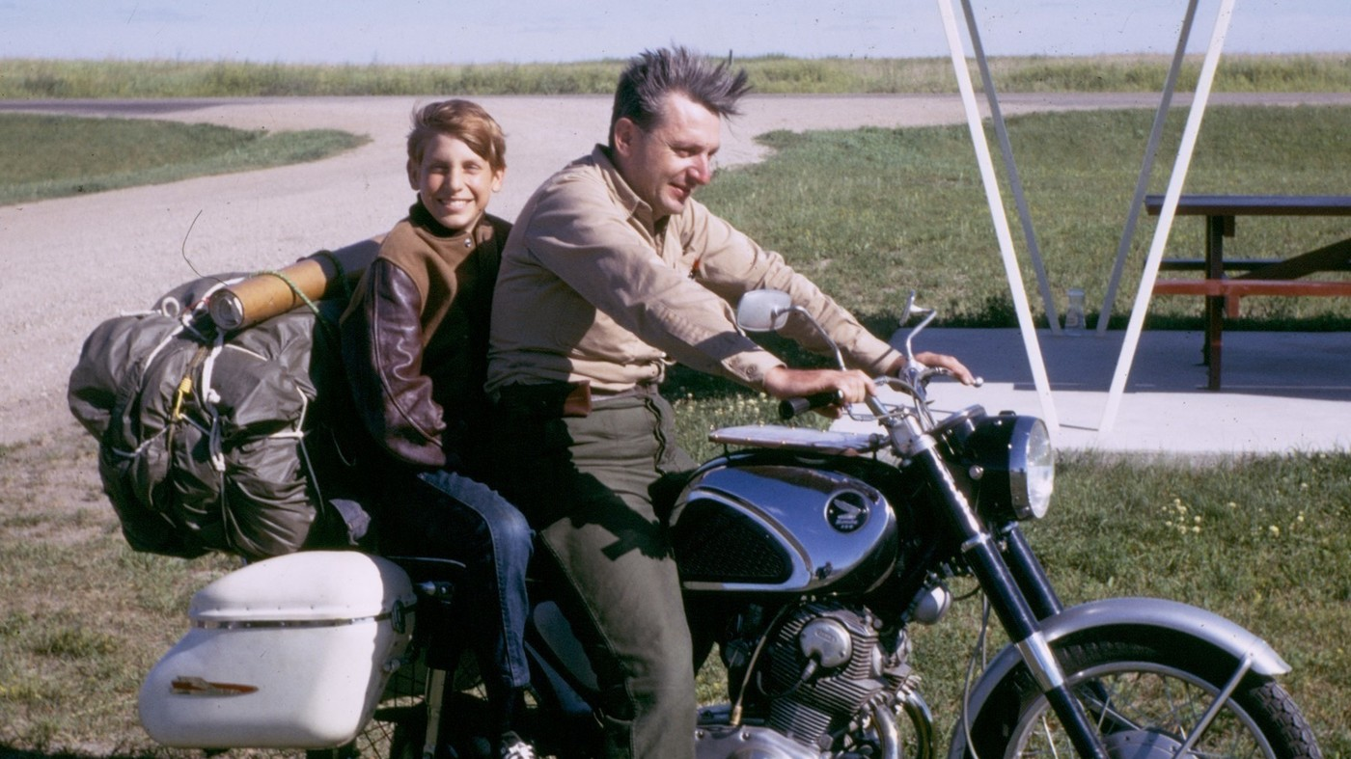
Pirsig (1972)
“Quality is not a thing, it is an event”, p. 215

Slide 60
What is Quality?
Quality ... you know what it is, yet you don't know what it is. But that's self-contradictory. But some things are better than others, that is, they have more quality. But when you try to say what the quality is, apart from the things that have it, it all goes poof! (Pirsig, 1974, p.184)

Slide 61
Professionalism
Teacher education
Conferences
Professional Dialogue
Scientific research and publications

Slide 62

TEN CORE SKILLS TO ΔΙΑΛΟΓΟΣ

Slide 63
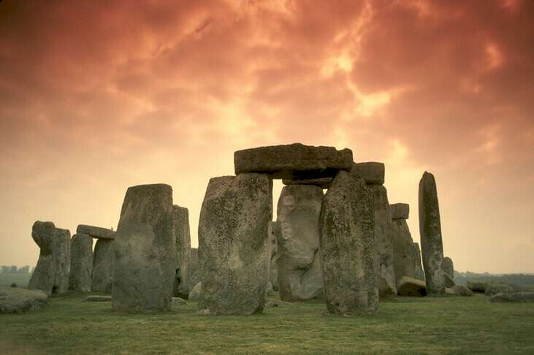

Slide 64
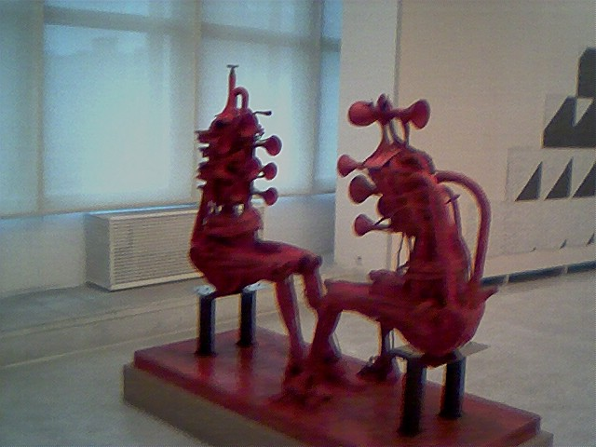
Ten core skills to the dialogue
Show radical respect;
Talk from the heart;
Suspend your judgements;
Take the attitude of a learner;
Be open;
Listen;
Slow down;
Productive reasoning;
Be interested;
Observe the observer.

Slide 65


Slide 66
The talking stick was commonly used by American Indian tribes in council circles to designate who had the right to speak. When matters of great concern came before the council, the leading elder would hold the talking stick and begin the discussion. When he finished what he had to say he would hold out the talking stick, and whoever wished to speak after him would take it. In this manner the stick was passed from one individual to another until all who wished to speak had done so.
Carol Locust, Ph.D.
Native American Research and Training Center
Tucson, Arizona

Slide 67

5.2. Auditing

Slide 68
What is an audit?
ISO 190011:2002
audit = systematic, independent and documented process for obtaining audit evidence and evaluating it objectively to determine the extent to which the audit criteria are fulfilled (or standards are met).

Slide 69


Slide 70
Objectives of audit
Continuous improvement (effectivity audit):
Provides baseline score to build on!!!
External or internal

Slide 71


External audit
Example:
The National League for Nursing Commission for Nursing Education Accreditation (NLN CNEA), the NLN’s autonomous accreditation division, promotes excellence and integrity in nursing education globally through a values-driven accreditation process.
They are coming !!!

Slide 72



Slide 73

External audit: ISO

Slide 74
What, if we cannot comply?
Step 1 Review report
Read the report(s) carefully to make sure you understand the non-compliances and where you have been falling short.
Step 2 Identify underlying cause of non‑compliance
Your understanding of the context of your operations – together with the report – should give you an understanding of why the non-compliances have occurred.
There could be several reasons why you have been found non-compliant including: inadequate systems or ineffective system implementation; staff unaware of policies and procedures; ineffective monitoring of assessment practices..

Slide 75
Step 3 Map out non-compliance
Prior to identifying the actions you need to undertake to address the issues of non-compliance, you will first need an understanding of the requirements of the clause or standard. Once you know what is required to ensure ongoing compliance, you can then determine where and how you need to strengthen your practices to deliver on quality VET – including the supporting evidence you will need to provide to demonstrate a return to compliance.
For all non-compliance, you must demonstrate that you have appropriate systems, governance and controls in place that will ensure ongoing compliance.

Slide 76
Step 4 Create plan
Once you have identified the actions required to return to compliance, you can create a plan that:
reflects the actions,
details the supporting evidence you need to provide, that demonstrates your actions have addressed the areas of non-compliance in a sustained way,
nominates the personnel required to undertake the tasks, and
estimates a timeframe of how long each action will take to complete to ensure the submission deadline is met.

Slide 77
Step 5 Check-ins
To ensure your return to compliance is progressing with your plan, hold regular meetings with personnel nominated to complete the actions.
If possible
Step 6 Cross-check
Once all actions are complete, cross-check your actions with the report(s) to ensure you have addressed all of the clauses or standards individually and that the actions you have completed are reflective of your plan.
Conduct checks against the standard to confirm that the documents you have modified or created demonstrate you are now compliant.

Slide 78
Positive and negative: external audit
+ Objectivity and distance
+ Gives more input for improvement
+ Very experienced auditors
+ “Strange eyes” force you to improve
− More expensive

Slide 79
Positive and negative: internal audit
- Sufficient distance and objectivity?
- Enough expertise available?
+ Quite easy to organize
+ Less “threatening”
+ No external ‘’big brother is watching me’

Slide 80
“IT IS VERY IMPORTANT TO SELECT SUPERIOR AUDITORS; WE HAVE FOUND THAT IT TAKES MORE THAN TEN YEARS TO EDUCATE AND TRAIN A GOOD AUDITOR”.
(by Kaoru Ishikawa)

Slide 81
Annual
monitor
Midterm audit
External audit
Year 4
Year 3
Year 5
Year 2
Year 1
Accreditation
DO BOTH!
81
Notes:
81

Slide 82

5.3. Self study
Kells, 1983

Slide 83



Design phase

Slide 84
5.4. Delegative leadership
Talk and you decide
Low directive
High supportive behaviour

Slide 85
Situational Leadership
Principle: instruction and support tune with characteristics employee and job

Slide 86
Situational leadership
Notes:
What kind of skills does this require from management?
Diagnosing maturity of followers?
Flexibility in style of leadership.

Slide 87
References
Kells, H.R., 1983, Self-Study Processes: a guide for postsecondary institutions, American Council on Education.
Van Kemenade, E. & Van Deutekom M. (1992), Handleiding Zelfevaluatie, Hogeschool Eindhoven
INK, Training Zelfevaluatie
Brinkerhoff et al. (1983), Program Evaluation. A practitioner’s guide for trainers and educators, Kluwer

