Slide 1
  Quality and leadership for NIPA
  15, 18 and 19 March 2024
  Everard van Kemenade, PhD

Slide 2
Welcome

Slide 3

ME
1953 born

Slide 4
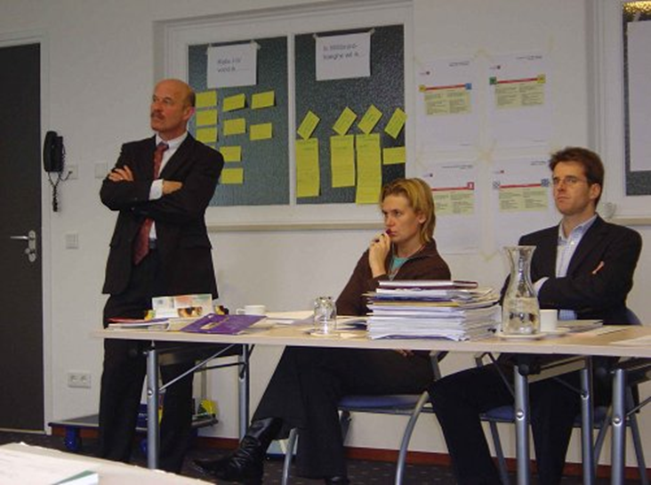
Passion 1 : QUALITY
1980 first assignment for: Van Kemenade ACT (audit, coaching and training)

Slide 5
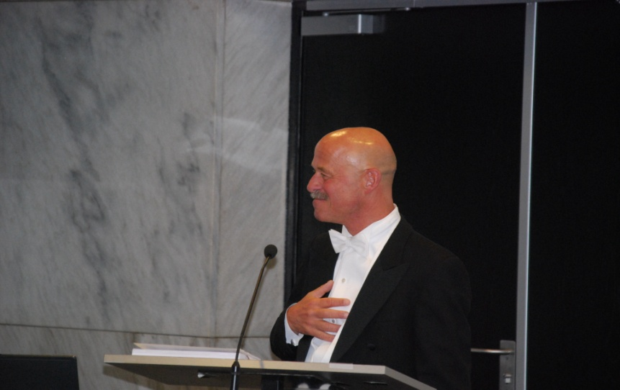
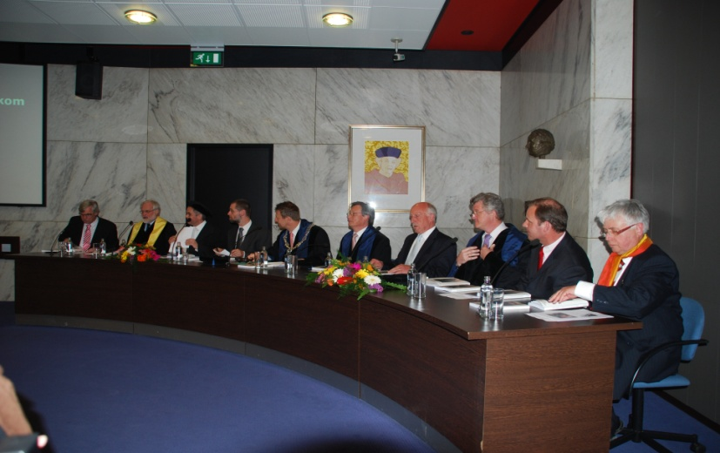
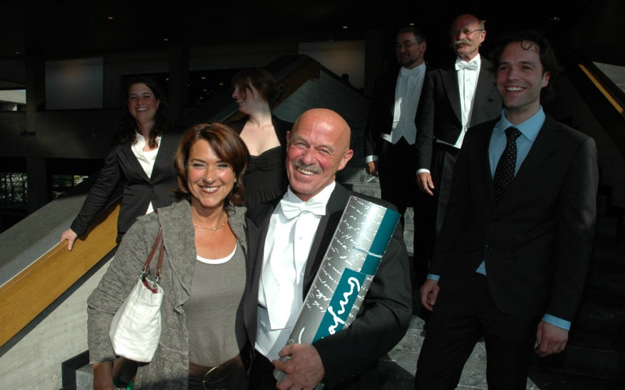
2009 PhD.
Passion 2: Research on Quality

Slide 6

Emergence & Quality

Slide 7

Notes:
Simpele regels (soms duizenden bij elkaar, veiliger voor roofvogels)
We vliegen allemaal even snel (36km per uur) (alignment)
Max 7 andere vogels in de gaten houden (limitation)
Veranderen deze van richting, verander ik mee (adaptation)
Vaste afstand van elkaar (separation)
Ze blijven in de groep (cohesion) Simple rules but unpredictable

Slide 8
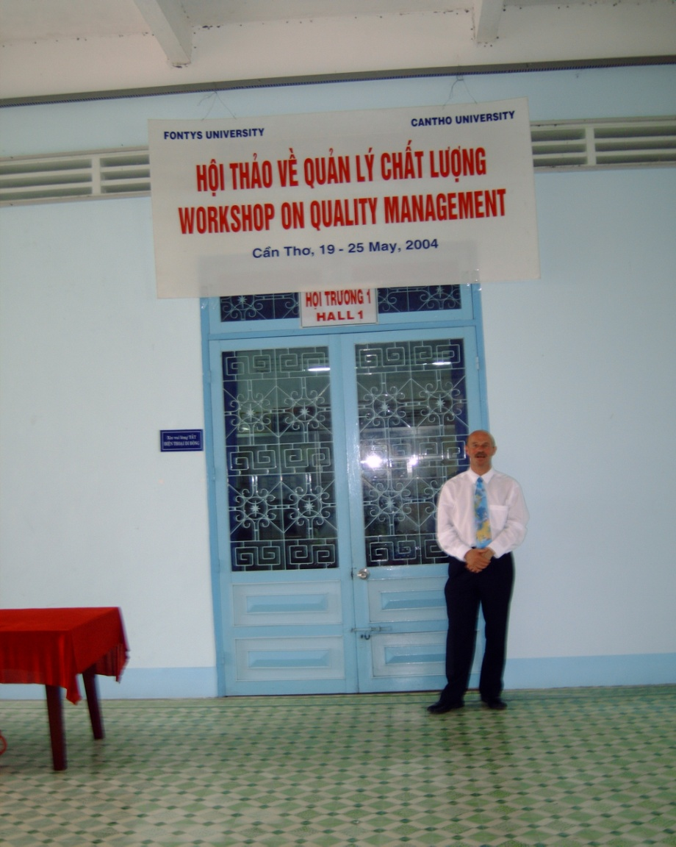
Passion 3:
International.
2004 first international assignment to Viet Nam

Slide 9

2015 first assignment Caribbean

Slide 10
INTERNATIONAL
QUALITY RESEARCH ON EMERGENCE

Slide 11
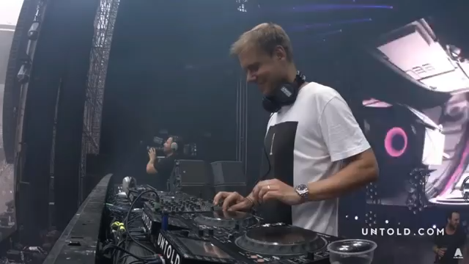
I love music

Slide 12
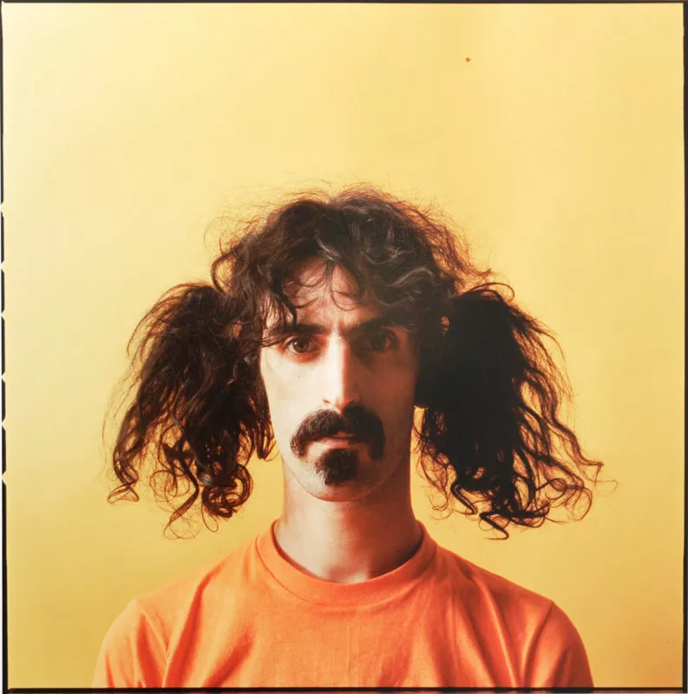
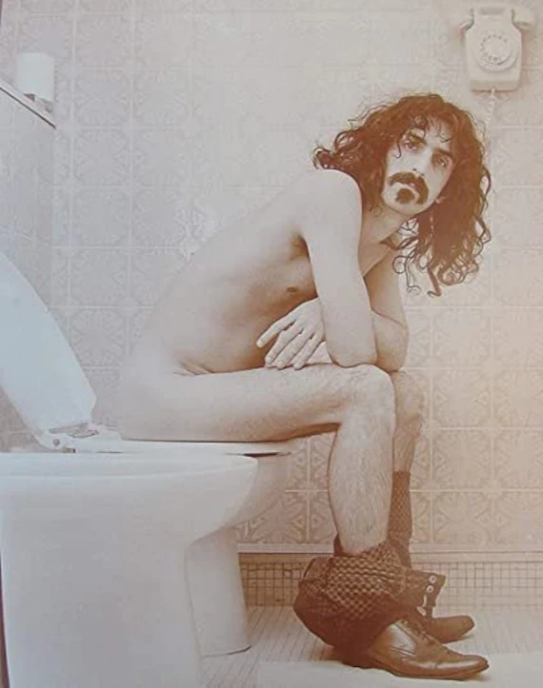
Frank Zappa (1940-1993)

Slide 13
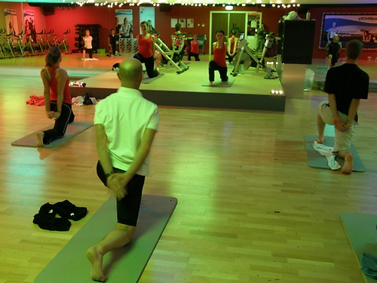
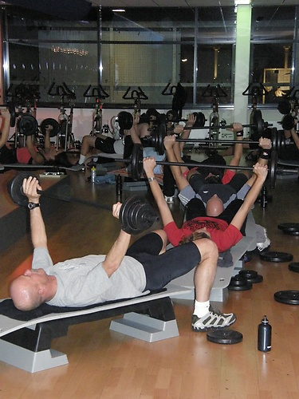

2008 first visit to fitness centre

Slide 14



But also
Mijn
‘huiskamer’
op stMaarten

Slide 15
AGENDA
(Half a ) day 1
Quality
Four paradigms
What we can learn from the empirical paradigm
Day 2
4. What can we learn from the reference paradigm?
Day 3
5. What can we learn from the emergence paradigm?

Slide 16
AGENDA
Day 4
Self evaluation
Day 5
Internal auditing
(Half a) day 6
Actual Wild Problems
Train the trainers

Slide 17
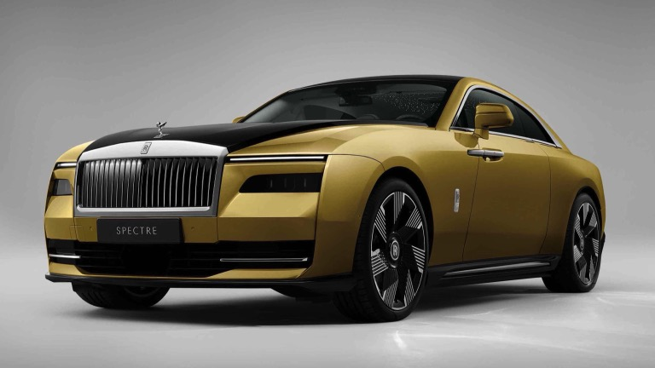
1. QUALITY

Slide 18
What is Quality?
Quality ... you know what it is, yet you don't know what it is. But that's self-contradictory. But some things are better than others, that is, they have more quality. But when you try to say what the quality is, apart from the things that have it, it all goes poof! (Pirsig, 1974, p.184)

Slide 19
What do you think is good quality education? (post its)
@
@
@
@
@

Slide 20
Definitions
The term quality is defined in ISO 9000 as the degree to which a set of inherent characteristics of an object fulfils requirements.
Quality is subjective and changes over time : it is a dynamic concept. Who wants which quality when??????

Slide 21

Who? Stakeholders

Slide 22
Stakeholders?
Students
World of work organisations (incl practice providers)
Family
Government (local and national)
Partners incl suppliers, sec schools
Other (e.g. higher) education institutes
Staff
Management, support staff.

Slide 23
Standards for Quality
European Standards and Guidelines
Accreditation (e.g. NL NVAO, NLN)
Sint Maarten gov.?
ISO 21001

Slide 24
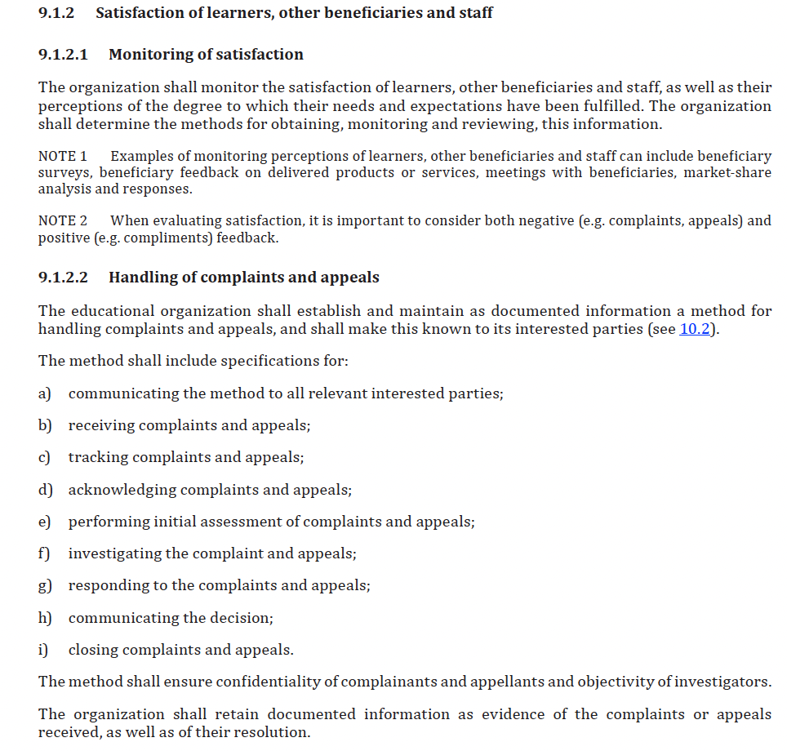
Example ISO

Slide 25
What do you have in place on SXM?

Slide 26

2. Four paradigms

Slide 27
Four windows at Quality
There is a lot of misunderstanding about what quality is
Misunderstanding between and also within professionals.
There are –at least- four windows /paradigms /worldviews /patterns.
Each window has advantages and disadvantages.
Thesis
Misunderstanding has its roots in thinking from different
values, windows, patterns.

Slide 28
Recognise these?

Slide 29
What is Quality?
Quality is conformance to requirements (Crosby, 1979)
  de ‘preciezen’
Quality is dynamic (Pirsig, 1991)
  De ‘rekkelijken’
Quality is fitness for use (Juran, 1992)
  de klant
Quality cannot be defined (Pirsig, 1972).
  de filosoof / professional

Slide 30
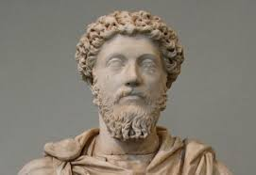
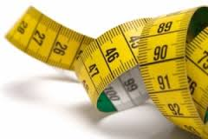

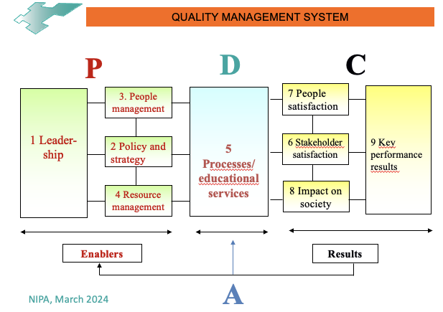
Four paradigms / patterns
Reflective
Empirical
UNORDER
ORDER
Emergence
Reference

Slide 31
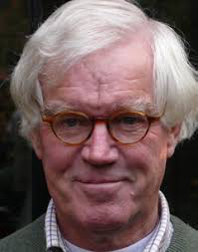
Discussion Dutch Academy for Quality
Initiator:
Vinkenburg, H. (2010),
Naar een derde school
in de kwaliteitskunde,
Synaps 31, pp 3-5
Dr. Huub Vinkenburg

Slide 32

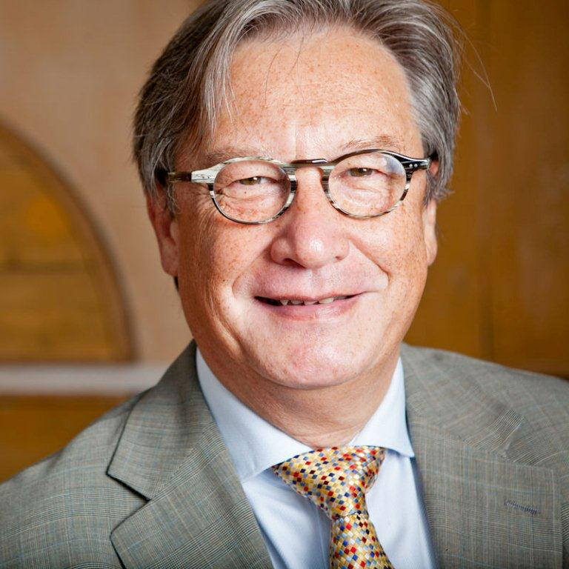


Discussion Dutch Academy for Quality
Van Kemenade E.A. & Hardjono T.W. (2018) "Twenty-first century Total Quality Management: the Emergence Paradigm", The TQM Journal, https://doi.org/10.1108/TQM-04-2018-0045
Hardjono, T.W. & Van Kemenade E.A. (2020), The emergence paradigm. A way towards radical innovation. Cham: Springer
Dr. Everard van Kemenade
Prof. dr. ing. Teun Hardjono

Slide 33
Four paradigms/windows/worldviews
Quality:
Decision:
Motto:
Metaphor:
Logic (Freidson)
Science:
Risk:
Leadershipstyle:
Tools:
Reflective
Empirical
Quality:
Decision:
Motto:
Metaphor:
Logic (Freidson):
Science:
Risk:
Leadershipstyle:
Tools:
Emergence
Reference
Notes:
Kleuren
blauw
oranje
groen
teal
Beck & Owan Spiral Dynamics

Slide 34
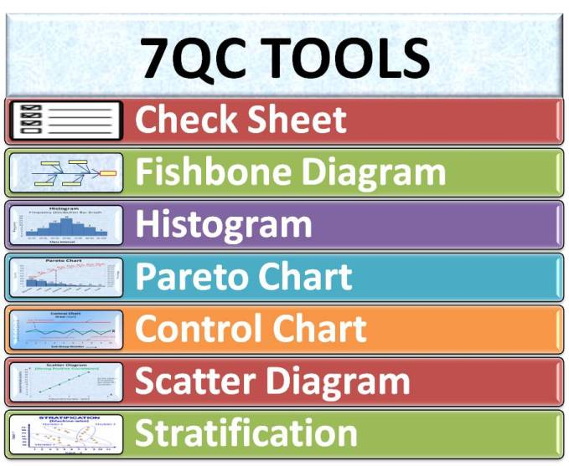
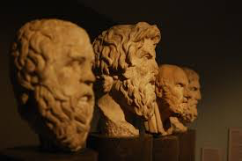




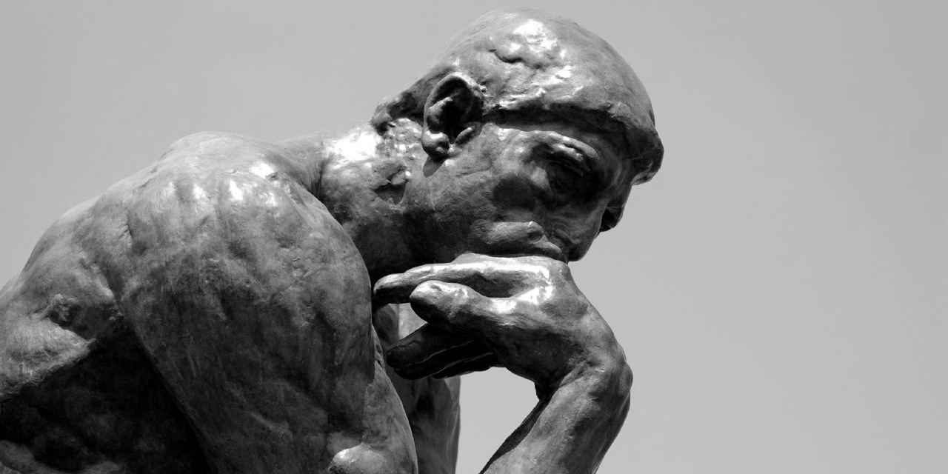


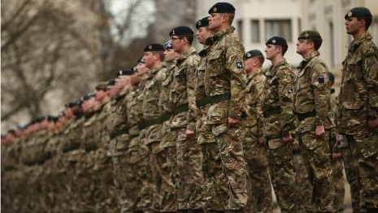






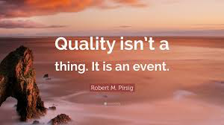
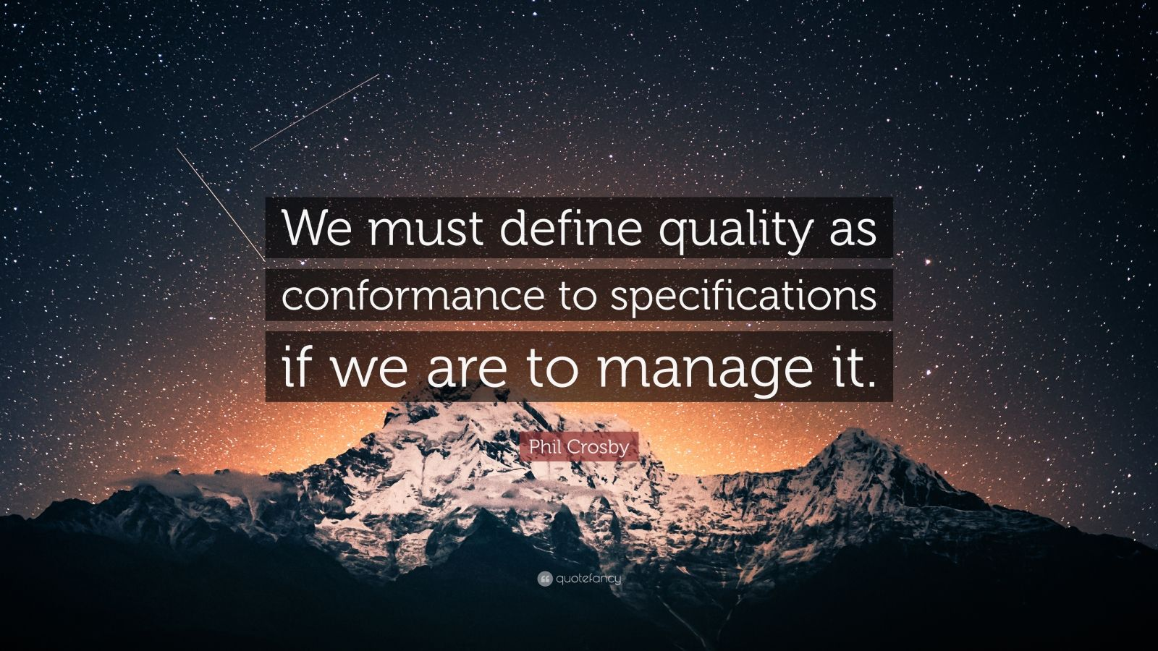



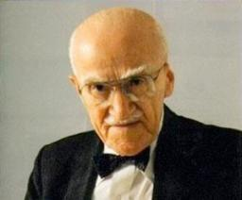
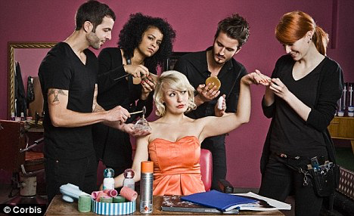
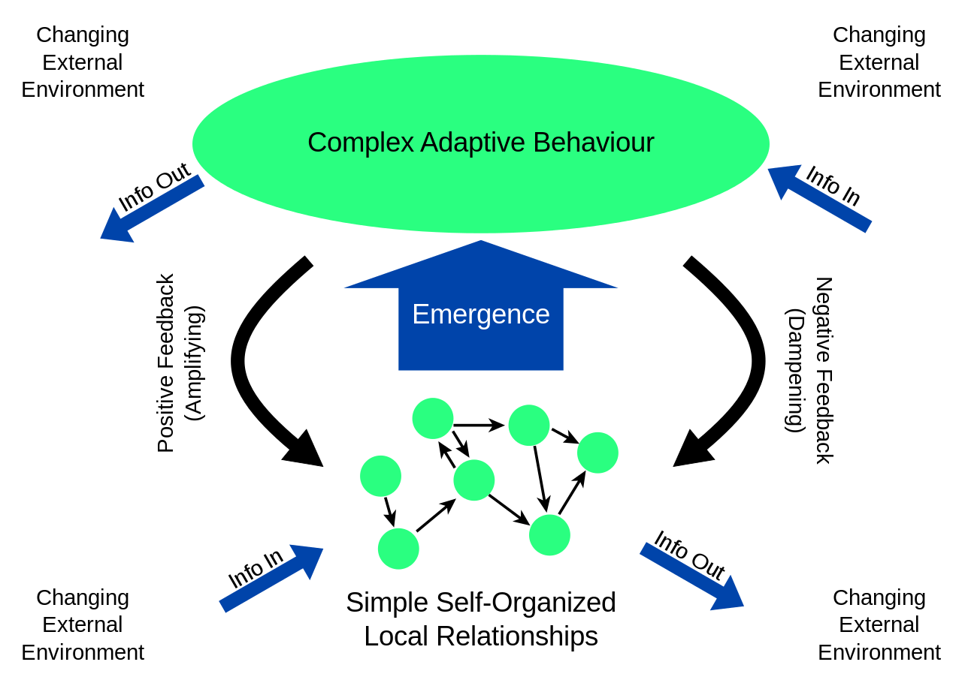
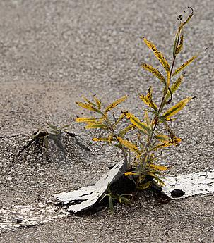
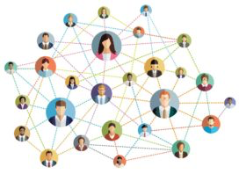
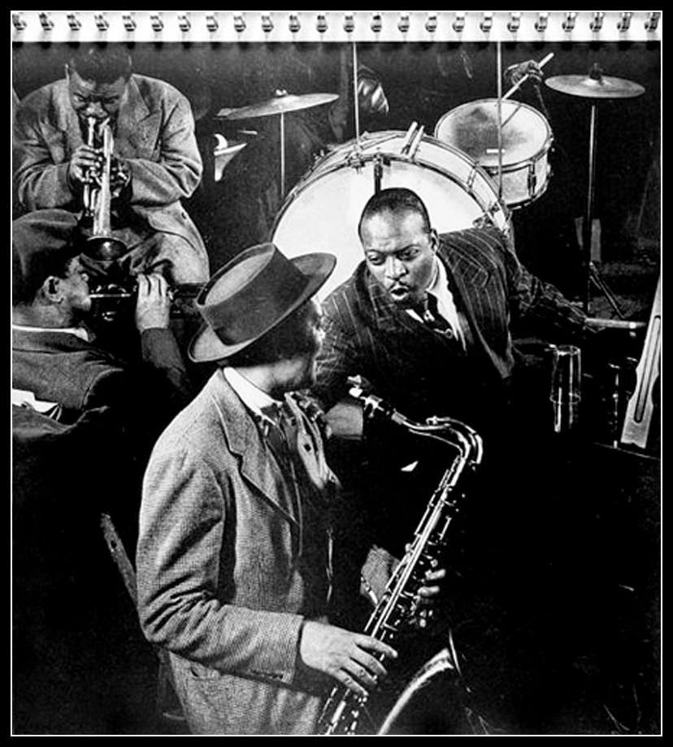
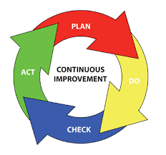



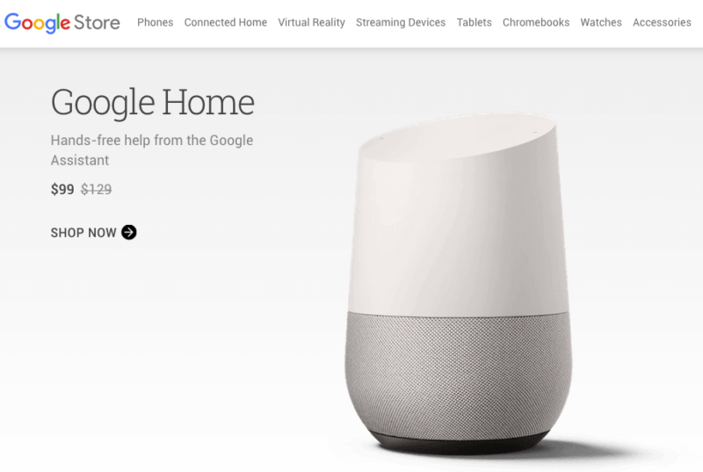



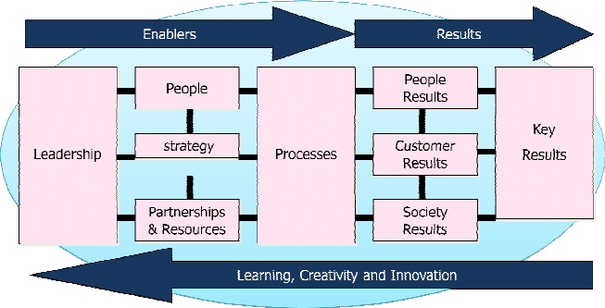
REFLECTIVE
EMPIRICAL
www.vankemenade-act.nl
reflective
empirical
“fitness for use”
emergence
reference
REFERENCE
EMERGENCE
Notes:
Quality: Decision: Values: Motto, Metaphor: Logic (Freidson): Leadership: Science: Risk: Leadership: Tools:

Slide 35
3. What we can learn from the empirical paradigm
3.1. Control
3.2. Key performance indicators
3.3. 7 tools of quality
3.4. Directive leadership
3.5. Management review

Slide 36
What is Quality?
Quality is conformance to requirements (Crosby, 1979)
  de ‘preciezen’
Quality is dynamic (Pirsig, 1991)
  De ‘rekkelijken’
Quality is fitness for use (Juran, 1992)
  de klant
Quality cannot be defined (Pirsig, 1972).
  de filosoof / professional

Slide 37
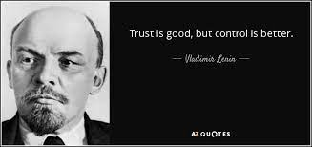
3.1. Control
Vladimir Lenin (first premier and founder of the Sovjet Union, who lived 1870-1924)

Slide 38
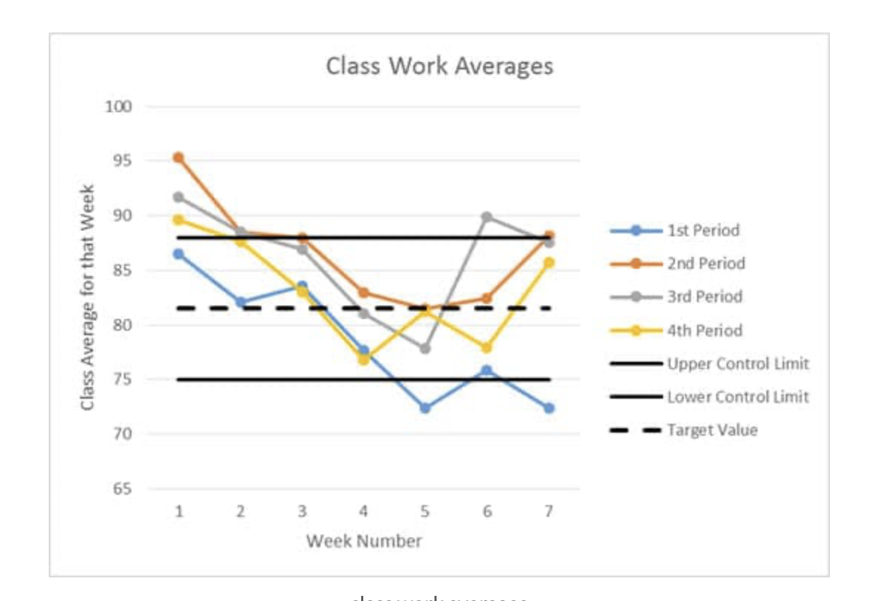
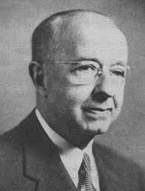
CONTROL CHARTS
Control charts, also known as Shewhart Charts or Statistical Process Control Charts (SPCC) are tools used to determine if a process is in a state of statistical control, or how much variation exists in a process. Like run charts, they are graphs of data over time.

Slide 39
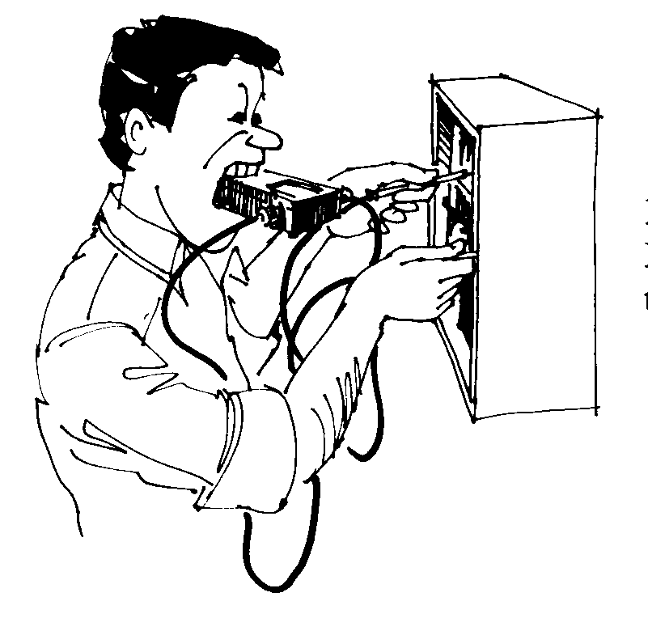
Results
To measure is to know

Slide 40
Sorts of result measurements
  Perception-indicators
Satisfaction of the parents, pupils
Questionnaires, interviews
  Performance indicators
Amount of students graduated; drop outs
Statistics

Slide 41
Result phases
Phase 1: Figures
Measurements available
  Statistics
  Proof

Slide 42
Result phases
Phase 2: Trends
Measurement results
compared to the past
  More data
  of higher quality

Slide 43
Result phases
Phase 3: Goalsetting
Indicators
compared to
standards

Slide 44
Result phases
Phase 4: Benchmarking
Comparison to other schools

Slide 45
Result phases
Phase 5: Excellence
Comparison to the
« best in class»

Slide 46
3.2. KPI’s
What is a Performance Indicator?
Cave (1997:24) defines it as a measure usually in quantitative form- of an aspect of an activity of a (higher) education institution.

Slide 47
Indicators and norms
Measurements only make sense in comparing to a norm (standard/benchmark).
Sources:
  Scientific research
  Customers
  Comparing to goals
  Comparing to own results
  Comparing to others (benchmark)

Slide 48
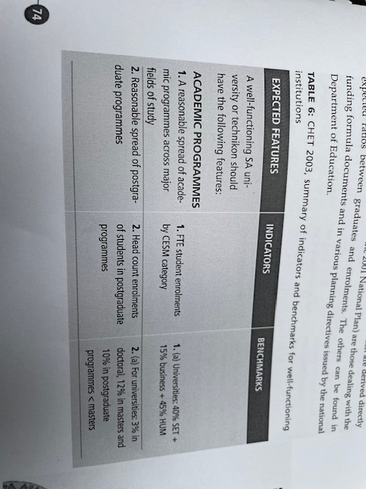
Examples (CHET, 2003)

Slide 49
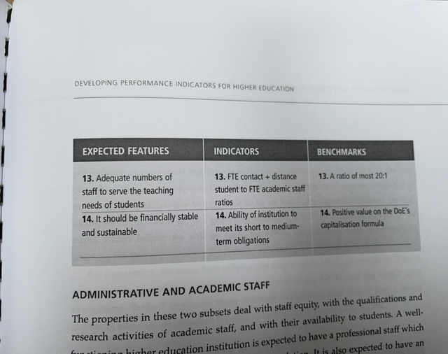
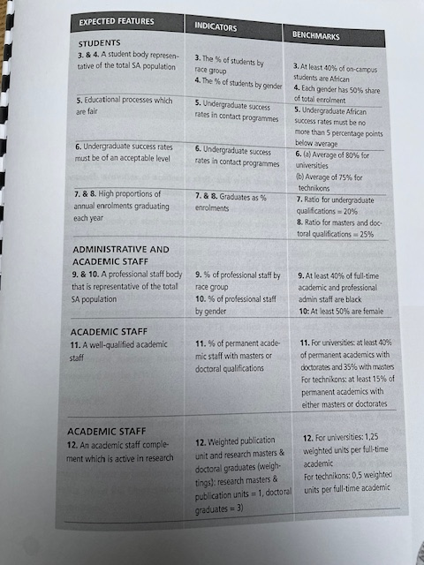

Slide 50
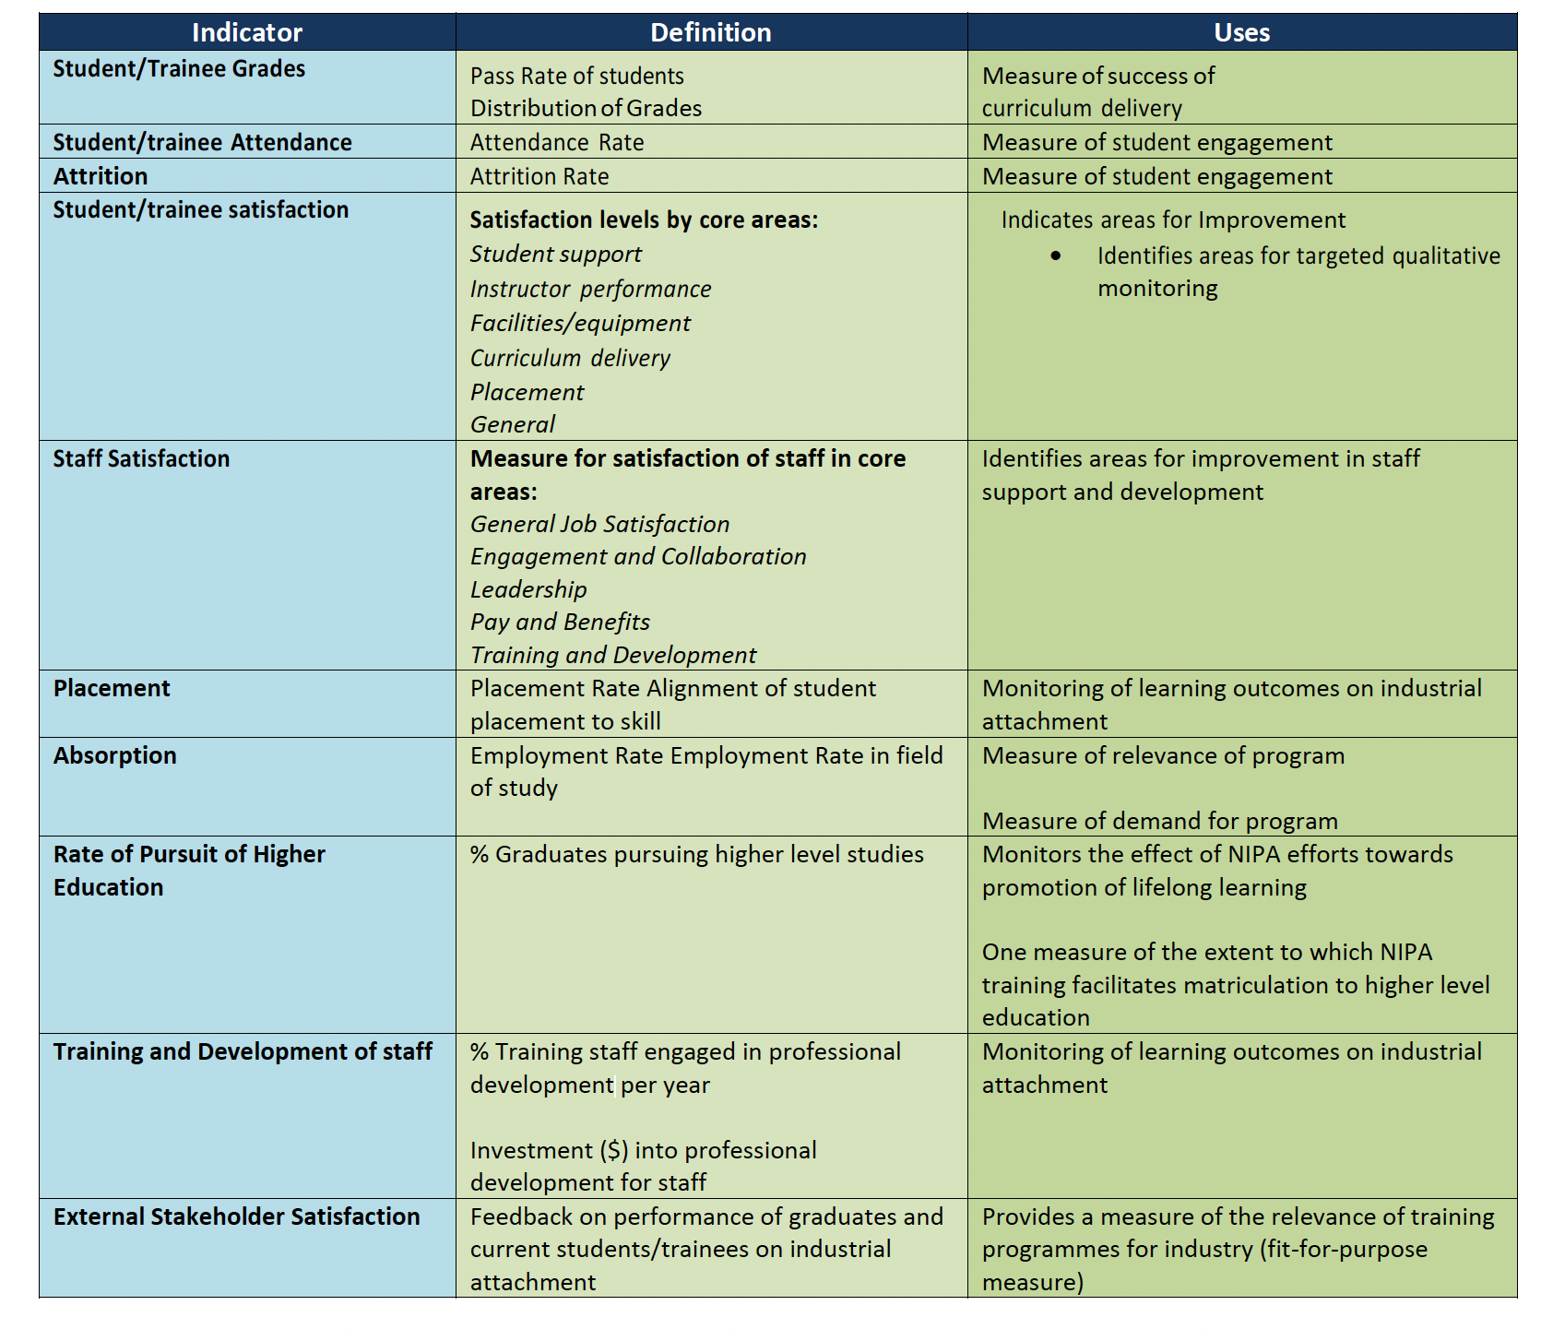
NIPA?

Slide 51
Prerequisites
Justified: Valid, reliable and convenient
Balanced: (Balanced Score Card, EFQM).
Use for improvement, not for punishment nor reward

Slide 52
Maar…The Tyranny of Metrics
We meten alleen wat te tellen is, niet wat BELANGRIJK is.
JEFFREY Z. MULLER

Slide 53
3.3. Seven tools of Quality

Slide 54
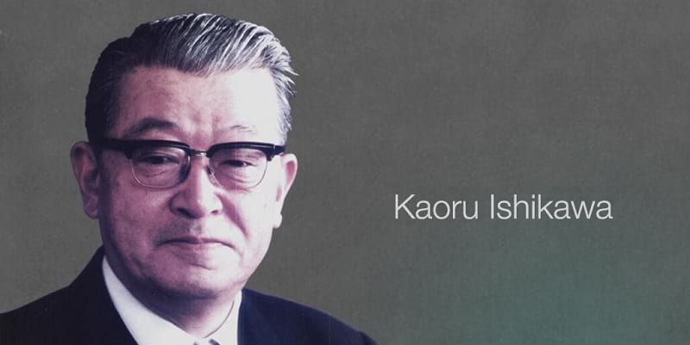
3.2.1 Fishbone diagram

Slide 55
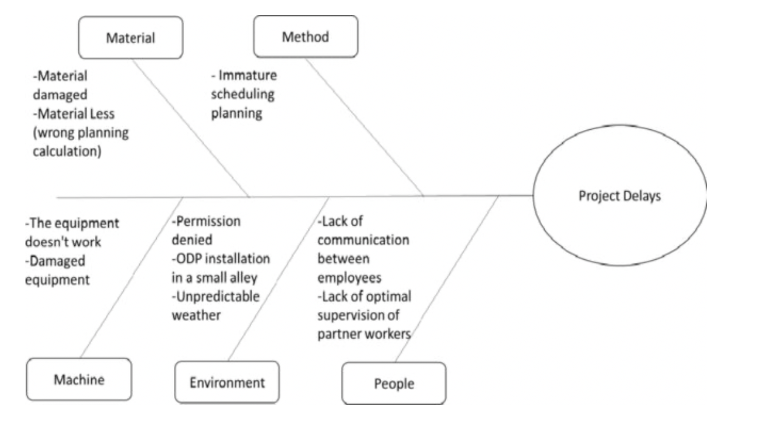

Slide 56
Exercise

Slide 57
3.4. Directive leadership
Leader decides
Authority
Low supportive behaviour

Slide 58
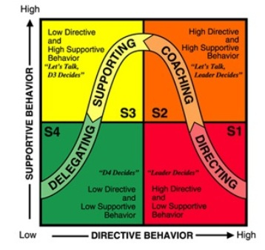
Situational Leadership
Principle: instruction and support tune with characteristics employee and job

Slide 59
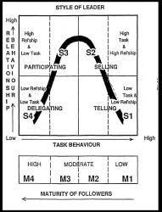
Situational leadership
Notes:
What kind of skills does this require from management?
Diagnosing maturity of followers?
Flexibility in style of leadership.

Slide 60
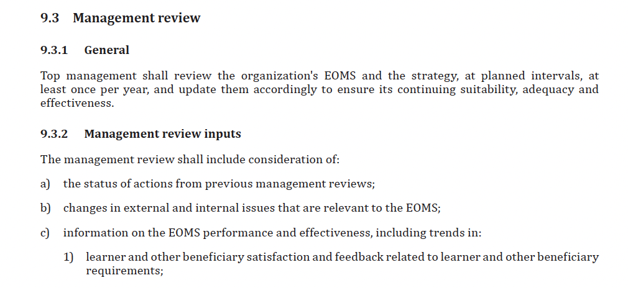
3.5. Management Review

Slide 61
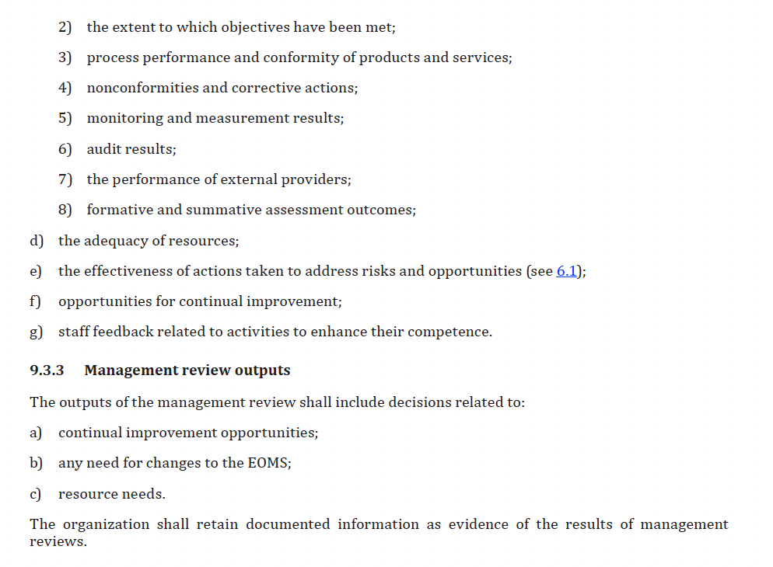
Management review cont’d

Slide 62
References
Bunting,L & Cloete, C. (2003), Measuring performance in South-African Higher Education, CHET, Cape Town
Crosby, P. B. (1979). Quality is free. New York, McGraw-Hill.
Juran, J.M. (1992). Juran over Kwaliteitsmanagement: plannen, besturen, verbeteren. Kluwer. ISBN 9020126873.
Ishikawa
Cave (1997)
Situational leadership

