Slide 1
Collective Reflexivity, a personalised integrated care approach
A workshop
Everard van Kemenade,
Marlou de Kuiper,
Laura van der Weijden.

Slide 2
1. The need for Collaborative Reflexivity by Everard 2. Reflection and Collaborative Reflexivity by Marlou 3. A case by Laura 4. Group session 5. Take home message
Nice to meet you: our program
Collective
Reflexivity

Slide 3
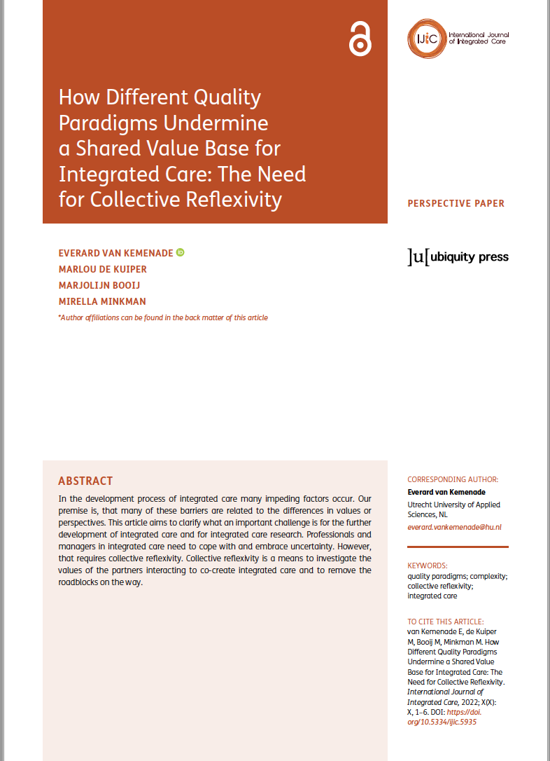
1. The need for collective reflexivity by Everard
Collective
Reflexivity
How Different Quality Paradigms
Undermine a Shared Value Base
for Integrated Care:
The Need for Collective Reflexivity¹
¹ ‘van Kemenade E, de Kuiper M, Booij M, Minkman M. How Different Quality Paradigms Undermine a Shared Value Base for Integrated Care: The Need for Collective Reflexivity. International Journal of Integrated Care, 2022; X(X): X, 1–6. DOI: https://doi. org/10.5334/ijic.5935

Slide 4
Four paradigms
Collective
Reflexivity
Van Kemenade, E.A., Hardjono T.W. (2018) “Twenty-first century Total Quality Management: the Emergence Paradigm”, The TQM Journal, 31(2): 150-166

Slide 5
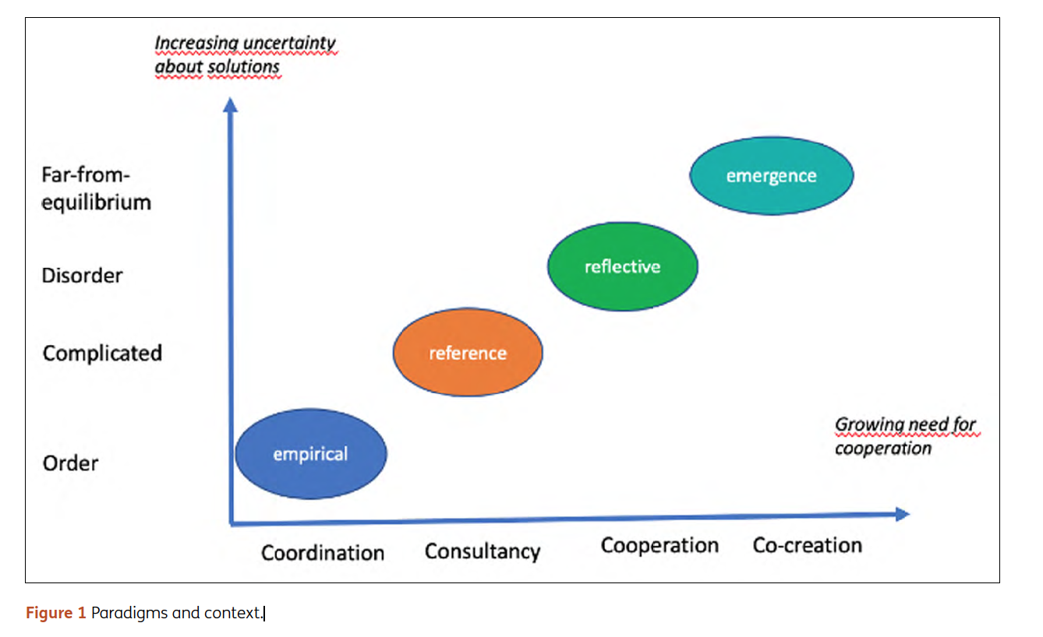
Collective reflexivity
Collective
Reflexivity
Van Kemenade, E.A., De Kuiper, M., Booij, M and Minkman M. (2022), How Different Quality Paradigms Undermine a Shared Value Base for Integrated Care: The Need for Collective Reflexivity,
International Journal of Integrated Care, DOI: https://doi.org/10.5334/ijic.5935

Slide 6
2. Collective Reflexivity: How? By Marlou.
Collective
Reflexivity

Slide 7
Collective
Reflexivity

Slide 8
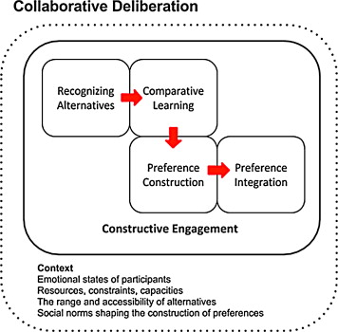
Collective
Reflexivity
Collaborative deliberation takes place when interactions between participants are characterized by curiosity, respect, and empathy

Slide 9
3. A case by Laura
Collective
Reflexivity
Dementia
Nursing home
Psychogeriatric care
Very serious problem behavior
80-90% in dementia patients problem behavior¹
1000-3000 very serious problem behavior¹
Definition (next slide)²
Background information
A case
Define problem
¹ -Stelt, van der, I. (2021). Cijfers en inspectie over probleemgedrag 2021. Geraadpleegd op 5 mei 2022 van https://www.zorgvoorbeter.nl/probleemgedrag-ouderen/cijfersinspectie.
-Brodaty H, Draper BM, Low LF. (2003). Behavioural and psychological symptoms of dementia: a seven-tiered model of service delivery. Med J Aust. 2003;178(5):231-4.
² Ukon. (2021, december). Dementie en zeer ernstig probleemgedrag: naar een doelgroepomschrijving. Geraadpleegd op 5 mei 2022 van https://www.ukonnetwerk.nl/media/1965/rapport-dzep-doelgroepomschrijving-final-hersteltabel-en-klankbordgroep.pdf
Notes:
This experienced aggression and growing difficulty is a result of the behavioral changes seen in dementia. In nearly all dementia patients (80-90%) there are records of problem behaviour, and in some cases it is labelled as very serious problem behavior (1000-3000) (Van der Stelt, 2021; Brodaty, Draper & Low, 2003).

Slide 10
A case
Collective
Reflexivity
Dementia
Nursing home
Psychogeriatric care
Very serious problem behavior
The story of
A video of the situation of Margot
Background information
A case
Define problem

Slide 11
The story of Margot
Collective
Reflexivity

Slide 12
A case
Collective
Reflexivity
Dementia
Nursing home
Psychogeriatric care
Very serious problem behavior
The story of Margot
Background information
A case
Define problem
Problem:
The current health care system in the Netherlands is not sufficiently resilient
for the increasingly very serious problem behaviour in the psychogeriatric care in nursing homes.
Notes:
Problem: ik denk dat we het probleem toch specifieker moeten richten op de casus en kwaliteit van leven.
Op de huidige manier kunnen we geen kwaliteit van leven ….
Weet jij iets?

Slide 13
4. Group session
Collective
Reflexivity
1. What are the alternatives?
2. What do we learn, if we compare them?
3. Which alternative has our preference
and why?
4. How does our prefered alternative fit
in the current context.

Slide 14
5. Take home message
Collective
Reflexivity

