Slide 1
SYNERGY
Presentation by
Christina Woodley-Charles
about

Slide 3
My organisation
Board of Directors
Finance and HR Administration
Manager Patient Care
Manager Facility Department
Manager Outpatient Department
Supervisory Board
Quality Officer
Laboratory
Midwifery
Frontdesk and Policlinic
X-ray
Nursing Ward
District Nursing
Ambulance
Kitchen
Housekeeping
Maintenance
Dir / Secr. Management Assistant
Island Physicians
Laundry
Physiotherapy
Manager Patient Care
Kche
Mi
Launr

Slide 4
Services
General practitioner / geriatric care
Hospital care
District nursing care
Emergency care
Obstetrics
Laboratory & Imaging (ultrasound / x-ray)
Policlinic care
Pharmaceutical care
Preventative care
Visiting specialists / other health care professionals

Slide 5
Our strengths
Qualified and dedicated staff
Ministry of Health VWS
ZVK
Inspectorate
Auxiliary Home
Golden Rock Pharmacy
Hospitals on Saba, St. Maarten, Bonaire
St. Maarten Laboratory Services
Many, Many, Many more companies and organizations
Finances

Slide 6
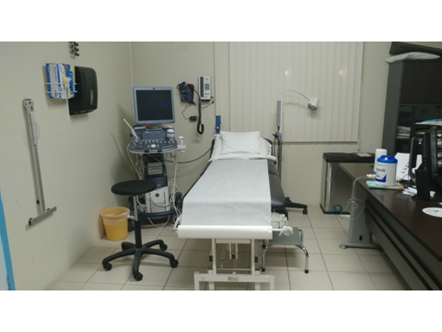

Slide 7
Our challenges
Isolated location and small scale
Support, training, supplies come from overseas
Patients sent abroad
Falcility has become too small to carry out all the specialist service that we would want too
Financial dependence

Slide 8
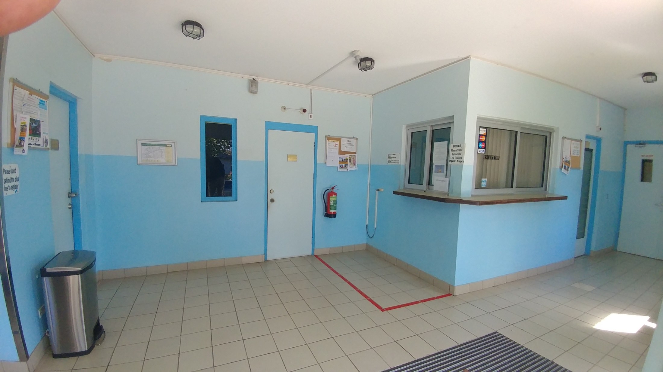

Slide 10
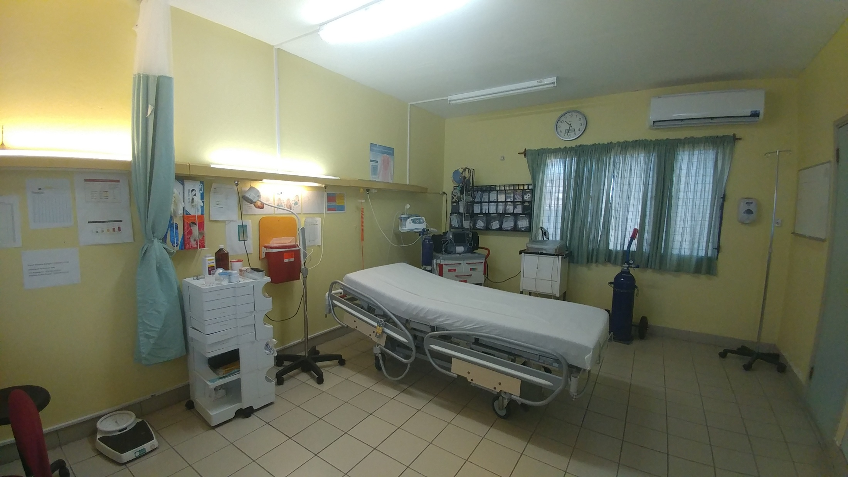

Slide 11
!THANK YOU!

