Slide 1
The
Mental Health Foundation

Slide 2
Giselle Codrington
Faraja and short and long stay coordinator

Slide 3
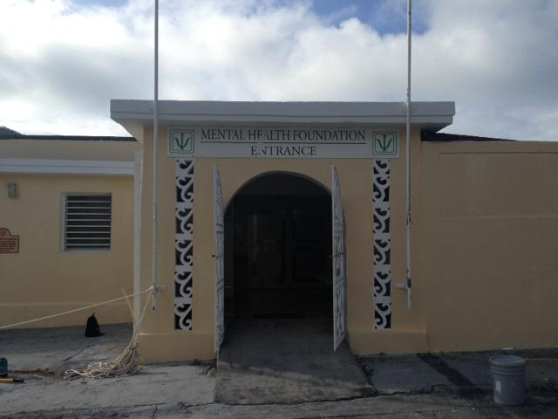
Introduction
The Mental Health Foundation was in augerated in 2006, but has been at its current location since 2011
Leopard Road 1 - Cay Hill
We are a secondary health care provider, offering psychiatric and psychological services to St. Maarten and neighboring islands

Slide 4
Numbers
40 staff members
20 call-up, interns, volunteers
7 care products
More than 1,000 patients

Slide 5
What is mental illness?
“Mental disorders comprise a broad range of problems, with different symptoms characterized by some combination of abnormal thoughts, emotions, behavior and relationships with others”
“Mental disorders are important risk factors for other diseases, as well as unintentional and intentional injury.
~ World Health Organization

Slide 6
What is mental health?
Mental health is a state of well-being in which an individual realizes his or her own abilities, can cope with the normal stresses of life, can work productively and is able to make a contribution to his or her community.
~ World Health Organization

Slide 7
MHF care products
Clinic (out-patient)
Ambulant care
Crisis intervention
Admissions (in-patient)
Short and long stay
Day treatment center
Information & Prevention

Slide 8
Strengths and Challenges

Slide 9
Corporate partners
The MHF acknowledges the following important corporate partners that have been instrumental for the MHF to operate and deliver care:
General Practitioners
Turning Point
Ministry of Public Health, Social Development and Labor
Ministry of Education, Culture, Youth and Sports
Ministry of Justice
Stichting Verslavingszorg en Psychiatrie Caribisch Nederland (SVP-CN: referrals)
Sint Maarten Medical Center (SMMC)
White and Yellow Cross Care Foundation
American University in the Caribbean
Pharmacist (medication management)
Insurance companies such as: SZV (AVBZ, ZV, FZOG, OZR), Guardian Group, NAGICO, ENNIA

Slide 11
Questions?

